Slide 1
containers
ow

Slide 2
Software issues
1. Installation Issues
Before installing any software, you usually have to check:
OS Compatibility: Will it run on Windows, Linux, or Mac?
Dependencies: Does it need other software like Java, Python, or a database?
Conflicts: Will it break existing software if installed?

Slide 3
Upgrading & Dependency Conflicts
Problem: Different apps may need different versions of the same dependency. If one app needs Python 3.8 but another requires Python 3.10, installing both versions could break things.
Uninstallation & Cleanup
When removing software, you must manually undo changes, delete files, and remove dependencies. Often, some files are left behind, wasting space and causing conflicts.

Slide 4
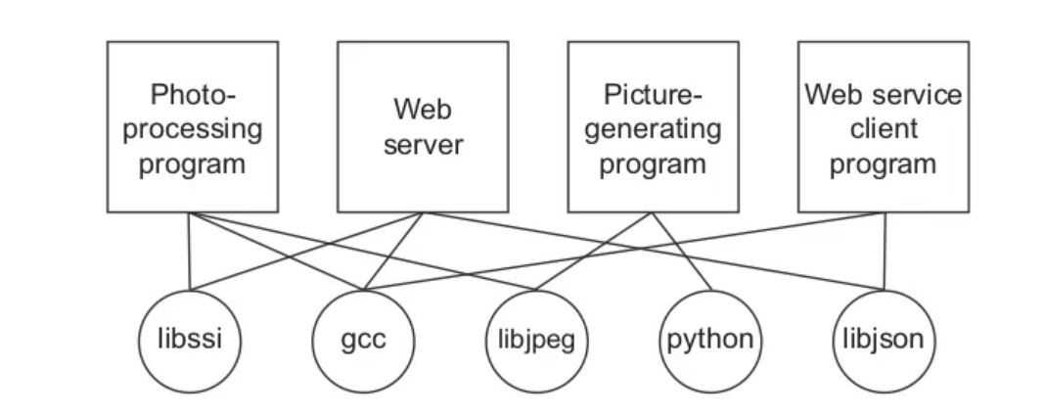
..
Security
Installing software manually can introduce security risks if dependencies are outdated or modified.

Slide 5
..
Shared Dependencies: Multiple applications depend on the same libraries (e.g., the "Web server" and "Photo-processing program" both rely on gcc).
Complex Interactions: Dependencies are interconnected, making software management challenging. If a library version is updated, it might break some applications while supporting others.
Potential Conflicts: Different applications might require different versions of the same dependency, leading to conflicts.
Resource Consumption Issues: If an application overuses resources, it may affect others running on the same system.

Slide 6
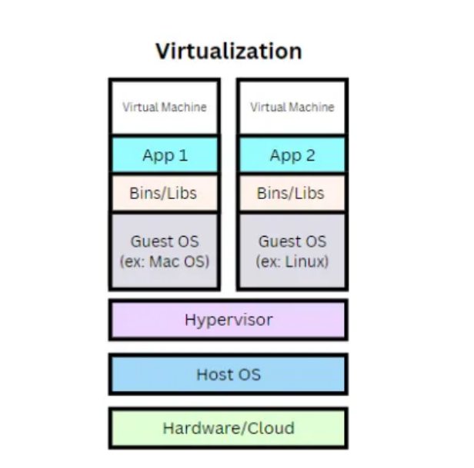
evolution
Now that we have seen how applications were deployed on physical servers, let’s see how virtual machines improved the situation.

Slide 7
..
Each virtual machine (like “VM 1” and “VM 2”) is a complete and independent instance with its own full operating system (Guest OS) and dependencies (app binaries, and libraries).
The hypervisor provides isolation between VMs, ensuring that they operate independently of each other.
However, VMs are bulkier because they include an entire operating system and dependencies (app binaries, and libraries) taking GBs of space which is heavy. This leads to more significant resource consumption, slower deployment times, and a slow bootup process compared to the lightweight

Slide 8
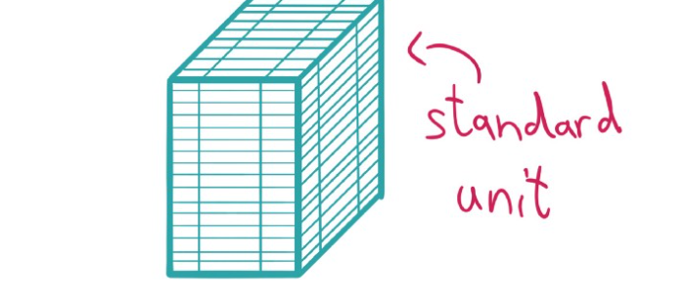
A standardized package: Build, Run and Ship
No Installation
Full isolation on unit
Unit contains application source code, runtime tool, configuration and dependency

Slide 9
History
In 2008 a project called Linux Containers (LXC) started to pop-up in the wild, which should revolutionize the container world. LXC combined cgroup and namespace technologies to provide an isolated environment for running applications
This means that Google started their own containerization project in 2007 called Let Me Contain That For You (LMCTFY), which works mainly at the same level as LXC does. With LMCTFY, Google tried to provide a stable and API driven configuration without users having to understand the details of cgroups and its internals.

Slide 10
..
2013 we see that there was a tool written called Docker, which was built on top of the already existing LXC stack. One invention of Docker was that the user is now able to package containers into images to move them between machines.
In 2015, where projects like Kubernetes hit version 1.0. A lot of stuff was ongoing during that time: The CNCF was founded as part of the Linux Foundation with the target to promote containers. The Open Container Initiative (OCI)was founded 2015 as well, as an open governance structure around the container ecosystem.

Slide 11
Container runtime
Application which can run container. For example, systemd is able to run containers via systemd-nspawn, and NixOS has integrated container management as well.
All the other existing container runtimes like CRI-O,, containerd, LXC, runc, and many more. A lot of them are now part of the Cloud Native Computing Foundation (CNCF)
Docker is also one of the container run time provider, which has build library as well.
Docker is a set of platform as a service products that use OS-level virtualization to deliver software in packages called container.

Slide 12
Docker
Docker is an open platform for developing, shipping and running applications
Enable separate application for delivering software quickly
Provide quick mechanism for shipping, testing and deploying code quickly
Docker provides the ability to package and run an application in an isolation environment called container
Isolation and security allow to run multiple container on the same host.

Slide 13
Lifecycle of container
Docker provides tooling and a platform to manage the lifecycle of container
Develop application and supporting components using container
Container become unit for distributing and testing application
Container image becomes the unit
It can be pushed and pulled from repo [Will be discussed in details]

Slide 14
Docker Engine
Docker engine is a client-server application with following components:
A server which is running daemon process [the dockerd command]
A rest api which specifies interfaces that program can use to talk to daemon and instruct what to do
A command line interface [CLI] client [the docker command]

Slide 15
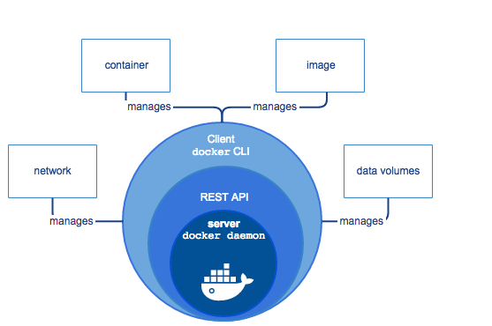
…

Slide 16
Docker Architecture
Docker uses client server architecture
The docker client talks to the docker daemon, which does the heavy lifting of building,running and distributing Docker container
Docker client and docker daemon can run on the same system as well or you can connect from remote as well
Client and daemon communicate using rest api over unix sockets or network interface

Slide 17
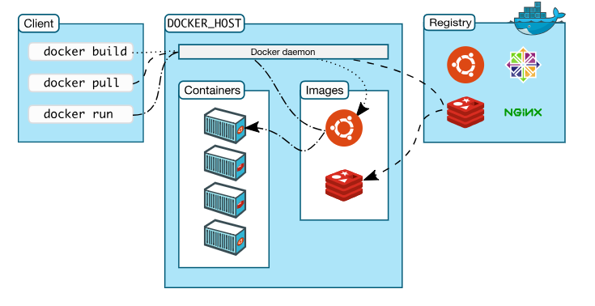

Slide 18
Lab1:
Set up the Docker

