Slide 1

Docker
OW

Slide 2
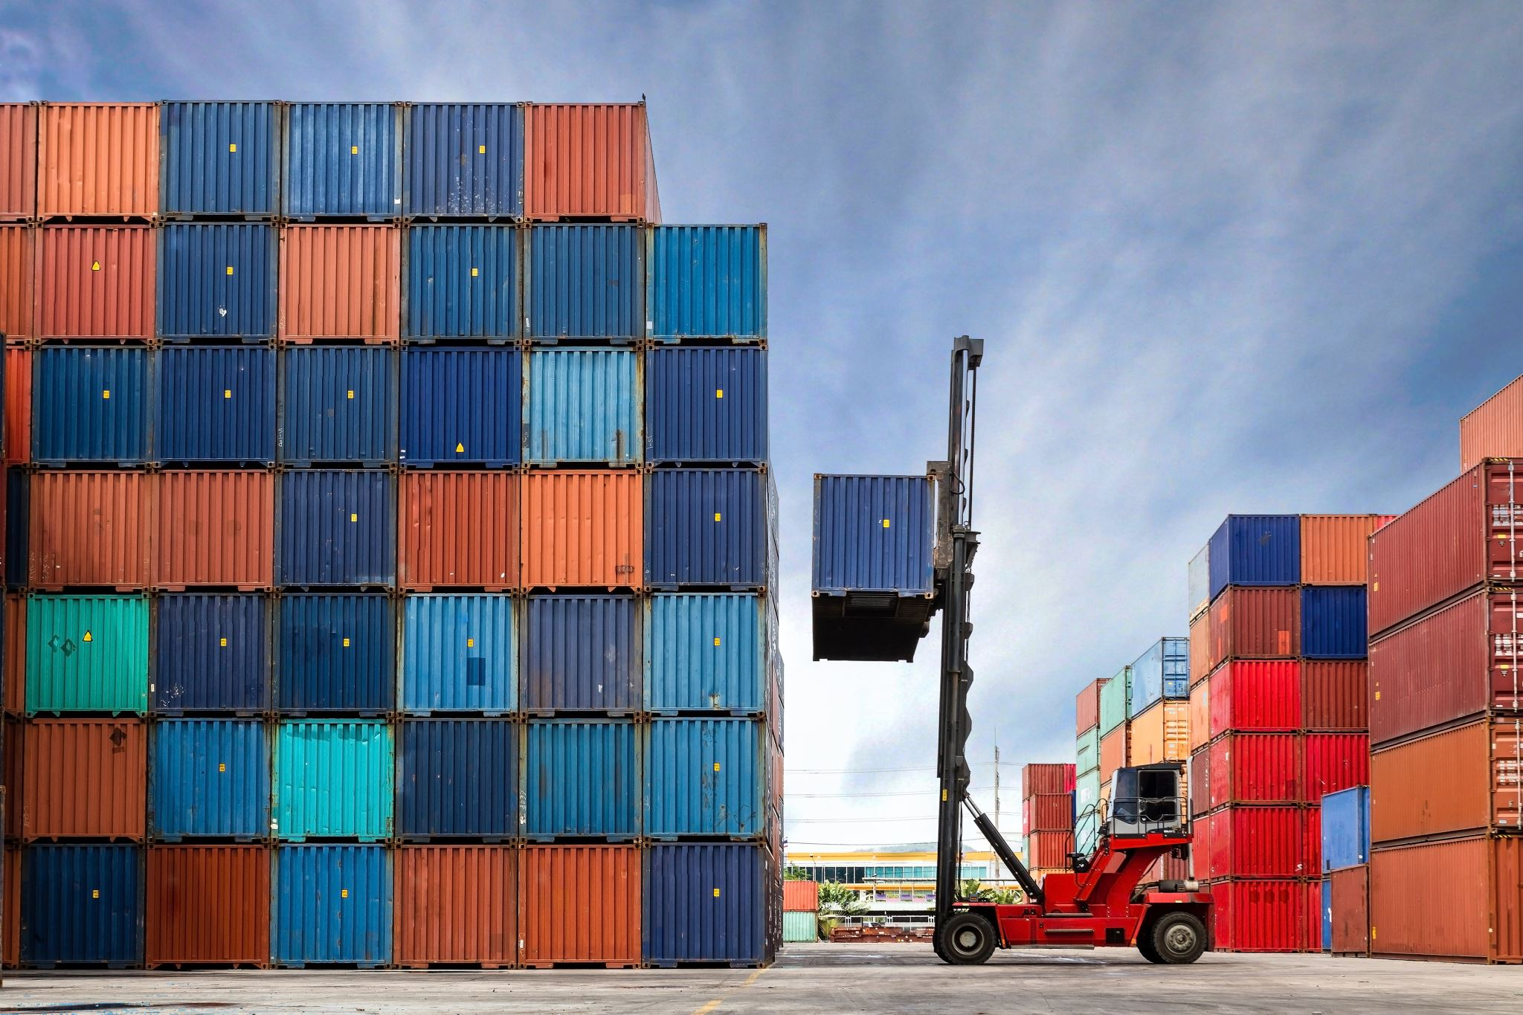
Docker Overview
Docker is an open platform for developing, shipping, and running applications.
Docker enables you to separate your applications from your infrastructure so you can deliver software quickly.
Docker provides the ability to package and run an application in a loosely isolated environment called a container.
Containers are lightweight and contain everything needed to run the application, so you don't need to rely on what's installed on the host

Slide 3

..
Docker provides tooling and a platform to manage the lifecycle of your containers:
Develop your application and its supporting components using containers.
The container becomes the unit for distributing and testing your application.
When you're ready, deploy your application into your production environment, as a container or an orchestrated service

Slide 4

Docker architecture
Docker uses a client-server architecture.
Docker client
Docker daemon
Docker registry
Docker desktop
Images

Slide 5
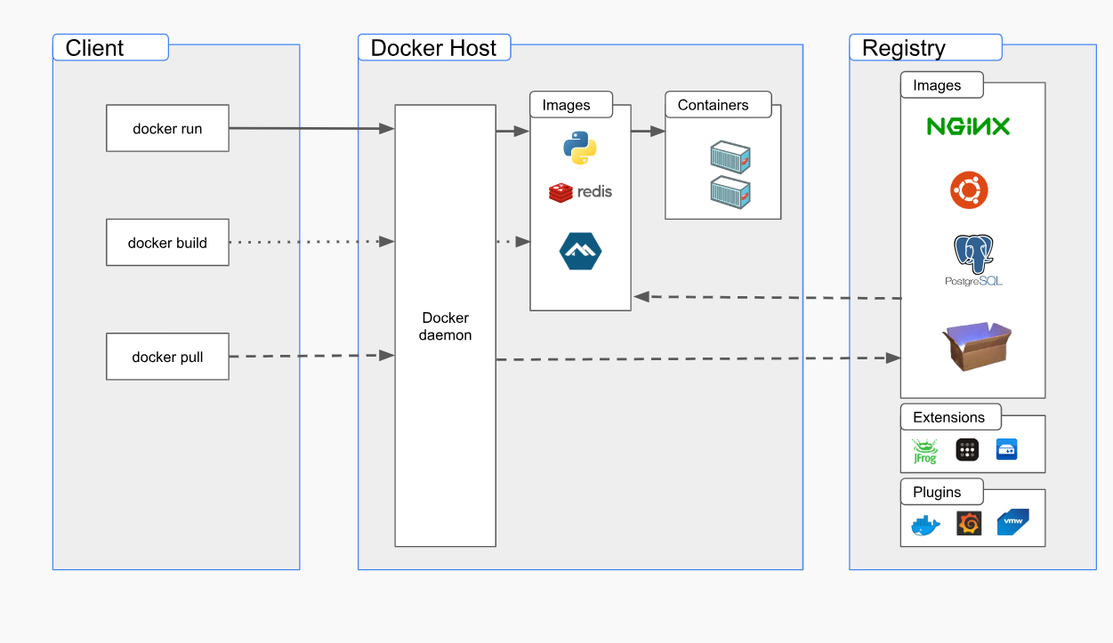
..

Slide 6
Docker Architecture
The Docker client talks to the Docker daemon, which does the heavy lifting of building, running, and distributing your Docker containers.
The Docker client and daemon can run on the same system, or you can connect a Docker client to a remote Docker daemon.
The Docker client and daemon communicate using a REST API, over UNIX sockets or a network interface

Slide 7

..
The Docker daemon
The Docker daemon (dockerd) listens for Docker API requests and manages Docker objects such as images, containers, networks, and volumes. A daemon can also communicate with other daemons to manage Docker services.
The Docker client
The Docker client (docker) is the primary way that many Docker users interact with Docker. When you use commands such as docker run, the client sends these commands to dockerd, which carries them out. The docker command uses the Docker API. The Docker client can communicate with more than one daemon.

Slide 8

..
Docker registries
A Docker registry stores Docker images. Docker Hub is a public registry that anyone can use, and Docker looks for images on Docker Hub by default. You can even run your own private registry.
Images
An image is a read-only template with instructions for creating a Docker container. Often, an image is_based on another image, with some additional customization. For example, you may build an image which is based on the ubuntu image, but installs the Apache web server and your application, as well as the configuration details needed to make your application run.

Slide 9
..
Containers
A container is a runnable instance of an image. You can create, start, stop, move, or delete a container using the Docker API or CLI. You can connect a container to one or more networks, attach storage to it, or even create a new image based on its current state.
By default, a container is relatively well isolated from other containers and its host machine. You can control how isolated a container's network, storage, or other underlying subsystems are from other containers or from the host machine.

Slide 10
Docker Engine
Docker Engine acts as a client-server application with:
A server with a long-running daemon process dockerd.
APIs which specify interfaces that programs can use to talk to and instruct the Docker daemon.
A command line interface (CLI) client docker.
The CLI uses Docker APIs to control or interact with the Docker daemon through scripting or direct CLI commands. Many other Docker applications use the underlying API and CLI. The daemon creates and manage Docker objects, such as images, containers, networks, and volume

Slide 11

The underlying technology link
Docker is written in the Go programming languageopen_in_new and takes advantage of several features of the Linux kernel to deliver its functionality.
Docker uses a technology called namespaces to provide the isolated workspace called the container. When you run a container, Docker creates a set of namespaces for that container.

Slide 12
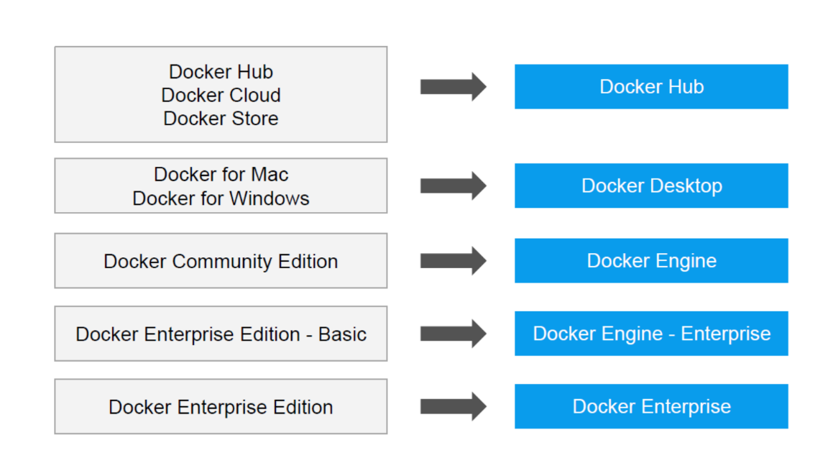
..

Slide 13
..

Slide 14

Install Docker
https://www.digitalocean.com/community/tutorials/how-to-install-and-use-docker-on-ubuntu-22-04

