Slide 1
DVS

Slide 2
..
A virtual switch, much like a physical switch, ensures the layer 2 network connectivity. A distributed virtual switch is a logical switch that is created on vCenter Server and is applied to all ESXi hosts added to the distributed virtual switch.
A distributed virtual switch is like a template stored in vCenter. When you create a distributed virtual switch in vCenter, identical hidden standard vSwitches are created on all ESXi hosts added to VDS configuration.
If you create a port group for VLAN on a distributed virtual switch, the same port group will be created on all vSwitches of ESXi hosts associated to that VDS. You only need to create a port group once, which is a significant advantage.
A distributed virtual switch created in vCenter is a control plane (used for management) and hidden standard vSwitches on ESXi hosts are the IO plane (responsible for network operation).

Slide 3
Features of dvs
Network I/O control: Inbound traffic shaping, bandwidth reservations.
Port mirroring: Allows you to send copies of frames detected on some port of a virtual switch to a specified port of another switch for monitoring, traffic analyzing, and debugging.
Network health check: Configuration such as VLAN settings, MTU, NIC teaming are checked every minute by default.
Support of protocols: Private VLAN (PVLAN), Link Aggregation Control Protocol (LACP), NetFlow, Link Layer Discovery Protocol (LLDP).
VM port blocking: This feature can be used for secure purposes and allows you to block sending or receiving data on the selected port.
Network vMotion: Preserves the connection of a VM virtual network adapter to the same port of the VMware distributed switch.
vNetwork switch API: Provides interfaces for implementing third-party virtual switches.
Backup and restoring network configuration.

Slide 4
Requirements
VMware distributed switching is available only if you use the vSphere Enterprise Plus license for ESXi hosts in vSphere. If you use a free trial license, all vSphere features including a distributed virtual switch are available for a 60-day period

Slide 5
VMware Distributed Switch Configuration
ESXi -1
ESXi-2
vCenter

Slide 6
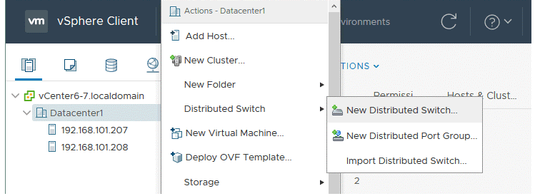
Creation

Slide 7
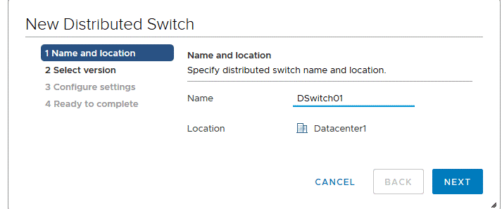
.

Slide 8
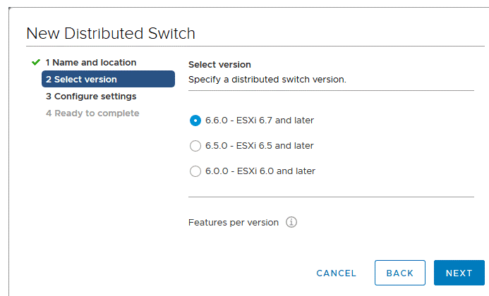
..

Slide 9
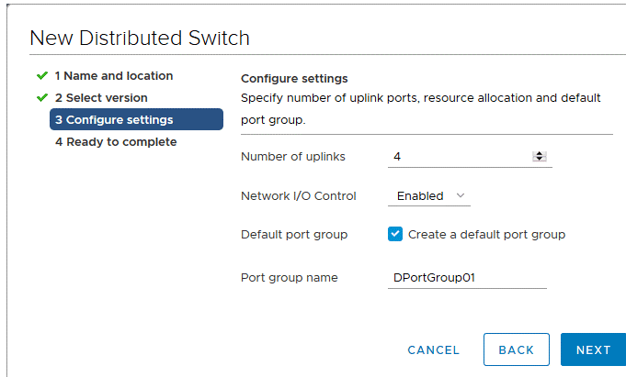
..

Slide 10
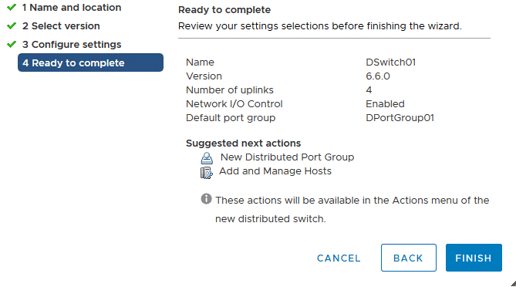
..

Slide 11
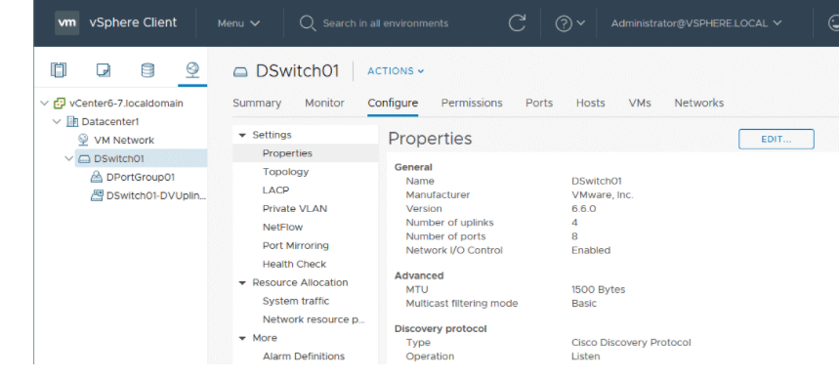
..

Slide 12
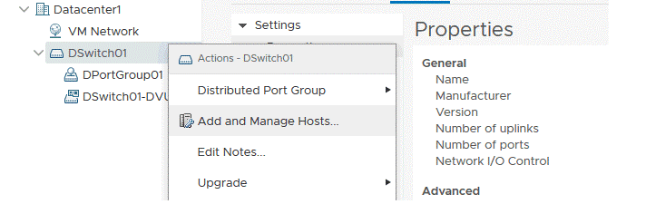
Adding ESXi hosts to a VMware distributed switch

Slide 13
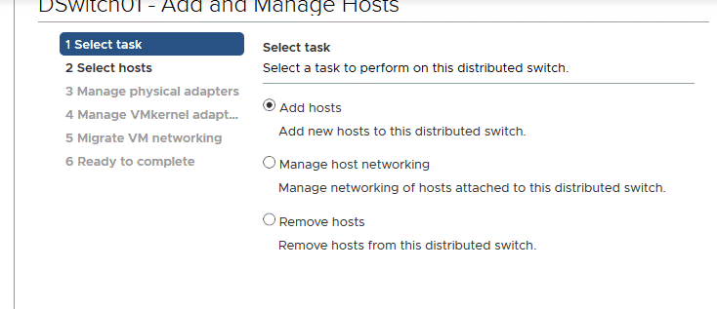
..

Slide 14
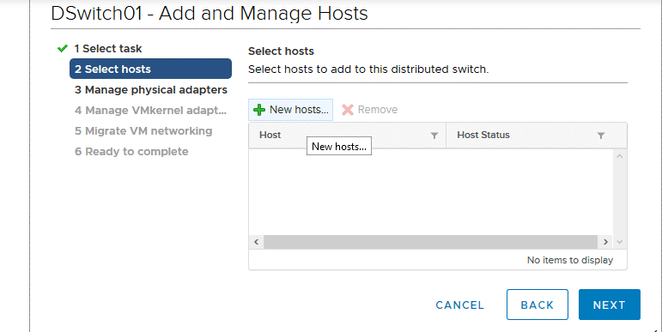
..

Slide 15
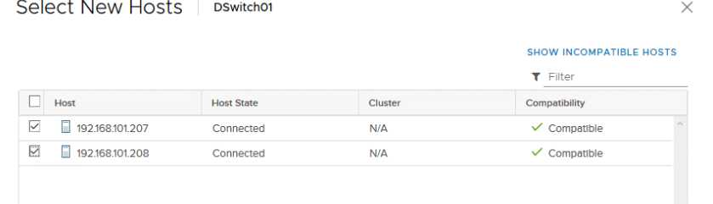
..

Slide 16
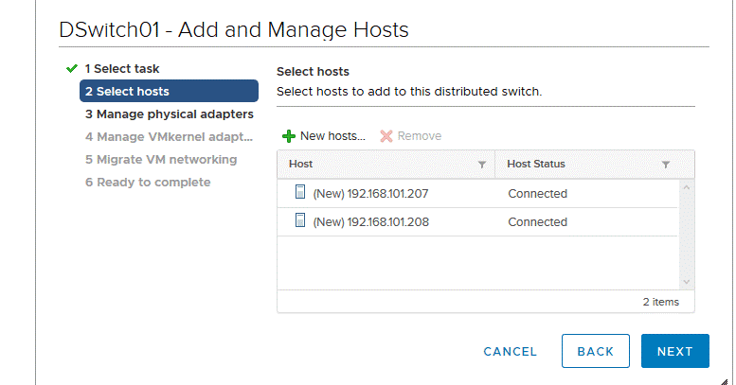
..

Slide 17
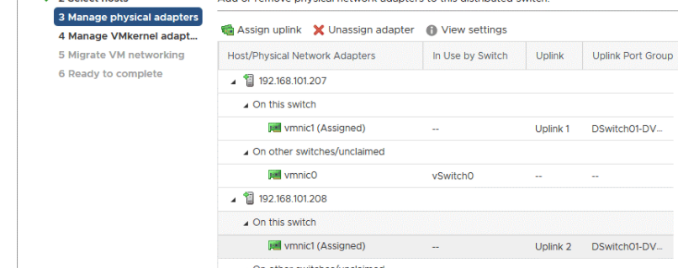
..

Slide 18
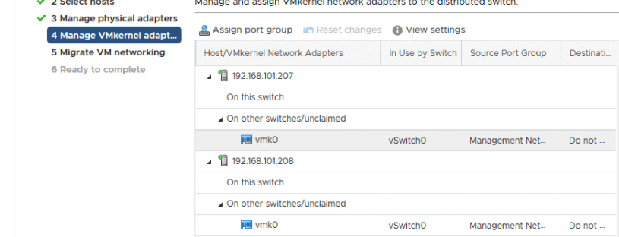
..

Slide 19
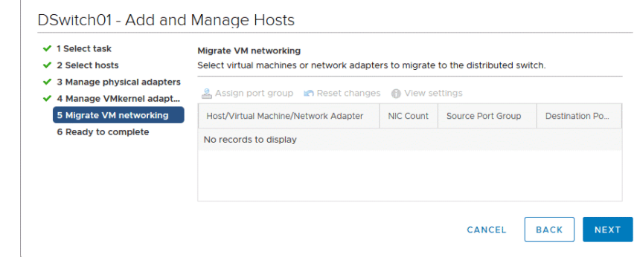
..

Slide 20
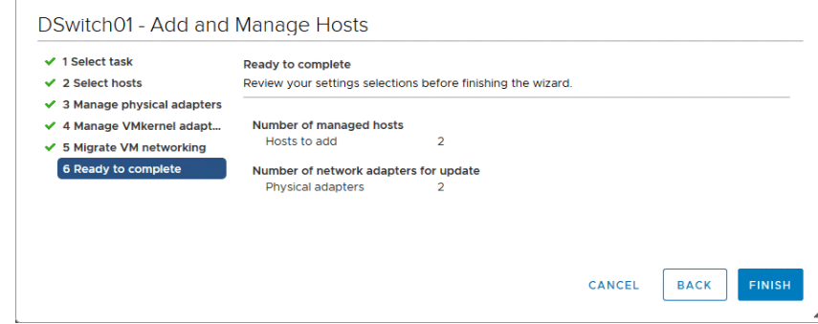
..

Slide 21
Adding VMkernel adapters
Assignment:

Slide 22
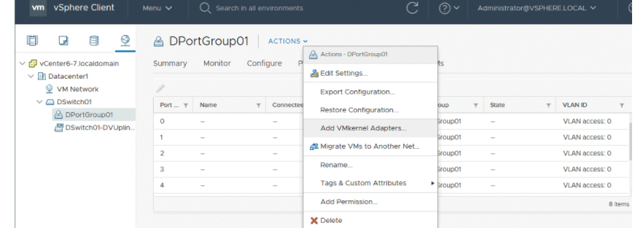
..

Slide 23
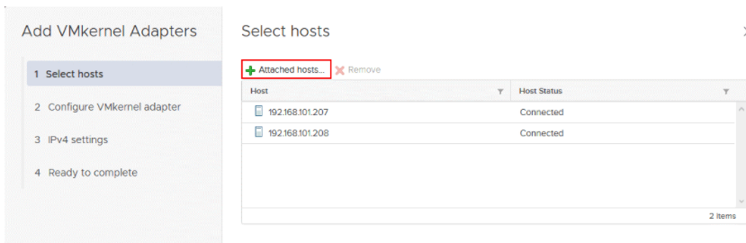
..

Slide 24
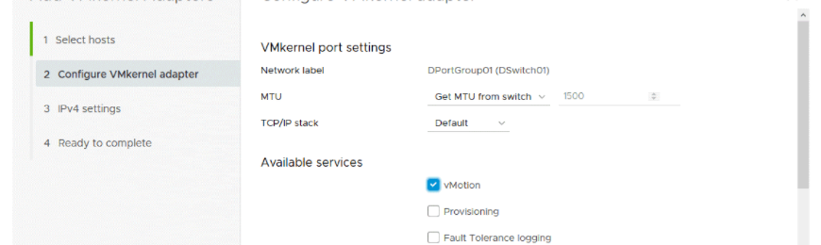
..

Slide 25
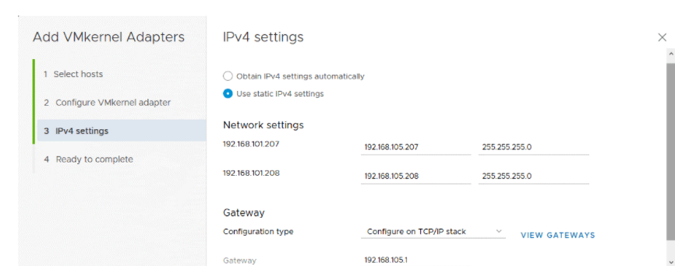
..

Slide 26
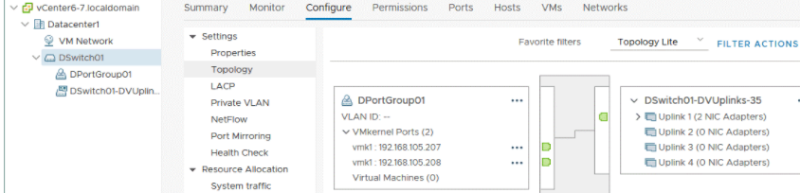
Checking VDS configuration

