Slide 1
VMware vSphere
Introduction

Slide 2
Agenda
Computer resources
Virtualization
Type of Virtualization
Physical machine vs Virtual machine
Introduction to VMware
ESXi Networking
Questions

Slide 3

Computer Resources
In our computer resources are:
CPU
Memory
Hard disk
Network
Utilization of Resources
Physical system limitation
How to increase the resource consumption

Slide 4
Virtualization
As per wiki
“In computing, virtualization or is the act of creating a virtual (rather than actual) version of something, including virtual computer hardware platforms, storage devices, and computer network resources.
Virtualization began in the 1960s, as a method of logically dividing the system resources provided by mainframe computers between different applications. Since then, the meaning of the term has broadened

Slide 5
Types of virtualization
OS Virtualization—aka Virtual Machines.
Application Virtualization.
Network Virtualization
Hardware Virtualization
Storage Virtualization

Slide 6
Vmware History
1998, VMware was founded by Diane Greene, Mendel Rosenblum, Scott Devine, Ellen Wang.
The first product, VMware Workstation, was delivered in May 1999, and the company entered the server market in 2001 with VMware GSX Server (hosted) and VMware ESX Server
In 2003, VMware launched VMware Virtual Center, vMotion, and Virtual SMP technology. 64-bit support was introduced in 2004.
2005 vmware has acquired by EMC2
^{2015 EMC2 has acquired by Dell}
^{Dell-> EMC2->VMWare}

Slide 7
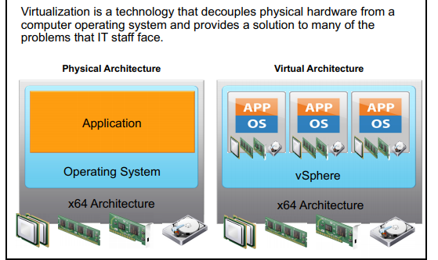
Physical vs Virtual

Slide 8
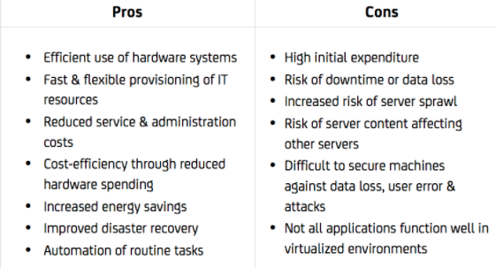
Pros and Cons of Virtualization

Slide 9
Server Virtualization and hosted virtualization
Hosted
Vmware Workstation
Oracle virtual box
Server
ESXi
Citrix Xen

Slide 10
Full vs Para virtualization
Full virtualization:
No modification to Guest OS
Guest OS unaware about virtualization
VMware ESXi
Para virtualization:
In paravirtualization, virtual machine does not implement full isolation of OS but rather provides a different API which is utilized when OS is subjected to alteration.
Citrix Xen

Slide 11
Hypervisor
A hypervisor, also known as a virtual machine monitor or VMM, is software that creates and runs virtual machines (VMs). A hypervisor allows one host computer to support multiple guest VMs by virtually sharing its resources, such as memory and processing.
Example of Hypervisor
VMware ESXi
Install on barematel
Main vendors which supports: Dell, HPE,Cisco,IBM(now Lenovo)

Slide 12
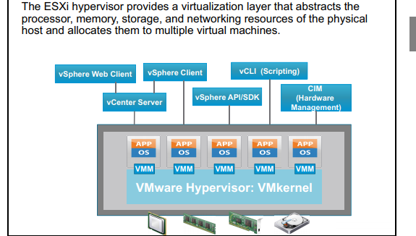
Hypervisor [ESXi)

Slide 13
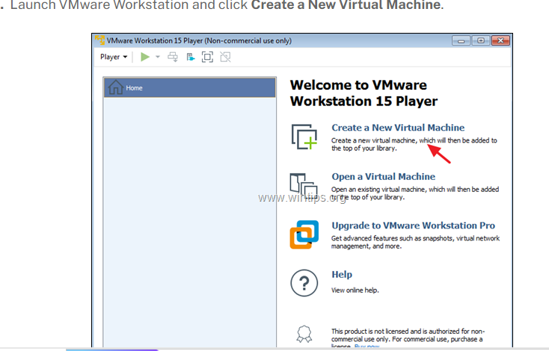

Slide 14
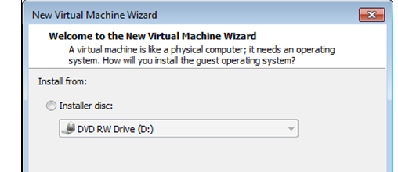
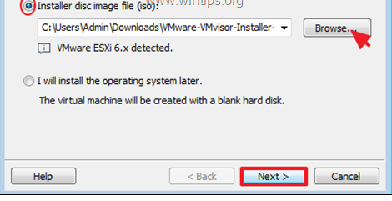

Slide 15
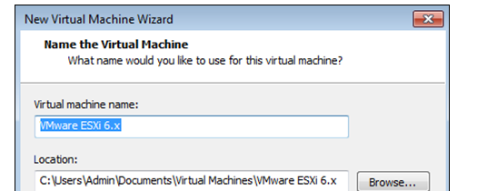
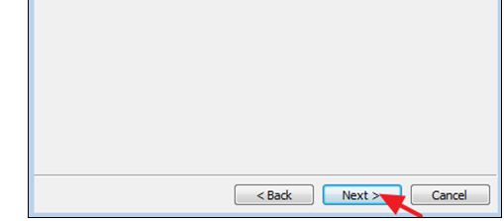

Slide 16
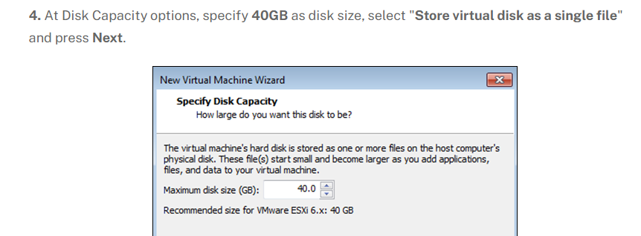
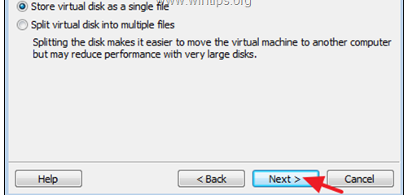

Slide 17
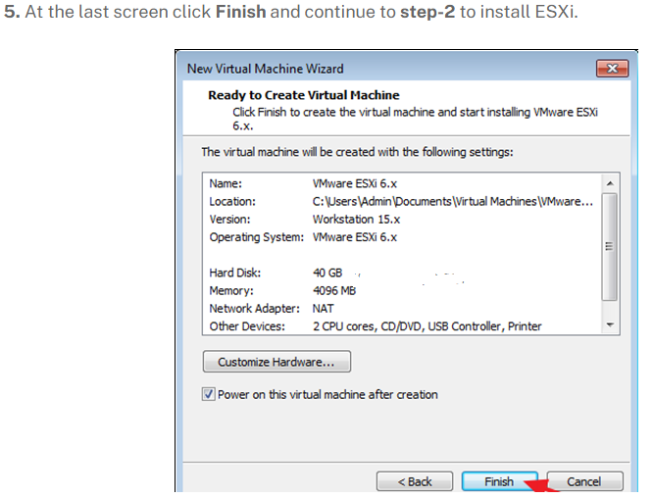

Slide 18
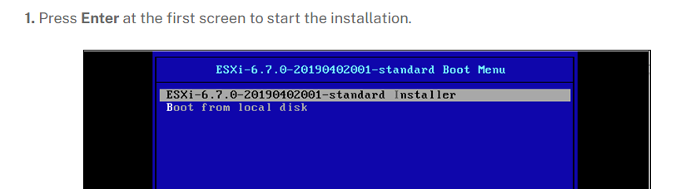

Slide 19
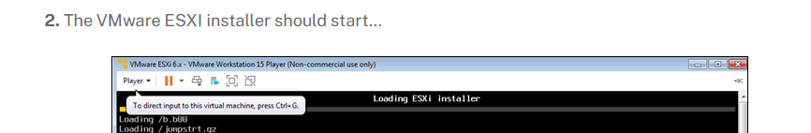

Slide 20

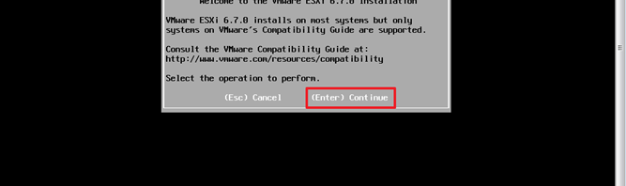

Slide 21

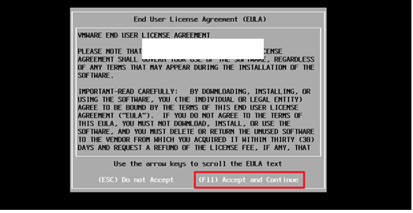

Slide 22
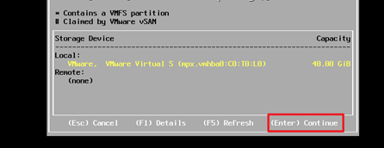

Slide 23
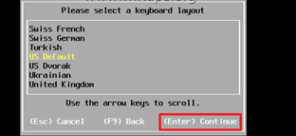

Slide 24
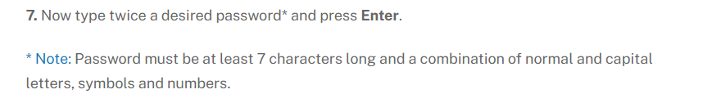
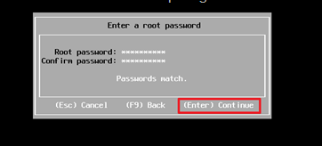

Slide 25

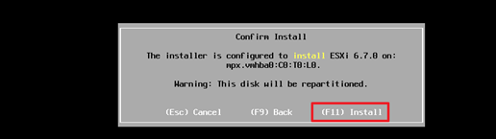

Slide 26
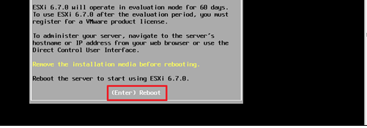

Slide 27
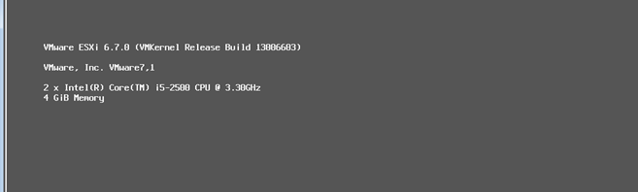
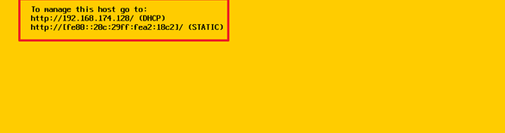

Slide 28
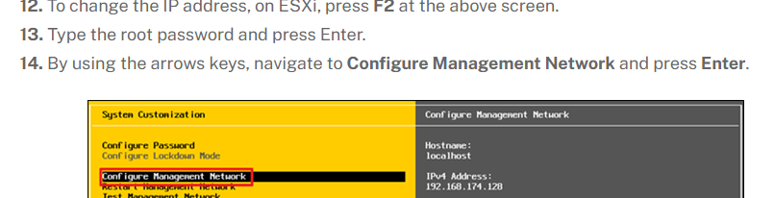

Slide 29
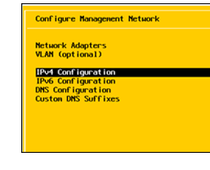

Slide 30
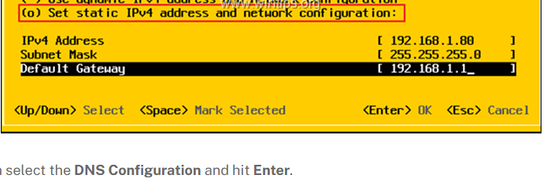

Slide 31
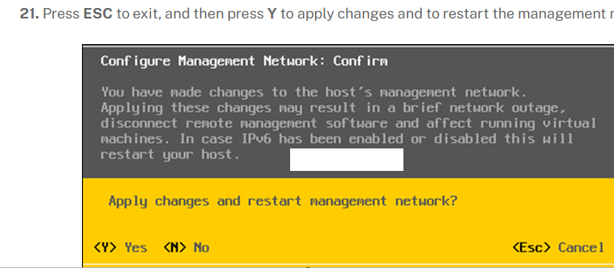

Slide 32
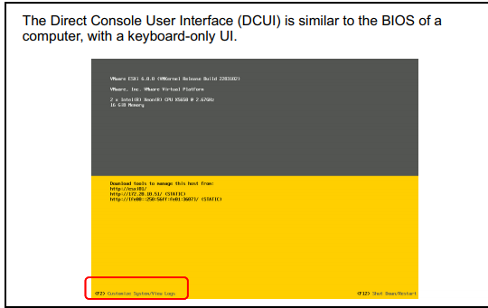
ESXi

Slide 33
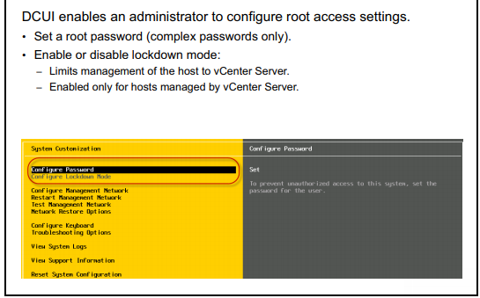
Setting password

Slide 34
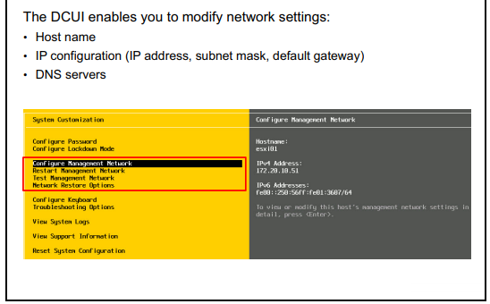
Network: How to access remotely

Slide 35
Some of terms
VC: Virtual Center
VM: Virtual Machine
GOS: Guest Operating tool
vSwitch: Virtual Switch
DVS: Distributed Virtual Switch
Vmtools: virtual machine tools
Vmdk: virtual machine harddisk

Slide 36
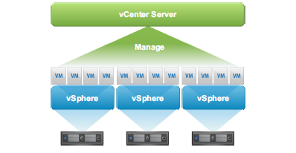
Overview of vCenter Server
VMware vCenter Server. enables you to centrally manage multiple VMware ESXi. hosts and their virtual machines. Failure to properly install, configure, and manage vCenter Server might result in reduced administrative efficiency or possible ESXi host and virtual machine downtime.

Slide 37
ESXi Networking
A virtual switch has specific connection types:
. Virtual machine port groups
. VMkernel port:
. For IP storage, VMware vSphere® High Availability, VMware vSphere® vMotion®
migration, VMware vSphere® Fault Tolerance, VMware Virtual SAN., and VMware
vSphere® Replication.
. For the ESXi management network

Slide 38
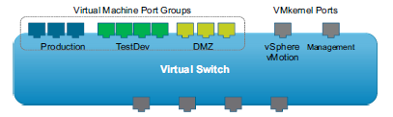
vSwitch Example

Slide 39
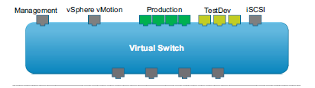
Connection Examples
More than one network can coexist on the same virtual switch. Or
networks can exist on separate virtual switches.

Slide 40
ESXi Port group
Vmkernel Port group
Management
Vmotion
Iscsi,nfs mapping
VM Port group
Need outbound adapter for vm
VM to VM communication

Slide 41
Question
Hypervisor Name VMware
Hypervisor Management Software name
Type of server virtualization
Type of vSwitch
Name the portgroup
Benefit of DVS

Slide 42
/vmfs/volumes/datastore1/centos7
Vmx : configuration file
Vmdk: metadata file for hd
-flat.vmdk: hd file
Vswp: swap file, size will be equivalent to memory size
Vmware.log: vm related logs

Slide 43
VM creation
Iso copying to datastore
Iso mounting to the vm
Installation
Vm operation
Power on, off,reset
Snapshot creation,deletion

Slide 44
Snapshot files (Activity)
Power off vm(centos)
Delete the vm from disk
Create dummy vm(windows)
Go into esxi (check files of the dummy vm)
Create a snapshot of vm
Now again check how many files are there

Slide 45
Cloning and template
Make exact copy of vm
Can perform all the activity
Poweron, power off

Slide 46
Template
Read only golden image
Activity
Creation of template
Create vm from template
Clone vm from dummy vm
Time :12:15

Slide 47
Lunch Break
I am back, will resume at 2pm
Any Question please ask.

Slide 48
Storage (External storage
Local storage can’t address that one
Iscsi storage (TCP/IP protocol
Fc storage (fiber channel protocol)
JBOD storage(scsi protocol)

Slide 49
Deploy an appliance to get iscsi storage
Configuring target
ESXi host
Map that target.

Slide 50
Activity
Physical nics
Vmnic 0
Vmnic1
vSwitch : vSwitch1
No out bound adapter
Portgroup: vmport
Defined the vSwitch1
Dummy vm
Add network adapter
Vmport
Power on vm and check a

