Slide 1
ConfigMap
OW

Slide 2
What is ConfigMaps?
A ConfigMap is an api object to store non-confidential data in key-value format.
Pods can consumed these config map as environment variable,command-line arguments or configuration file in a volume.
Decouple environment specific configuration from the image.
ConfigMap doesn’t provide encryption.
ConfigMap cannot hold data more than 1 Mib,

Slide 3
ConfigMap Object
ConfigMap allows to store data, which other objects consume.
In spec section of ConfigMap api, we provide data or binaryData.
data or binaryData are optional field in ConfigMap api.
Each key under the data or the binaryData field must consist of alphanumeric characters, -, _ or .
The Pod and the ConfigMap must be in the same namespace.
kubelet uses the data from the ConfigMap when it launches container(s) for a Pod.

Slide 4
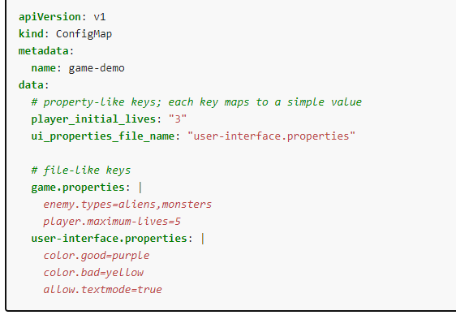
yaml

Slide 5
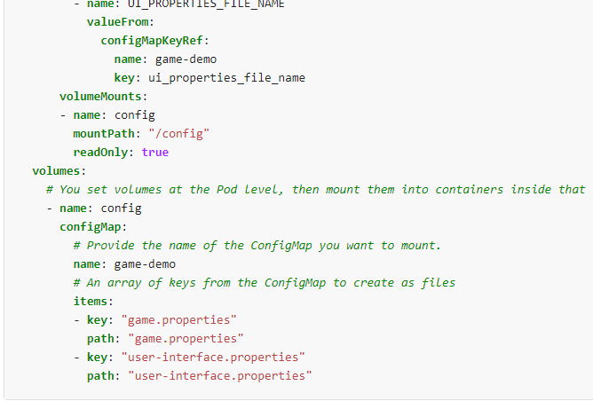
Mapping in Pod
For this example, defining a volume and mounting it inside the demo container as /config creates two files, /config/game.properties and /config/user-interface.properties, even though there are four keys in the ConfigMap.

Slide 6
..
Create a ConfigMap or use an existing one. Multiple Pods can reference the same ConfigMap.
Modify your Pod definition to add a volume under .spec.volumes[]. Name the volume anything, and have a .spec.volumes[].configMap.name field set to reference your ConfigMap object.
Add a .spec.containers[].volumeMounts[] to each container that needs the ConfigMap. Specify .spec.containers[].volumeMounts[].readOnly = true and .spec.containers[].volumeMounts[].mountPath to an unused directory name where you would like the ConfigMap to appear.
Modify your image or command line so that the program looks for files in that directory. Each key in the ConfigMap data map becomes the filename under mountPath.

