Slide 1
Istio
ow

Slide 2
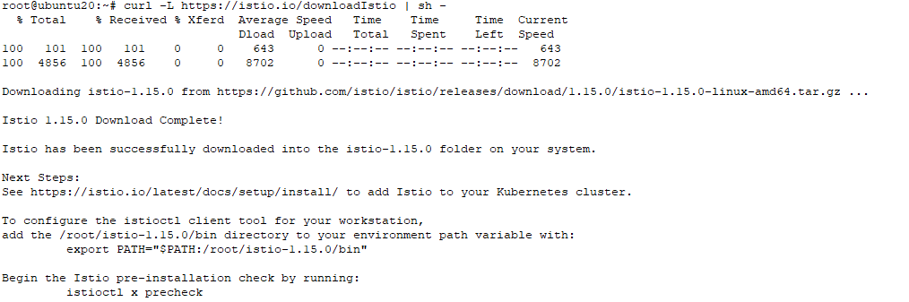
Setup istio
Download and setup istio
https://istio.io/latest/docs/setup/getting-started/
curl -L https://istio.io/downloadIstio | sh -

Slide 3
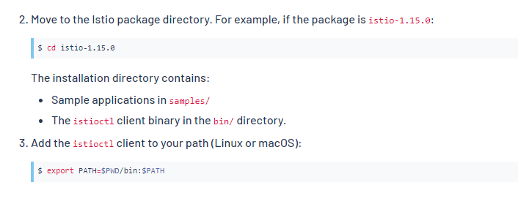
Steps to follow

Slide 4
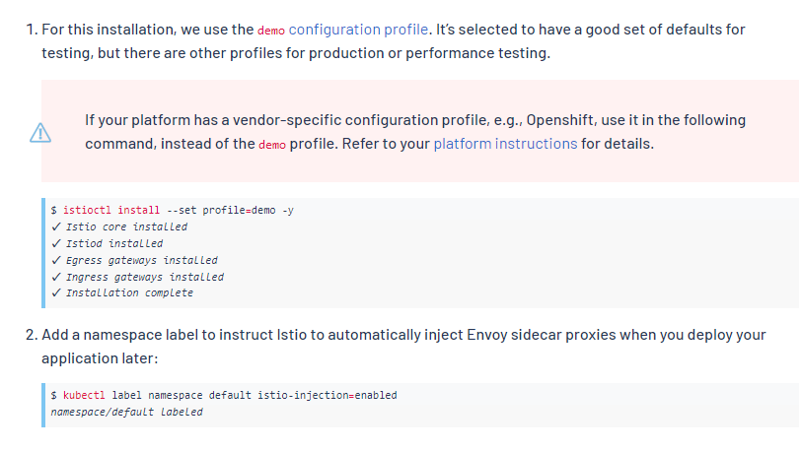
..

Slide 5
Add a namespace
Add a namespace label to instruct Istio to automatically inject Envoy sidecar proxies when you deploy your application later:
Create a new namespace
kubectl create ns test-istio
kubectl label namespace test-istio istio-injection=enabled

Slide 6
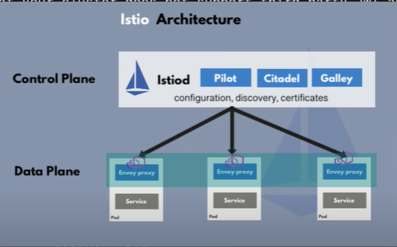
Istio Architecture

Slide 7
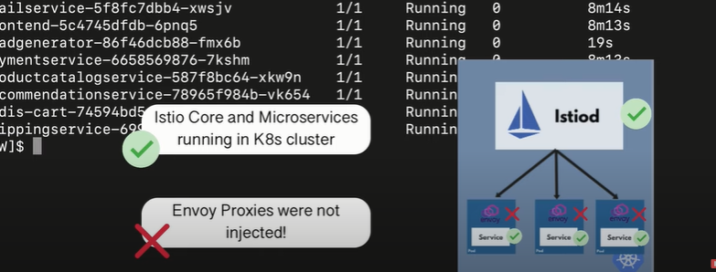
.Demo
Istio will inject envoy proxy each of the micro-service it manages.
Download google microservice demo
https://raw.githubusercontent.com/GoogleCloudPlatform/microservices-demo/main/release/kubernetes-manifests.yaml
kubectl create -f kubernetes-manifests.yaml

Slide 8
..
By-default all the configuration will go in default namespace
Check the labels for default namespace
kubectl get ns default --show-labels
NAME STATUS AGE LABELS
default Active 16d kubernetes.io/metadata.name=default
We need to enable the istio-injection (key-value pair) so it can inject envoy
kubectl label namespace default istio-injection=enabled

Slide 9
..
Now we need to shutdown all the resources, which we have deployed using manifest
kubectl delete -f kubernetes-manifests.yaml
Recreate it again, it will deploy the envoy proxy

Slide 10
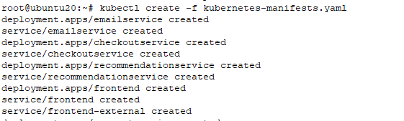
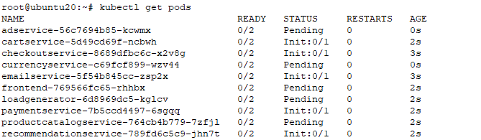
..

Slide 11
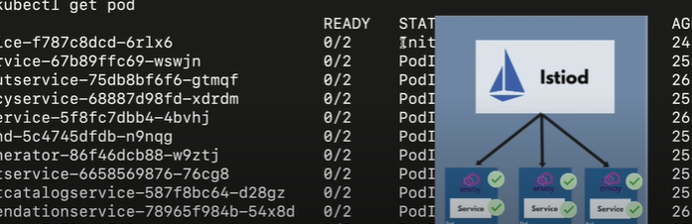
..

Slide 12
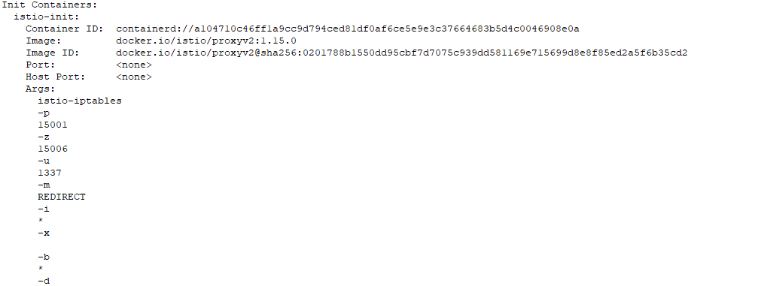
Describe one of the pod

Slide 13
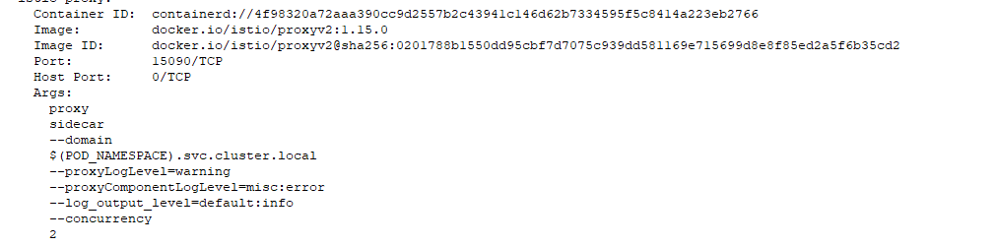
..

Slide 14
Check the manifest file
Check the kuberentes-manifest.yaml
Did you find any init container ?
Any istio code added??

Slide 15



