Slide 1
Jobs
OW

Slide 2
What is job??
A Job creates one or more Pods and will continue to retry execution of the Pods until a specified number of them successfully terminate.
When a specified number of successful completions is reached, the task (ie, Job) is complete. Deleting a Job will clean up the Pods it created.
Suspending a Job will delete its active Pods until the Job is resumed again.
A simple case is to create one Job object in order to reliably run one Pod to completion. You can also use a Job to run multiple Pods in parallel.

Slide 3
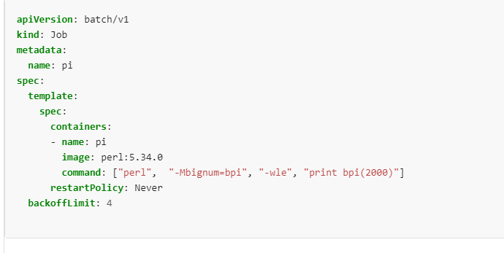
Job yaml

Slide 4
..
Non-parallel Jobs
normally, only one Pod is started, unless the Pod fails.
the Job is complete as soon as its Pod terminates successfully.
.spec.completions
specify a non-zero positive value for .spec.completions.
the Job represents the overall task, and is complete when there are .spec.completions successful Pods.
when using .spec.completionMode="Indexed", each Pod gets a different index in the range 0 to .spec.completions-1

Slide 5
Parallel Jobs with a work queue
when any Pod from the Job terminates with success, no new Pods are created.
once at least one Pod has terminated with success and all Pods are terminated, then the Job is completed with success.
once any Pod has exited with success, no other Pod should still be doing any work for this task or writing any output. They should all be in the process of exiting.

Slide 6
Pod backoff failure policy
There are situations where you want to fail a Job after some amount of retries due to a logical error in configuration etc. To do so, set .spec.backoffLimit to specify the number of retries before considering a Job as failed. The back-off limit is set by default to 6.
If your job has restartPolicy = "OnFailure", keep in mind that your Pod running the Job will be terminated once the job backoff limit has been reached.

Slide 7
.spec.activeDeadlineSeconds
Another way to terminate a Job is by setting an active deadline. Do this by setting the .spec.activeDeadlineSeconds field of the Job to a number of seconds.
The activeDeadlineSeconds applies to the duration of the job, no matter how many Pods are created. Once a Job reaches activeDeadlineSeconds, all of its running Pods are terminated and the Job status will become type: Failed with reason: DeadlineExceeded. Note that a Job's .spec.activeDeadlineSeconds takes precedence over its .spec.backoffLimit

Slide 8
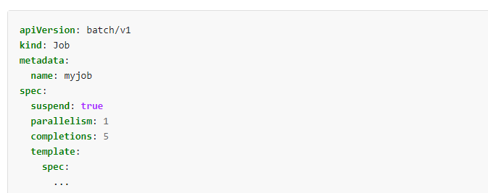
.

Slide 9
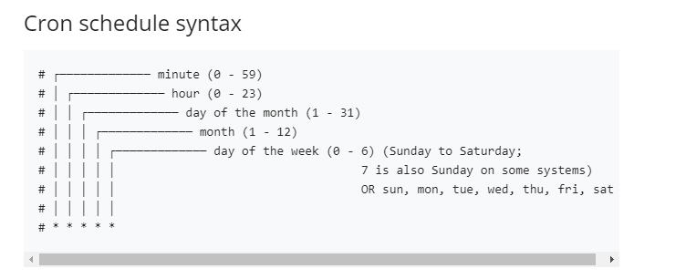
CronJob
A CronJob creates Jobs on a repeating schedule.
One CronJob object is like one line of a crontab (cron table) file. It runs a job periodically on a given schedule, written in Cron format.

Slide 10
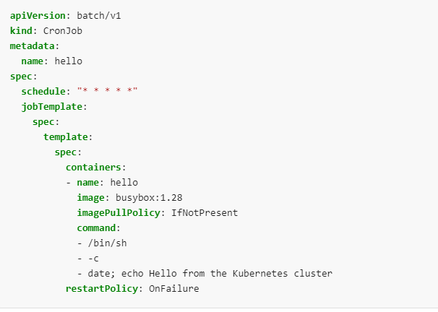
yaml

Slide 11



