Slide 1
Namespace

Slide 2
Namespace
In Kubernetes, namespaces provides a mechanism for isolating groups of resources within a single cluster.
Names of resources need to be unique within a namespace, but not across namespaces. Namespace-based scoping is applicable only for namespaced objects (e.g. Deployments, Services, etc)
not for cluster-wide objects (e.g. StorageClass, Nodes, PersistentVolumes, etc)

Slide 3
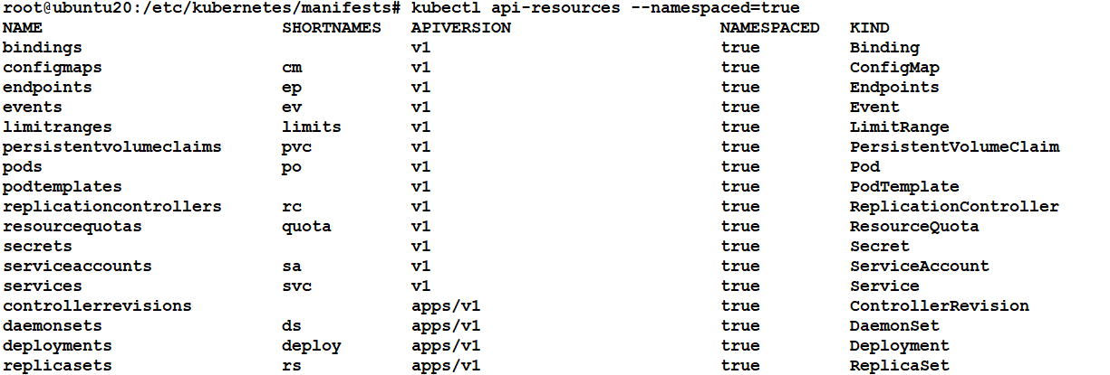
Check the scope using kubectl cmd
kubectl api-resources namespaced=true

Slide 4
When to Use Multiple Namespaces
Namespaces are intended for use in environments with many users spread across multiple teams, or projects.
Namespaces provide a scope for names. Names of resources need to be unique within a namespace, but not across namespaces.
Namespaces cannot be nested inside one another
Avoid creating namespaces with the prefix kube-, since it is reserved for Kubernetes system namespaces.

Slide 5
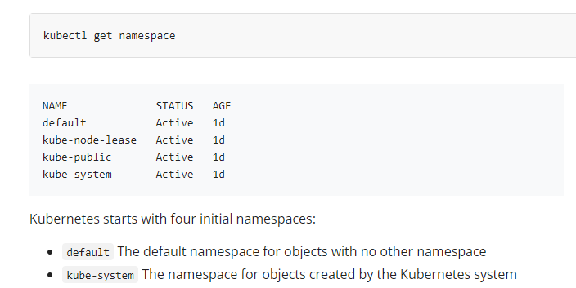
Default Namespace

Slide 6
kubectl cmds for namespace
Get the summary of namespace
kubectl get namespaces <name>
Describe the specific namespace
kubectl describe namespaces <name>
Create namespace
kubectl create namespace <insert-namespace-name-here>
Delete namespace
kubectl delete namespaces <insert-some-namespace-name>
Note: This deletes everything under the namespace!

Slide 7
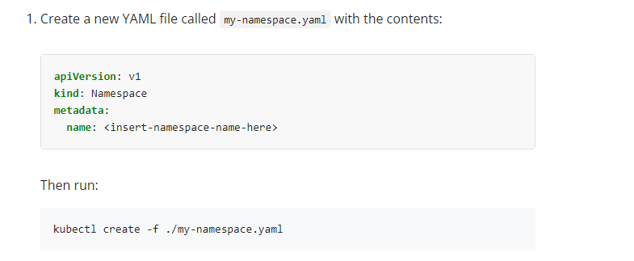
Yaml file for name space

Slide 8
ResourceQuota
ResourceQuota sets aggregate quota restrictions enforced per namespace
apiVersion: v1
kind: ResourceQuota
metadata (ObjectMeta)
spec (ResourceQuotaSpec)

Slide 9
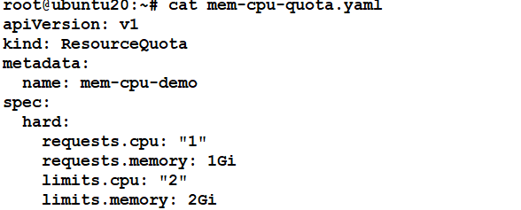
Yaml file for object

Slide 10
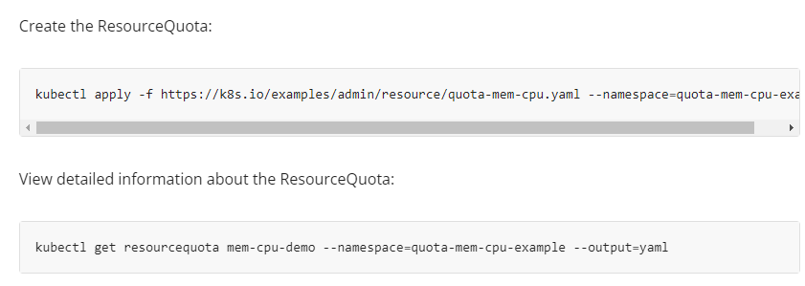
Create and map object

