Slide 1
Pod

Slide 2
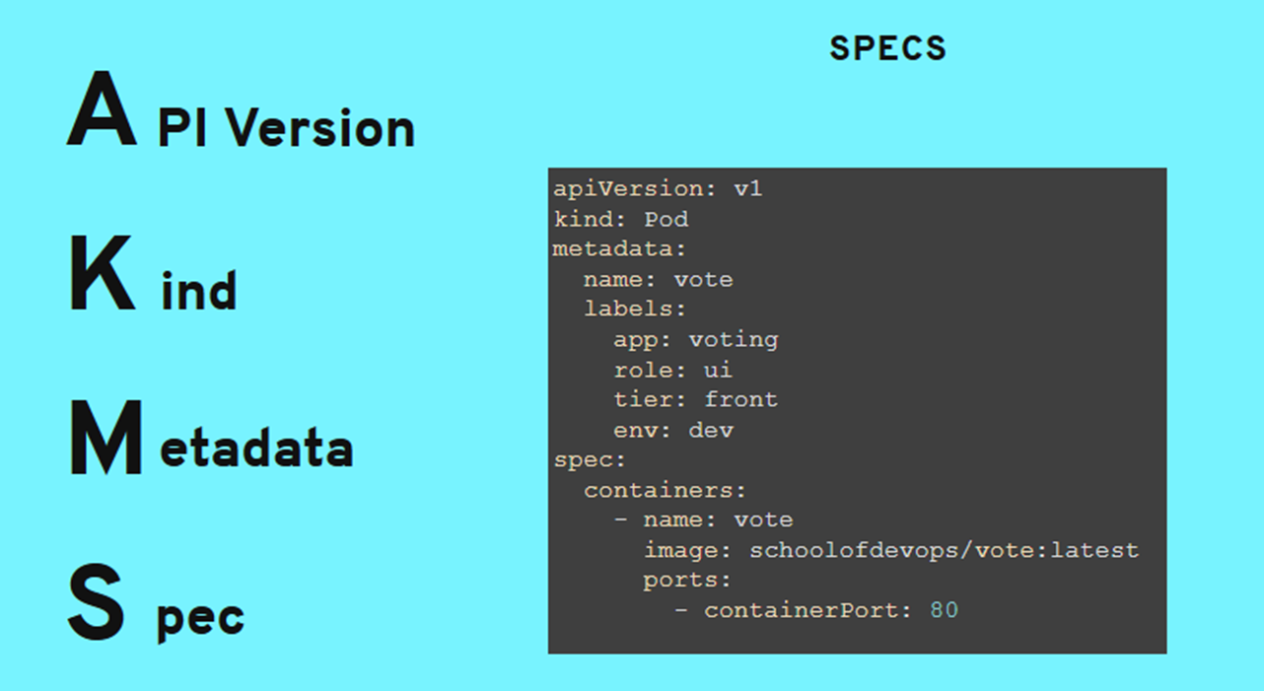
AKMS

Slide 3
..
apiVersion — This defines the Kubernetes API version that we want to use in this YAML file. You can read more about API versioning in Kubernetes here.
kind — This defines what kind of Kubernetes object we want to create.
metadata — This is data that helps us uniquely identify the object that we want to create. Here we can provide a name for our app, as well as apply labels to our object.
spec — This defines the state that we want or our object. The format that we use for spec.

Slide 4
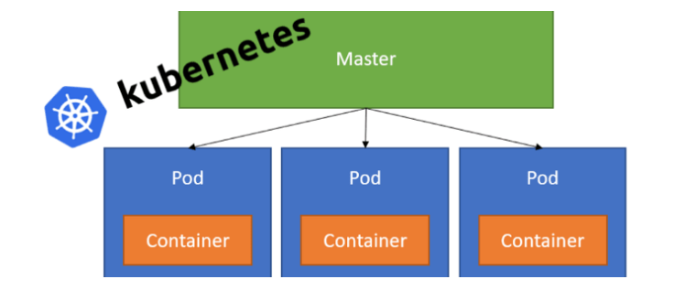
POD

Slide 5
Pods
Pods are the smallest deployable units of computing that you can create and manage in Kubernetes.
A Pod ( is a group of one or more containers, with shared storage and network resources, and a specification for how to run the containers.
While Kubernetes supports more container runtimes than just Docker, Docker is the most commonly known runtime
containerd
CRI-O
Docker Engine

Slide 6
Pods type
Pods in a Kubernetes cluster are used in two main ways:
Pods that run a single container. The "one-container-per-Pod" model is the most common Kubernetes use case; in this case, you can think of a Pod as a wrapper around a single container; Kubernetes manages Pods rather than managing the containers directly.
Pods that run multiple containers that need to work together. A Pod can encapsulate an application composed of multiple co-located containers that are tightly coupled and need to share resources. The Pod wraps these containers, storage resources, and an ephemeral network identity together as a single unit.

Slide 7
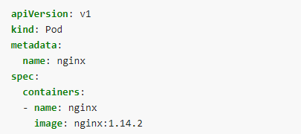
Pod yaml file

Slide 8
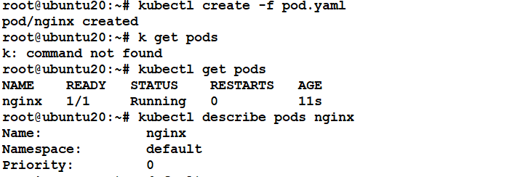
..

Slide 9
kubectl cmds
kubectl create –f <pod yaml>
kubectl get pods
kubectl describe pods nginx
kubectl get pod nginx -o wide
kubectl delete pod nginx

Slide 10
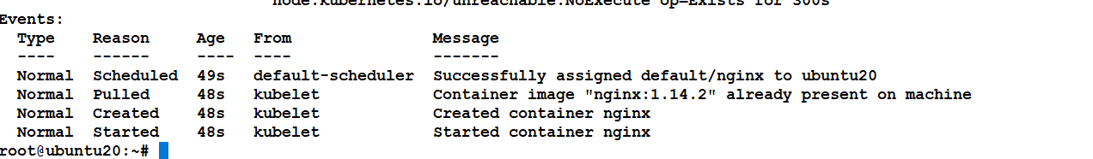
Events during pod creating

Slide 11
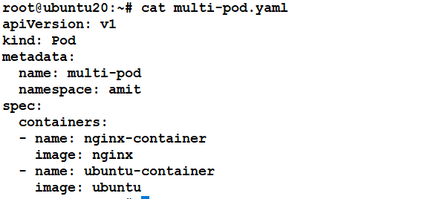
Multiple container pod

Slide 12
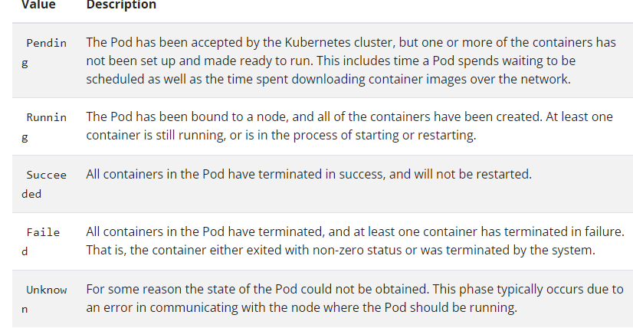
Pod lifecycle
The phase of a Pod is a simple, high-level summary of where the Pod is in its lifecycle.

