Slide 1
Probes

Slide 2
Probes
Probes are used to check the health of application inside the pod
Types of probe:
Liveness Probe:The kubelet uses liveness probes to know when to restart a container. For example, liveness probes could catch a deadlock, where an application is running, but unable to make progress
Readiness Probe:The kubelet uses readiness probes to know when a container is ready to start accepting traffic. A Pod is considered ready when all of its containers are ready.

Slide 3
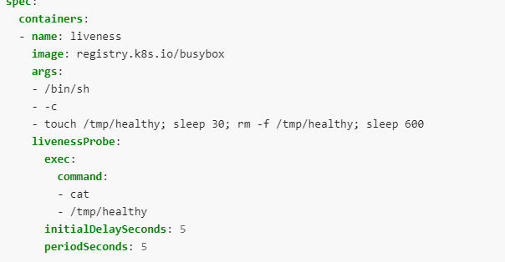
Liveness Probe

Slide 4
..
The periodSeconds field specifies that the kubelet should perform a liveness probe every 5 seconds. The initialDelaySeconds field tells the kubelet that it should wait 5 seconds
.To perform a probe, the kubelet executes the command cat /tmp/healthy in the target container. If the command succeeds, it returns 0, and the kubelet considers the container to be alive and healthy. If the command returns a non-zero value, the kubelet kills the container and restarts it.

Slide 5
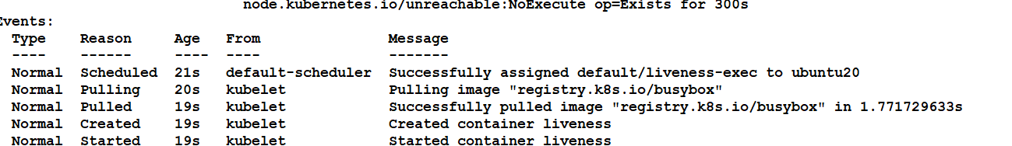
Within 30 seconds, view the Pod events:

Slide 6
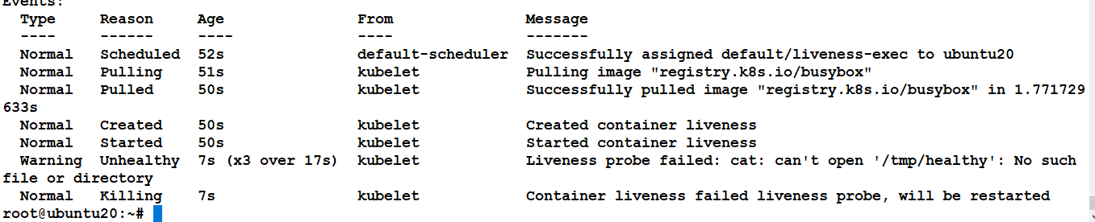
After 35 seconds, view the Pod events again:

Slide 7
Wait another 30 seconds, and verify that the container has been restarted:

Slide 8
ReadinessProbe
Sometimes, applications are temporarily unable to serve traffic. For example, an application might need to load large data or configuration files during startup, or depend on external services after startup. In such cases, you don't want to kill the application, but you don't want to send it requests either.
Readiness probes runs on the container during its whole lifecycle.
Readiness probes are configured similarly to liveness probes. The only difference is that you use the readinessProbe field instead of the livenessProbe field.

Slide 9
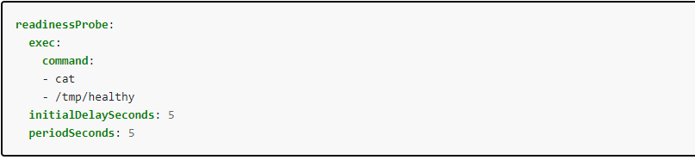
..

Slide 10
..
Readiness and liveness probes can be used in parallel for the same container. Using both can ensure that traffic does not reach a container that is not ready for it, and that containers are restarted when they fail.

