Slide 1
Prometheus
OW

Slide 2
Explained
What is Prometheus?
Where and Why it should use?
Prometheus Architecture
Explain configuration

Slide 3
What is Prometheus?
It is monitoring tool, to monitor the highly dynamic environment
It can be used in non container environment
Complex infra:
Server
Running 100 of containers
All are interconnected and keep on changing
Monitor h/w as well application
Distributed env is challenge
User authentication is failing in UI, where the issue occurred?
Need a tool which monitor the environment

Slide 4
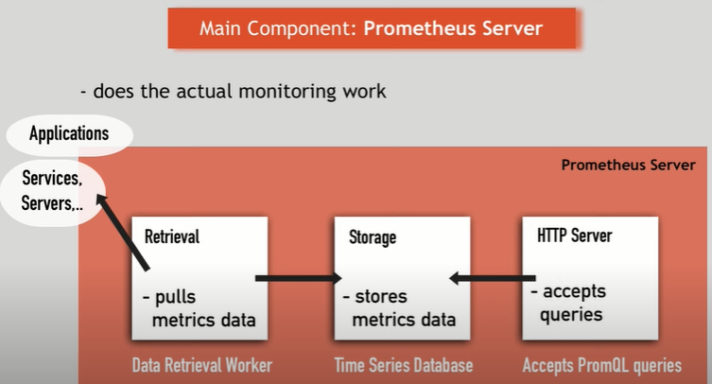
Prometheus Architecture

Slide 5
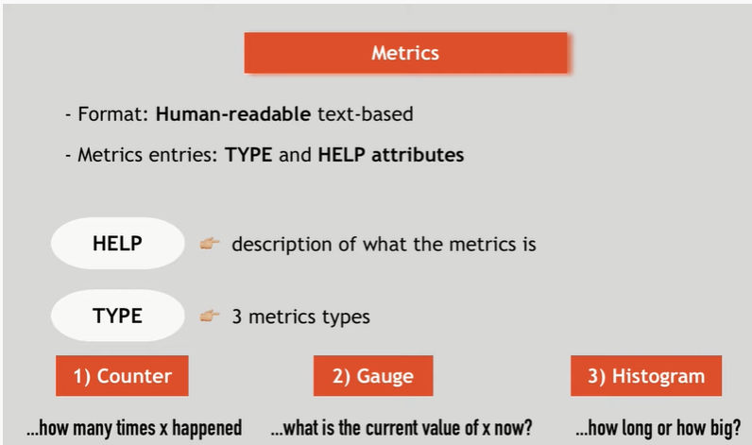
Metrics

Slide 6
How data collected
All the component has to provide endpoint for metrics collection
They must be in metrics format
All data will be collected by Prometheus server only in-supported format
If that is not in supported format, we need “Exporter”
Exporter will collect the data from the endpoint and convert into the supported metrics format.
Expose them /metrics endpoint, and Server will pull that data
Different exporters are available from vendors

Slide 7
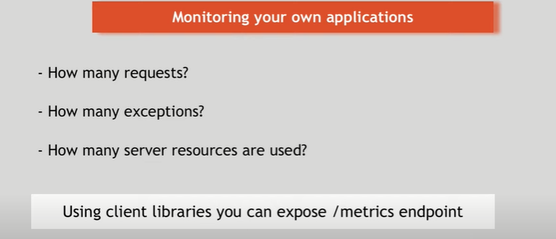
..

Slide 8
Push vs pull request
Aws cloud watch
Push mechanism
With push mechanism every component has to send the request to centralized sever
Prometheus
Pull : Server goes and pull the data
Server pull data in specific format

Slide 9
Configuring Prometheus
Prometheus provide yaml file
In yaml file configure need to mention the targets
Intervals
It usage service discover mechanism to discover the target and pull the data from the target server with regular interval
Retrieval will pull the data and store it in Prometheus server storage
Download yaml
https://raw.githubusercontent.com/istio/istio/release-1.15/samples/addons/prometheus.yaml

Slide 10
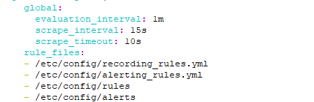

Check the yaml
Configure time and rule ,target which it monitors

Slide 11
How alerts are triggering?
Prometheus has component called alert manager
It receives config for alerts from server
Once alerts triggers it send through mail, Slack
Stores metrics data on-disk
Default is local disk
Query metrics data , using api
PromQL query language
Dashboard UI also available

Slide 12
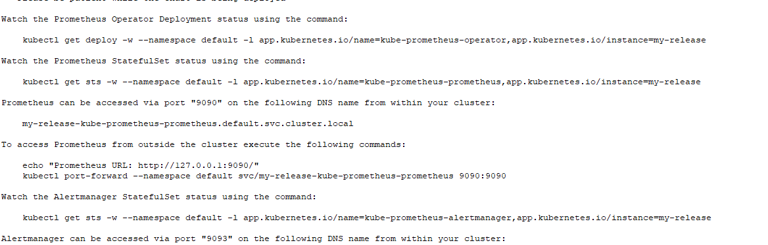
Using helm
Add repo
helm repo add bitnami https://charts.bitnami.com/bitnami
helm install my-release bitnami/kube-prometheus

