Slide 1
RBAC
OW

Slide 2
What is RBAC?
Role-Based access control (RBAC) is method of regulating the access to computer or network resources based on the roles.
RBAC authorization uses the rbac.authorization.k8s.io api to drive authorization decision.
RBAC declares four kind of objects:
Role
ClusterRole
RoleBinding
ClusterRoleBinding

Slide 3
RBAC vs CLUSTERROLE
A Role always sets permissions within a particular namespace; when you create a Role, you have to specify the namespace it belongs in.
ClusterRoles, by contrast, is a non-namespaced resource.
ClusterRoles have several uses. You can use a ClusterRole to:
define permissions on namespaced resources and be granted access within individual namespace(s)
define permissions on namespaced resources and be granted access across all namespaces
define permissions on cluster-scoped resources

Slide 4
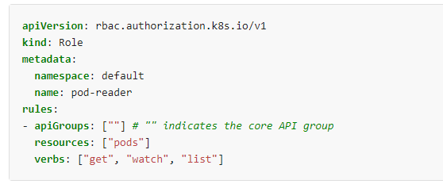
Role example

Slide 5
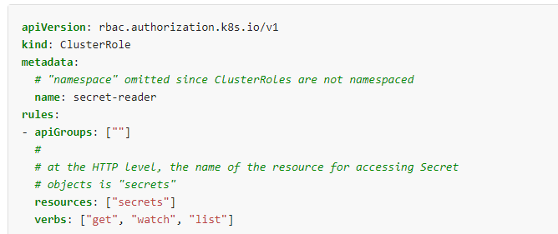
ClusterRole

Slide 6
What next: RoleBinding and ClusterRoleBinding
A role binding grant the permission defined in a role to a user or set of users.
Its holds a list of subjects such as users,group,service account and a reference to the role being granted.
A RoleBinding is specific to namespace
A ClusterRoleBinding grants access cluster-wide
A RoleBinding can refer to ClusterRole as well.
If you bind a ClusterRole to all the namespace, use ClusterRoleBinding

Slide 7
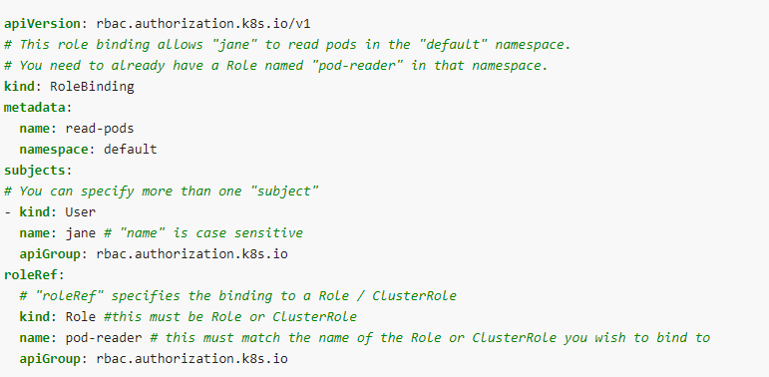
RoleBinding Refer to Role

Slide 8
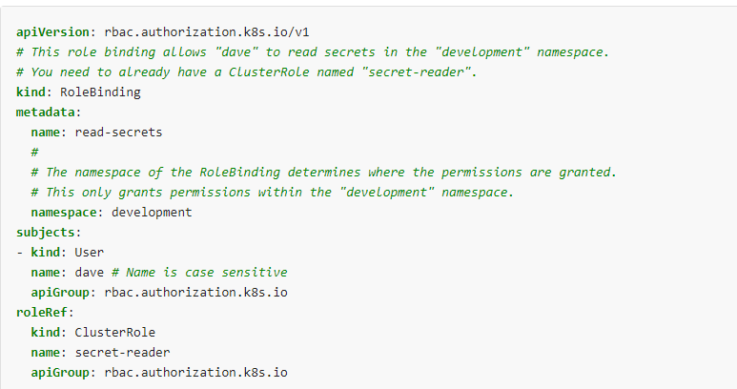
RoleBinding Refer to ClusterRole

Slide 9
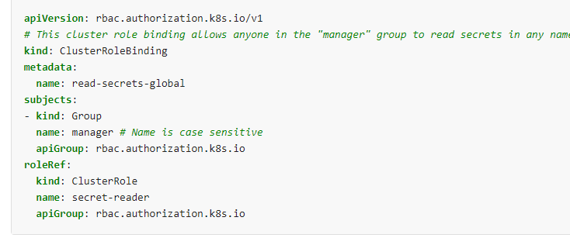
ClusterRoleBinding Example

Slide 10
Good To know facts
After you create a binding, you cannot change the Role or ClusterRole that it refers to. If you try to change a binding's roleRef, you get a validation error.
If you do want to change the roleRef for a binding, you need to remove the binding object and create a replacement.
Any change in roleRef, binding need to be recreated.
The kubectl auth reconcile command-line utility creates or updates a manifest file containing RBAC objects, and handles deleting and recreating binding objects if required to change the role they refer to

Slide 11
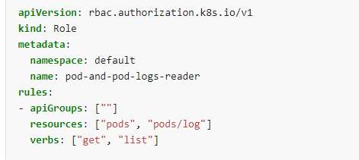
Referring to resources
In the Kubernetes API, most resources are represented and accessed using a string representation of their object name, such as pods for a Pod. RBAC refers to resources using exactly the same name that appears in the URL for the relevant API endpoint.
In this case, pods is the namespaced resource for Pod resources, and log is a subresource of pods. To represent this in an RBAC role, use a slash (/) to delimit the resource and subresource. To allow a subject to read pods and also access the log subresource for each of those Pods, you write

Slide 12

How to access sub resources
kubectl proxy &
curl -s http://localhost:8001/api/v1/namespaces/default/pods/

Slide 13
Don’t use wildcards
Using wildcards in resource and verb entries could result in overly permissive access being granted to sensitive resources. For instance, if a new resource type is added, or a new subresource is added, or a new custom verb is checked, the wildcard entry automatically grants access.

Slide 14
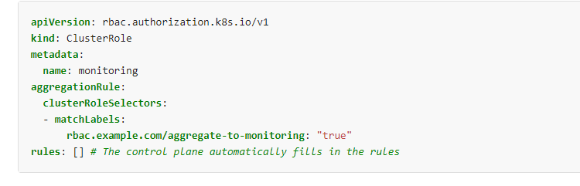
Aggregated ClusterRoles
aggregate several ClusterRoles into one combined ClusterRole
The aggregationRule defines a label selector that the controller uses to match other ClusterRole objects that should be combined into the rules field of this one.

Slide 15
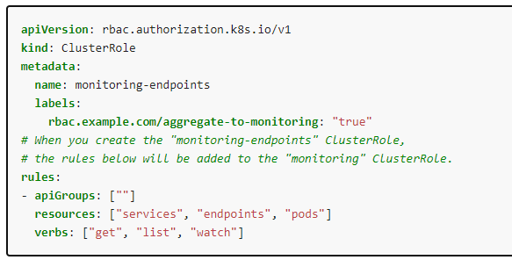
..

Slide 16
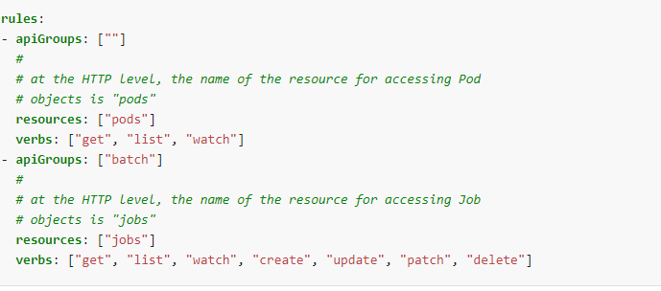
Rules

Slide 17
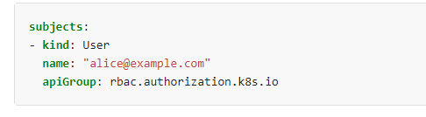
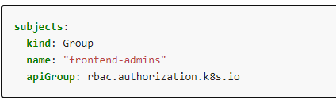
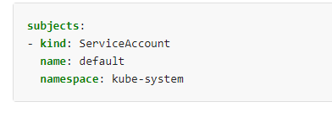
Subject in RoleBinding
A RoleBinding or ClusterRoleBinding binds a role to subjects. Subjects can be groups, users or ServiceAccounts.

Slide 18
Try commands and yaml
Labs and cmds

