Slide 1
Secret
Ow

Slide 2
Secret in kubernetes
A Secret is an object that contains a small amount of sensitive data such as a password, a token, or a key.
here arePod to use a Secret:
As files in a volume mounted on one or more of its containers.
As container environment variable.
You can specify the data and/or the stringData field when creating a configuration file for a Secret. The data and the stringData fields are optional.
Individual secrets are limited to 1MiB in size.

Slide 3
Secret in Data/StringData
The kubernetes.io/basic-auth type is provided for storing credentials needed for basic authentication. When using this Secret type, the data field of the Secret must contain one of the following two keys:
username: the user name for authentication
password: the password or token for authentication
Both values for the above two keys are base64 encoded strings. You can, of course, provide the clear text content using the stringData for Secret creation.

Slide 4
Manifest file
apiVersion: v1
kind: Secret
metadata:
name: secret-basic-auth
type: kubernetes.io/basic-auth
stringData:
username: admin # required field for kubernetes.io/basic-auth
password: t0p-Secret # required field for kubernetes.io/basic-auth

Slide 5
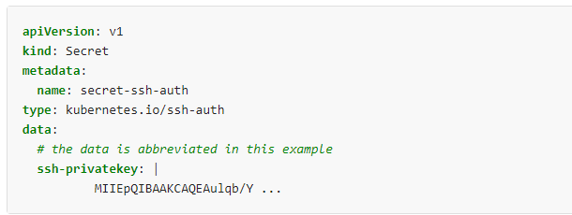
Ssh authentication secuirty
The builtin type kubernetes.io/ssh-auth is provided for storing data used in SSH authentication. When using this Secret type, you will have to specify a ssh-privatekey key-value pair in the data (or stringData) field as the SSH credential to use.

Slide 6
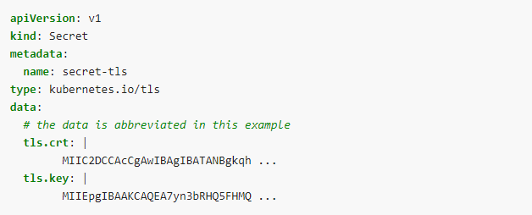
TLS Secret
Kubernetes provides a builtin Secret type kubernetes.io/tls for storing a certificate and its associated key that are typically used for TLS.
Using this type of Secret, the tls.key and the tls.crt key must be provided in the data field of the Secret configuration

Slide 7
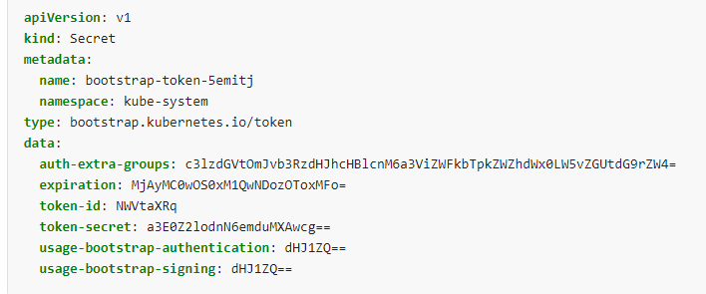
BootStrap Token
A bootstrap token Secret can be created by explicitly specifying the Secret type to bootstrap.kubernetes.io/token. This type of Secret is designed for tokens used during the node bootstrap process.

Slide 8
..
token-id: A random 6 character string as the token identifier. Required.
token-secret: A random 16 character string as the actual token secret. Required.
description: A human-readable string that describes what the token is used for. Optional.
expiration: An absolute UTC time using RFC3339 specifying when the token should be expired. Optional.
usage-bootstrap-<usage>: A boolean flag indicating additional usage for the bootstrap token.
auth-extra-groups: A comma-separated list of group names that will be authenticated as in addition to the system:bootstrappers group.

Slide 9
Secret using kubectl command
echo -n 'admin' > ./username.txt
echo -n '1f2d1e2e67df' > ./password.txt
https://kubernetes.io/docs/tasks/configmap-secret/managing-secret-using-kubectl/
kubectl create secret generic db-user-pass \
--from-file=./username.txt \
--from-file=./password.txt

