Slide 1
ServiceAccount
OW

Slide 2
What is ServiceAccount??
When you (a human) access the cluster (for example, using kubectl), you are authenticated by the apiserver as a particular User Account (currently this is usually admin, unless your cluster administrator has customized your cluster). Processes in containers inside pods can also contact the apiserver. When they do, they are authenticated as a particular Service Account (for example, default)
When you create a pod, if you do not specify a service account, it is automatically assigned the default service account in the same namespace. If you get the raw json or yaml for a pod you have created (for example, kubectl get pods/<podname> -o yaml), you can see the spec.serviceAccountName field has been automatically set.

Slide 3
Default SA
root@ubuntu20:~# kubectl get sa default -o yaml
apiVersion: v1
kind: ServiceAccount
metadata:
creationTimestamp: "2022-09-09T10:36:59Z"
name: default
namespace: default
resourceVersion: "312"
uid: 78c148ca-9c79-4ac7-8f2e-2e7308738ac4
root@ubuntu20:~#

Slide 4
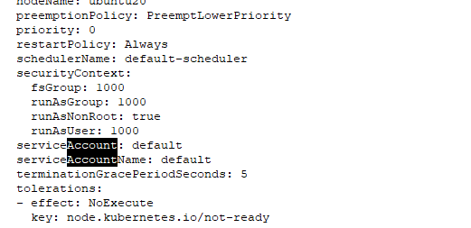
In pod yaml:kubectl get pods/<podname> -o yaml

Slide 5
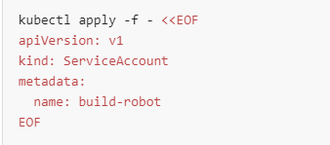
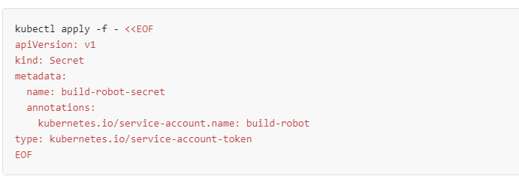
Create sa and sa token using api

Slide 6
SA in POD
The kubelet can also project a service account token into a Pod. You can specify desired properties of the token, such as the audience and the validity duration.
These properties are not configurable on the default service account token.
The service account token will also become invalid against the API when the Pod or the ServiceAccount is deleted.
The kubelet will request and store the token on behalf of the pod, make the token available to the pod at a configurable file path, and refresh the token as it approaches expiration. The kubelet proactively rotates the token if it is older than 80% of its total TTL, or if the token is older than 24 hours.

