Slide 1
ingress
ow

Slide 2
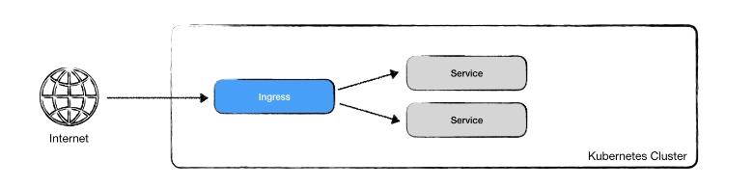
Ingress
Ingress is a Kubernetes resource type, that can be applied just like other resources. Its purpose is to define routing cluster-external requests to cluster-internal services. An Ingress will map URLs (hostname and path) to cluster-internal services.

Slide 3
.
In Kubernetes, an Ingress is an object that allows access to Kubernetes services from outside the Kubernetes cluster. You can configure access by creating a collection of rules that define which inbound connections reach which services.
An Ingress controller is responsible for fulfilling the Ingress, usually with a load balancer, though it may also configure your edge router or additional frontends to help handle the traffic.

Slide 4
Ingress controller
Ingress controller is an application that runs in a cluster and configures an HTTP load balancer according to Ingress resources.
In order to Ingress resource work, the cluster must have an ingress controller running.
You can deploy any number of ingress controllers within a cluster.
There are many different Ingress controllers, and there’s support for cloud-native load balancers (from GCP, AWS, and Azure).
e.g. Nginx, Ambassador, EnRoute, HAProxy, AWS ALB, AKS Application Gateway

Slide 5
Prerequisites
You must have an Ingress controller to satisfy an Ingress. Only creating an Ingress resource has no effect.
You may need to deploy an Ingress controller such as ingress-nginx. You can choose from a number of Ingress controllers.
Ideally, all Ingress controllers should fit the reference specification. In reality, the various Ingress controllers operate slightly differently.

Slide 6
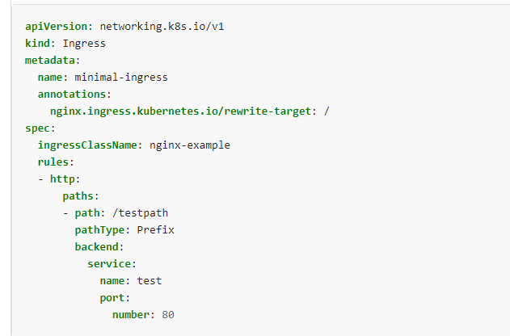
Ingress resource

Slide 7
..
An Ingress needs apiVersion, kind, metadata and spec fields.
The name of an Ingress object must be a valid DNS subdomain name.
Ingress frequently uses annotations to configure some options depending on the Ingress controller, an example of which is the rewrite-target annotation. Different Ingress controllers support different annotations. Review the documentation for your choice of Ingress controller to learn which annotations are supported.

Slide 8
Ingress rules
Each HTTP rule contains the following information:
An optional host. In this example, no host is specified, so the rule applies to all inbound HTTP traffic through the IP address specified. If a host is provided (for example, foo.bar.com), the rules apply to that host.
A list of paths (for example, /testpath), each of which has an associated backend defined with a service.name and a service.port.name or service.port.number. Both the host and path must match the content of an incoming request before the load balancer directs traffic to the referenced Service.
A backend is a combination of Service and port names as described in the Service doc

Slide 9
DefaultBackend
An Ingress with no rules sends all traffic to a single default backend and .spec.defaultBackend is the backend that should handle requests in that case.
The defaultBackend is conventionally a configuration option of the Ingress contr oller and is not specified in your Ingress resources. If no .spec.rules are specified, .spec.defaultBackend must be specified.
If defaultBackend is not set, the handling of requests that do not match any of the rules will be up to the ingress controller

Slide 10
Nginx ingress controller setup using helm
helm upgrade --install ingress-nginx ingress-nginx \ --repo https://kubernetes.github.io/ingress-nginx \ --namespace ingress-nginx --create-namespace

Slide 11
Path types
Each path in an Ingress is required to have a corresponding path type. Paths that do not include an explicit pathType will fail validation
Exact: Matches the URL path exactly and with case sensitivity.
Prefix: Matches based on a URL path prefix split by /. Matching is case sensitive and done on a path element by element basis. A path element refers to the list of labels in the path split by the / separator. A request is a match for path p if every p is an element-wise prefix of p of the request path.

Slide 12
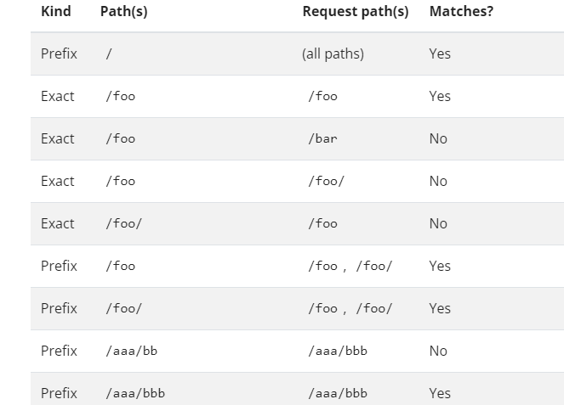
..

Slide 13
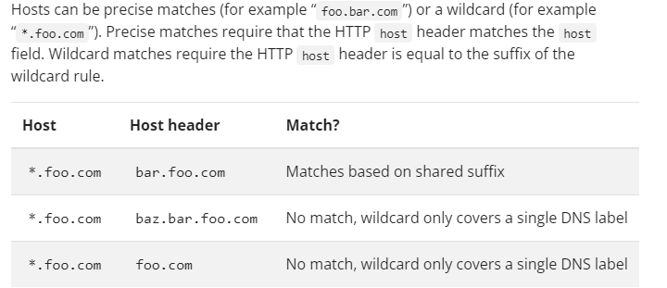
Hostname wildcards

Slide 14
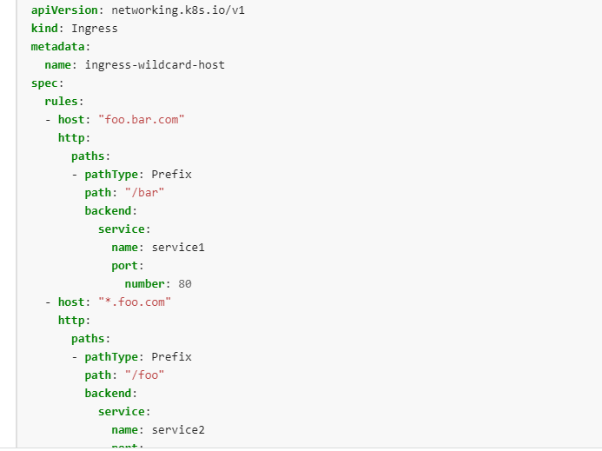
..

Slide 15
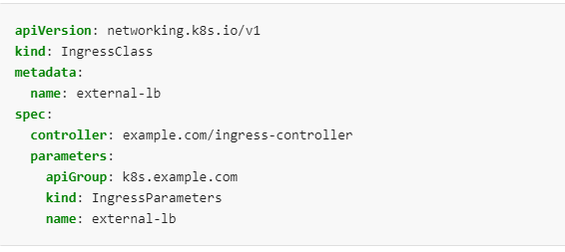
Ingress class
Ingresses can be implemented by different controllers, often with different configuration. Each Ingress should specify a class, a reference to an IngressClass resource that contains additional configuration including the name of the controller that should implement the class.

Slide 16
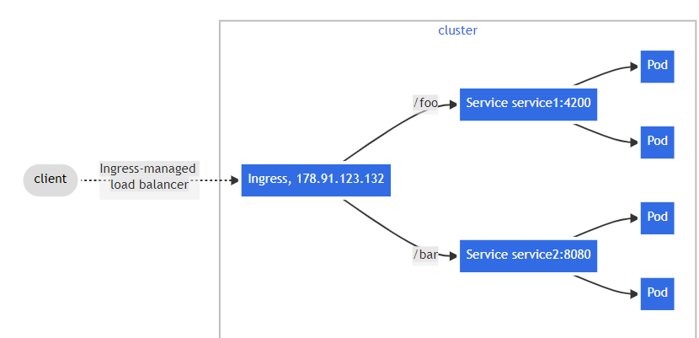
Example for ingress

Slide 17



