Slide 1
kubeclt

Slide 2
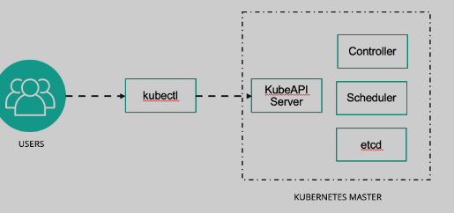
Overview of kubectl
The Kubernetes command-line tool, kubectl, allow you to run commands against Kubernetes cluster
We can use kubectl to deploy applications, inspect and manage cluster, resources and view logs

Slide 3
Installation of kubectl
https://kubernetes.io/docs/tasks/tools/install-kubectl-linux/
sudo apt-get update
sudo apt-get install -y ca-certificates curl
sudo curl -fsSLo /usr/share/keyrings/kubernetes-archive-keyring.gpg https://packages.cloud.google.com/apt/doc/apt-key.gpg
sudo apt-get update
sudo apt-get install -y kubectl

