Slide 1
Rancher
OW

Slide 2
Rancher intro
Rancher 1.0 shipped in 2016. It included easy to use container orchestration framework cattle
Rancher 2.0 focused only on Kubernetes
Setup the Kubernetes cluster in single click
Rancher Kubernetes Engine (RKE):RKE is an extremely simple, lightning fast Kubernetes installer that works everywhere. RKE is particularly useful in standing up Kubernetes clusters on VMware clusters, bare metal servers, and VM instances on clouds that do not yet support Kubernetes service.

Slide 3
Rancher API Server
Rancher is api based .
Rancher api server is built on top of an embedded Kubernetes api server and etcd database and implements following:
User management: The Rancher API server manages user identities that correspond to external authentication providers like Active Directory or GitHub, in addition to local users.
Authorization: The Rancher API server manages access control and security policies.

Slide 4
Working with kubernetes
Provisioning Kubernetes cluster: Rancher API server can provision Kubernetes cluster on existing node or perform Kubernetes upgrades
Catalog management: Rancher has capability to use a catalog of Helm charts that makes repeatedly deploy application
Manage Projects: A project is a group of multiple namespaces and access control policies within a cluster.
Fleet Continuous Delivery: Rancher provides capability of Continuous delivery (CD) using fleet
Istio: integration with Istio is designed so that a Rancher operator, such as an administrator or cluster owner, can deliver Istio to developers. Then developers can use Istio to enforce security policies, troubleshoot problems, or manage traffic for green/blue deployments, canary deployments, or A/B testing.

Slide 5
RKE2
RKE 2 launches control plane component as static pods managed by kubelet
RKE 2 doesn’t use docker as runtime, its embedded container runtime is containerd
RKE2 focuses on security and compliances and allow cluster to pass CIS Kubernetes benchmarking
Regularly scan components for CVE

Slide 6
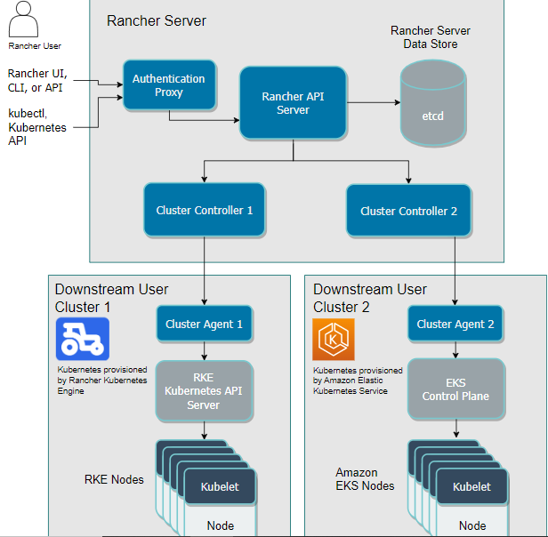
Rancher Server

Slide 7
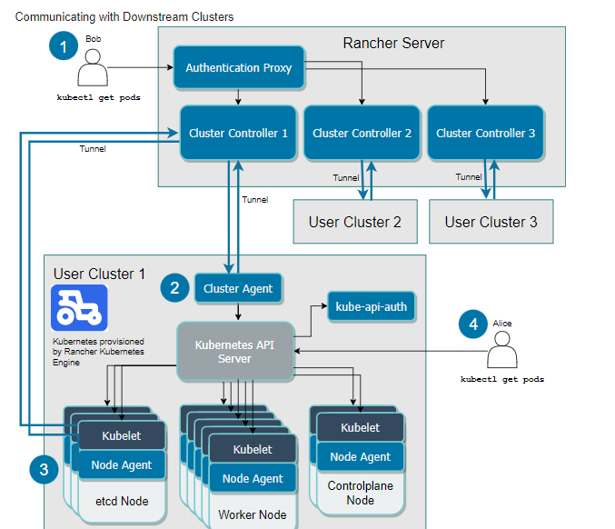
Communicating with Downstream User Clusters

Slide 8
Authentication Proxy
In this diagram, a user named User wants to see all pods running on a downstream user cluster called User Cluster 1. From within Rancher, he can run a kubectl command to see the pods. Bob is authenticated through Rancher's authentication proxy.
The authentication proxy forwards all Kubernetes API calls to downstream clusters. It integrates with authentication services like local authentication, Active Directory, and GitHub. On every Kubernetes API call, the authentication proxy authenticates the caller and sets the proper Kubernetes impersonation headers before forwarding the call to Kubernetes masters.
Rancher communicates with Kubernetes clusters using a service account, which provides an identity for processes that run in a pod.
By default, Rancher generates a kubeconfig file that contains credentials for proxying through the Rancher server to connect to the Kubernetes API server on a downstream user cluster. The kubeconfig file (kube_config_rancher-cluster.yml) contains full access to the cluster.

Slide 9
Cluster Controllers and Cluster Agents
Every downstream cluster has a cluster agent, which open a tunnel to corresponding cluster controller within the Rancher Server.
There is one cluster controller and one agent for each downstream cluster. Each cluster controller:
Watches the resource changes in the downstream cluster
Brings the current state of downstream cluster to desired state
Configures access control policies to clusters and projects

Slide 10
Cattle-cluster-agent
This is the agent, that runs in each downstream clusters
It performs following tasks:
Connect to the k8s api server of rancher launcher Kubernetes
Manage workloads, resource creation for each object
Communication between the cluster and Rancher server (through a tunnel) about events, stats and health
If cattle-cluster-agent is not available, one of the node agents creates a tunnel
Cattle-node-agent is deployed as daemon set in rancher launched k8s
It interacts with the nodes when cluster is performing task and get the updates

Slide 11
Authorized Cluster endpoints
An authorized cluster endpoint allows users to connect to the k8s api server without having to route their requests
This only worked in rancher launched k8s clusters [using RKE]
To access the downstream server when Rancher is down
The kube-api-auth microservice is deployed to provide the user authentication functionality for the authorized cluster endpoint. When you access the user cluster using kubectl, the cluster's Kubernetes API server authenticates you by using the kube-api-auth service as a webhook.
With this endpoint enabled for the downstream cluster, Rancher generates an extra Kubernetes context in the kubeconfig file in order to connect directly to the cluster. This file has the credentials for kubectl and helm

Slide 12
Important files
rancher-cluster.yml: The RKE cluster configuration file.
kube_config_rancher-cluster.yml: The Kubeconfig file for the cluster, this file contains credentials for full access to the cluster. You can use this file to authenticate with a Rancher-launched Kubernetes cluster if Rancher goes down.
rancher-cluster.rkestate: The Kubernetes cluster state file. This file contains credentials for full access to the cluster. Note: This state file is only created when using RKE v0.2.0 or higher.

Slide 13
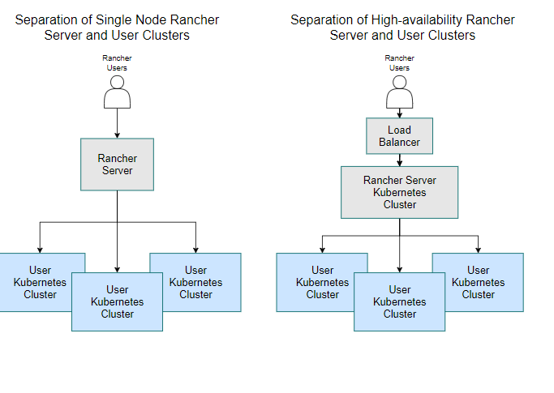
Architecture Recommendations

Slide 14
K3S running Rancher Management clusters
One option for the underlying Kubernetes cluster is to use K3s Kubernetes. K3s is Rancher's CNCF certified Kubernetes distribution. It is easy to install and uses half the memory of Kubernetes, all in a binary of less than 100 MB. Another advantage of K3s is that it allows an external datastore to hold the cluster data, allowing the K3s server nodes to be treated as ephemeral.
Architecture of a K3s Kubernetes Cluster Running the Rancher Management Server

Slide 15
Rancher server setup
You can install Rancher on a single node, or on a high-availability Kubernetes cluster.
A high-availability Kubernetes installation is recommended for production.
A Docker installation of Rancher is recommended only for development and testing purposes. The ability to migrate Rancher to a high-availability cluster depends on the Rancher version:
The Rancher backup operator can be used to migrate Rancher from the single Docker container install to an installation on a high-availability Kubernetes cluster.

Slide 16
Deploying Rancher Server
Use one of the following guides to deploy and provision Rancher and a Kubernetes cluster in the provider of your choice.
AWS (uses Terraform)
AWS Marketplace (uses Amazon EKS)
Azure (uses Terraform)
DigitalOcean (uses Terraform)
GCP (uses Terraform)
Hetzner Cloud (uses Terraform)
Vagrant
Equinix Metal
Outscale (uses Terraform)

Slide 17
Installation using docker
https://docs.ranchermanager.rancher.io/v2.5/pages-for-subheaders/rancher-on-a-single-node-with-docker
docker run -d --restart=unless-stopped \ -p 80:80 -p 443:443 \ --privileged \ rancher/rancher:latest
https://rancher.com/docs/rancher/v2.5/en/faq/technical/

Slide 18
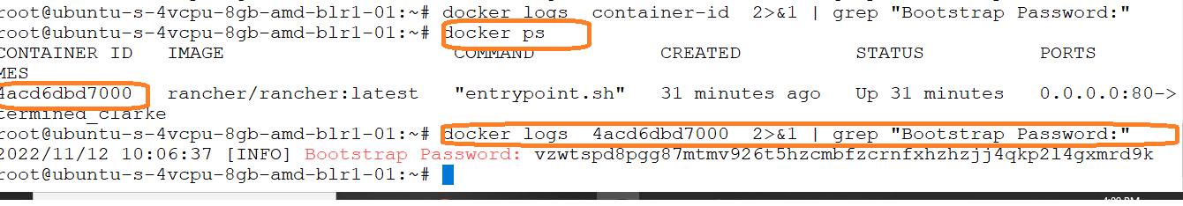
..

Slide 19
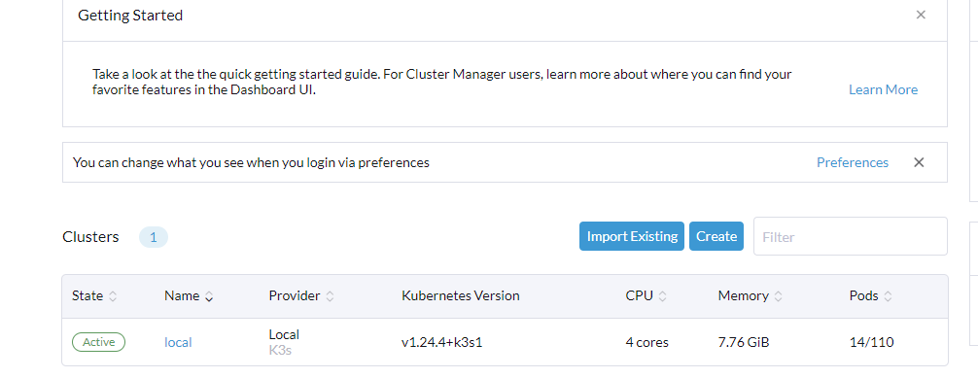
Rancher Dashboard

Slide 20
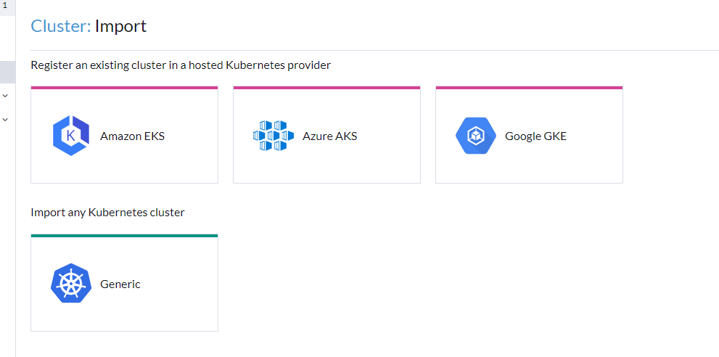
Import existing

Slide 21
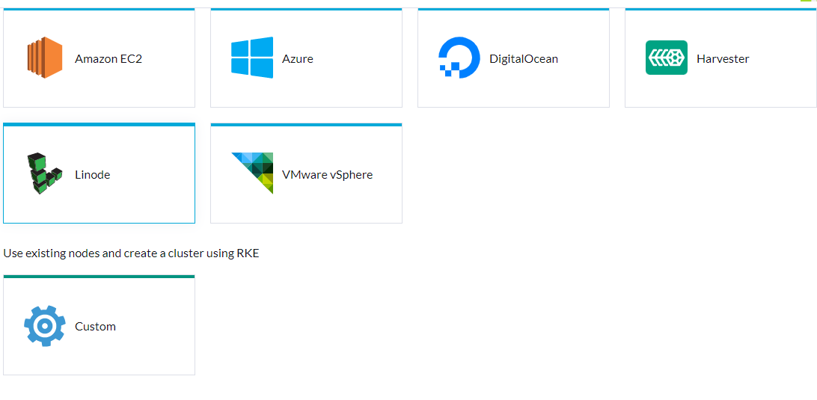
Create RKE Cluster

Slide 22
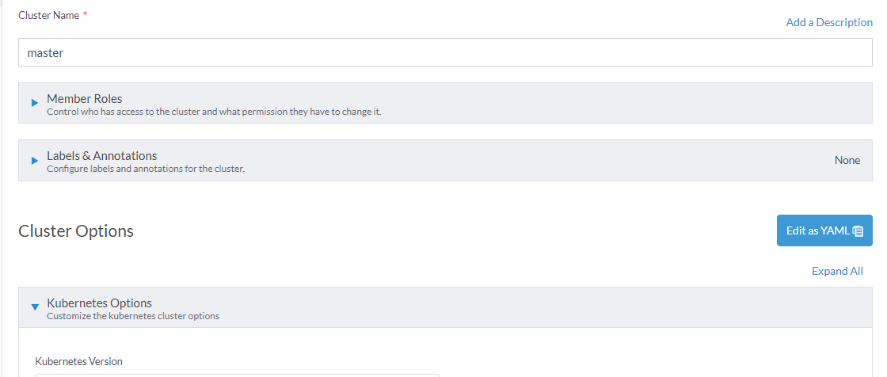
Create custom RKE

Slide 23

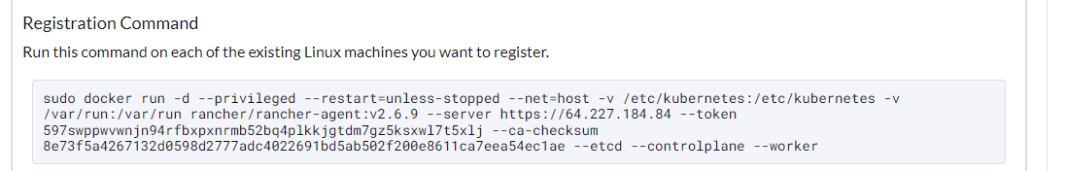
Provision without worker node

Slide 24
RKE2 cluster configuration
https://docs.ranchermanager.rancher.io/reference-guides/cluster-configuration/rancher-server-configuration/rke2-cluster-configuration

