Slide 1
Helm
ow

Slide 2
Intro
Helm is a package manager for Kubernetes. Similar to yum but for Kubernetes.
It bundles all related manifests(such as deployment, service, etc) into a chart. When installing chart, helm creates a release.
Benefits of helm is it provide templating, repeatability, reliability, multiple environment and ease of collaboration.

Slide 3
Installing Helm
wget https://get.helm.sh/helm-v3.10.2-linux-amd64.tar.gz
tar -zxvf helm-v3.10.2-linux-amd64.tar.gz
mv linux-amd64/helm /usr/local/bin/helm

Slide 4
How helm works
helm use the Kubernetes cluster/host via the config file
~/.kube/config
Advantage of using Helm
Traditional deployments in Kubernetes is done with Kubectl across files into separately managed items. Helm deploys units called charts as managed releases.
We can search for charts https://helm.sh/ . Charts can be pulled(downloaded) and optionally unpacked(untar).

Slide 5
chart
Chart Repo
Location where Helm charts can be stored and shared
Respond to REST API GET requests to get packages
Creating your first chart
The easiest way to get started with chart is by using helm create command. The below command create a new chart named myhelmchart

Slide 6
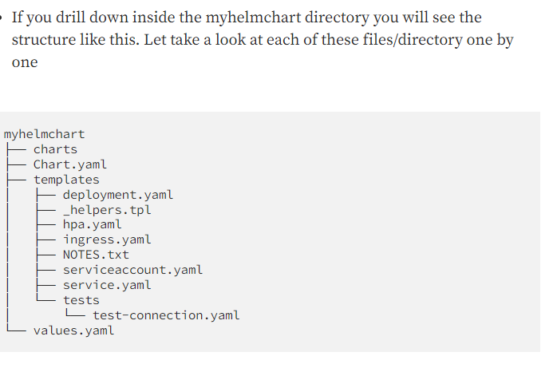
..

Slide 7
..
templates
Templates is one of the most important directory and this is where helm looks for your kubernetes object yaml definitions(Deployment,Services,etc).
values.yaml
If templates holds the resource definition, then values provides the way to parameterize it.
Chart.yaml
This file contain the metadata such as chart version, application version or constraints like minimum version of kubernetes/Helm which is required to manage this chart. Some required fields in Chart.yaml

Slide 8
Cmds in helm
helm install [app-name] [chart]
Install an app in a specific namespace:
helm install [app-name] [chart] --namespace [namespace]

