Slide 1
kubedb
ow

Slide 2
What is kubedb
Kubedb is the k8s native db management solution which simplifies and automates routine db task:
Provisioning
Monitoring
Upgrade
Scaling
Backup
Volume expansion

Slide 3
DB supported
PostgreSQL,
MySQL,
MongoDB, MariaDB, Elasticsearch,
Redis, ProxySQL,
Percona XtraDB,
Memcached and PgBouncer.

Slide 4
..
Install KubeDB
Deploy PostgreSQL Clustered Database
Install Stash
Backup PostgreSQL Database Using Stash
Recover PostgreSQL Database Using Stash

Slide 5
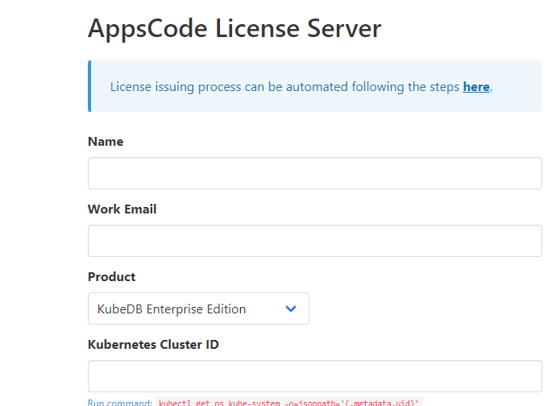
License key for kubedb
Get cluster id for license purpose
kubectl get ns kube-system -o jsonpath='{.metadata.uid}'
https://license-issuer.appscode.com/

Slide 6
Install kubedb
$ helm repo add appscode https://charts.appscode.com/stable/
$ helm repo update
$ helm search repo appscode/kubedb
helm install kubedb appscode/kubedb \
--version v2022.10.18 \
--namespace kubedb --create-namespace \
--set kubedb-provisioner.enabled=true \
--set kubedb-ops-manager.enabled=true \
--set kubedb-autoscaler.enabled=true \
--set kubedb-dashboard.enabled=true \
--set kubedb-schema-manager.enabled=true \
--set-file global.license=/path/to/the/license.txt

Slide 7
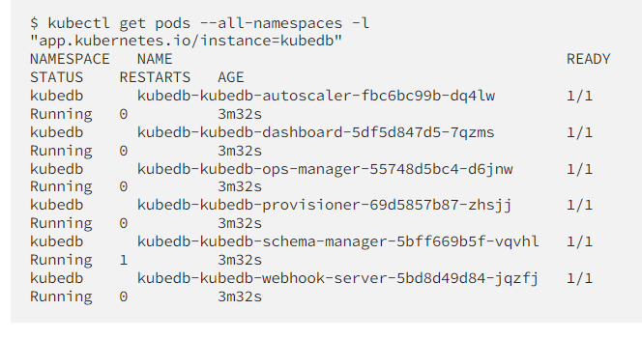
Verify installation and CRD groups

Slide 8
Deploy PostgreSQL Clustered Database
Now, we are going to Deploy PostgreSQL with the help of KubeDB. At first, let’s create a Namespace in which we will deploy the database.
kubectl create ns demo
Using CRD create yaml
apiVersion: kubedb.com/v1alpha2
kind: Postgres
metadata:
name: postgres-cluster
namespace: demo
spec:
version: "14.2"
replicas: 3
storageType: Durable
storage:
storageClassName: "gp2"
accessModes:
- ReadWriteOnce
resources:
requests:
storage: 1Gi
terminationPolicy: WipeOut

Slide 9
Yaml expaination
In this yaml we can see in the spec.version field specifies the version of PostgreSQL. Here, we are using PostgreSQL version 14.2. You can list the KubeDB supported versions of PostgreSQL by running $ kubectl get postgresversions command.
spec.storage specifies PVC spec that will be dynamically allocated to store data for this database. This storage spec will be passed to the StatefulSet created by KubeDB operator to run database pods. You can specify any StorageClass available in your cluster with appropriate resource requests.
And the spec.terminationPolicy field is Wipeout means that the database will be deleted without restrictions. It can also be “Halt”, “Delete” and “DoNotTerminate

Slide 10
cmds
kubectl create -f postgres-cluster.yaml
kubectl get postgresversions
kubectl get all -n demo
kubectl get postgres -n demo postgres-cluster
kubectl get secret -n demo -l=app.kubernetes.io/instance=postgres-cluster
kubectl get service -n demo -l=app.kubernetes.io/instance=postgres-cluster

Slide 11
..
Get user name
kubectl get secrets -n demo postgres-cluster-auth -o jsonpath='{.data.username}' | base64 –d
Get password
kubectl get secrets -n demo postgres-cluster-auth -o jsonpath='{.data.password}' | base64 –d
Access db
kubectl exec -it postgres-cluster-0 -n demo -c postgres – bash
psql -d "user=<provide username> password=<provide password>

