Slide 1
VMware vSphere
Introduction

Slide 2
Agenda
Computer resources
Virtualization
Type of Virtualization
Physical machine vs Virtual machine
Introduction to VMware
ESXi Networking
Questions

Slide 3
Computer Resources
In our computer resources are:
CPU
Memory
Hard disk
Network
Utilization of Resources
Physical system limitation
How to increase the resource consumption

Slide 4
Virtualization
As per wiki
“In computing, virtualization or is the act of creating a virtual (rather than actual) version of something, including virtual computer hardware platforms, storage devices, and computer network resources.
Virtualization began in the 1960s, as a method of logically dividing the system resources provided by mainframe computers between different applications. Since then, the meaning of the term has broadened

Slide 5
Types of virtualization
OS Virtualization—aka Virtual Machines.
Application Virtualization.
Network Virtualization
Hardware Virtualization
Storage Virtualization

Slide 6
Vmware History
1998, VMware was founded by Diane Greene, Mendel Rosenblum, Scott Devine, Ellen Wang.
The first product, VMware Workstation, was delivered in May 1999, and the company entered the server market in 2001 with VMware GSX Server (hosted) and VMware ESX Server
In 2003, VMware launched VMware Virtual Center, vMotion, and Virtual SMP technology. 64-bit support was introduced in 2004.

Slide 7
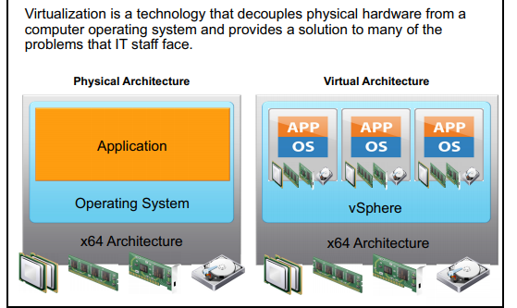
Physical vs Virtual

Slide 8
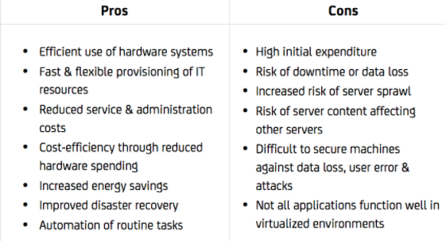
Pros and Cons of Virtualization

Slide 9
Server Virtualization and hosted virtualization
Hosted
Vmware Workstation
Oracle virtual box
Server
ESXi
Citrix Xen

Slide 10
Full vs Para virtualization
Full virtualization:
No modification to Guest OS
Guest OS unaware about virtualization
VMware ESXi
Para virtualization:
In paravirtualization, virtual machine does not implement full isolation of OS but rather provides a different API which is utilized when OS is subjected to alteration.
Citrix Xen

Slide 11
Hypervisor
A hypervisor, also known as a virtual machine monitor or VMM, is software that creates and runs virtual machines (VMs). A hypervisor allows one host computer to support multiple guest VMs by virtually sharing its resources, such as memory and processing.
Example of Hypervisor
VMware ESXi
Install on barematel
Main vendors which supports: Dell, HPE,Cisco,IBM(now Lenovo)

Slide 12
VMware ESX vs ESXi
ESX :
Redhat based kernel
Bootstrap from redhat kernel
Security patches provided by redhat
Classic ESX is no longer available now
ESXi
No rhel kernel
Vmkernel bootstrap itself
In-memory OS
Can install on SDRAM,USB as well

Slide 13
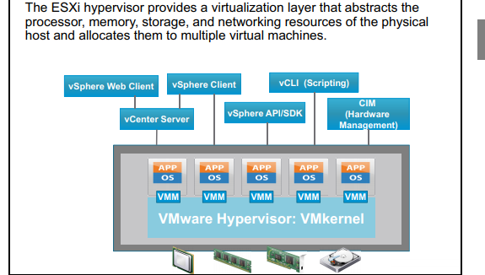
Hypervisor [ESXi)

