Slide 1
DPL

Slide 2
DPL
Dynatrace Pattern Language is used to define detection patterns, naming rules, tagging rules, and data extraction from logs, traces, metrics, or events.
It is especially powerful in:
Log processing
Entity detection rules
Service naming
Custom tags
Metadata extraction

Slide 3
..
Dynatrace Pattern Language (DPL) is a pattern language that allows you to describe patterns using matchers, where a matcher is a mini-pattern that matches a certain type of data. For example, INTEGER (or INT) matches integer numbers, and IPADDR matches IPv4 or IPv6 addresses. There are matchers available to handle all kinds of data types.
A written pattern is interpreted from left to right, ignoring extra whitespaces, line breaks, and comments in between. You can write the pattern describing an integer followed by a single space, IP address, and line break as the following one-liner:
INT ' ' IPADDR:ip EOL

Slide 4
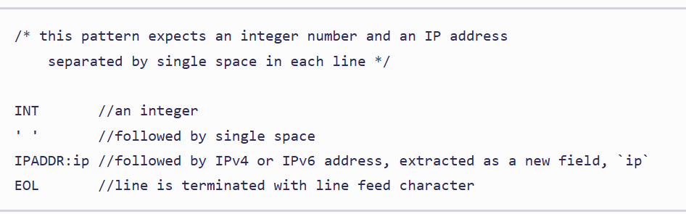
..

Slide 5
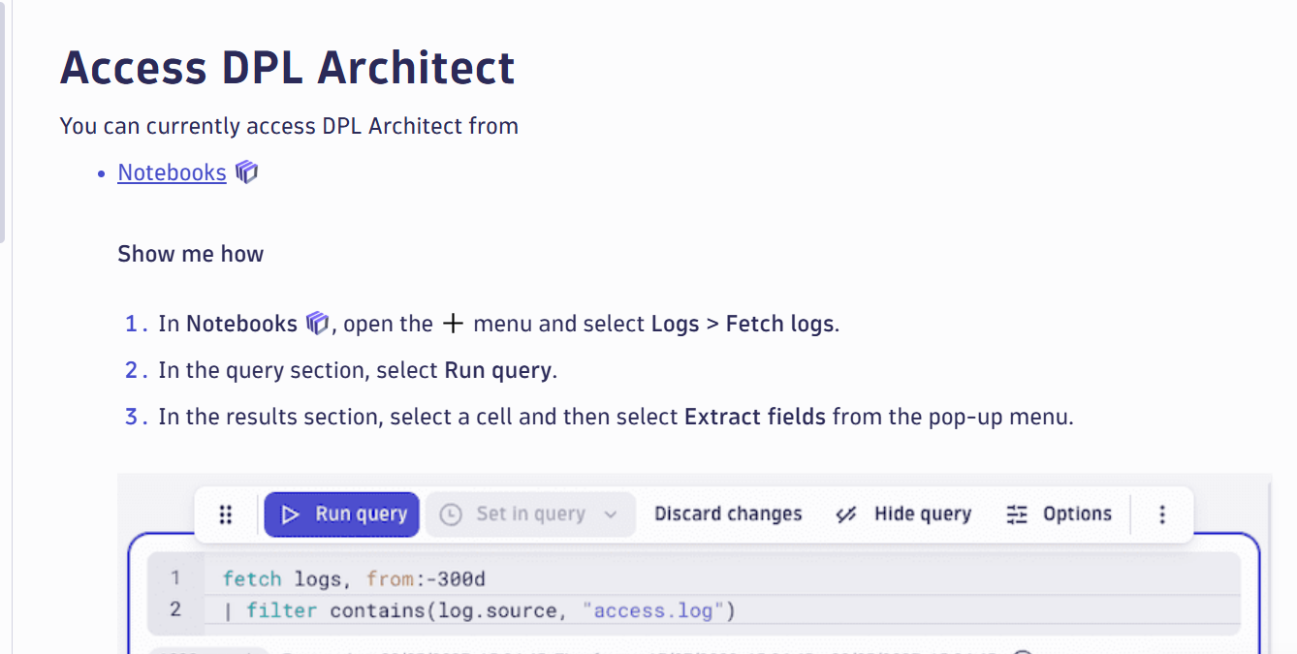
Dpl architect

Slide 6
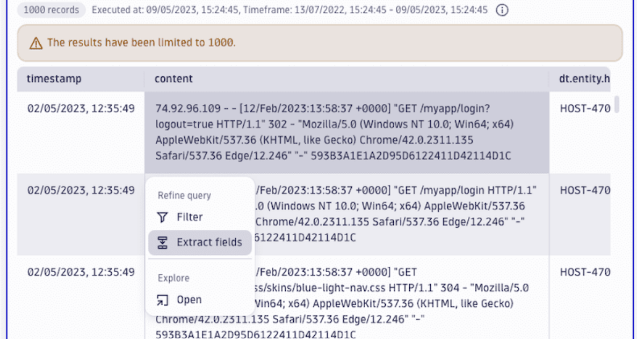
..

Slide 7
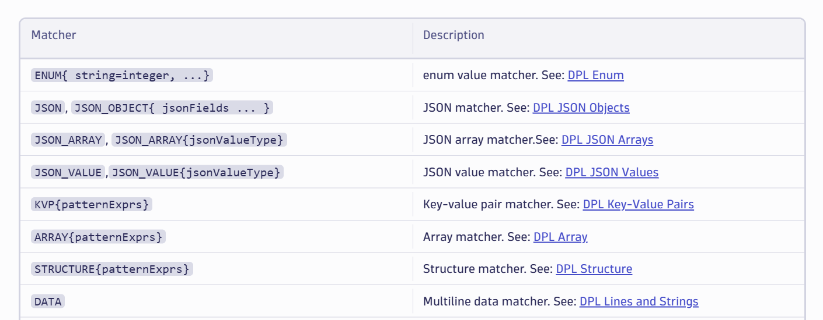
..Grammer

