Slide 1
openpipeline
ow

Slide 2
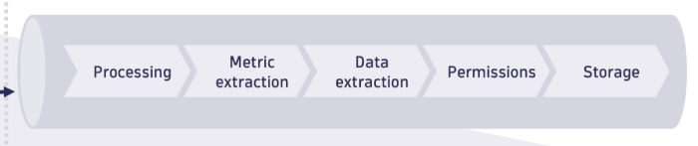
definition
With OpenPipeline, you can ingest data in the Dynatrace platform from a wide variety of formats and providers, through ingest sources. Data is then routed to pipelines for processing, and stored in Grail buckets.

Slide 3
Ingest source
Data reaches the Dynatrace platform via different ingestion sources, such as API endpoints, OneAgent, and extensions, which collect data from data providers. In OpenPipeline, they are defined by a name and a path. You can leverage:
Built-in ingest sources
Custom ingest sources for events, which support pre-processing and static routing.
Once the records reach your Dynatrace SaaS environment via ingest sources, you can route it to a pipeline.

Slide 4
Pre-processing
Optional data processing that occurs after ingestion and before routing. By setting pre-processing, you can transform raw data into structured formats as soon as it reaches your Dynatrace SaaS environment.
Pre-processed data is then routed to a pipeline and is available for further processing before storage.
Set up pre-processing to avoid creating complex matching conditions based on provider-specific data format

Slide 5
Routing
After data is ingested (and optionally pre-processed), it's routed to pipelines. Routing depends on The data type
Pipelines are specific to a data type. Different data types are routed to different pipelines.
The ingest source
You can configure routing for each ingest source. Multiple ingest sources of the same data type can be routed to the same pipeline.

Slide 6
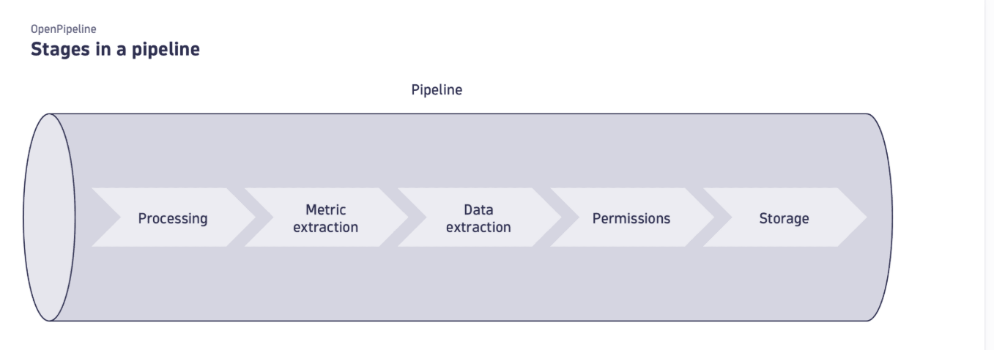
..

Slide 7
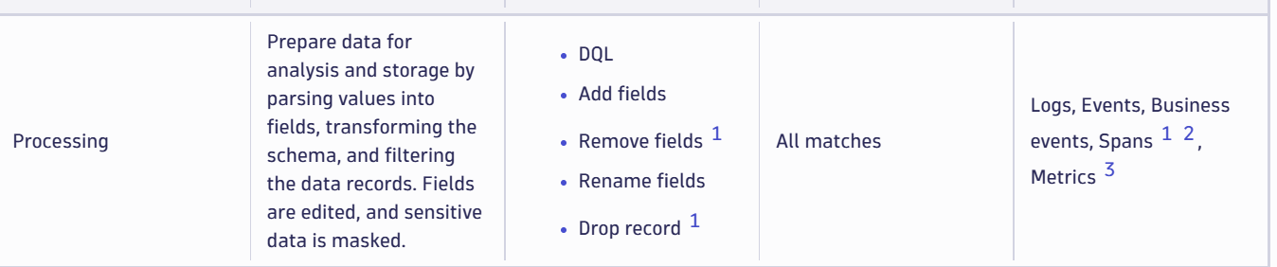
processor

Slide 8
..
A processor is a pre-formatted processing instruction that focuses either on modifying (for example, by renaming or adding a new field) or extracting data (for example, by creating an event from a log line or extracting metrics).
While the processor format is predefined, it contains a configurable matcher and processing definition.
The matcher defines the target of a processor via a DQL query. It narrows down the available data to the specific set you want to process.
The processing definition instructs Dynatrace on how to transform or modify the data filtered by the matcher.

Slide 9
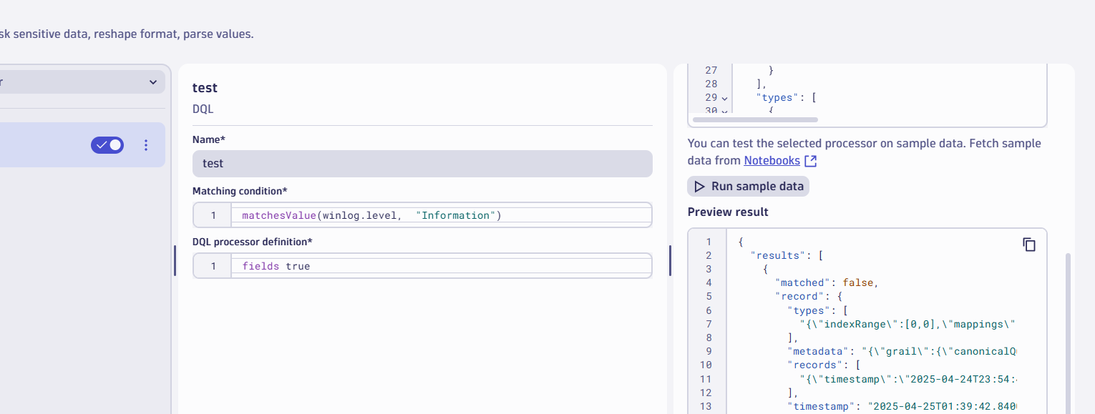
lab
Processing example

Slide 10
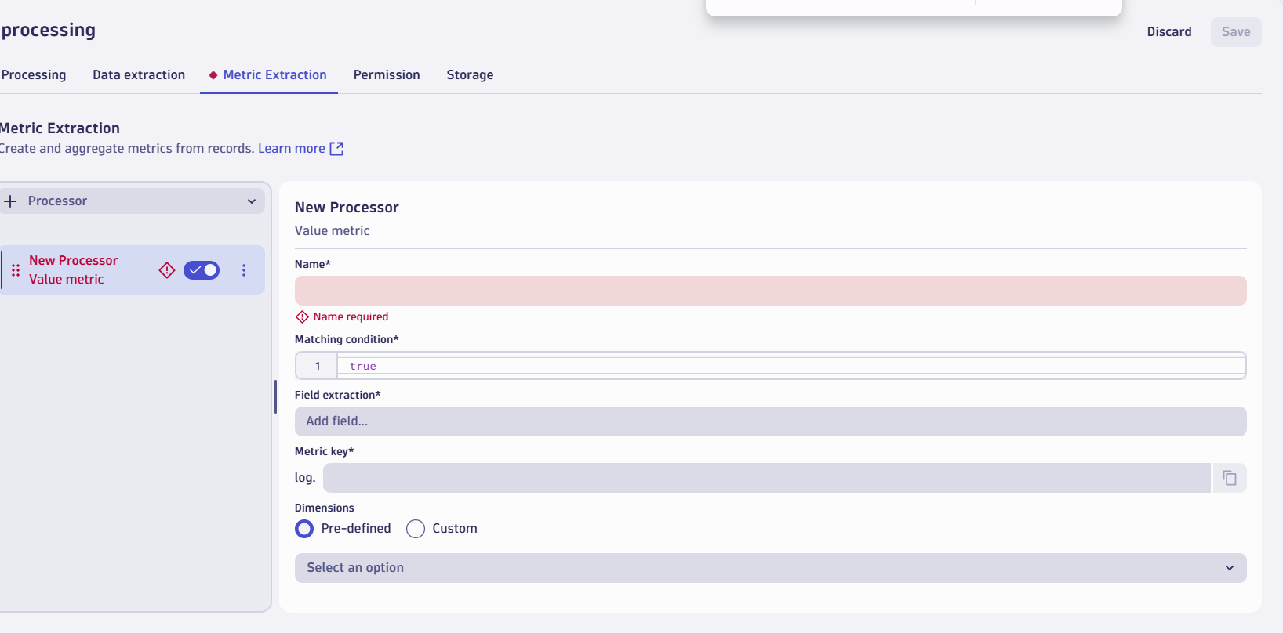
Extract metrics

Slide 11
Route Data
There are several use cases to split incoming records into different streams, for example, separating non-production-relevant data or enabling teams to safely format only records of the applications and services they own.
This shows you how to route logs of multiple production-relevant services to dedicated pipelines.

Slide 12
Determine the condition
You can use Notebooks Notebooks to determine how many routes are needed and their matching conditions. To determine the conditions of significant production-relevant services
Fetch logs of all production-relevant services and summarize the records by an attribute.
When you fetch logs via DQL in Notebooks you get an overview of the detected attributes that you can use to narrow down your results, f

Slide 13
..
Go to OpenPipeline OpenPipeline app and select Logs > Pipelines.
Create a pipeline for each service.
Select Pipeline and enter a pipeline title—for example, Checkout service pipeline for the checkoutservice service.
Select Save

Slide 14
..
Route records to the dedicated pipeline
Create a route for each pipeline
Go to OpenPipeline OpenPipeline app and select Logs > Pipelines > Dynamic route.
Define the routing condition with
A name
A matching condition
The target pipeline

Slide 15
lab

