Slide 1
Architecture
ow

Slide 2
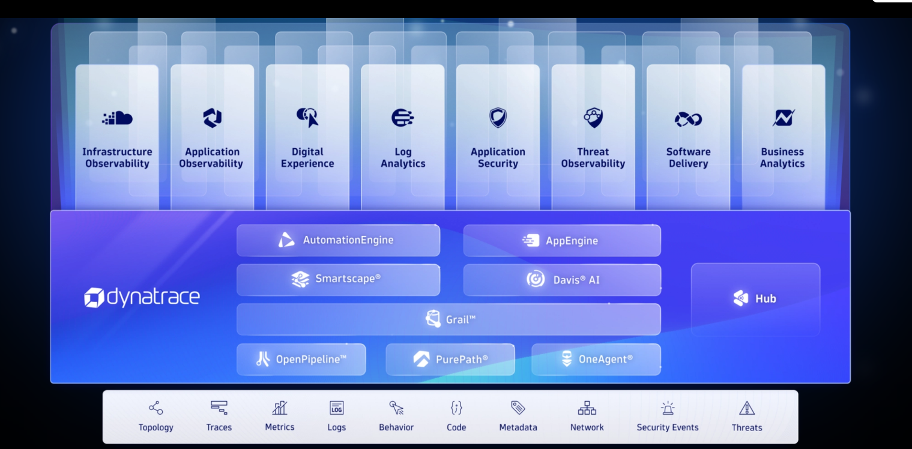
..

Slide 3
..
What is the Dynatrace Platform?
Dynatrace is a unified observability and security platform designed to help organizations gain deep insights into their infrastructure and applications. It provides automation, monitoring, analytics, and AI-powered intelligence to improve reliability, performance, and security across environments.

Slide 4
..
What is Dynatrace?
A full-stack platform offering observability, automation, and security.
Why use Dynatrace?
To proactively detect issues, optimize system performance, and automate remediation and operations.

Slide 5
Observability & Security – Simplified
Observability
The ability to gain insights and intelligence by processing metrics, logs, traces, and topology."Collects real-time and historical data.
Uses AI and ML to provide actionable insights.Traces user actions, API calls, and infrastructure performance.
Security
A set of strategies to safeguard data, networks, and systems from unauthorized access."Maintains confidentiality, integrity, and availability.
Identifies vulnerabilities and prevents data leaks.Analyzes threats using AI-based insights.

Slide 6
..
Data Sources (Bottom Layer):
Code, Logs, Metrics, Traces, Topology
Examples:
VPN servers,
Kubernetes clusters on GCP
Cloud

Slide 7
..
Data Ingestion Technologies:
OneAgent: Collects logs, traces, and metrics
PurePath: Tracks all transactions and user actions across services
Unified Ingest: Collects all observability data

Slide 8
..
Data Processing Layer:
Grail: Dynatrace’s real-time, high-performance database with its own query language (DQL)
Davis AI: Analyzes problems and provides root cause analysis & actionable recommendations
Smartscape: Auto-discovers system topology (services, processes, hosts)
Automation Engine & App Engine: Enables automatic actions, custom apps, and workflows

Slide 9
..
Infrastructure Observability
Understands infrastructure health, trends, and performance
Enables proactive issue detection
Application Observability
Code-level insights into app performance and behavior
Helps identify and prevent errors and slow code

Slide 10
..
Security Protection
Detects vulnerabilities and blocks potential threats
Security Analytics
Provides prevention-focused analysis and threat modelling
Digital Experience
MonitoringTracks user experience across apps and platformsHelps optimize UI/UX and responsiveness
Business Analytics
Links system performance to business outcomesCost insights, revenue tracking, and usage metrics

