Slide 1
SLO
OW

Slide 2
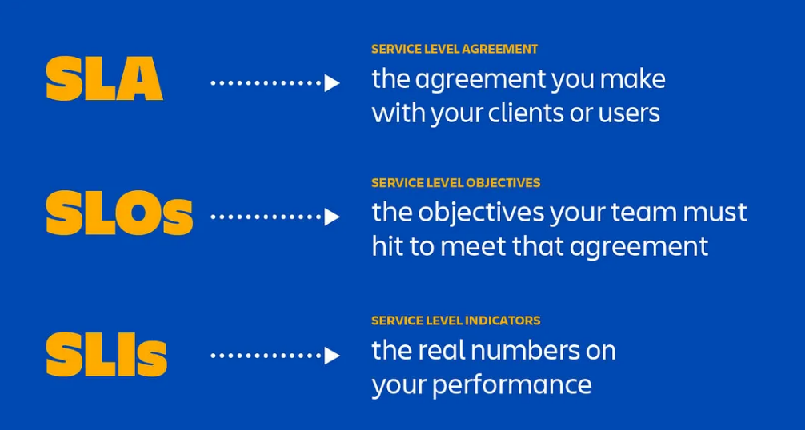
Definition

Slide 3
SLO
An SLO, or Service Level Objective, is the promise that a company makes to users regarding a specific metric such as incident response or uptime. SLOs exist within an SLA as individual promises contained within the full user agreement.
The SLO is the specific goal that the service must meet in order to be in compliance with the SLA. According to Google Product Managers Jay Judkowitz and Mark Carter, an SLO should “define the lowest level of reliability that you can get away with for each service.” In Google’s SLA that promises a 99.99% Monthly Uptime Percentage, the SLO is 99.99%.

Slide 4
..
SLOs should always be simple, clearly defined, easily measured to determine whether or not the objective is being fulfilled.
This will also keep your engineers from hitting roadblocks when something doesn’t make sense.

Slide 5
Example's: Website Uptime
Objective: Ensure the website is available and operational.
Measurement: Uptime percentage.
Target: 99.9% uptime over the course of a month
Details: This means that the website can have a maximum of 43.2 minutes of downtime per month.
This SLO is simple, clearly defined, and easily measurable. It allows the team to monitor the website's uptime and ensure that it meets the specified target, thus helping to identify and address issues promptly before they become significant problems.

Slide 6
Example of a Service Level Objective (SLO) Derived from a Service Level Agreement (SLA)
SLA for E-commerce Website:
Service: E-commerce website hosting and operation.
Availability: The website will be available 99.95% of the time each calendar month.
Response Time: Customer support inquiries will be responded to within 1 hour.
Performance: Page load time will be under 2 seconds for 95% of user interactions.

Slide 7
Service Level Objectives (SLOs) Derived from the SLA
SLO for Website Availability:
Objective: Ensure the website is available and operational.
Measurement: Uptime percentage.
Target: 99.95% uptime over the course of a month.
Details: This translates to a maximum downtime of approximately 21.6 minutes per month.

Slide 8
SLO for Customer Support Response Time:
Objective: Ensure timely responses to customer inquiries.
Measurement: Average response time to customer inquiries.
Target: Respond to 95% of customer inquiries within 1 hour.
Details: This involves monitoring response times and ensuring the support team meets the target.

Slide 9
SLO for Page Load Performance:
Objective: Ensure fast page load times for users.
Measurement: Percentage of page loads under 2 seconds.
Target: 95% of page loads should be under 2 seconds.
Details: This requires performance monitoring tools to measure and report page load times.

Slide 10
To implement these SLOs effectively:
Website Availability: Use monitoring tools like uptime robots or cloud monitoring services to track the website's uptime.
Customer Support Response Time: Utilize a ticketing system with response time tracking capabilities.
Page Load Performance: Implement performance monitoring tools such as Google Analytics, New Relic, or other APM (Application Performance Management) tools to measure page load times.

Slide 11
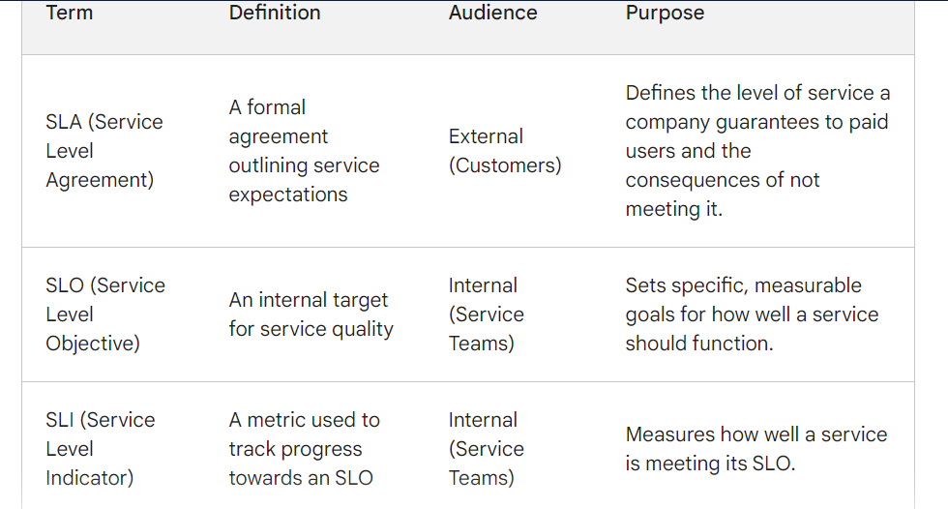
SLAs vs. SLOs: What’s the Difference?

