Slide 1
purepath
ow

Slide 2
Definition
PurePath® is Dynatrace’s patented distributed tracing and code-level analysis technology. It automatically integrates high-fidelity distributed tracing with user experience data, data from open-source technologies, and code-level, including OpenTelemetry, and code-level analytics.
PurePath® is Dynatrace’s special technology that helps you trace what’s happening inside your application, from the user click all the way to the backend systems.

Slide 3
..
Imagine you click a button on a website — PurePath follows that click step-by-step as it goes through:
The website code
The application servers (like Java, Node.js, .NET)
The database
Other services or APIs
This helps you see exactly what happens, where things are slow, or where errors occur.

Slide 4
..
What makes it powerful?
Automatic: No need to add custom code — Dynatrace does it for you.
Detailed: Tracks every request and code execution path.
End-to-end: Connects user actions to backend processes.
OpenTelemetry support: Works with popular open-source tools.

Slide 5
Why it’s useful:
Find slow parts of your app easily
Understand how different services talk to each other
Fix bugs faster
Improve user experienceIn short, PurePath® gives you X-ray vision into your application, helping you track and fix problems faster than ever.

Slide 6
Smartscape : Real-time map of your environment
Smartscape, our near real-time environment-topology visualization tool, is one of the most powerful features of Dynatrace.
Smartscape auto-discovery delivers a quick and efficient visualization of all the topological dependencies in your infrastructure, processes, and services:
On the vertical axis, it displays full-stack dependencies across all tiers
On the horizontal axis, it visualizes all ingoing and outgoing call relationships within each tier

Slide 7
..
With just a few clicks, Smartscape gives you access to a detailed topological view of your entire environment, giving you more insight into and control over your environment.
Make better decisions, such as adjusting your service architecture or infrastructure to improve application performance.
Examine cross-tier and same-tier process, host, and service interdependencies to better understand how dependencies affect the performance of your applications.
Drill down to gain clearer insight into problems. For example, Dynatrace might identify an issue with third-party dependencies and help you understand the impact of the issue on your application's performance

Slide 8
..
When Show problems is selected, each Smartscape tier includes a dedicated tab with a health indicator. Select the tier at which you want to view the topology:
Applications
Services
Processes
Hosts
Data centers

Slide 9
..
Each tier shows a different entity type: application, service, process, host, or data center.
To view a different tier, select that tier's tab.
To zoom in and out, use the +/- buttons at the top-right corner or rotate the mouse wheel.
To shift your view to a different position, select and drag anywhere in Smartscape.
To view the name of an entity, hover your cursor over the entity's symbol. While the name is displayed, you can select the arrow next to the entity name to go to that entity's overview page

Slide 10
Smartscape organizes your environment into five distinct tiers:​
Applications: User-facing applications, including web and mobile apps.
Services: Backend services that handle business logic and data processing.
Processes: Running instances of applications or services.
Hosts: Physical or virtual machines where processes run.
Data Centers: Logical groupings of hosts, often representing physical locations or cloud regions.

Slide 11
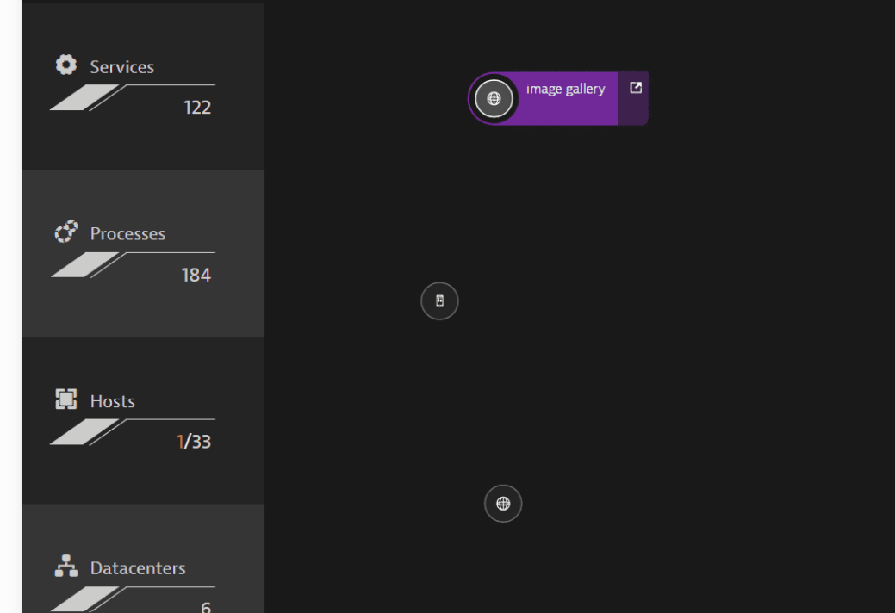
.

Slide 12
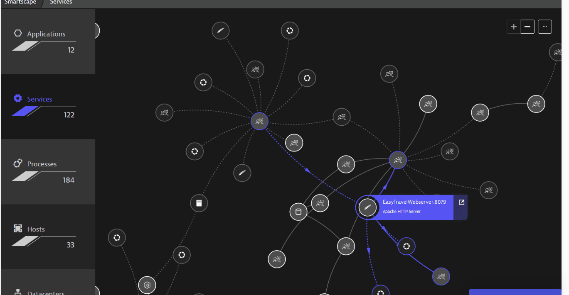
Services
The Services tab displays the topology of all the services that are running in your environment.

Slide 13
..
Optimize Architecture: Understand dependencies to make informed decisions about service architecture and infrastructure improvements.
Identify Issues: Quickly pinpoint problems, such as third-party service failures, and assess their impact on your applications.
Enhance Performance: Analyze cross-tier and same-tier interdependencies to fine-tune performance.

Slide 14
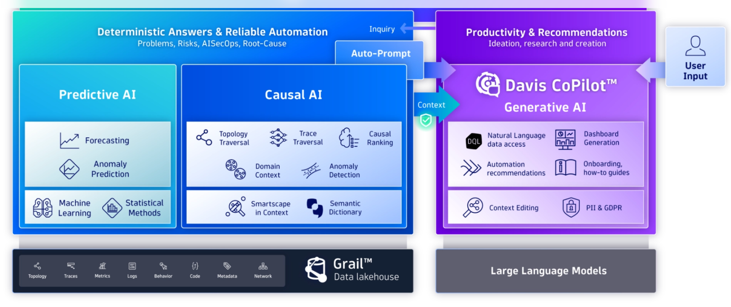
Davis ai

Slide 15
..
Davis's predictive AI continuously forecasts and detects anomalies across multidimensional baselines, application traffic, and service loads.
It is aware of seasonality and patterns, enabling proactive identification of potential issues before they impact operations
Causal AI analyzes observability and security data within the context of topology information. It groups anomalies, pinpoints root causes, and prioritizes issues based on business impact, facilitating efficient problem resolution

Slide 16
Generative AI: Davis CoPilot™
Davis CoPilot™, the generative AI component, leverages insights from predictive and causal AI to create queries, dashboards, and workflows. It translates natural language prompts into actionable items, simplifying analytics and providing automation recommendation

Slide 17
Core Capabilities
Automatic Root-Cause Analysis: Davis detects and analyzes root causes of problems using topology, transaction, and code-level information.
Natural Language Queries: Utilizing the Dynatrace Query Language (DQL), Davis CoPilot allows users to explore data and discover patterns through natural language inputs.

Slide 18
Playground Labs

