Slide 1
Affinity
ow

Slide 2
NodeSelector
In Kubernetes, a node selector is a field of a pod's specification that is used to constrain which nodes the pod is eligible to be scheduled based on node labels.
Node labels are key-value pairs associated with nodes in the cluster. By using node selectors, you can control where specific pods are scheduled within the cluster based on the characteristics of the nodes.
You can setup label, or use the defined one

Slide 3
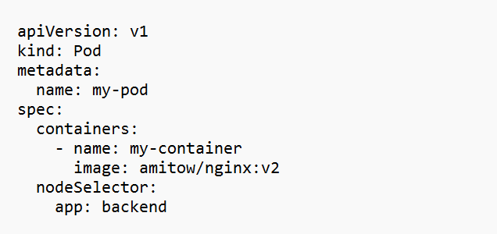
Example

Slide 4
Overview
Affinities are used to express Pod scheduling constraints that can match characteristics of candidate Nodes and the Pods .
A Pod that has an “affinity” to a given Node is more likely to be scheduled to it
“anti-affinity” makes it less probable it’ll be scheduled.

Slide 5
Soft vs Hard
Affinity assessments can produce either hard or soft outcomes.
A “hard” result means the Node must have the characteristics defined by the affinity expression.
“Soft” affinities act as a preference, indicating to the scheduler that it should use a Node with the characteristics if one is available

Slide 6
Affinity Condition
Node Affinity — Used to constrain the Nodes that can receive a Pod by matching labels of those Nodes. Node Affinity can only be used to set positive affinities that schedule Pods to the Node.
Inter-Pod Affinity — Used to constrain the Nodes that can receive a Pod by matching labels of the existing Pods already running on each of those Nodes. A Pod with the same condition but defined as an Inter-Pod Affinity will be scheduled to a Node that already hosts a Pod with a label=value label.

Slide 7
Node Affinity
requiredDuringSchedulingIgnoredDuringExecution – This is the “hard” affinity matcher that requires the Node meet the constraints you define.
preferredDuringSchedulingIgnoredDuringExecution – This is the “soft” matcher to express a preference that’s ignored when it can’t be fulfilled.

Slide 8
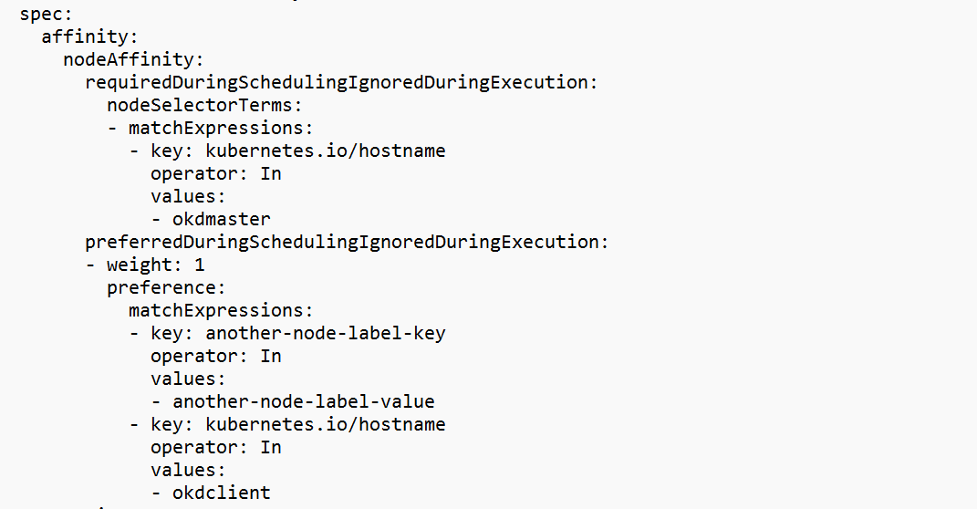
..

Slide 9
Pod affinity
Inter-Pod Affinities work very similarly to Node Affinities but do have some important differences. The “hard” and “soft” modes are indicated using the same requiredDuringSchedulingIgnoredDuringExecution and preferredDuringSchedulingIgnoredDuringExecution fields.
These should be nested under the spec.affinity.podAffinity or spec.affinity.podAntiAffinity fields depending on whether you want to increase or reduce the Pod’s affinity upon a successful match.

Slide 10
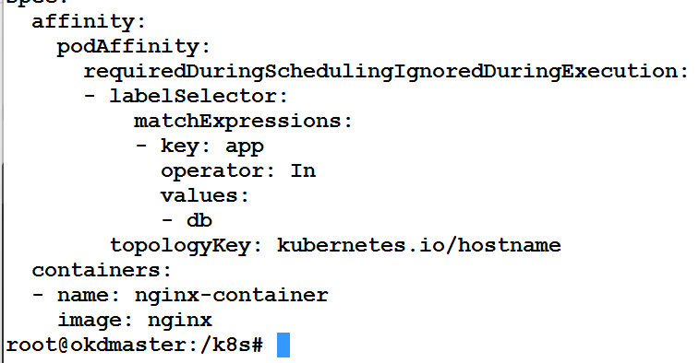
..

Slide 11
..
Each matchExpressions constraint needs to be nested under labelSelector
It means we should have already one pod must be already running with that labels
Pod affinities need a topologyKey field. This is used to limit the overall set of Nodes that are considered eligible for scheduling, before the matchExpressions are evaluated.

Slide 12
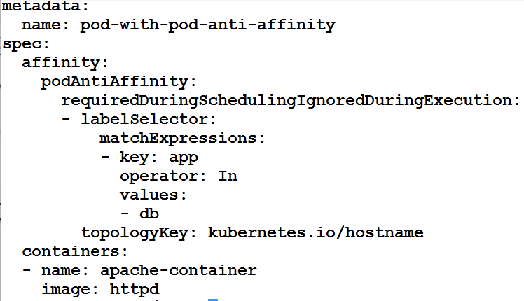
Antiaffinity

Slide 13
..
The third YAML block defines a Pod named "pod-with-pod-anti-affinity" with a pod anti-affinity rule.
This rule specifies that the pod should not be scheduled on a node where there is already a pod with the label app=db. The topology key is set to kubernetes.io/hostname.

Slide 14
Node affinity
Node affinity is conceptually similar to nodeSelector, allowing you to constrain which nodes your Pod can be scheduled on based on node labels. There are two types of node affinity:
requiredDuringSchedulingIgnoredDuringExecution: The scheduler can't schedule the Pod unless the rule is met. This functions like nodeSelector, but with a more expressive syntax.
preferredDuringSchedulingIgnoredDuringExecution: The scheduler tries to find a node that meets the rule. If a matching node is not available, the scheduler still schedules the Pod.

Slide 15
..
affinity:
nodeAffinity:
requiredDuringSchedulingIgnoredDuringExecution:
nodeSelectorTerms:
- matchExpressions:
- key: kubernetes.io/hostname
operator: In
values:
- okdmaster
preferredDuringSchedulingIgnoredDuringExecution:
- weight: 1
preference:
matchExpressions:
- key: kubernetes.io/hostname
operator: In
values:
- okdclient

Slide 16
..
Type Reason Age From Message
---- ------ ---- ---- -------
Normal Scheduled 63s default-scheduler Successfully assigned default/with-node-affinity to okdmaster
Normal Pulled 56s kubelet Container image "k8s.gcr.io/pause:2.0" already present on machine
Normal Created 55s kubelet Created container with-node-affinity
Normal Started 54s kubelet Started container with-node-affinity

Slide 17
.
nodeSelectorTerms:
- matchExpressions:
- key: kubernetes.io/os
operator: In
values:
- linux
preferredDuringSchedulingIgnoredDuringExecution:
- weight: 1
preference:
matchExpressions:
- key: kubernetes.io/hostname
operator: In
values:
- okdmaster
- weight: 50
preference:
matchExpressions:
- key: kubernetes.io/hostname
operator: In
values:
- okdclient
containers:
- name: with-node-affinity
image: k8s.gcr.io/pause:2.0
~

Slide 18
..
Normal Scheduled 83s default-scheduler Successfully assigned default/with-affinity-anti-affinity to okdclient
Normal Pulling 80s kubelet Pulling image "k8s.gcr.io/pause:2.0"
Normal Pulled 76s kubelet Successfully pulled image "k8s.gcr.io/pause:2.0" in 3.679330889s
Normal Created 76s kubelet Created container with-node-affinity
Normal Started 75s kubelet Started container with-node-affinity

