Slide 1
OpenShift
OW

Slide 2
What is Openshift??
OpenShift gives applications distributed computing power.
It is PAAS(platform as a service)
This is product from redhat, which provides a web console, using that we can deploy and manage the workload
OpenShift built on two opensource keystones
Containers
Kubernetes container orchestrator

Slide 3
Linux Containers
Containers are an atomic unit of execution. Each running instance of a container is stamped from an Open Container Initiative (OCI) image that packages an application executable with all the pieces it needs to run. These dependencies can include shared libraries, programs, language runtimes, and anything else the application requires.
Container images are stored in a repository often called a container registry. Linux
kernel facilities isolate and mediate running containers. . A running container has its own filesystem and a defined share of the resources of the node where it runs.

Slide 4
Kubernetes
OpenShift is a distribution of Kubernetes. Kubernetes is an open source project started at Google and developed by a group of companies and individuals since its release in 2014.
This community has adopted formal governance through the Cloud Native Computing Foundation (CNCF).
Red Hat has been a leading contributor to Kubernetes since the project began, and OpenShift is developed in collaboration with the Kubernetes community

Slide 5
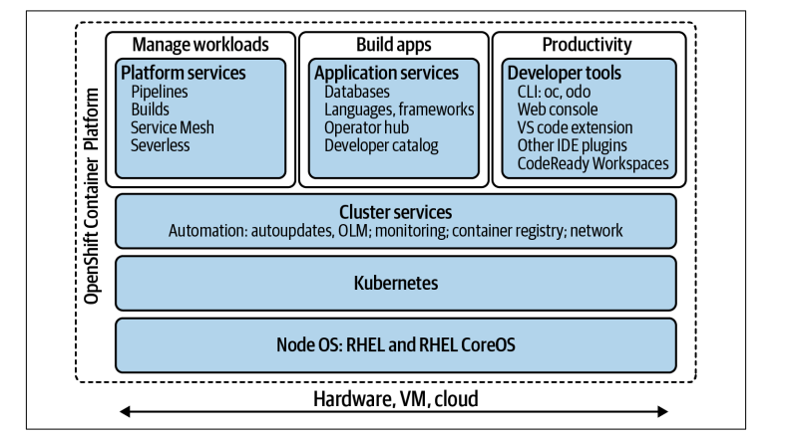
What OpenShift adds??

Slide 6
Web Console
The OpenShift Web Console is a graphical view of the cluster and your applications.
As the name suggests, it runs in a web browser.
The Web Console lets you do every‐ thing necessary to deploy and run your software projects with graphical controls and forms for configuration, rather than sifting through so many lines and indentations of underlying YAML

Slide 7
..
OpenShift is a superset of Kubernetes. Kubernetes concepts, commands, and practi‐ ces work on OpenShift. You can do any of the usual kubectl operations in the Open‐ Shift API. The reverse is not true. OpenShift has features and entire workflows that are not part of Kubernetes.
For example, BuildConfig and Build resources in the OpenShift API represent the configuration and iterative executions of a process to build an application. They are not in the Kubernetes API, because Kubernetes doesn’t define a mechanism for compiling software and assembling container images.
Open‐ Shift adds these two types of resources and the facilities that use them. Likewise, while Kubernetes has a namespace to organize resources, OpenShift augments the namespace to form the Project.

Slide 8
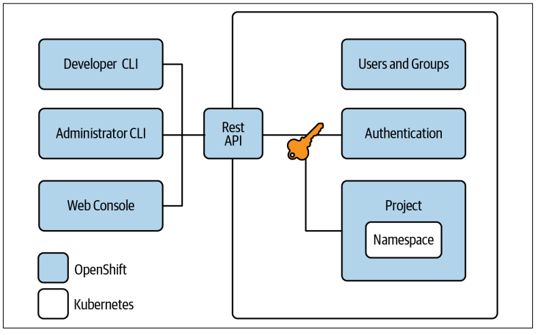
..

Slide 9



