Slide 1
DeploymentConfig
OW

Slide 2
Overview
Defines the template for a pod and manages the new images or configuration whenever the image attributes changes
A single DC is usually analogous to a single micro service
It has capability of rolling update and rollback
We can provide pre and post web hook in deployment configuration

Slide 3
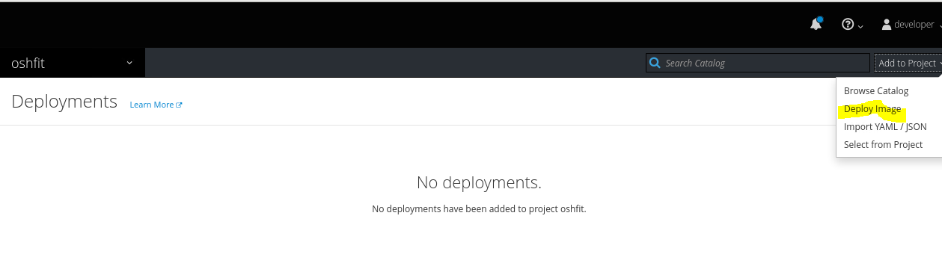
..

Slide 4
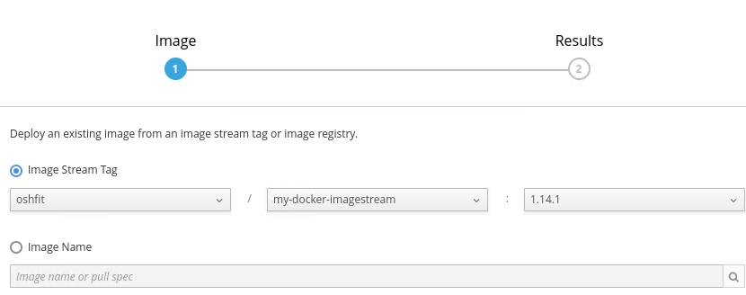
..

Slide 5
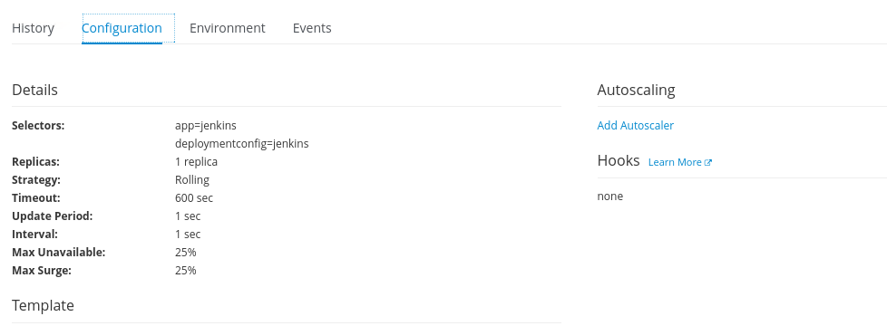
..

Slide 6
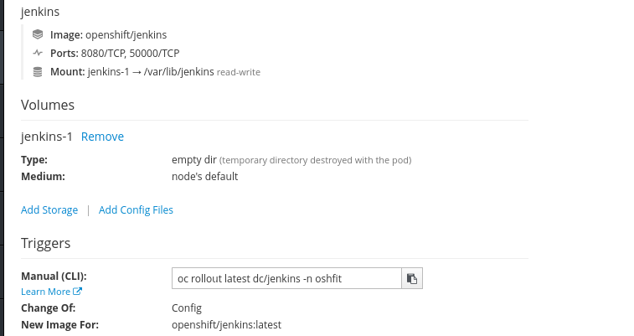
Triggers

Slide 7

AutoScaler

Slide 8



