Slide 1
Routes
OW

Slide 2
Overview
In OpenShift, routes are used to expose services to the external network, allowing external traffic to reach applications running within the cluster. Routes provide an easy way to access applications, enable load balancing, and support secure communication over HTTPS.

Slide 3
Routes components
Host: The hostname at which the application will be accessible. It can be a subdomain of the cluster's domain.
Path: The URL path that specifies the route to a specific service or resource within the application.
Service: The target service that the route forwards incoming traffic to.
Port: The port on which the target service is listening.

Slide 4
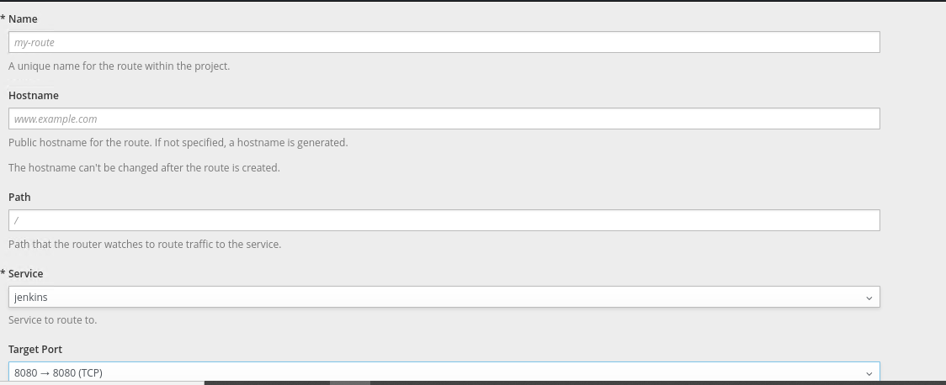
..

Slide 5
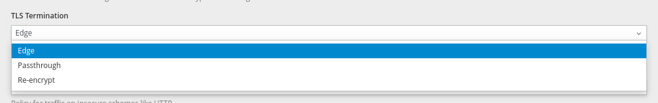
..

Slide 6
..
Edge Route: This type of route is used for exposing applications over HTTP or HTTPS. It terminates SSL/TLS traffic at the router.
Passthrough Route: Passthrough routes forward encrypted traffic directly to the service without terminating SSL/TLS. Useful for applications that handle SSL/TLS themselves.

Slide 7
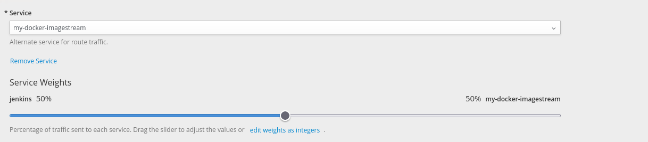
Split Traffic

