Slide 1
OCI CONSOLE WALKTHROUGH
Object Storage in Oracle Cloud
Understanding Buckets and How to Create Them

Slide 2
What Is Object Storage?
Object Storage is a service for storing unstructured data — files, backups, images, logs — as objects inside containers called buckets.
BUCKET
invoice.pdf
backup.tar.gz
A bucket is a logical container — it holds any number of objects
Each object is a file plus metadata, identified by a unique key
Buckets belong to a compartment and a storage namespace
No fixed limit on the amount of data stored in a bucket
photo.jpg
app.log

Slide 3
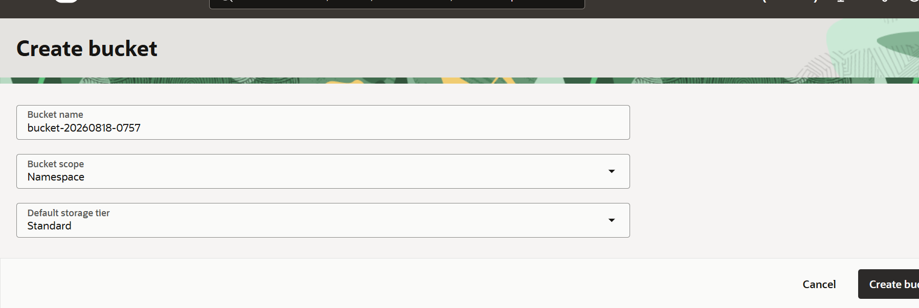
Creating a Bucket in the Console
Navigate to: Storage → Object Storage & Archive Storage → Buckets → Create Bucket

Slide 4
Key Configuration Fields
Field | What It Controls
Bucket name | A unique, human-readable identifier for the bucket within its namespace (e.g. bucket-20260818-0757)
Bucket scope | Whether the bucket is scoped to the tenancy's Namespace (default, unique tenancy-wide) or to a Compartment
Default storage tier | The access tier new objects are stored in — Standard, Infrequent Access, or Archive — which drives cost and retrieval time

Slide 5
Default Storage Tiers Compared
Tier | Best For | Retrieval | Relative Cost
Standard | Frequently accessed, active data | Immediate | Highest storage cost
Infrequent Access | Data accessed less than once a month | Immediate | Lower storage, retrieval fee applies
Archive | Long-term retention, rarely accessed | Hours (restore required) | Lowest storage cost
Storage tier can be changed per object after creation without moving the object between buckets.

Slide 6
Summary
A bucket is the top-level container for objects in OCI Object Storage
Bucket name must be unique within its scope — Namespace or Compartment
Default storage tier sets the cost/retrieval trade-off for new objects
Tiers can be mixed and changed per object after the bucket is created
Buckets are created from Storage → Object Storage & Archive Storage → Buckets

