Slide 1
Serverless
Build and run applications without thinking about servers

Slide 2
Definition
Serverless computing is a cloud computing execution model in which the cloud provider allocates machine resources on demand, taking care of the servers on behalf of their customers.
"Serverless" is a misnomer in the sense that servers are still used by cloud service providers to execute code for developers.
Developers of serverless applications are not concerned with capacity planning, configuration, management, maintenance, fault tolerance, or scaling of containers, virtual machines, or physical servers. When an app is not in use, there are no computing resources allocated to the app.

Slide 3
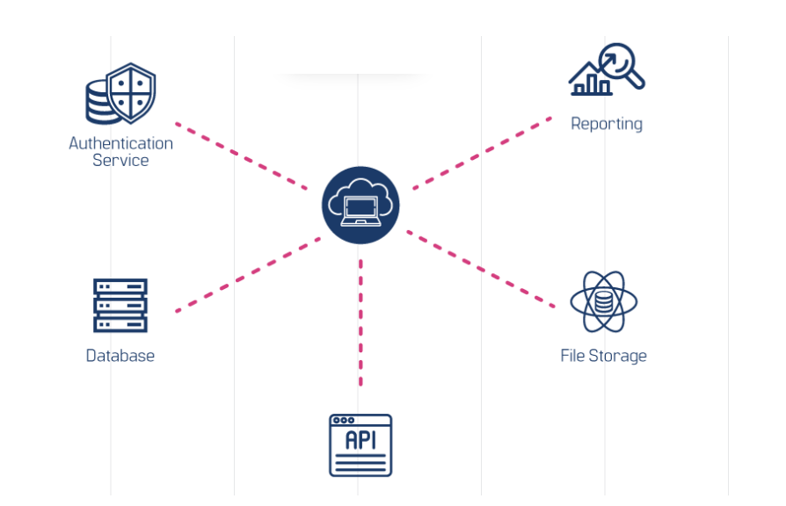
..

Slide 4
Why use serverless
With serverless architectures, developers do not need to worry about purchasing, provisioning, and managing backend servers.
The serverless computing service takes your functions as input, performs logic, returns your output, and then shuts down. You are only billed for the resources used during the execution of those functions.
The serverless computing service takes your functions as input, performs logic, returns your output, and then shuts down. You are only billed for the resources used during the execution of those functions.

Slide 5
..
No Server Management
Serverless computing makes it easy for you to focus on the core of development – coding – rather than on operations. You also need not worry about scalability as the serverless model scales on demand and based on usage.
Cost Efficiency
Pay-per-use or pay-as-you-go is one of the other benefits of serverless computing. You will only be charged based on how many times a code runs, how much memory is utilized, what the duration of the execution was, and so on. So there is no need to pay for idle time.

Slide 6
..
Shorter time to market
A serverless architecture eliminates backend configurations and the need to upload the code to servers. You need not wait until all the coding is completed to release the new product – you can write bits of code and keep adding them as you go.
Decreased latency
Network latency is a problem that often limits the scalability of an application. Serverless eliminates this problem because applications are not hosted on an origin server. With points of presence near every user, the application can run efficiently anywhere in the world.

Slide 7
When you should use?
If you are considering developing an application that includes high latency background tasks and those where the load on the server is unpredictable, serverless architecture is an option you should seriously consider. This will include applications that are heavy on multimedia or data processing.
You may also consider using a serverless architecture for applications that will need rapid scalability and evolving features. Serverless is also suitable to run stateless applications and can be a cost-effective choice for applications that don’t need to run all of their components at all times.

Slide 8
prototyping
Prototyping on a serverless architecture allows you to evaluate its suitability for your specific application, helping you make an informed decision before fully committing.
This experimentation phase can reveal potential limitations or areas where serverless may not be the best fit, ensuring that your final choice aligns with your application's needs and goals.

Slide 9
Function as a service(faas): Aws lambda)
FaaS allows developers to write small, self-contained pieces of code (code-snippet) that can be triggered whenever needed, making it easier to build applications without having to manage the underlying infrastructure.
lets you run code without thinking about servers. You pay only for the compute time that you consume — there is no charge when your code is not running. With Lambda, you can run code for virtually any type of application or backend service, all with zero administration.

Slide 10
Function in lambda
Lambda function is a serverless compute service that allows you to run code without provisioning or managing servers. Lambda functions automatically scale with the size of your workload, and you are only charged for the compute time you consume.
Event-Driven: Lambda functions are triggered by events, such as changes to data in an S3 bucket, updates to a DynamoDB table, or HTTP requests from an API Gateway.
Runtime: You can write your Lambda function code in various programming languages, including Python, Node.js, Java, Ruby, Go, .NET Core, and more.

Slide 11
How it works?
Write Code: You write a function using your preferred programming language and upload it to AWS Lambda.
Trigger Function: You define events that trigger your function, such as an HTTP request via API Gateway, an object uploaded to S3, or a change in a DynamoDB table.
Execute Function: AWS Lambda automatically scales your function by running code in response to each trigger event.
Return Results: After the function completes its execution, it can return results to the calling service, store results in a database, or perform any other required actions.

Slide 12
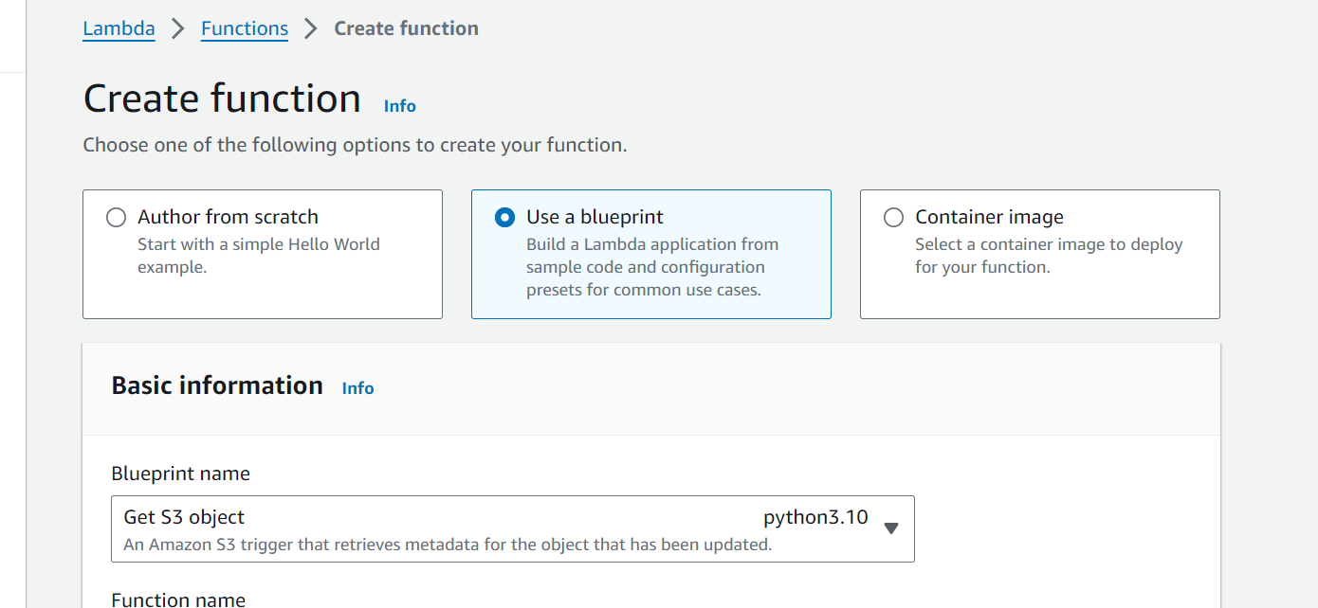
labs

Slide 13
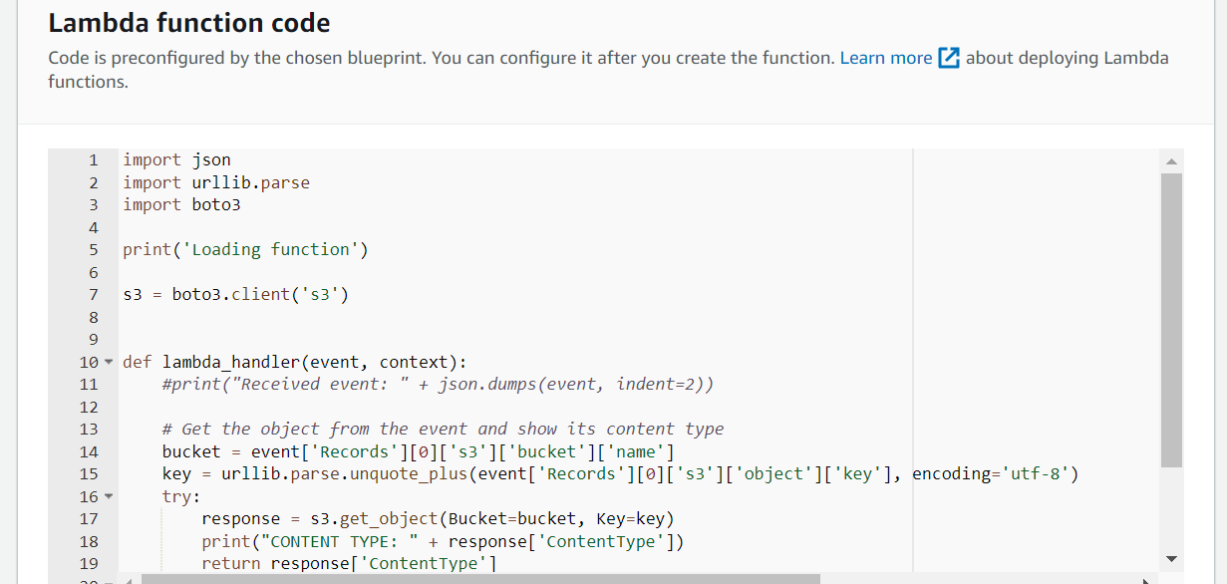
..

Slide 14
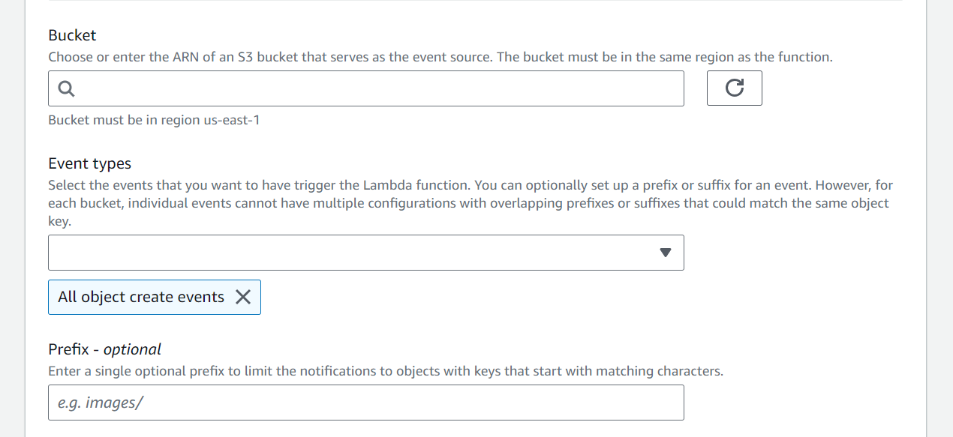
triggers

Slide 15
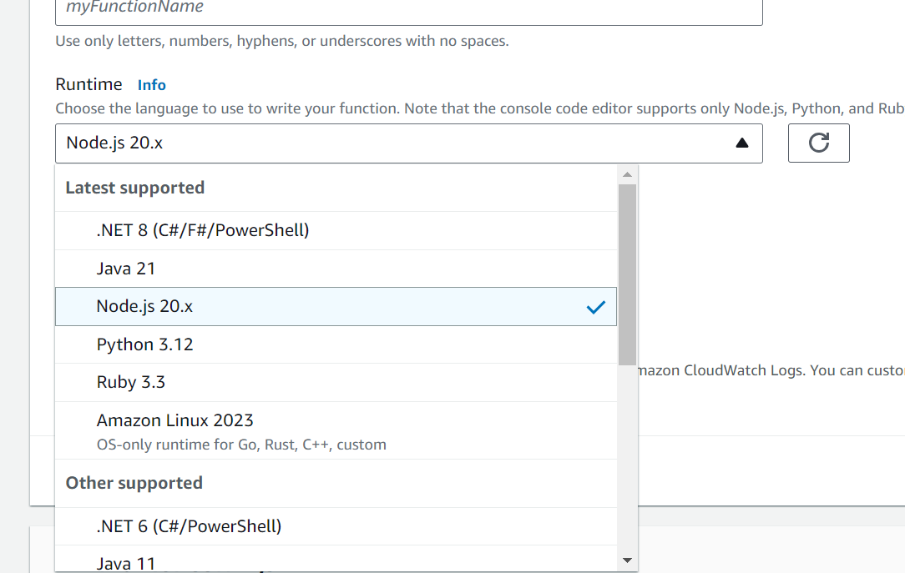
runtime

Slide 16
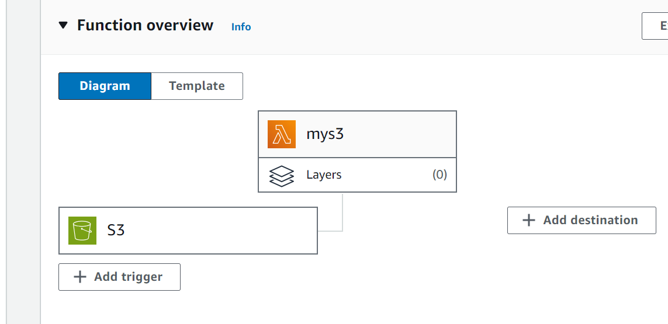
..

Slide 17
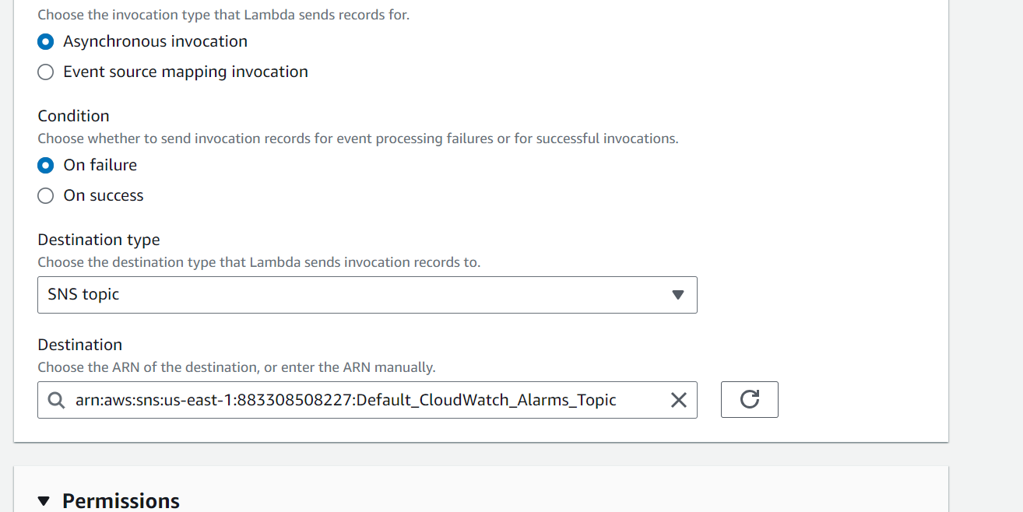
..

Slide 18
Lambda layers
Lambda Layers: These are ZIP archives that include libraries, custom runtimes, or other dependencies, which you can attach to your Lambda function.
Execution Environment: When you add layers to a Lambda function, the contents are extracted into the /opt directory during execution. Layers are extracted in the order they are added, with files in later layers overwriting those in earlier ones if they have the same name.
Layer Management: You can manage the order in which layers are merged using "Merge earlier" and "Merge later" buttons. You can also update the layer version that your functions use by specifying a new version.

Slide 19
Aws fargate
AWS Fargate is a compute engine for Amazon Elastic Container Service(ECS) that allows you to run containers without having to provision, configure & scale clusters of VMs that host container applications.
AWS Fargate eliminates the need for users to manage the EC2 instances on their own. In fact, users don’t need to use EC2 instances at all. Fargate itself will act as compute engine.
With Fargate launch type, all you need to do is package your application in containers, specify the memory and CPU requirements, define IAM policies & launch your application.

Slide 20
Image and containers
Container:
A Docker container is a standardized unit of software development, containing everything that your software application needs to run code, runtime, system tools, system libraries, etc. These containers are created from a read-only template called a container image.
Container Image:
Images are typically built from a docker-file which is a plain text file that specifies all of the components that are included in the container. These images are stored in a registry from which they can be downloaded & run in the container.

Slide 21
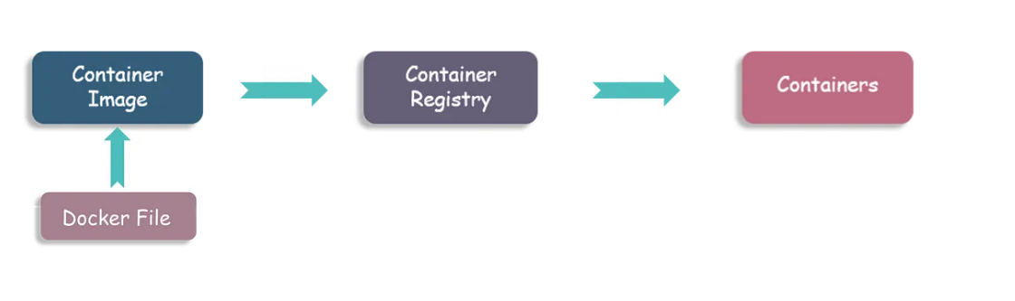
..

Slide 22
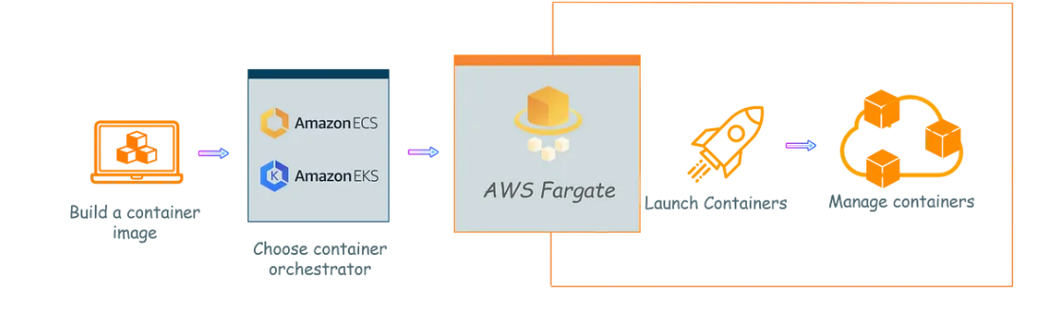
fargate

Slide 23
flow
Build a Container Image: Start by creating a container image that encapsulates your application and its dependencies. This image is stored in a container registry, such as Amazon Elastic Container Registry (ECR).
Choose an Orchestration Service: Select a container orchestration service to manage your containers. You can choose between:
Amazon ECS (Elastic Container Service): A fully managed container orchestration service.
Amazon EKS (Elastic Kubernetes Service): A managed Kubernetes service.

Slide 24
..
Assign Resources: Define and assign the necessary resources to your application within the chosen orchestration service.Create a Cluster: Group all the assigned resources into a cluster. This is where your containers will run.
Select AWS Fargate Launch Type: When using AWS Fargate, it will handle the launching and running of your containers. Fargate abstracts the underlying infrastructure, so you don't need to manage EC2 instances or clusters.Automatic
Scaling and Management: AWS Fargate automatically scales your application based on its needs, handling all the infrastructure management behind the scenes.

Slide 25
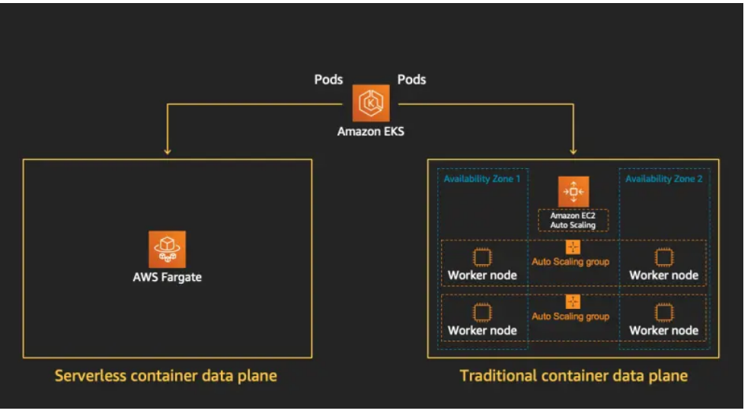
..

Slide 26
labs

Slide 27
knative
Knative is indeed a platform-agnostic solution designed to run serverless workloads. It is an open-source Kubernetes-based platform that provides a set of components for deploying, running, and managing serverless applications.
Google Cloud Run and OpenShift both use Knative as a foundational technology
Google Cloud Run is ideal if you are looking for a fully managed serverless platform with minimal overhead, especially for developers who want to focus solely on writing code and deploying containers without managing infrastructure.
OpenShift with Knative is better suited for organizations that require more control over their environment, want to deploy across hybrid or multi-cloud environments, and need enterprise-level features.

Slide 28
Types
Knative Serving: Focuses on deploying and serving your applications. It manages the lifecycle of your services, including scaling them up from zero instances to handle traffic and back down to zero when idle. It supports auto-scaling based on traffic, canary deployments, and integrates with Istio for networking.
Knative Eventing: Provides a framework for building event-driven applications. It allows you to decouple producers and consumers through event brokers, enabling the creation of reactive applications that respond to events such as changes in data or requests from other services.

Slide 29
Event source
An Event Source in the context of Knative or event-driven systems is a component that generates events. Think of it as something that watches for certain activities or changes in your environment (like a new file being added to a storage bucket or a message being sent to a queue) and then creates an event when that activity occurs.
In simple terms, an Event Source is like a sensor or a notifier that says, "Hey, something happened here!" It then sends out this information (the event) so that other parts of your system can react to it

Slide 30
Api event source
The API Server Source in Knative is a specialized event source that listens to events from the Kubernetes API server.
This means it can watch for changes happening in your Kubernetes cluster, like when a pod is created, updated, or deleted.
When such an event occurs, the API Server Source captures it and forwards it to a Knative Eventing system.

Slide 31
Brokers
The event broker is a component that acts as an intermediary for events. It receives events from event sources and makes them available to the event consumers. It can be thought of as a messaging layer where events are temporarily stored.
Knative Eventing Broker: Typically, the events are sent to a Knative Eventing broker, which acts as a middleman that can route these events to various consumers, like your Knative services

Slide 32
..
Watch Kubernetes Events: The API Server Source monitors specific events from the Kubernetes API server (like when resources such as pods or services change).
Forward Events: Once it detects these events, it forwards them to a designated event sink. An event sink could be a Knative service or another component that will do something useful with this event.
Knative Eventing Broker: Typically, the events are sent to a Knative Eventing broker, which acts as a middleman that can route these events to various consumers, like your Knative services.

Slide 33
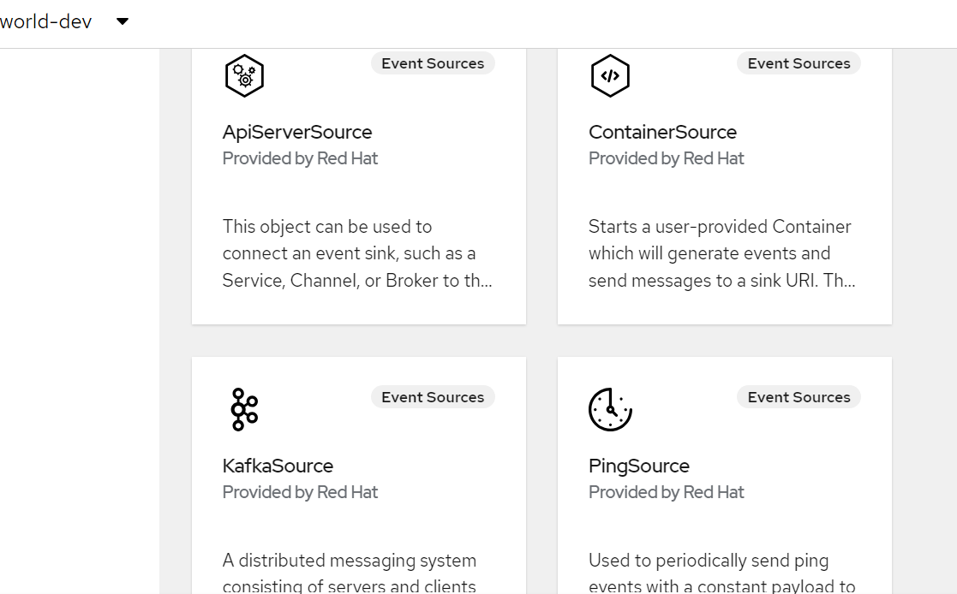
..

Slide 34
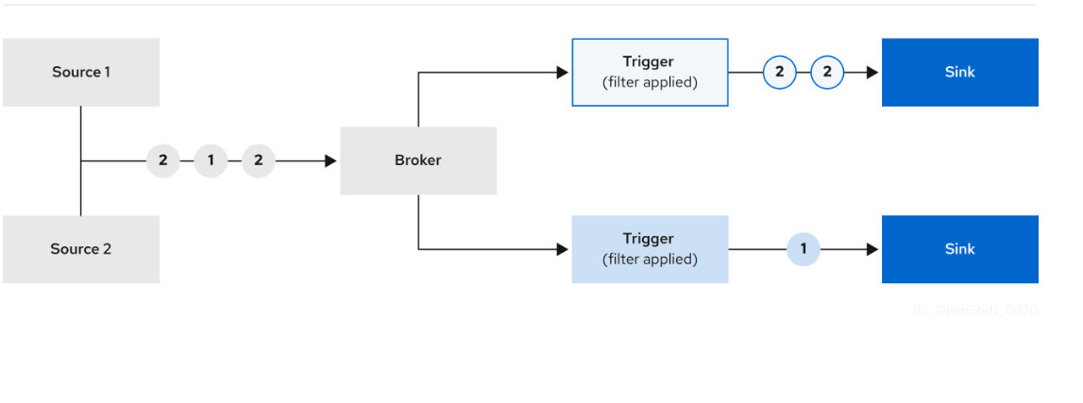
..

Slide 35
Yaml file
apiVersion: sources.knative.dev/v1alpha1
kind: ApiServerSource
metadata:
name: testevents
spec:
serviceAccountName: events-sa
mode: Resource
resources:
- apiVersion: v1
kind: Event

Slide 36
Event sink
When you create an event source, you can specify an event sink where events are sent to from the source. An event sink is an addressable or a callable resource that can receive incoming events from other resources.
Knative services, channels, and brokers are all examples of event sinks. There is also a specific Apache Kafka sink type available.
Addressable objects receive and acknowledge an event delivered over HTTP to an address defined in their status.address.url field. As a special case, the core Kubernetes Service object also fulfills the addressable interface.

Slide 37
..
kn source binding create bind-heartbeat --namespace sinkbinding-example --subject "Job:batch/v1:app=heartbeat-cron" --sink http://event-display.svc.cluster.local --ce-override "sink=bound"

Slide 38
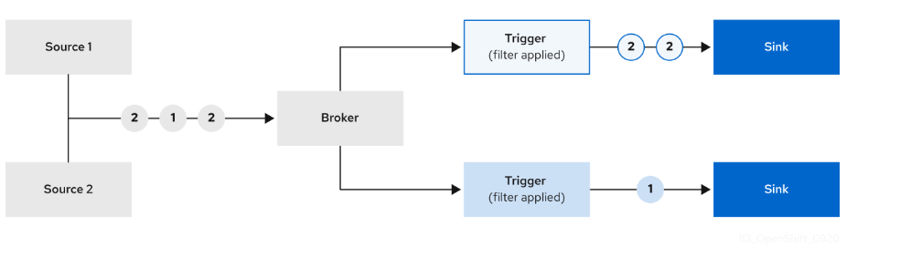
Event broker
Brokers can be used in combination with triggers to deliver events from an event source to an event sink.
Events are sent from an event source to a broker as an HTTP POST request. After events have entered the broker, they can be filtered by CloudEvent attributes using triggers, and sent as an HTTP POST request to an event sink.

Slide 39
trigger
Brokers can be used in combination with triggers to deliver events from an event source to an event sink. Events are sent from an event source to a broker as an HTTP POST request.
After events have entered the broker, they can be filtered by CloudEvent attributes using triggers, and sent as an HTTP POST request to an event sink.

Slide 40
yaml
apiVersion: eventing.knative.dev/v1
kind: Trigger
metadata:
annotations:
eventing.knative.dev/injection: enabled
name: <trigger_name>
spec:
broker: default
subscriber:
ref:
apiVersion: serving.knative.dev/v1
kind: Service
name: <service_name>

Slide 41
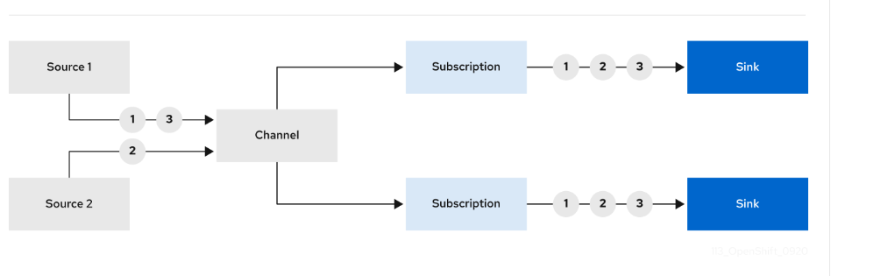
Channels and subscriptions
Channels are custom resources that define a single event-forwarding and persistence layer. After events have been sent to a channel from an event source or producer, these events can be sent to multiple Knative services or other sinks by using a subscription

Slide 42
LABS

Slide 43
Knative serving
Knative Serving is a component of the Knative project, designed to manage and deploy serverless workloads on Kubernetes.
It provides a framework for building, deploying, and managing stateless services in a serverless fashion, meaning you don't need to worry about the underlying infrastructure management.

Slide 44
..
Automatic Scaling: Knative Serving can automatically scale applications up and down, including scaling down to zero when there is no traffic. This helps optimize resource usage and reduce costs.
Traffic Management: It allows you to manage traffic routing, enabling canary deployments, blue-green deployments, and gradual rollouts. You can split traffic between different revisions of your application.
Revisions: Each time you deploy a new version of your application, Knative creates a new revision. This makes it easy to roll back to a previous version if something goes wrong.

Slide 45
..
Creating Knative resources by using YAML files uses a declarative API, which enables you to describe applications declaratively and in a reproducible manner.
To create a serverless application by using YAML, you must create a YAML file that defines a Knative Service object, then apply it by using oc apply.
After the service is created and the application is deployed, Knative creates an immutable revision for this version of the application. Knative also performs network programming to create a route, ingress, service, and load balancer for your application and automatically scales your pods up and down based on traffic.

Slide 46
..
apiVersion: serving.knative.dev/v1
kind: Service
metadata:
name: showcase
namespace: default
spec:
template:
spec:
containers:
- image: quay.io/openshift-knative/showcase
env:
- name: GREET
value: Bonjour

Slide 47
setup
To create serverless applications using the Administrator perspective, ensure that you have completed the following steps.
The OpenShift Serverless Operator and Knative Serving are installed.
You have logged in to the web console and are in the Administrator perspective.
Procedure
Navigate to the Serverless → Serving page.
In the Create list, select Service.
Manually enter YAML or JSON definitions, or by dragging and dropping a file into the editor.
Click Create.

Slide 48
autoscaling
Knative Serving provides automatic scaling, or autoscaling, for applications to match incoming demand.
For example, if an application is receiving no traffic, and scale-to-zero is enabled, Knative Serving scales the application down to zero replicas. If scale-to-zero is disabled, the application is scaled down to the minimum number of replicas configured for applications on the cluster.
Replicas can also be scaled up to meet demand if traffic to the application increases.

Slide 49
..
apiVersion: serving.knative.dev/v1
kind: Service
metadata:
name: showcase
namespace: default
spec:
template:
metadata:
annotations:
autoscaling.knative.dev/min-scale: "0"

Slide 50
concurrency
Concurrency determines the number of simultaneous requests that can be processed by each replica of an application at any given time. Concurrency can be configured as a soft limit or a hard limit:
A soft limit is a targeted requests limit, rather than a strictly enforced bound. For example, if there is a sudden burst of traffic, the soft limit target can be exceeded.
A hard limit is a strictly enforced upper bound requests limit. If concurrency reaches the hard limit, surplus requests are buffered and must wait until there is enough free capacity to execute the requests.

Slide 51
..
apiVersion: serving.knative.dev/v1
kind: Service
metadata:
name: showcase
namespace: default
spec:
template:
metadata:
annotations:
autoscaling.knative.dev/target: "200"

Slide 52
Enabling scale to zero
You can use the enable-scale-to-zero spec to enable or disable scale-to-zero globally for applications on the cluster.
You are using the default Knative Pod Autoscaler. The scale to zero feature is not available if you are using the Kubernetes Horizontal Pod Autoscaler.
spec:
config:
autoscaler:
enable-scale-to-zero: "false"

Slide 53
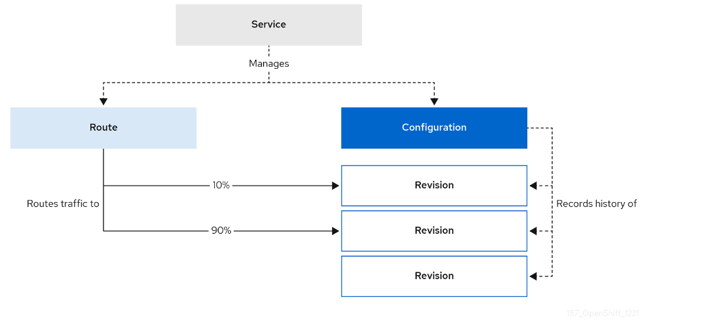
Traffic splitting
In a Knative application, traffic can be managed by creating a traffic split. A traffic split is configured as part of a route, which is managed by a Knative service.

Slide 54
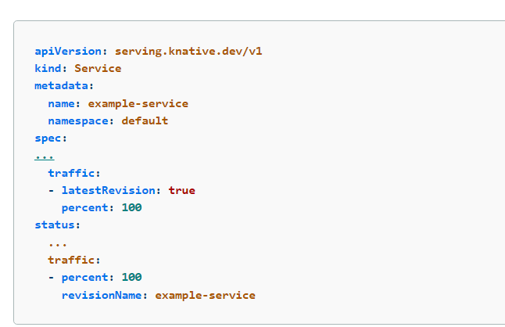
..

Slide 55



