Slide 1
DevOps: Bridging the Gap Between Development and Operations
ow

Slide 2
Agenda
Introduction to DevOps
Benefits of DevOps
Challenges of DevOps
Implementing DevOps
DevOps Best Practices
The Future of DevOps

Slide 3
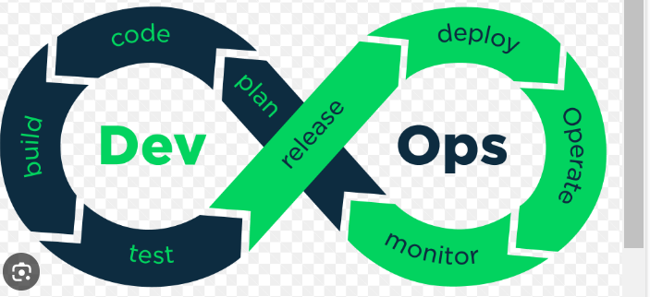
Introduction to DevOps
DevOps is a software development methodology that emphasizes collaboration, communication, and integration between software developers and IT operations professionals.
The goal of DevOps is to increase the speed and efficiency of software delivery while maintaining high levels of quality and reliability.

Slide 4
Approach
The DevOps approach involves automating as much of the software development and deployment process as possible, using tools like continuous integration and continuous delivery (CI/CD) pipelines.
By automating routine tasks, DevOps teams can focus on more strategic activities, such as improving code quality and enhancing customer experiences.
Tools we use:
Git,Github
Jenkins, Github actions, Gitlabs..

Slide 5
Benefits of DevOps
One of the key benefits of DevOps is faster time-to-market for software products.
By automating the development and deployment process, DevOps teams can release new features and updates more frequently, which allows them to respond quickly to changing market conditions and customer needs.
Finding the Bugs in early stage.
Integration is quite easier, as platforms are compatible

Slide 6
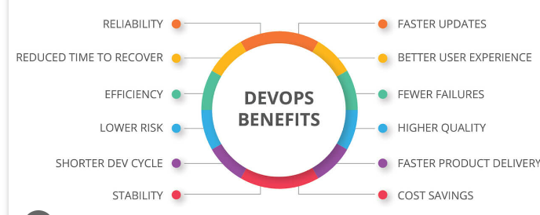
..
Another benefit of DevOps is improved collaboration between development and operations teams.
By breaking down silos and encouraging cross-functional teams, DevOps fosters a culture of collaboration and communication that leads to better outcomes for everyone involved.

Slide 7
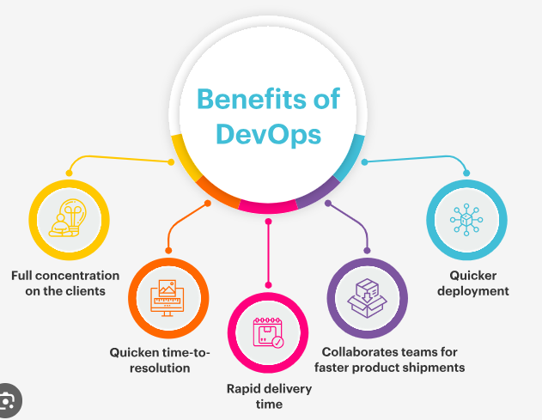
Benefit Tree

Slide 8
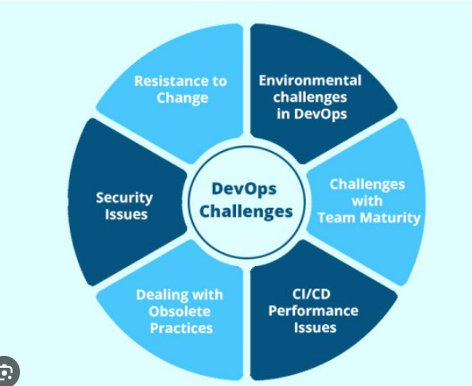
Challenges of DevOps
While DevOps offers many benefits, there are also some challenges associated with this approach. One of the biggest challenges is cultural resistance to change.

Slide 9
..
DevOps requires a shift in mindset and a willingness to embrace new ways of working, which can be difficult for some teams to accept.
Shifting from Traditional approach to Microservice Approach
Tools knowledge (Lot of integration are supported), which itself become a challenges

Slide 10
Implementing DevOps
To successfully implement DevOps, organizations must first assess their current processes and identify areas for improvement.
This may involve conducting a gap analysis or performing a maturity assessment to determine where the organization stands in terms of DevOps readiness.
Once the organization has identified areas for improvement, it can begin implementing DevOps practices and tools.
This may involve adopting new technologies, such as CI/CD pipelines, or reorganizing teams to promote cross-functional collaboration and communication.

Slide 11
DevOps Best Practices
There are several best practices that organizations can follow to ensure successful DevOps implementation. These include automating routine tasks wherever possible, using version control to manage code changes, and monitoring performance and user feedback to identify areas for improvement.
Other best practices include fostering a culture of collaboration and continuous learning, promoting transparency and accountability, and prioritizing security and compliance throughout the development and deployment process.

Slide 12
The Future of DevOps
As software development continues to evolve, so too will the DevOps approach. Some experts predict that artificial intelligence and machine learning will play an increasingly important role in DevOps, helping to automate even more tasks and improve decision-making.
Other trends that may shape the future of DevOps include a focus on microservices and containerization, as well as a greater emphasis on security and compliance in the wake of high-profile data breaches and cyber attacks

