Slide 1
IAC
OW

Slide 2
IAC tools
There are various tools available that deploy infrastructure as a code
Terraform
Heat
Ansible
Puppet
Chef
CloudFromation

Slide 3
What is IAC
IAC is all about provisioning the server and Infra templates
How these tools are more focused towards different vendors
How we can maintain the state?
How these tools are different from configuration management
Can Ansible do IAC??

Slide 4
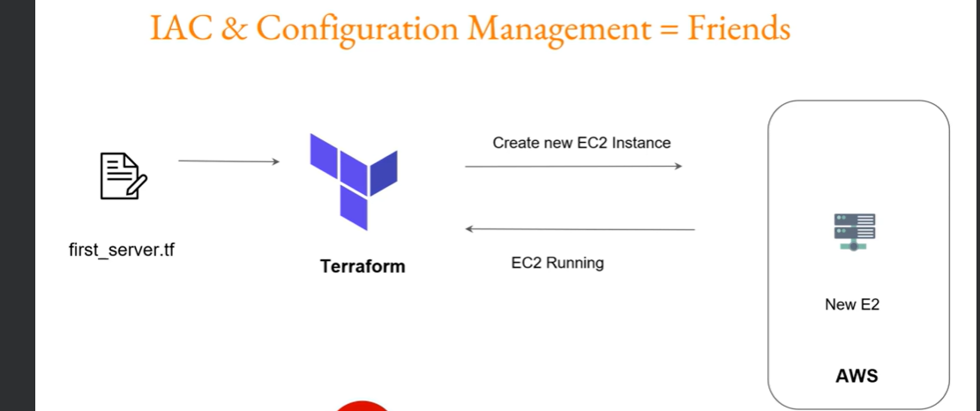
How IAC works?

Slide 5
Terraform Parameters
Terraform Lot of providers (support for lot of vendors)
Well integrates with configuration management
Help of plugins
Simple configuration language
Free

Slide 6
Installation Process
Download the binary
Install in the workstation
https://developer.hashicorp.com/terraform/install
wget -O- https://apt.releases.hashicorp.com/gpg | sudo gpg --dearmor -o /usr/share/keyrings/hashicorp-archive-keyring.gpg
echo "deb [signed-by=/usr/share/keyrings/hashicorp-archive-keyring.gpg] https://apt.releases.hashicorp.com $(lsb_release -cs) main" | sudo tee /etc/apt/sources.list.d/hashicorp.list
sudo apt update && sudo apt install terraform

Slide 7
IDE
Notepad++
Atom
Visual Studio Code

Slide 8
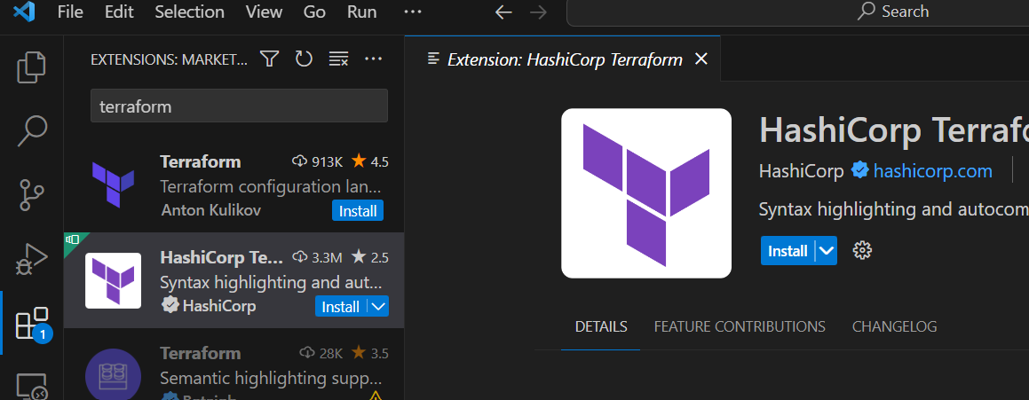
Setting up visual studio code
Need to install extensions, which works as add-ons
These provide many features such as functionality related to colors, auto-complete, reports spelling error etc

