Slide 1
Meta-Arguments
OW

Slide 2
depends_on
Use the depends_on meta-argument handles resource dependency that terraform cannot handle automatically
Explicitly define the dependency when a resource relies on another resources
The depends_on argument instructs terraform to complete all the actions on the dependency object before performing action on the object who declares the dependency
You should use depends_on as a last resort because it can cause Terraform to create more conservative plans that replace more resources than necessary.

Slide 3
..
resource "aws_instance" "example" {
ami = "ami-0b8987a72eee28c3d" # Replace with your desired AMI ID
instance_type = "t2.micro"
subnet_id = "subnet-0e09953db95a5ac65" # Replace with your desired subnet ID
key_name = "my-key-pair" # Replace with your desired key pair name
depends_on = [aws_security_group.example_sg]
}
resource "aws_security_group" "example_sg" {
name = "example_sg"
description = "Example security group"
depends_on = [aws_vpc.example_vpc]
}
resource "aws_vpc" "example_vpc" {
cidr_block = "10.0.0.0/16"
}

Slide 4
explain
depends_on: It specifies that the creation of this EC2 instance depends on the completion of the security group (aws_security_group.example_sg) creation.
It specifies that the creation of this security group depends on the completion of the VPC (aws_vpc.example_vpc) creation.

Slide 5
Count Meta-Argument
count is a meta-argument defined by the Terraform language. It can be used with modules and with every resource type.
The count meta-argument accepts a whole number, and creates that many instances of the resource or module. Each instance has a distinct infrastructure object associated with it, and each is separately created, updated, or destroyed when the configuration is applied

Slide 6
example
resource "aws_instance" "server" {
count = 4 # create four similar EC2 instances
ami = "ami-a1b2c3d4"
instance_type = "t2.micro"
tags = {
Name = "Server ${count.index}"
}
}

Slide 7
Count.index
count.index — The distinct index number (starting with 0) corresponding to this instance.
for example, aws_instance.server[0], aws_instance.server[1], etc.) refers to individual instances.

Slide 8
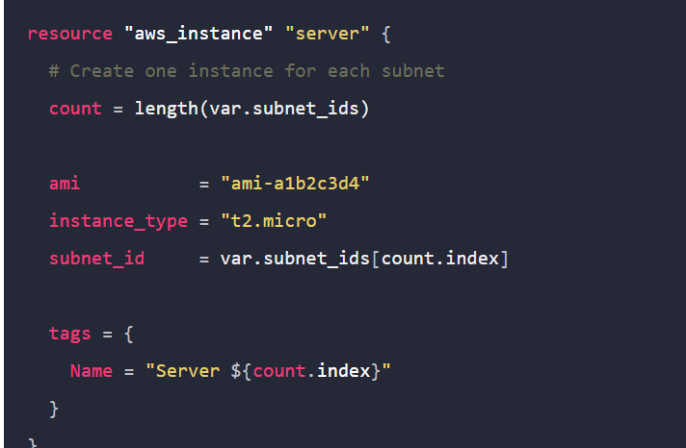
For_each
If your instances are almost identical, count is appropriate. If some of their arguments need distinct values that can't be directly derived from an integer, it's safer to use for_each.

Slide 9
The lifecycle Meta-Argument
lifecycle is a nested block that can appear within a resource block. The lifecycle block and its contents are meta-arguments, available for all resource blocks regardless of type.
The arguments available within a lifecycle block are create_before_destroy, prevent_destroy, ignore_changes, and replace_triggered_by.

Slide 10
..
create_before_destroy (bool) - By default, when Terraform must change a resource argument that cannot be updated in-place due to remote API limitations, Terraform will instead destroy the existing object and then create a new replacement object with the new configured arguments.
prevent_destroy (bool) - This meta-argument, when set to true, will cause Terraform to reject with an error any plan that would destroy the infrastructure object associated with the resource, as long as the argument remains present in the configuration.

Slide 11
..
The ignore_changes feature is intended to be used when a resource is created with references to data that may change in the future, but should not affect said resource after its creation.

