Slide 1
Modules
Ow

Slide 2
Definition
A module is a container for multiple resources that are used together.
Every Terraform configuration has at least one module, known as its root module, which consists of the resources defined in the .tf files in the main working directory.
A module can call other modules, which lets you include the child module's resources into the configuration in a concise way. Modules can also be called multiple times, either within the same configuration or in separate configurations, allowing resource configurations to be packaged and re-used.

Slide 3
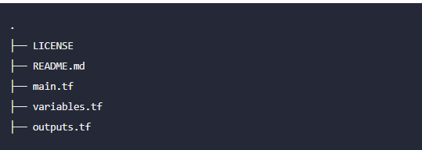
Root Module
A Terraform module is a set of Terraform configuration files in a single directory. Even a simple configuration consisting of a single directory with one or more .tf files is a module. When you run Terraform commands directly from such a directory, it is considered the root module

Slide 4
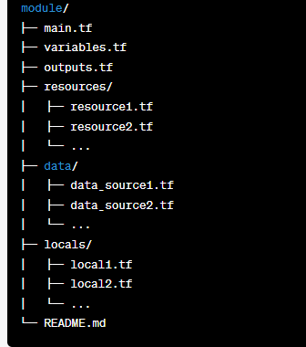
Module Structure
When structuring a Terraform module, it is common to follow a recommended directory structure for better organization and maintainability. Here is an example of a typical Terraform module structure:

Slide 5
..
main.tf: The main configuration file for the module. It contains the definition of resources, data sources, and other Terraform constructs specific to the module.
variables.tf: This file defines input variables that allow customization of the module. Declare variables, specify their types, and define any defaults or validation rules.
outputs.tf: Here, you define the outputs of the module. These outputs represent values that can be accessed or used by the calling module or the Terraform CLI.
resources/: This directory contains individual resource configuration files (resource1.tf, resource2.tf, etc.). Each file defines the resources created by the module, such as AWS instances, security groups, or S3 buckets.
data/: This directory contains individual data source configuration files (data_source1.tf, data_source2.tf, etc.). Each file defines data sources used by the module to fetch information from external systems.
locals/: This directory contains individual local value configuration files (local1.tf, local2.tf, etc.). Each file defines local values or computations that can be used within the module.
README.md: An optional file that provides documentation for the module. You can include usage examples, important notes, and any other relevant information.

Slide 6
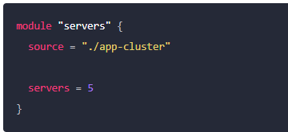
Calling module
To call a module means to include the contents of that module into the configuration with specific values for its input variables. Modules are called from within other modules using module blocks:
Within the block body (between { and }) are the arguments for the module. Module calls use the following kinds of arguments:
The source argument is mandatory for all modules.
The version argument is recommended for modules from a registry.

Slide 7
Source
All modules require a source argument, which is a meta-argument defined by Terraform.
Its value is either the path to a local directory containing the module's configuration files, or a remote module source that Terraform should download and use
The same source address can be specified in multiple module blocks to create multiple copies of the resources defined within, possibly with different variable values.
After adding, removing, or modifying module blocks, you must re-run terraform init to allow Terraform the opportunity to adjust the installed modules

Slide 8
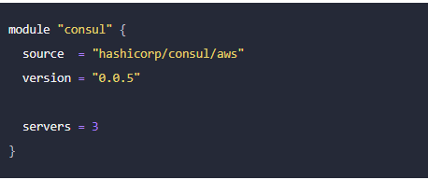
Version
When using modules installed from a module registry, we recommend explicitly constraining the acceptable version numbers to avoid unexpected or unwanted changes.
Use the version argument in the module block to specify versions:

Slide 9
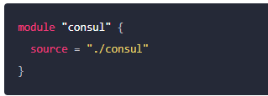
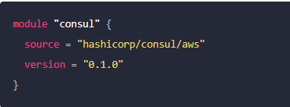
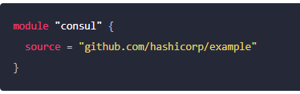
Module Sources

