Slide 1
Ai in devops [aiops]
OW

Slide 2
monitoring
Monitoring mainly checks the system’s overall health and sends alerts when something goes wrong.
Monitoring (Proactive) Covers:
Alerting – Notifies when something goes wrong.
Overview – Provides a summary of system health.
We can use notification channel such as slack and email notification for the same

Slide 3
Observability
Observability is more advanced than monitoring. It doesn't just give a basic overview of a system's health; it also provides deep insights into hidden problems that might cause failures.
An observable system helps understand how things work inside, making it easier to find and fix complex issues.
Debugging – Helps find and fix issues in the system.
Profiling – Analyses performance and resource usage.
Dependency Analysis – Understands relationships between system components.
Anticipating the Future – Predicts potential failures and performance issues.

Slide 4
diff
Monitoring tells you when something is wrong, while observability helps you understand why it happened.
Observability is a property of the system itself—it means the system is designed in a way that allows engineers to understand its internal state based on external outputs (logs, metrics, traces).
Monitoring is an action we perform on the system—it involves collecting and analyzing data to check if everything is running as expected and trigger alerts when something goes wrong.

Slide 5
MELT: The Four Essential Telemetry Data Types
Metrics – Numerical values collected over time (e.g., CPU usage, memory consumption, response times).
Events – Significant changes or actions in the system (e.g., deployments, scaling, errors).
Logs – Detailed records of system activities (e.g., error logs, access logs).
Traces – Tracks requests as they move through different services in a distributed system (e.g., request flow from frontend to backend to database).

Slide 6
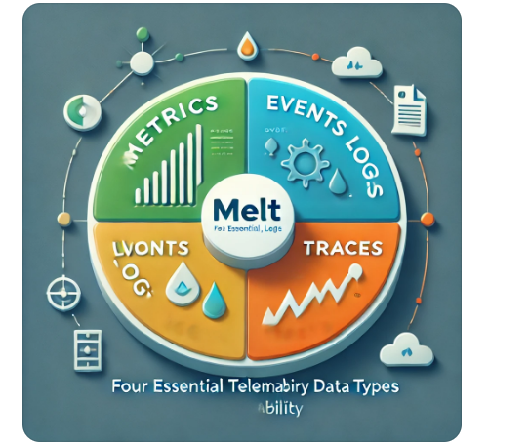
Why MELT Matters?
Helps in detecting performance issues and finding root causes quickly.
Essential for observability in cloud-native, microservices, and distributed systems.
Used in APM tools like Datadog, Prometheus, OpenTelemetry, and Grafana.

Slide 7
Observability Components & Their Roles
Type | Definition | examples
Traces | Shows relationships between events and requests across services | Identifies which application components were involved during a request with an error.
metrics | Quantifiable measurements of system performance. | Throughput, error rate, request rate, request duration
logs | Human-readable records of system activity. | System startup output, process output.

Slide 8
..
Functionality → Need → Ease of Use → Hard to Replicate
The Agent – Collects system metrics, integrates with essential software, and provides a standard interface for applications to send custom metrics.
Integrations – Offers prebuilt integrations to fetch data from nearly all critical services in use.
Events – Consolidates event streams through integrations, allowing filtering and searching as needed.
Dashboards – Enables the creation of dashboards that merge metrics from various sources, allowing transformation and enhanced usability. It also provides an interactive interface for exploring metrics.
Alerting – Features robust stream processing for generating alerts and can surface them in services like PagerDuty and Slack.

Slide 9
What is Datadog?
Datadog is a cloud-based monitoring and observability platform designed to help organizations monitor their applications, infrastructure, logs, and security in real time.
It provides a centralized platform for collecting and analyzing metrics, logs, and traces from various sources, making it a powerful tool for DevOps, SREs, and security teams.

Slide 10
Why Do We Need Datadog?
Unified Monitoring – It integrates with cloud services, containers, databases, and on-prem infrastructure, providing a single pane of glass for monitoring.
Real-time Observability – Helps track application performance, system health, and security events in real time to detect and resolve issues faster.
Prebuilt Integrations – Supports 600+ integrations with cloud providers (AWS, Azure, GCP), databases, Kubernetes, Docker, and third-party tools.
Log Management – Centralizes logs from different sources, allowing search, filtering, and correlation with application performance data.

Slide 11
LAb
Datadog setup

Slide 12
..
Alerting and Automation – Generates intelligent alerts and can integrate with tools like Slack, PagerDuty, and email for incident response.
Security Monitoring – Detects vulnerabilities, security threats, and compliance violations using advanced SIEM (Security Information and Event Management) capabilities.
Scalability – Suitable for small startups to large enterprises, capable of handling vast amounts of telemetry data efficiently.

Slide 13
..
Infrastructure Monitoring (Servers, Kubernetes, Cloud Instances)
Application Performance Monitoring (APM)
Log Management & Analysis
Security Monitoring & Compliance
User Experience Monitoring (RUM, Synthetic Monitoring)

Slide 14
Datadog agent
The Datadog Agent is a lightweight software that runs on hosts (servers, VMs, containers) to collect and report metrics, logs, and traces to the Datadog platform.
It acts as a bridge between your infrastructure and Datadog's cloud-based monitoring system.

Slide 15
Role of datadog agent
Metrics Collection
Gathers system-level CPU, memory, disk, network usage, and process stats.
Collects custom application metrics using DogStatsD.
Supports integration with cloud services (AWS, GCP, Azure) to fetch additional telemetry data.
Log Collection & Forwarding
Collects and forwards logs from applications, system logs, and services.
Supports log processing, filtering, and tagging for better correlation.
Helps in centralized log management and troubleshooting.

Slide 16
..
Distributed Tracing (APM - Application Performance Monitoring)
Captures application traces and spans to monitor request latency and dependencies.
Helps in identifying slow microservices and database queries.
Provides code-level visibility into performance bottlenecks.
Event & Alert Processing
Detects anomalies and incidents in real time.
Triggers alerts based on predefined thresholds.
Supports integration with PagerDuty, Slack, and email notifications.

Slide 17
How the Datadog Agent Works
Installed on a Host or Container – Runs as a service or DaemonSet in Kubernetes.
Collects Data – Captures system, network, logs, and application performance data.
Processes & Tags Data – Enriches data with metadata (tags, labels).
Sends Data to Datadog Cloud – For visualization, analysis, and alerting.

Slide 18
Setup agent
Install datadog on ec2 instance
Collect the monitoring logs

Slide 19
Datadog Synthetic Testing
Datadog Synthetic Testing helps teams proactively monitor application availability and performance by simulating user interactions and API calls. It ensures that websites, APIs, and critical workflows function correctly before users experience issues.
API Tests Monitor API endpoints, uptime, and response timesValidate HTTP requests, SSL certificates, and authenticationDetect latency issues and failures in microservices
Browser Tests Simulate real user interactions (clicks, form submissions, page loads)Detect JavaScript errors, broken UI elements, and slow load timesTest across multiple locations and devices

Slide 20
benefit
Early Issue Detection – Identify problems before they affect users
Continuous Monitoring – Track uptime, performance, and reliability 24/7
Improved User Experience – Ensure fast and error-free web interactions
Global Reach – Test applications from different locations worldwide
Seamless Integration – Works with Datadog dashboards, alerts, and logs

Slide 21
lab

Slide 22
RUM (Real user monitoring)
Real User Monitoring (RUM) is a technology that helps track and analyze how users interact with a web application in real-time. It provides insights into actual user experiences by collecting data directly from users' browsers.
Datadog RUM enables teams to monitor frontend performance, troubleshoot issues, and enhance user experience by capturing user interactions, errors, and performance metrics. It helps teams identify slow pages, JavaScript errors, and network issues before they impact users.

Slide 23
benefits
By monitoring frontend performance, teams can:
Detect and resolve latency issues before users complain
Ensure a smooth user experience across different devices and browsers
Identify and fix JavaScript errors affecting functionality
Improve application performance through data-driven optimizations

Slide 24
lab

