Slide 1
Azure

Slide 2
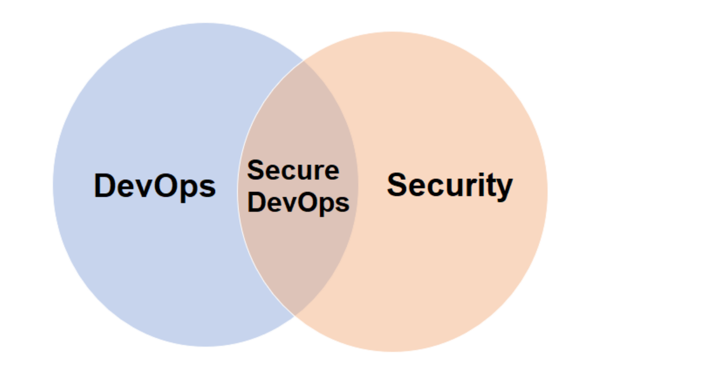
devsecops
Cloud environments brought unprecedented infrastructure and scale to DevOps teams. They can be approached by some of the most nefarious actors on the internet, as they risk the security of their business with every application deployment.

Slide 3
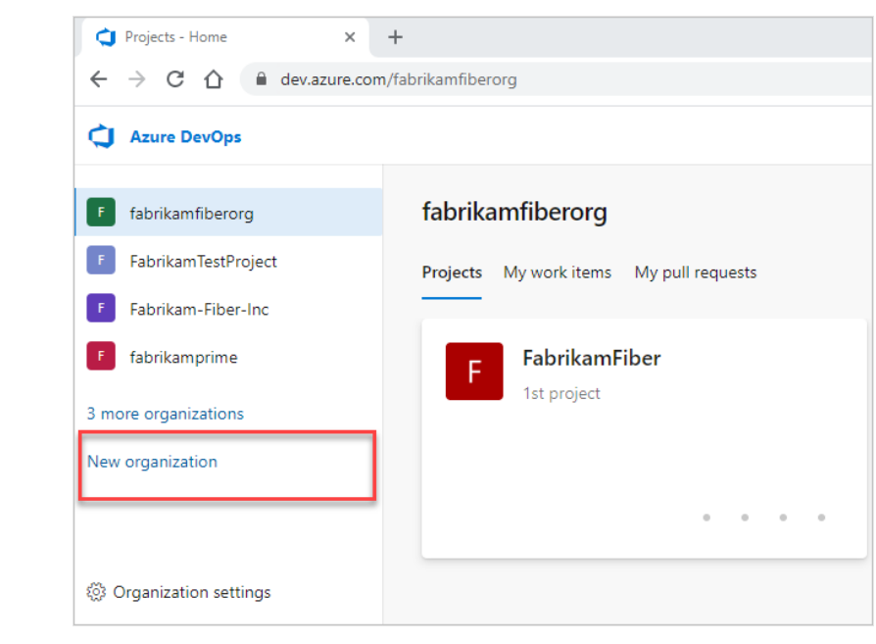
organization
Use an organization to connect groups of related projects and help scale up your enterprise. You can use a personal Microsoft account, GitHub account, or a work or school account.

Slide 4
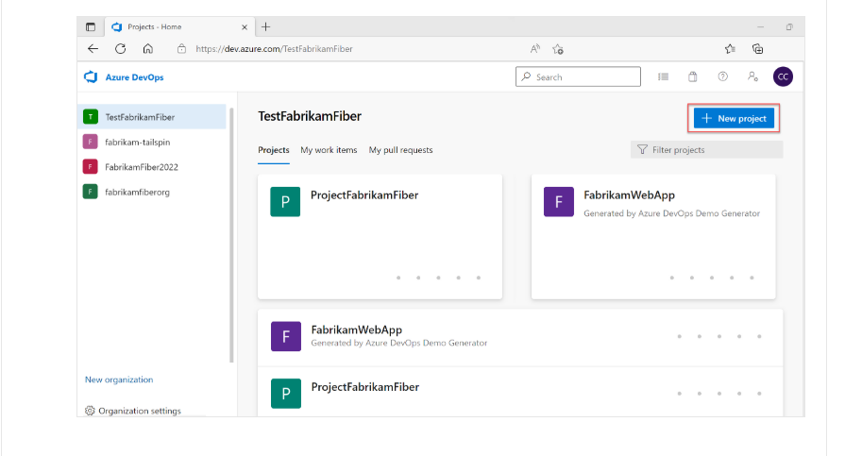
projects
Create an Azure DevOps project to establish a repository for source code and to plan and track work. You can manage and structure your project to support your business needs.

Slide 5
lab
Create organization, project
Map to visual studio
Create git repos

Slide 6
Repository permissions
You can also grant or restrict access to repositories to lock down who can contribute to your source code and manage other features. You can set permissions across all Git repositories by making changes to the top-level Git repositories entry. Individual repositories inherit permissions from the top-level Git Repositories entry.
As with project permissions, you must be a member of the Project Administrators Group or have your Manage permissions set to Allow for Git repositories.

Slide 7
Lab 4

