Slide 1

ENERGY INTELLIGENCE ENGINE
ORBIC
The Energy Intelligence Engine for
Retail Energy Providers
Contract to settlement — one connected platform for ERCOT retail electric providers.
Investor Briefing · Confidential
Notes:
ORBIC is a purpose-built energy intelligence engine for retail energy providers (REPs) operating in ERCOT — not a generic SaaS tool retrofitted for energy. Investor takeaway: this is a single connected platform spanning the entire retail energy lifecycle, from the moment a contract is confirmed through settlement and risk monitoring, with an AI layer operating on top of live data rather than bolted on as a chatbot.

Slide 2
THE PROBLEM
Retail energy providers run on disconnected systems
A typical ERCOT REP stitches together a CRM, a billing vendor, spreadsheets for hedging, and a separate BI tool — none of which share a data model.
Fragmented lifecycle
Manual portfolio risk
Enrollment, billing, and collections live in different systems with no single source of truth for a customer's contract history.
Open position, hedge coverage, and mark-to-market are tracked in spreadsheets, refreshed periodically instead of continuously.
Forecasting blind spots
Operational data buried
Load forecasts are built once and rarely reconciled against what ERCOT actually settles — errors compound silently.
Staff spend hours per day searching multiple screens just to answer routine questions about a customer or an account.
ORBIC
02 / 12
Notes:
Investor takeaway: the pain isn't a missing feature — it's structural fragmentation. Every REP either buys 4-5 point solutions and integrates them poorly, or accepts blind spots in risk and forecasting. That fragmentation is the wedge ORBIC is built to close.

Slide 3
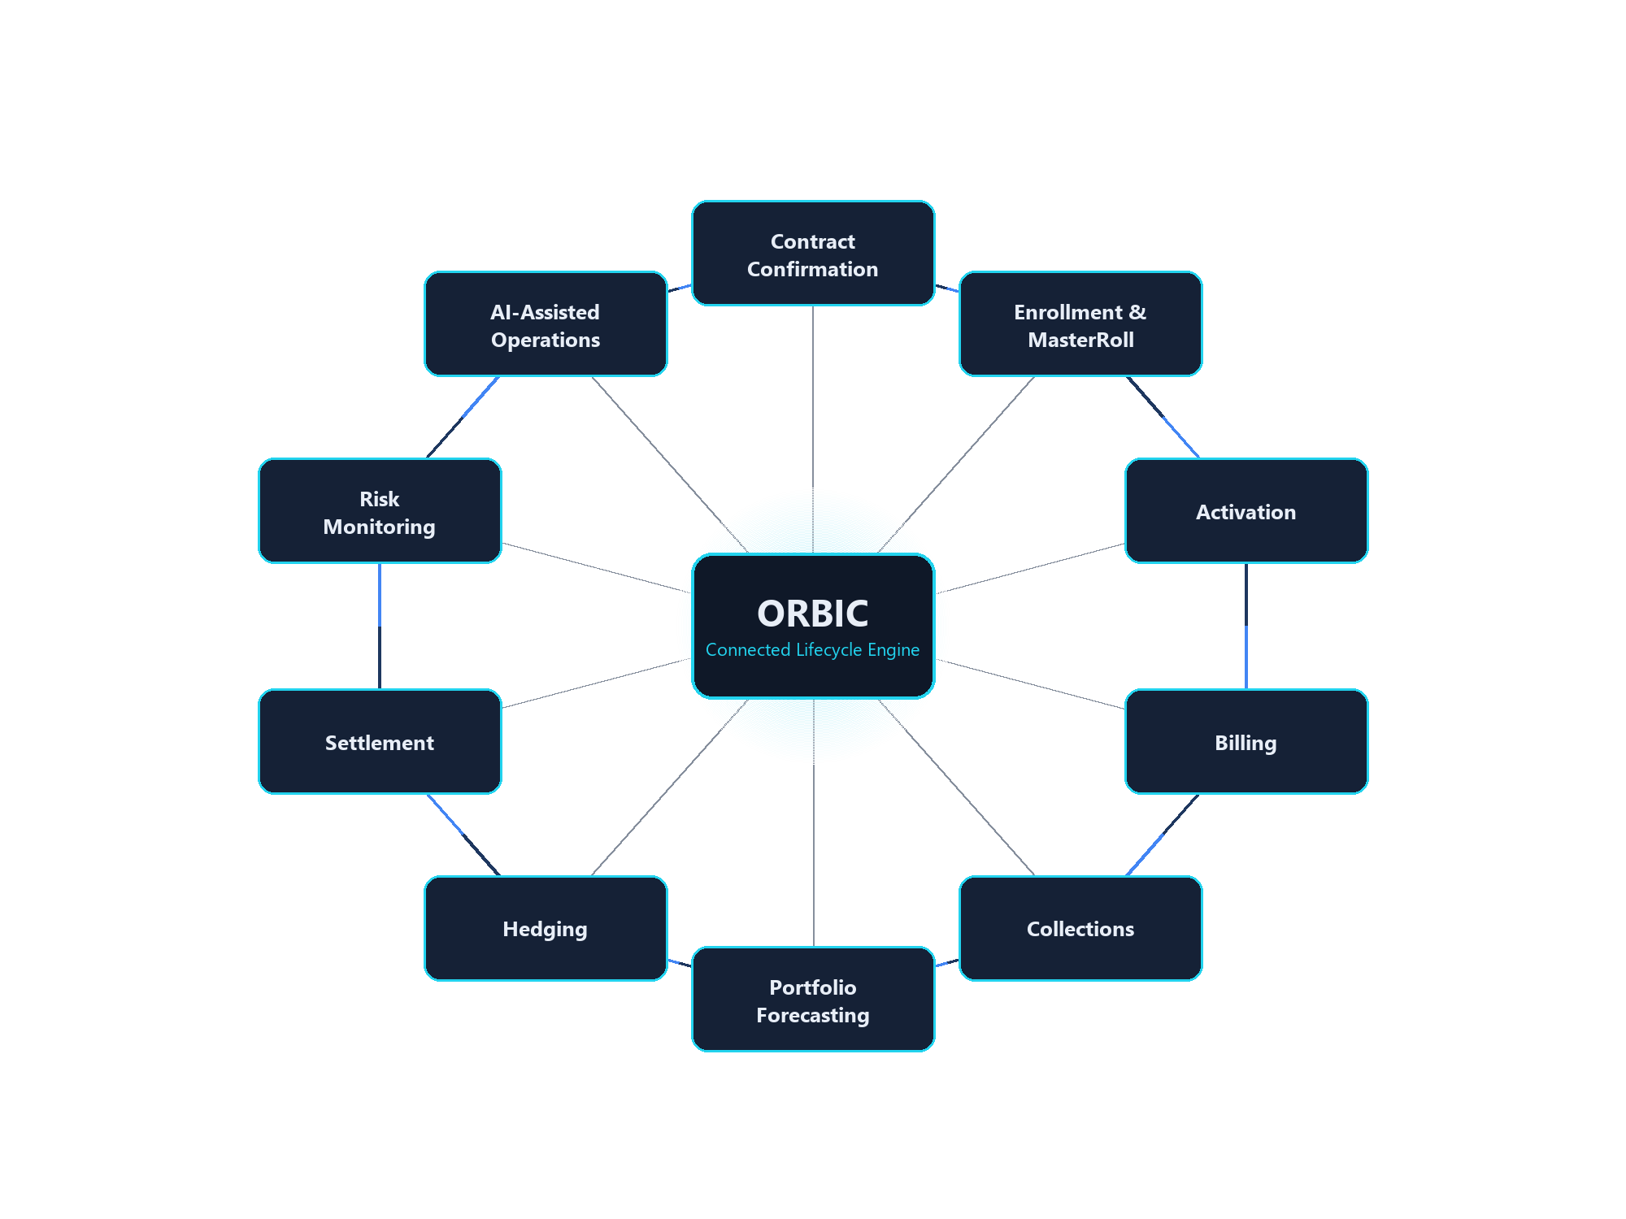
THE SOLUTION
One connected platform for the full retail energy lifecycle
ORBIC
03 / 12
Notes:
ORBIC models the retail energy business as one continuous lifecycle rather than a set of separate modules: contract confirmation flows into enrollment and MasterRoll generation, into activation, into billing and collections, and in parallel drives portfolio forecasting, hedging, settlement, and risk monitoring — with an AI layer that can answer questions across all of it. Investor takeaway: the value isn't any single module, it's that they all read and write the same underlying data.

Slide 4
WHY ORBIC IS DIFFERENT
Not a CRM. Not a billing tool. Not a chatbot bolted onto a dashboard.
A generic CRM
Tracks contacts and deals — has no concept of ERCOT contract types, MasterRoll generation, or TDSP switch rules.
A billing platform
Processes charges — has no visibility into open position, hedge coverage, or forecast risk driving those charges.
A BI dashboard
Visualizes historical data — has no forecasting engine, no self-healing checkpoints, and can't take action.
A standalone AI chatbot
Answers from a static knowledge base or general training data — has no live connection to a REP's actual accounts, pricing, or positions.
ORBIC is the operational system of record — the AI agent and every module act on the same live contracts, positions, and prices.
ORBIC
04 / 12
Notes:
Investor takeaway: ORBIC's differentiation isn't a feature list — it's that one connected data model underlies enrollment, billing, portfolio, risk, and the AI agent. Competitors are point solutions; ORBIC is the system of record those point solutions would otherwise need to integrate with.

Slide 5
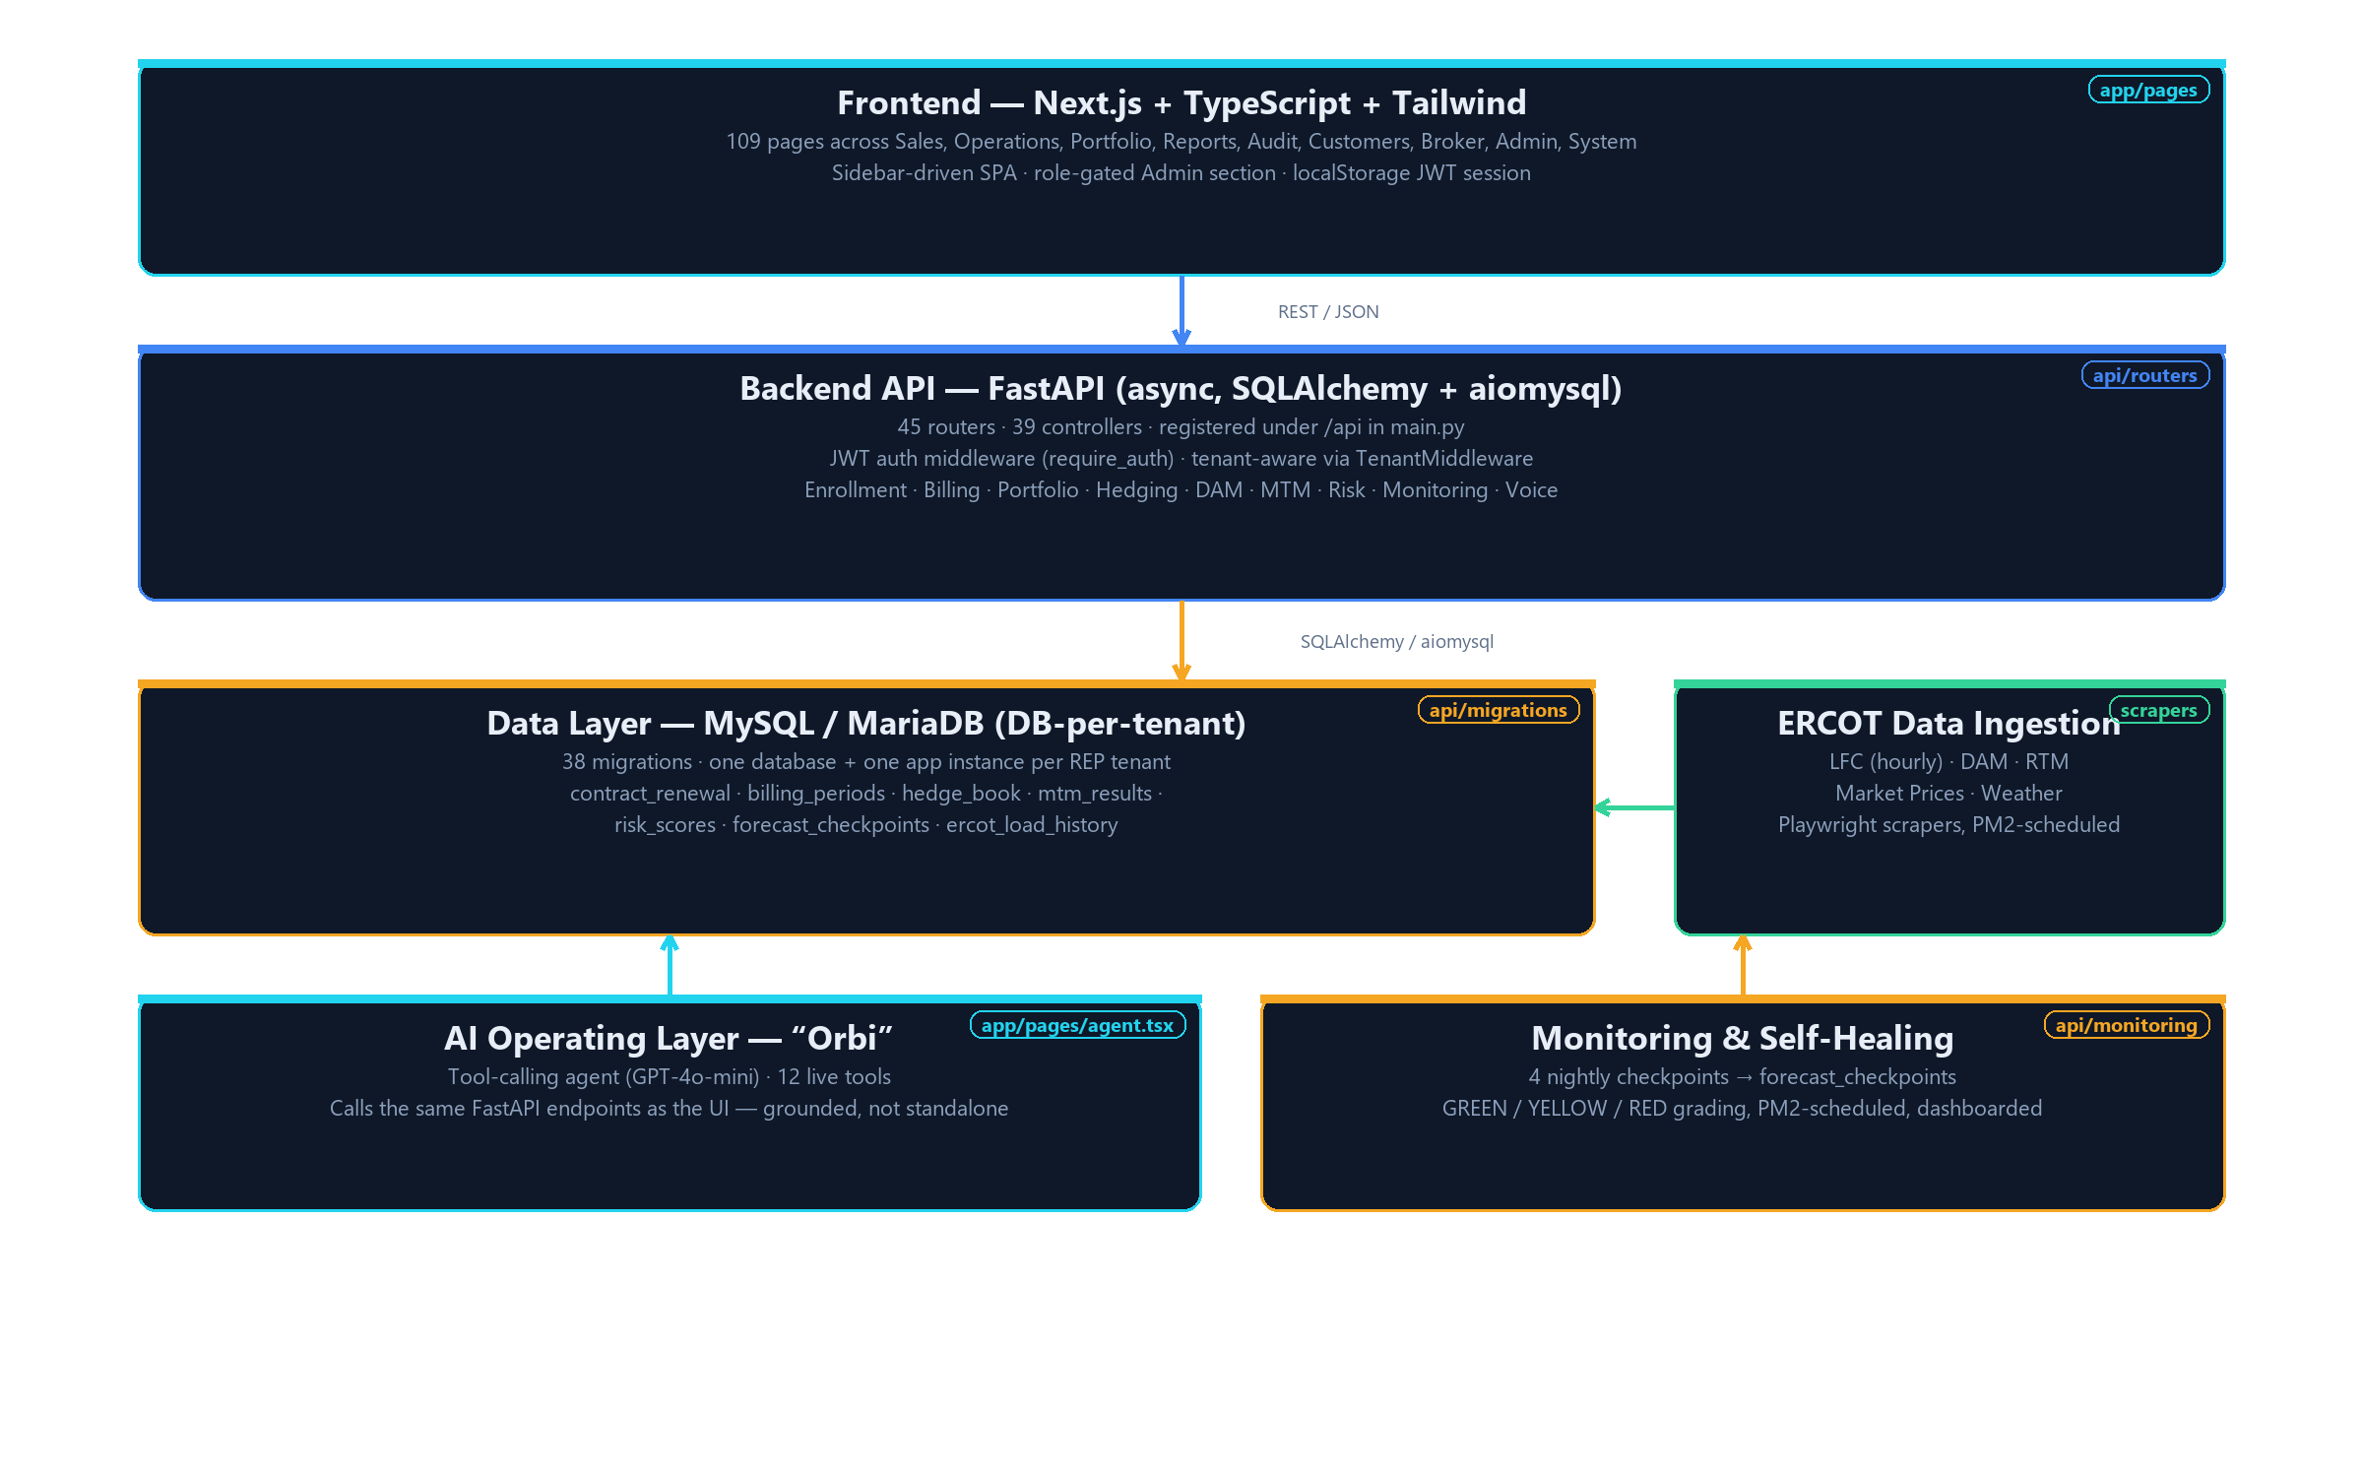
APPLICATION ARCHITECTURE
A modern, tenant-isolated technology stack
109
Frontend pages
45
API routers
39
Controllers
38
DB migrations
ORBIC
05 / 12
Notes:
Investor takeaway: this is a real, sizable codebase — 45 API routers and 109 frontend pages — not a prototype. Each REP tenant runs its own isolated database and app instance (confirmed via TenantMiddleware and the tenant provisioning script), which is a meaningful data-isolation and compliance story for enterprise energy customers.

Slide 6
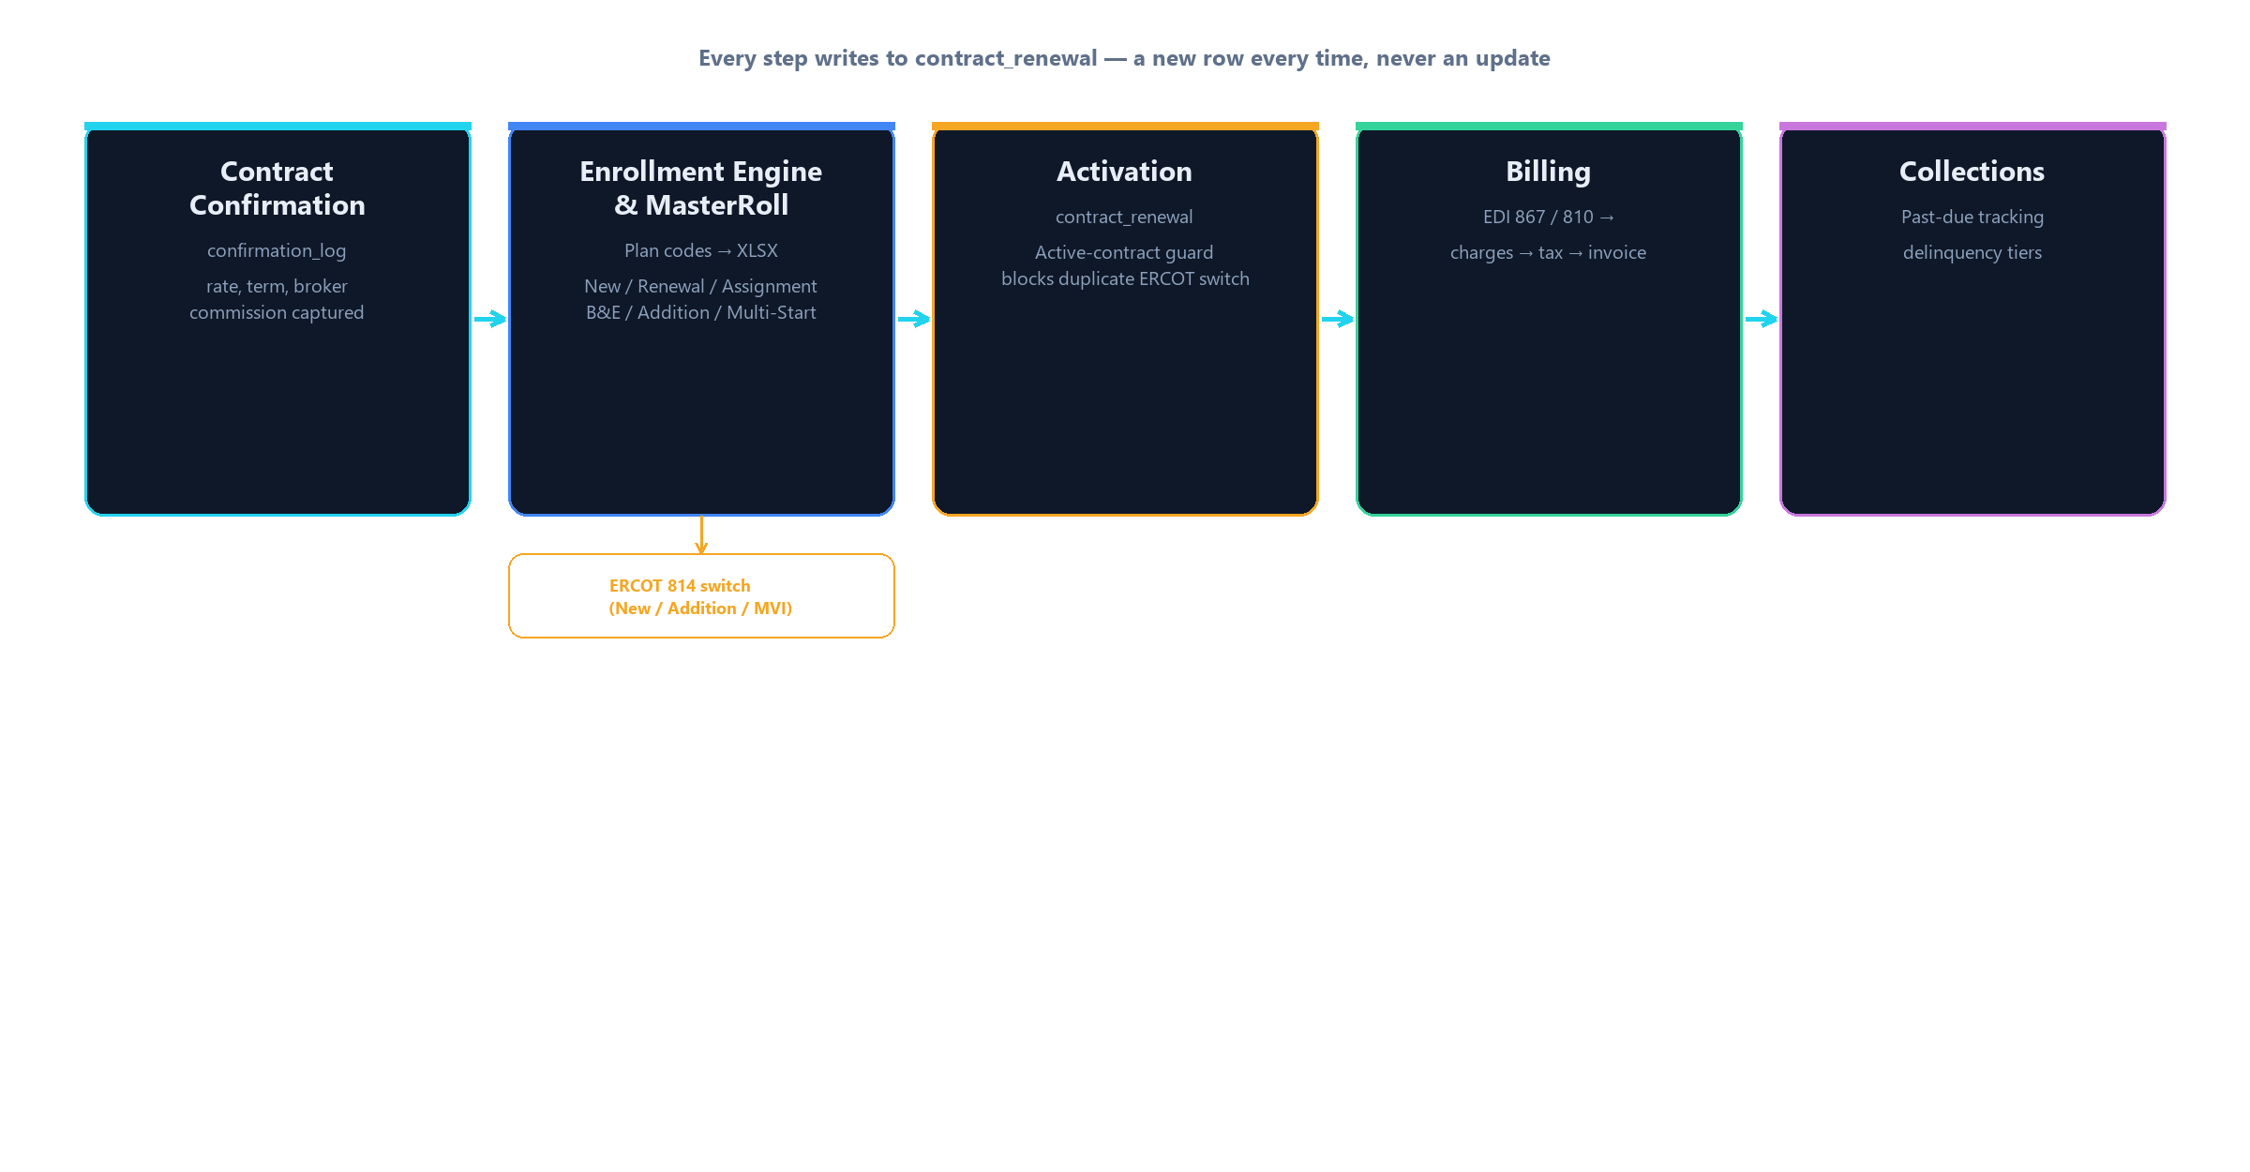
CUSTOMER & CONTRACT LIFECYCLE
From confirmation to collections — one auditable chain
BUILT
Enrollment Engine, MasterRoll, Activation, Billing pipeline
ROADMAP
Enrollment-time county/exemption capture
ORBIC
06 / 12
Notes:
Investor takeaway: the enrollment engine supports six real ERCOT contract types (New, Renewal, Assignment, B&E, Addition, Multi-Start) with active-contract guard rules, generates a 128-column MasterRoll file, and activation writes directly into contract_renewal — the single source of truth. The billing engine's EDI 867/810 ingestion, tax computation, and invoice generation are built and verified against real data. One open item: county/exemption capture at enrollment time is not yet built.

Slide 7
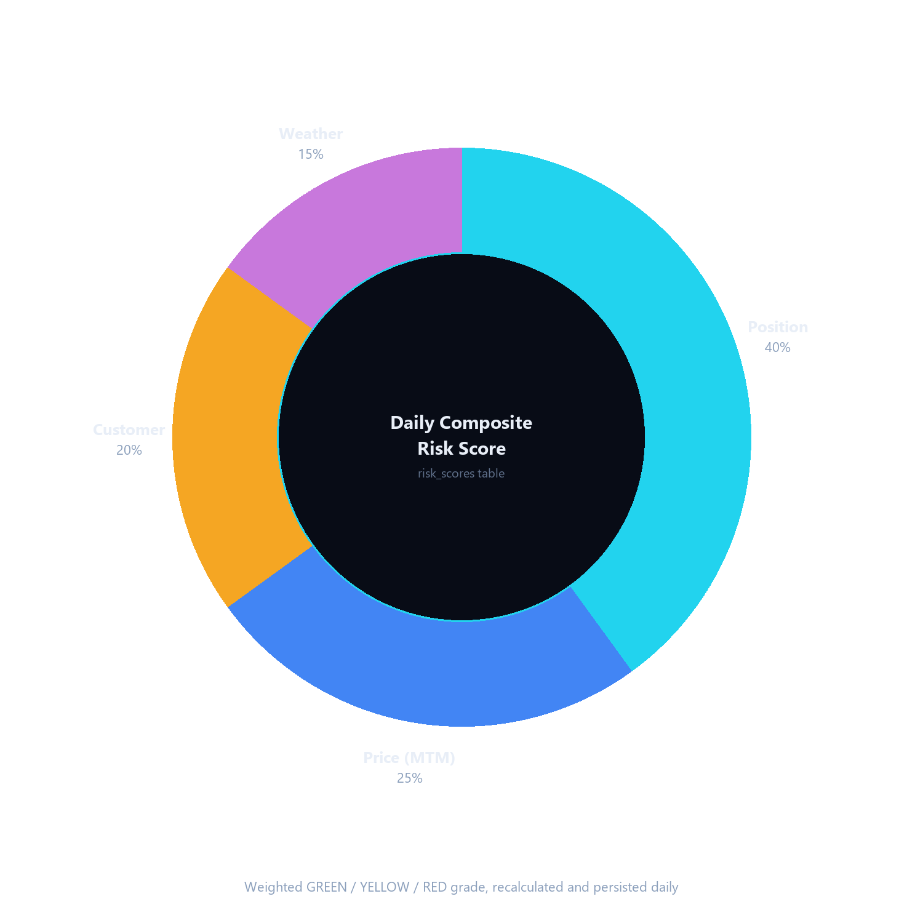
PORTFOLIO & RISK INTELLIGENCE
A daily, weighted view of portfolio risk
Position Risk — 40%
Forecast load vs. hedged supply, evaluated across four time horizons.
BUILT
Price Risk — 25%
Mark-to-market P&L computed from the hedge book against market prices.
BUILT
Customer Risk — 20%
Collections delinquency exposure across the active customer base.
BUILT
Weather Risk — 15%
Near-term load forecast compared against prior-year actuals.
BUILT
ORBIC
07 / 12
Notes:
Investor takeaway: this Risk Assessment Dashboard is one of the most recently shipped features (verified via git history) — a real 4-factor weighted engine, not a mockup. Position, price, customer, and weather risk are each computed from live tables (hedge_book, mtm_results, collections, load forecasts) and rolled into one daily GREEN/YELLOW/RED score persisted to risk_scores. This turns portfolio risk from a periodic spreadsheet exercise into a live, always-current signal.

Slide 8
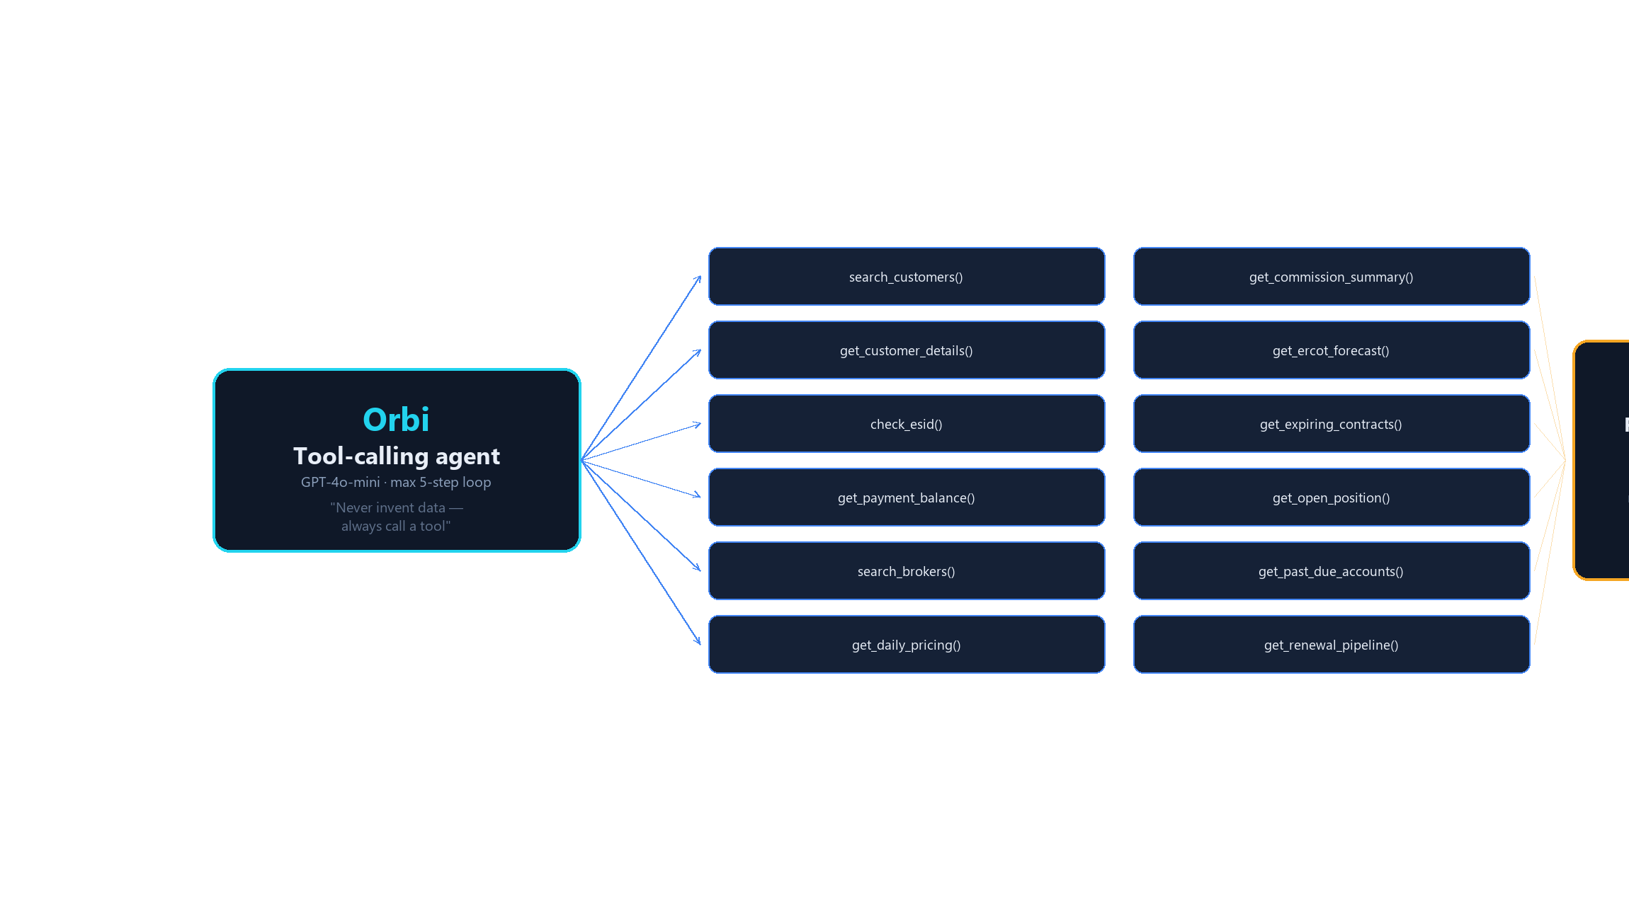
AI OPERATING LAYER
Orbi: an agent grounded in live operational data
BUILT
12 live tool-calling functions against production FastAPI endpoints
ORBIC
08 / 12
Notes:
Investor takeaway: Orbi is not a chatbot with a system prompt and hope — it's a tool-calling agent (OpenAI GPT-4o-mini) with 12 real functions (search_customers, get_open_position, get_ercot_forecast, get_past_due_accounts, and more) that call the exact same FastAPI endpoints the UI uses. Its system prompt explicitly instructs it to never invent data and always call a tool. This is what makes it an operating layer on top of ORBIC's data, not a separate product.

Slide 9
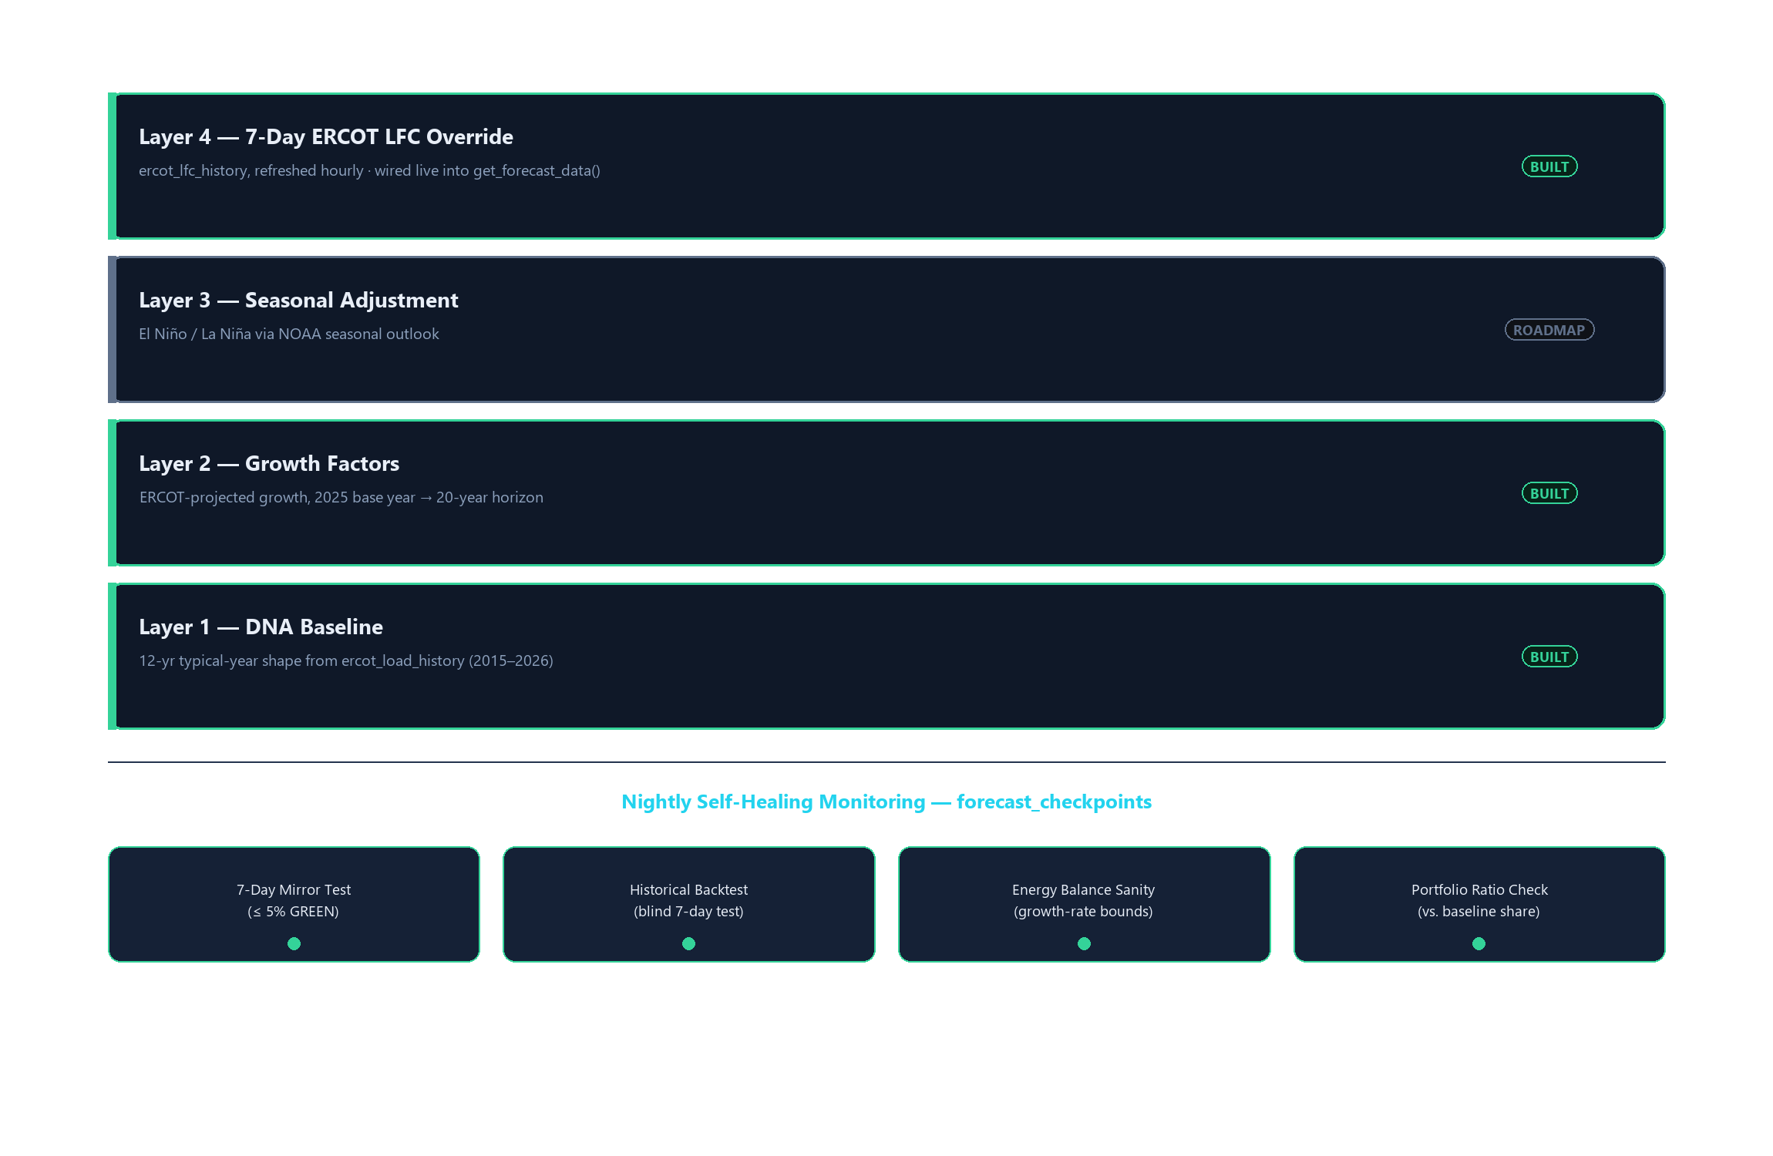
FORECASTING & MONITORING ADVANTAGE
A layered forecast engine that checks its own work
ORBIC
09 / 12
Notes:
Investor takeaway: three of four forecast layers are built and live — including Layer 4, the 7-day ERCOT LFC override, which is wired directly into the production forecast path used by the Position Screen today. Layer 3 (NOAA seasonal El Niño/La Niña adjustment) is explicitly roadmap, not yet built — we are not claiming it as complete. On top of the forecast itself, four nightly self-healing checkpoints (7-Day Mirror Test, Historical Backtest, Energy Balance Sanity, Portfolio Ratio Check) continuously grade forecast quality and persist results — this automatic quality control is a meaningful differentiator most REP forecasting tools don't have.

Slide 10
CURRENT PRODUCT MATURITY
What's built, what's operational, what's next
Enrollment Engine & MasterRoll
BUILT
Billing Engine (EDI ingestion → tax → invoice)
BUILT
Contract Activation & Guard Rules
BUILT
Portfolio / Hedging / DAM Purchases
BUILT
Manual Mark-to-Market (MTM)
BUILT
Risk Assessment Dashboard (4-factor)
BUILT
Forecast Layers 1, 2 & 4 (DNA, Growth, LFC Override)
BUILT
Self-Healing Monitoring (4 nightly checkpoints)
BUILT
Orbi AI Agent (12 live tools)
BUILT
Enrollment-time county / exemption capture
ROADMAP
Forecast Layer 3 — NOAA seasonal adjustment
ROADMAP
Live MTM market-price feeds (CME / ICE / Bloomberg)
ROADMAP
Settlement reconciliation (3-way match)
ROADMAP
ORBIC
10 / 12
Notes:
Investor takeaway: this is a candid maturity snapshot, not a sales sheet — nine capabilities are built and operational today across enrollment, billing, portfolio, risk, forecasting, monitoring, and AI. Four specific items are explicitly labeled roadmap and are not claimed as complete: county/exemption capture at enrollment, NOAA seasonal forecast adjustment (Layer 3), live MTM market-price feeds, and full settlement reconciliation.

Slide 11
TARGET CUSTOMERS & BUSINESS MODEL
Built for licensed retail electric providers in ERCOT
Who ORBIC serves
How ORBIC is delivered
Licensed Retail Electric Providers (REPs) operating in the ERCOT market
Multi-tenant architecture: one isolated database and app instance per REP tenant, provisioned via a repeatable onboarding script
REPs currently running enrollment, billing, and portfolio tracking across disconnected point solutions and spreadsheets
Platform model: the same enrollment, billing, portfolio, and AI modules serve every tenant, with tenant-specific data fully isolated
Growing REPs that need portfolio and risk visibility without building an in-house engineering team
Deployment is verified and repeatable (provision_tenant.py), which is the operational foundation for onboarding additional REPs
ORBIC
11 / 12
Notes:
Investor takeaway: we are deliberately not citing market-size, revenue, or customer-count figures here — none are verified yet. What is verified is the architecture: a real, scripted, DB-per-tenant provisioning path (api/scripts/provision_tenant.py) that is the operational basis for a multi-tenant SaaS business model serving licensed ERCOT REPs.

Slide 12
LONG-TERM VISION
The energy intelligence engine
for every retail energy provider
Complete the forecast stack
Deepen the risk & settlement layer
Ship Layer 3 seasonal adjustment and live MTM market-price feeds to close the remaining roadmap items.
Extend risk monitoring toward full settlement reconciliation and richer historical analysis.
Scale the AI operating layer
Onboard additional REP tenants
Grow Orbi's tool coverage as new modules ship, keeping every answer grounded in live tenant data.
Use the existing provisioning path to bring on new licensed ERCOT retail providers.
ORBIC
12 / 12
Notes:
Investor takeaway: the vision is a natural extension of what's already built — completing the forecast and settlement stack, scaling the AI layer as new modules ship, and onboarding additional REP tenants onto the existing multi-tenant provisioning path. No revenue, market-size, or customer projections are asserted here, consistent with using only verified claims throughout this deck; those figures belong in a dedicated financial model reviewed separately with the team.

