Slide 1
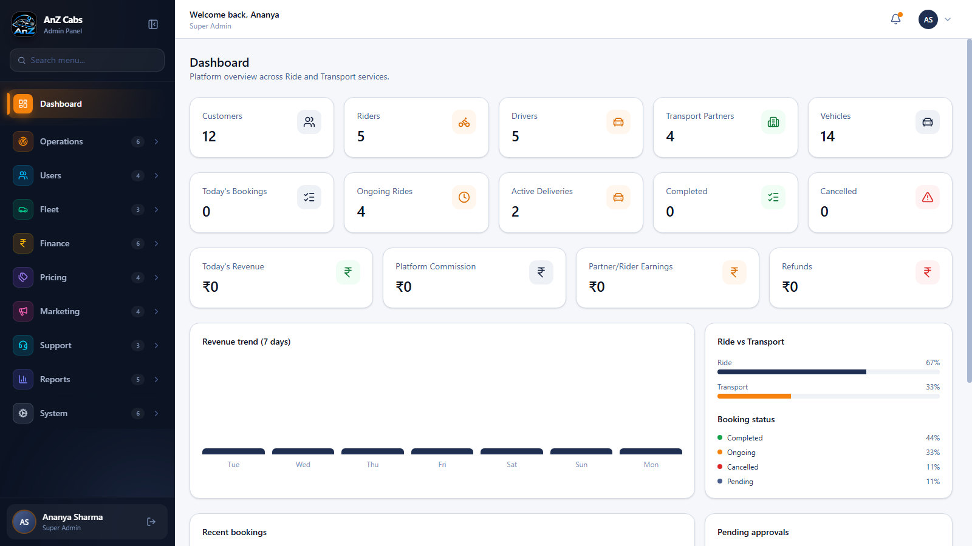
ANZ CABS / RIDE + TRANSPORT
Ride & Transport
Admin Platform
A visual walkthrough of the browser-based control center
Operations, users, fleet, finance and platform controls
ADMIN WEB UI • SCREENSHOTS CAPTURED FROM THE RUNNING APP
01

Slide 2
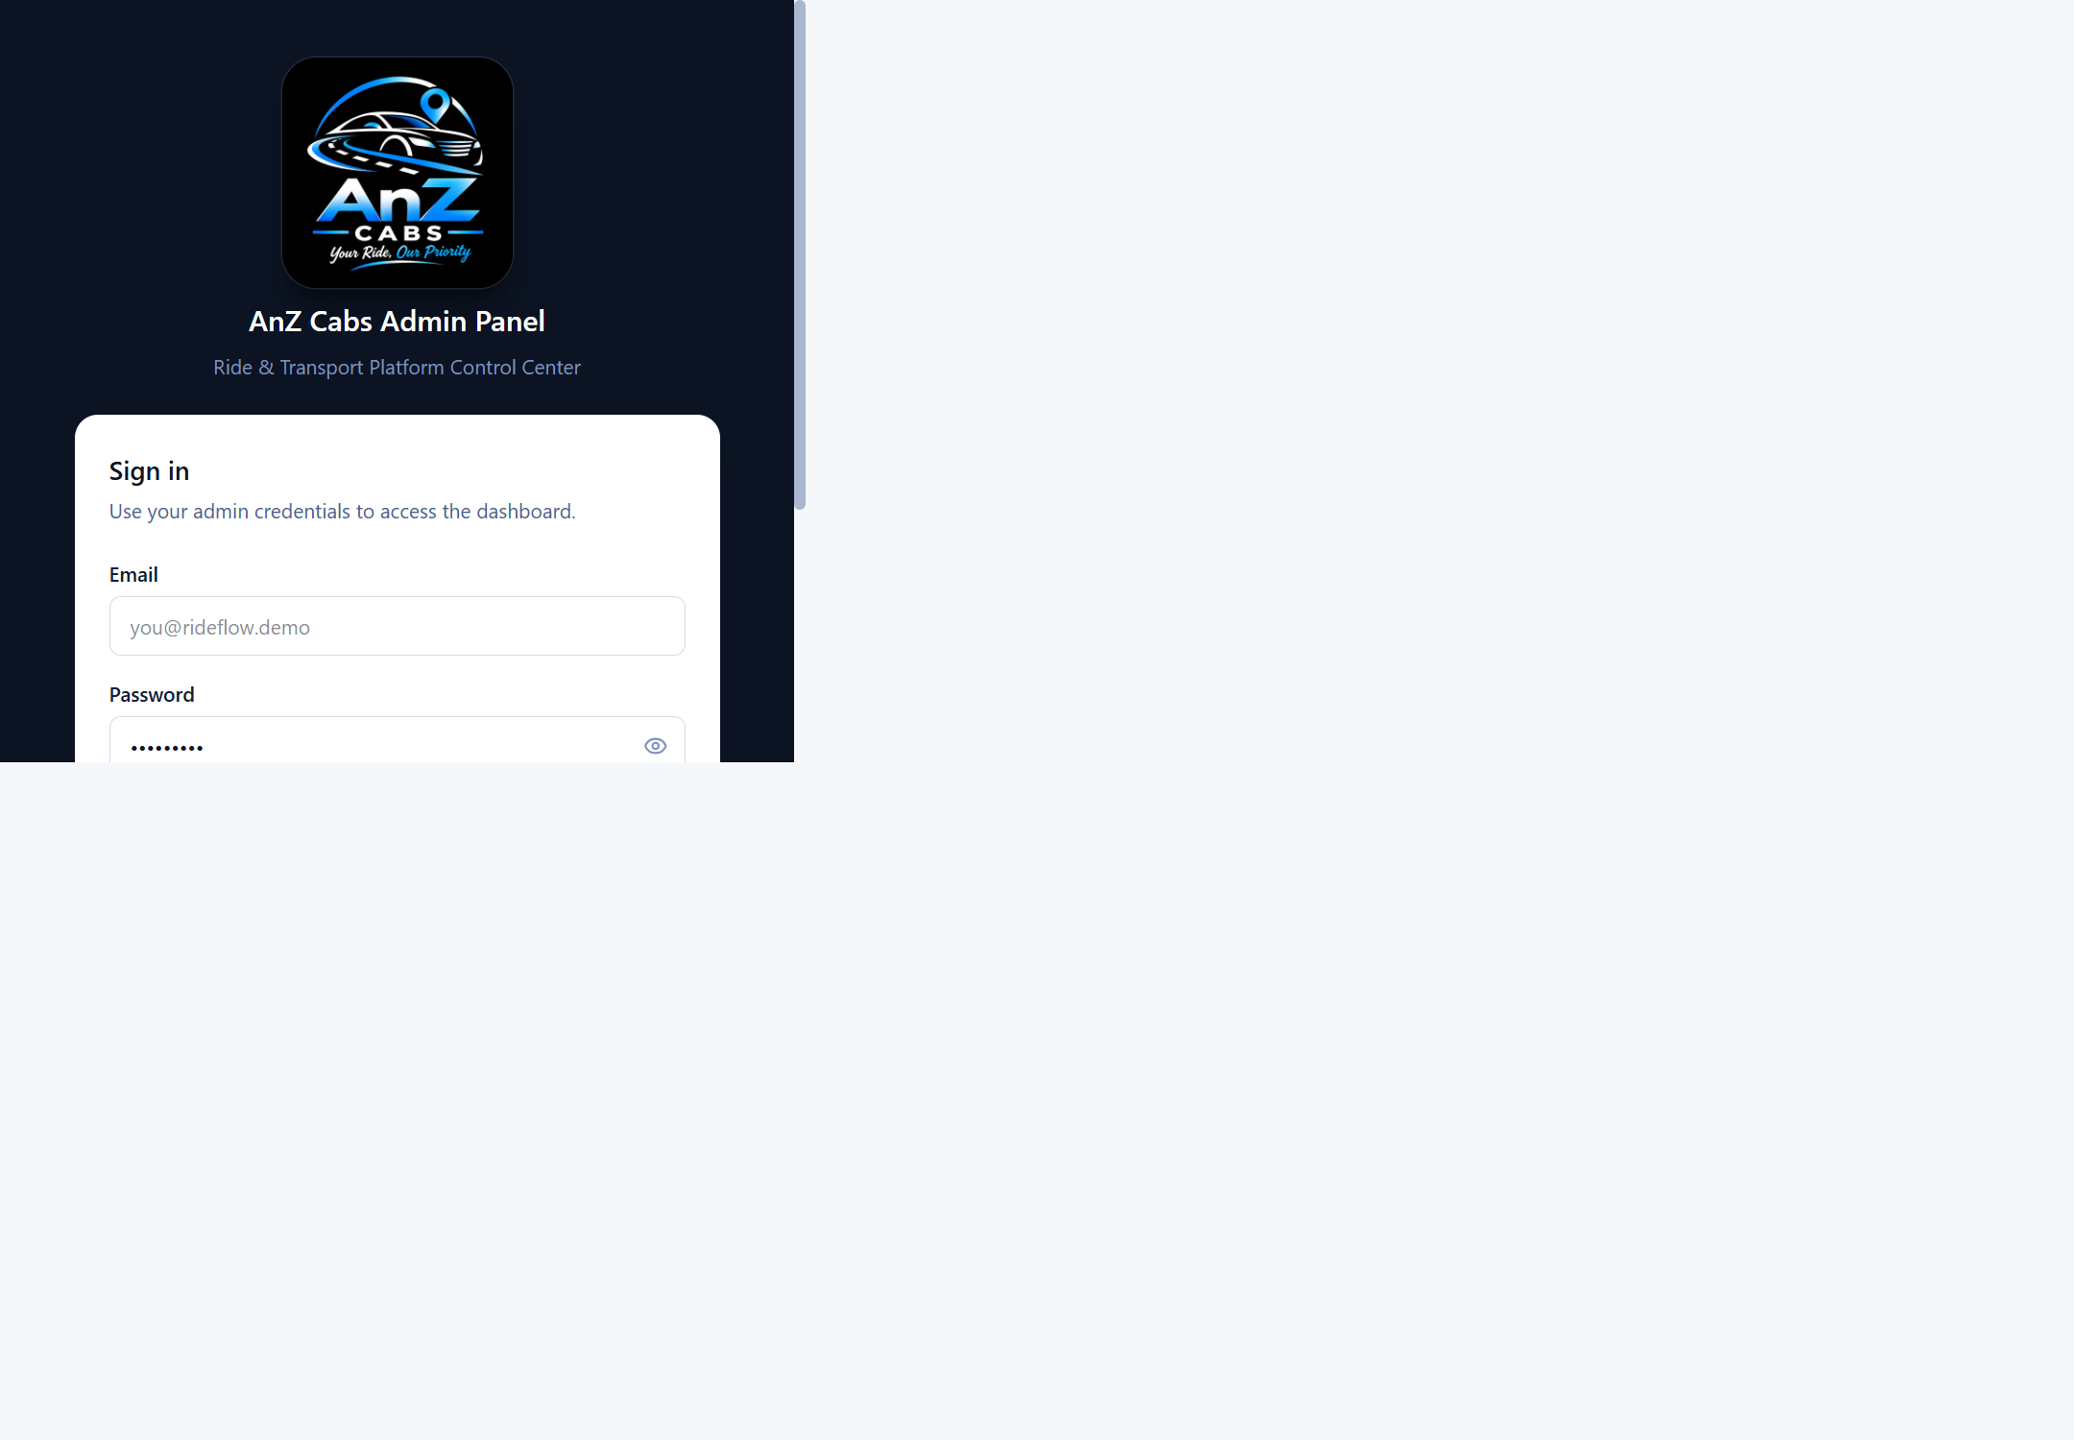
Admin web frontend
A dedicated sign-in flow protects the operations console.
Two-step sign-in
1 Enter an admin email and password
2 Verify the one-time code sent to the admin phone
Development mode displays the OTP in the UI for demo access.
Role-based access is enforced by the API.
ANZ CABS | RIDER & TRANSPORT PLATFORM
02

Slide 3
Operations dashboard
Live overview across Ride and Transport services
ANZ CABS | RIDER & TRANSPORT PLATFORM
03

Slide 4
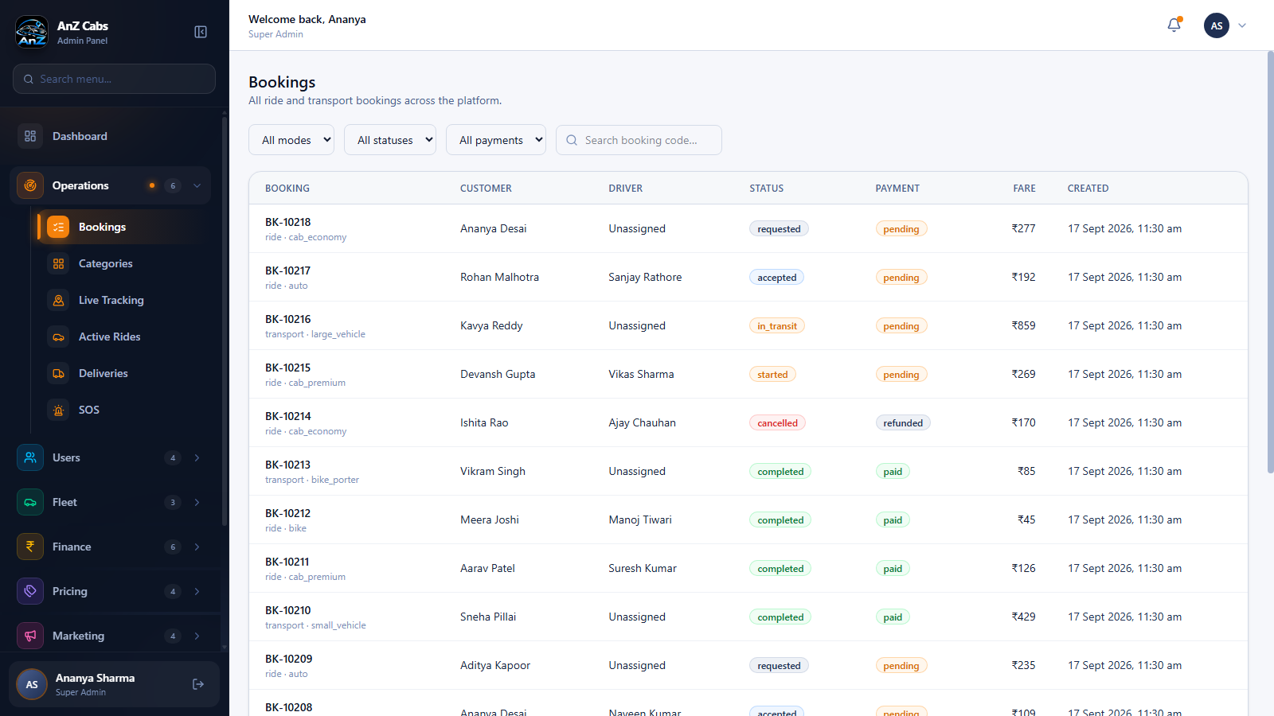
Bookings & service operations
Manage booking workflows, active services and exceptions
ANZ CABS | RIDER & TRANSPORT PLATFORM
04

Slide 5
Platform capabilities
A single admin console covers the main operational domains.
OPERATIONS
USERS & FLEET
Bookings • categories • live tracking
Active rides • deliveries • SOS
Customers • riders • drivers • partners
Vehicles • documents • approvals
FINANCE & PRICING
MARKETING & SUPPORT
Payments • wallets • commissions
Refunds • settlements • fare rules
Coupons • offers • notifications
Complaints • tickets • ratings
REPORTS
SYSTEM & GOVERNANCE
Booking • revenue • rider • partner
Financial reports and CSV export
Admin roles • CMS • service areas
Settings • audit logs
ANZ CABS | RIDER & TRANSPORT PLATFORM
05

Slide 6
App scope & local run
What this repository contains
INCLUDED
NOT INCLUDED IN THIS REPOSITORY
• Browser-based admin frontend
• Admin REST API: /api/v1/admin/*
• Mobile-client API routes: /api/v1/app/*
• MongoDB-backed dashboard and modules
No separate customer-facing website or mobile app screens are present here. The app-facing API is available for client applications; their UI belongs to a separate project.
LOCAL SERVICES
This walkthrough shows the available admin experience—not a mock customer app.
Frontend http://localhost:5180
API http://localhost:5050
MongoDB 127.0.0.1:27017
ANZ CABS | RIDER & TRANSPORT PLATFORM
06

