Slide 1

Credit Card Fraud Detection
Presenter : Amit Padgaonkar

Slide 2
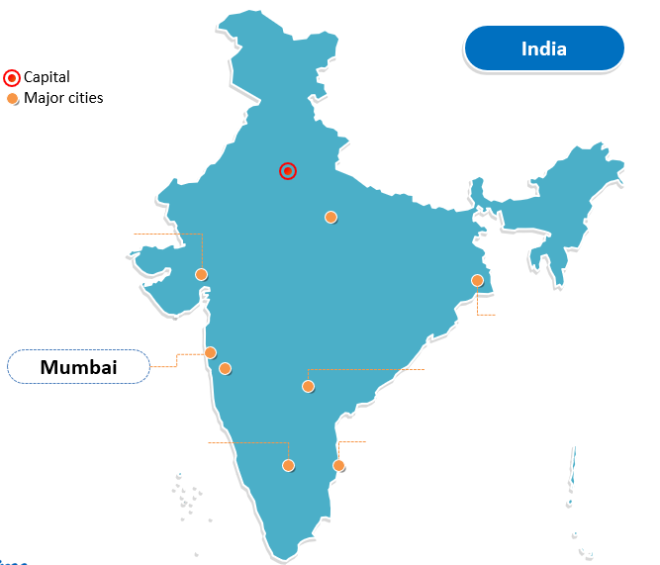
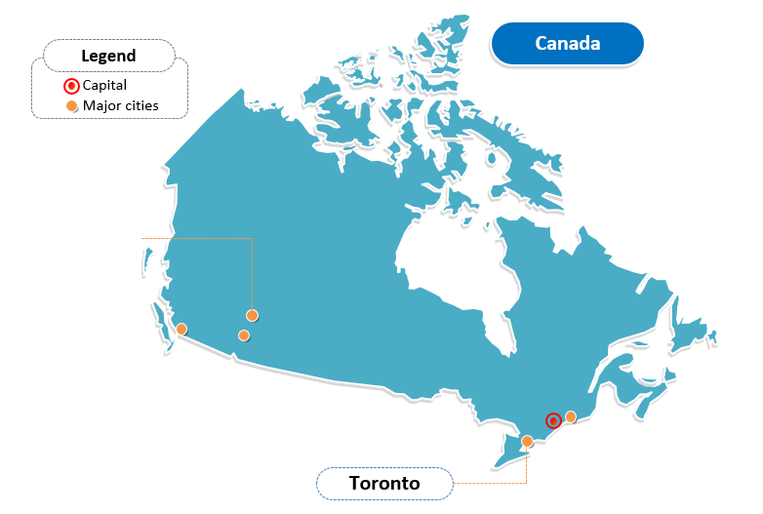
About Me
Born And Brought Up In Bombay, India
Bachelors Degree In Engineering From Bombay University
Software Developer/Consultant For 15 Years
Canadian Citizen Presently Living In Toronto
Pursuing Data Science Specialization at UCR

Slide 3
About the Project

Slide 4
Prevent Credit Card Fraud
Credit Card Fraud happens when Card is Used for Unauthorized Transactions
Billions of Dollars are Lost Every Year
Results in
Financial Loss
Loss of Trust in Financial Institutions [1]
Goals of this Project are
Explore Different ML Algorithms that can be Used
Create Effective Model(s) using the Fraud Dataset on Kaggle

Slide 5
About the Dataset

Slide 6
About the Dataset
Provided by Université Libre de Bruxelles on Kaggle [2]
Transactions Made by European Cardholder in 2 Days of 2013
Contains 284,407 Credit Card Transactions
Dataset already Pre-Processed
With Principal Component Analysis
All Features are Numeric
All Features Except Class, Time & Amount are Anonymized

Slide 7
Exploratory Analysis

Slide 8
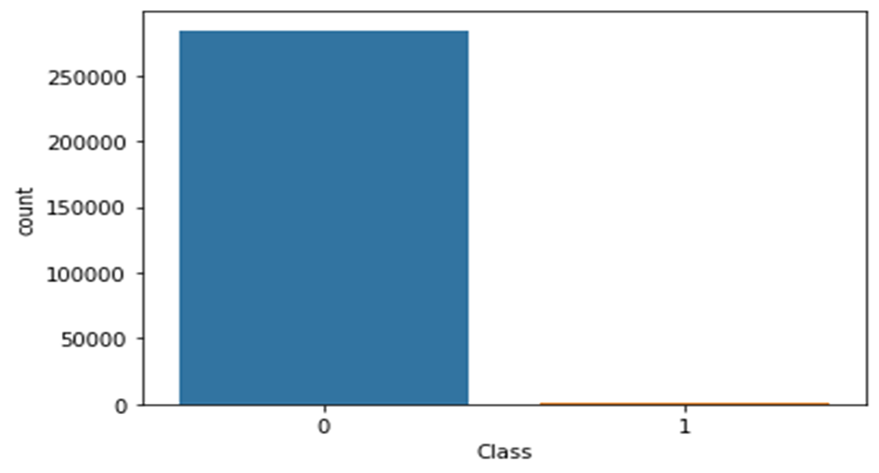
Exploratory Analysis
Dataset has 284,407 Rows and 31 Columns
All the Features are Numeric
Saves Time from Text to Numeric Conversion
Target Variable is Class
Class Value 1 for Fraudulent Transactions
Class Value 0 for Non-Fraudulent Transactions
Distribution of Data Across Target Variables
Total | Fraudulent | Legitimate
284,407 | 492 | 284,315

Slide 9
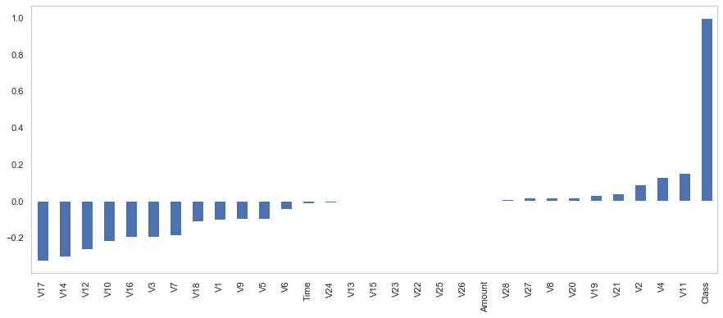
Exploratory Analysis
Only 0.172% of the Transactions are Fraudulent
This is a HEAVILY Imbalanced Dataset
Correlation of Dataset to Target Variable
Distribution of Variables V22, V25, V26

Slide 10
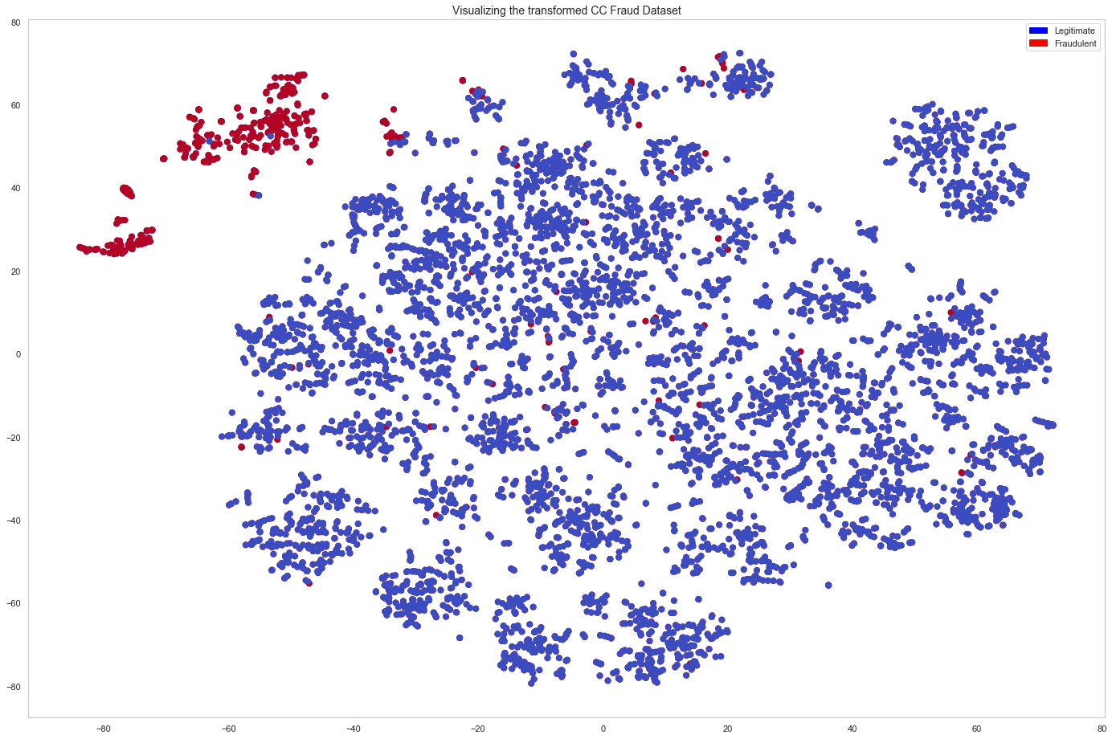
Exploratory Analysis
Visualization of the Dataset
Dataset has 31 Dimensions
Difficult to Render in 2 or 3 Dimensions
We Use T-SNE Technique to Overcome this Limitation [3]
Plot Data in 2-Dimesions with about 2% of Legitimate Transactions
We Can Clearly See the Clusters of Fraudulent & Legitimate Transactions
We Can also See Blue & Red Dots Interspersed with
Each Other
About 10-20% of Fraudulent Transaction will Present
Challenges

Slide 11
Challenges

Slide 12
Challenges
Futility of Traditional Algorithms
Most ML Algorithms don’t Work with Imbalanced Data [4]
Most ML Algorithms Simply Ignore Minority Class Data [5]
We will Need to Select Appropriate Algorithm for this Problem
Right Metric for Evaluation
Even with No-Skill We Can have High Accuracy for this Problem
However, Accuracy would be Incorrect Metric
Suitable Metric for this Problem would be AUC_ROC, Recall etc. [6]

Slide 13
Challenges
Lack of Data for Minority Class
Only 492 Fraud Class Transactions
Not Sufficient Data for Algorithms to Learn
Need to Find Ways to Bring Balance to Our Dataset [7]
Perfect Segregation of Fraudulent Transactions Very Difficult
T-SNE Visualization Showed Interspersed Red & Blue Dot within Clusters
Identifying All Fraudulent Transactions Difficult

Slide 14
Data Pre-Processing

Slide 15
Data Pre-Processing
Exclude Insignificant Columns
V22, V25 & V26 have No Impact on Target Variable
We will Drop these Columns
Use Logarithmic Scale for Amount Class
Stratified Data Sampling
Very Few Minority Class Data Samples
Regular Random Splitting May Leave No Fraud Class Samples for Test
To Maintain Proportionate Distribution in Train & Test Set
 | Train | Test
Legitimate (Class 0) | 199020 | 85295
Fraudulent (Class 1) | 344 | 148
Use Stratified Data Sampling [8]
After 70/30 Split Dataset Looks Good

Slide 16
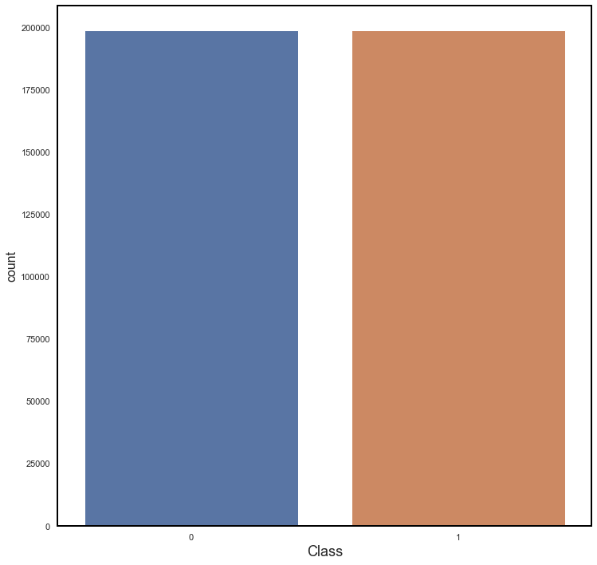
Data Pre-Processing
Scaling the Dataset
Standardize the Data with StandardScaler
StandardScaler Transforms Data with Mean 0 and
Standard Deviation [9]
Oversampling of Minority Class Data
Increase the Minority Class Samples with Oversampling [10]
Consider Synthetic Minority Oversampling TEchnique (SMOTE)
Use SVMSMOTE, an Extension of SMOTE
Use SVM to Generate Borderline Minority Class Instances [11]
With SVMSMOTE, We have Equal Counts of Minority & Majority
Class

Slide 17
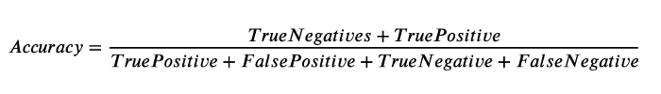
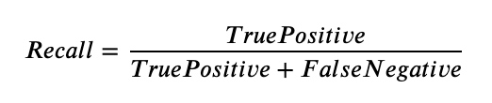
Performance Evaluation Metrics
Most Metrics Become Unreliable for Imbalanced Data
Even a No-Skill Algorithm Can have High Accuracy
Algorithm with Higher Fraud Detection will Tend to Reject a Lot of Legitimate Transactions
Goal is to have High Accuracy along with High Identification of Fraud
Right Metrics for Our Purposes would be
Accuracy - Legitimate Transactions should Flow through Smoothly
Recall - Identify High Number of Fraudulent Transactions
ROC-AUC - Ability of Algorithms to Distinguish between Classes [12]

Slide 18
New Suitable Algorithms

Slide 19

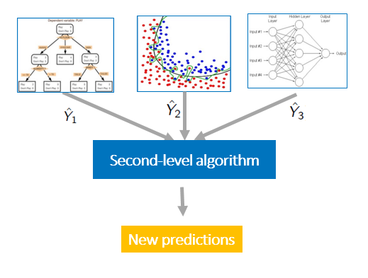
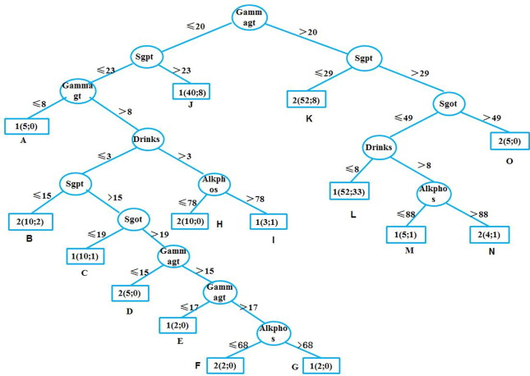
New Suitable Algorithms
Most Algorithms Assume that All Misclassification Errors are Equal
However, for Our Dataset Identifying Fraud is More Important
Traditional Algorithms such as SVM, KNN do NOT Provide Options for Fine-Tuning
For Our Dataset, We will Consider 2 Types of Algorithms
Ensemble Algorithms
They Enhance ML by Combining Several Model [13]
Cost-Sensitive Algorithms
They Take into Account Cost of Predicting Different classes [14]

Slide 20
Ensemble Algorithms

Slide 21
Balanced Bagging Classifier
Ensemble Machine Learning Algorithm
Selects Random Samples from Dataset with Replacement
Creates Multiple Weak Learners, One from Each Sample
Applies Data Sampling on Bootstrap Sample Prior to Fitting Weak Learners
Uses Random Undersampling to Balance the 2 Classes
Random Undersampling is Controlled by HyperParameter sampling_strategy

Slide 22
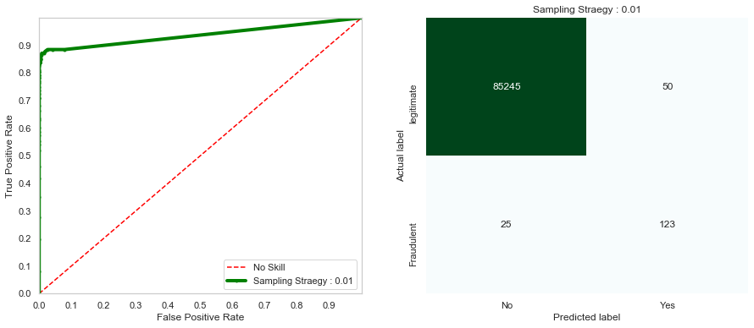
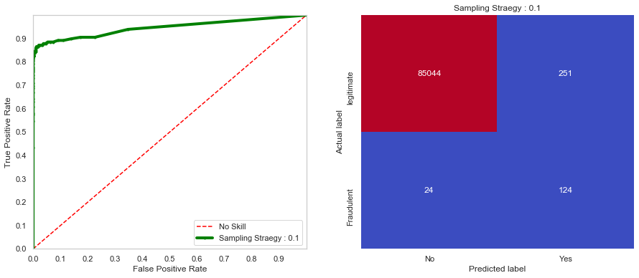
Balanced Bagging Classifier
Results
Sampling Strategy = 0.01
Sampling Strategy = 0.1

Slide 23
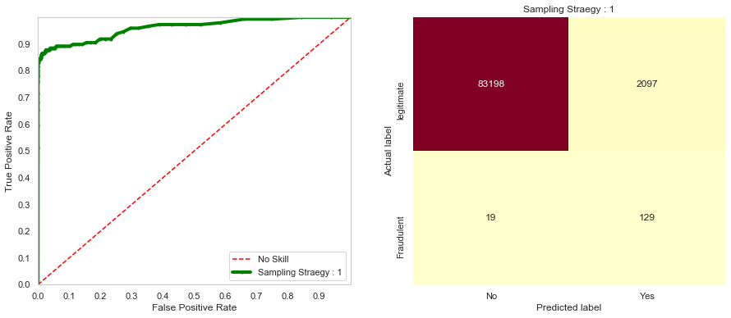
Balanced Bagging Classifier
Results
Sampling Strategy = 1
Results Table
Sampling Strategy | Confusion Matrix |  | Recall (Sensitivity) | AUC-ROC | Accuracy
0.01 | 85245 | 50 | 0.831081 | 0.937494 | 0.999122
 | 25 | 123
0.1 | 85044 | 251 | 0.837838 | 0.945874 | 0.996781
 | 24 | 125
1 | 83198 | 2097 | 0.871622 | 0.961538 | 0.975235
 | 19 | 129
Results Summary
Balanced Bagging Classifier Balances Both Accuracy & Recall
Predictably Controls Desired Metrics by Tweaking HyperParameter

Slide 24
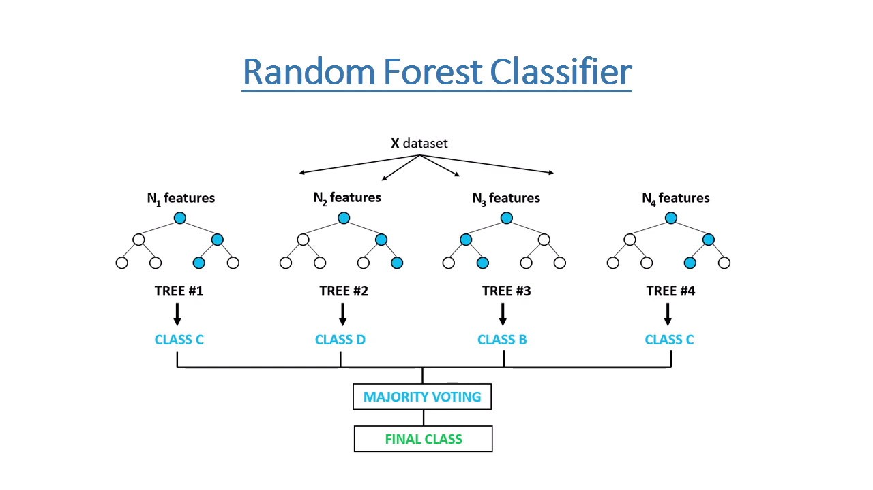
Random Forest Classifier
Extension of Bagging Classifier
Selects only a Random Subset of Features for Each Sample [16]
This Makes Decision Tree More Independent
Improves the Ensemble Prediction
Algorithm Can be Modified to Change the Weight of Each Class ( class_weight )
This Modification Favors the Minority Class in Imbalanced Data Calculations

Slide 25
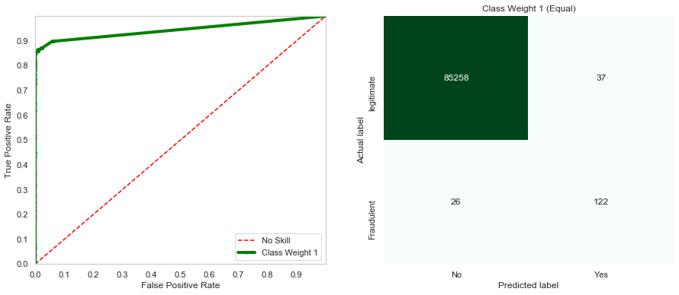
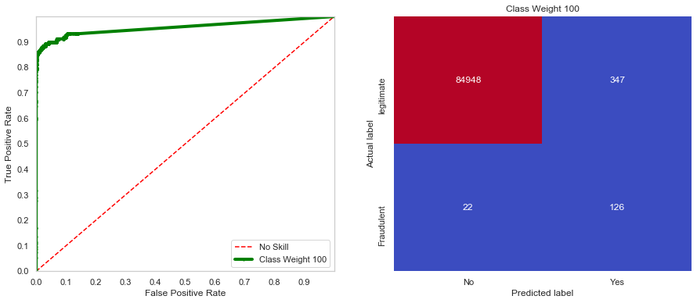
Random Forest Classifier
Results
Class Weight = 1
Class Weight = 100

Slide 26
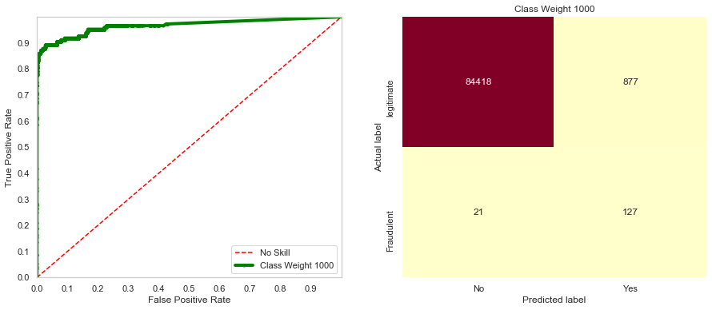
Random Forest Classifier
Results
Class Weight = 1000
Results Table
Class_Weight | Confusion Matrix |  | Recall (Sensitivity) | AUC-ROC | Accuracy
{0:1, 1:1} | 85258 | 37 | 0.831081 | 0.915347 | 0.999321
 | 26 | 122
{0:1, 1:100} | 84948 | 347 | 0.851351 | 0.923483 | 0.995365
 | 22 | 126
{0:1, 1:1000} | 84118 | 877 | 0.871622 | 0.930172 | 0.988519
 | 21 | 127
Results Summary
Random Forest Classifier has Given Better Results than Bagging Classifier
With class_weight We Can Easily Tune Accuracy & Recall

Slide 27
Cost-Sensitive Algorithms

Slide 28
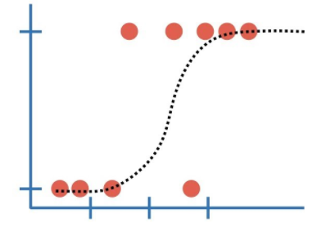
Weighted Logistic Regression
Logistic Regression Predicts the Probability of a Class
Does NOT Support Imbalanced Classification Directly
We Can Specify the Class Weight Configuration to Influence
the Coefficients
This is Done through HyperParameter class_weight

Slide 29
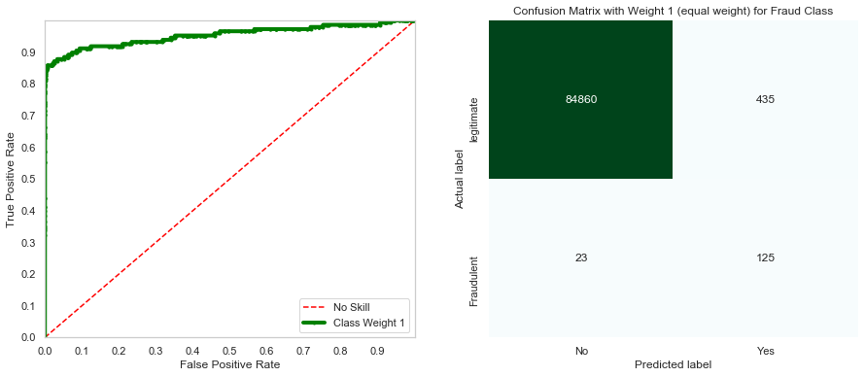

Weighted Logistic Regression
Results
Class Weight = 1
Class Weight = 100

Slide 30
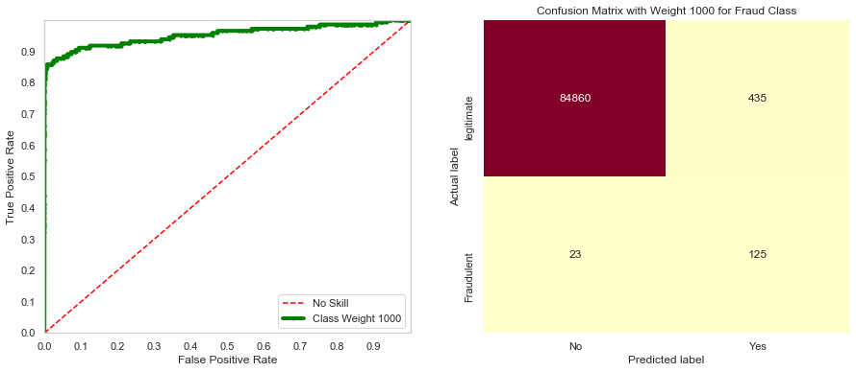
Weighted Logistic Regression
Results
Class Weight = 1000
Results Table
Class_Weight | Confusion Matrix |  | Recall (Sensitivity) | AUC-ROC | Accuracy
{0:1, 1:1} | 84860 | 435 | 0.844595 | 0.953544 | 0.994640
 | 23 | 125
{0:1, 1:100} | 84860 | 435 | 0.844595 | 0.953544 | 0.994640
 | 23 | 125
{0:1, 1:1000} | 84860 | 435 | 0.844595 | 0.953544 | 0.994640
 | 23 | 125
Results Summary
Weighted Logistic Regression has Given Disappointing Results
Change in class_weight did NOT have Any Influence on Accuracy & Recall

Slide 31
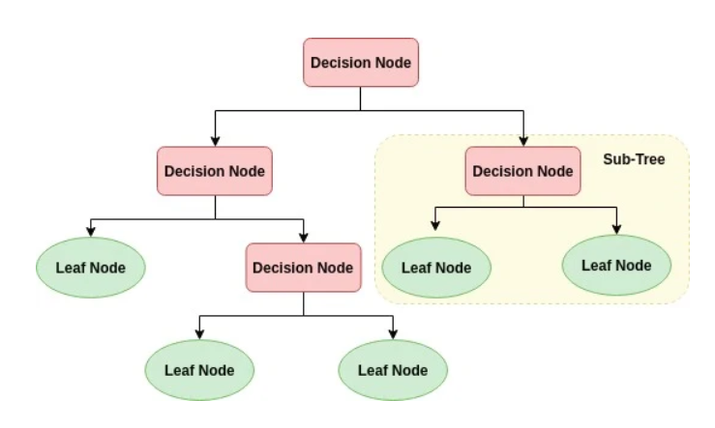
Cost Sensitive Decision Trees
Decision Trees do NOT Perform Well on Imbalanced Datasets
Tend to Ignore Minority Class Data at Split Points
To Overcome this We Modify Criteria for Calculation of Impurity [18]
We Can Specify class_weight Configuration to Influence Coeffiecients

Slide 32
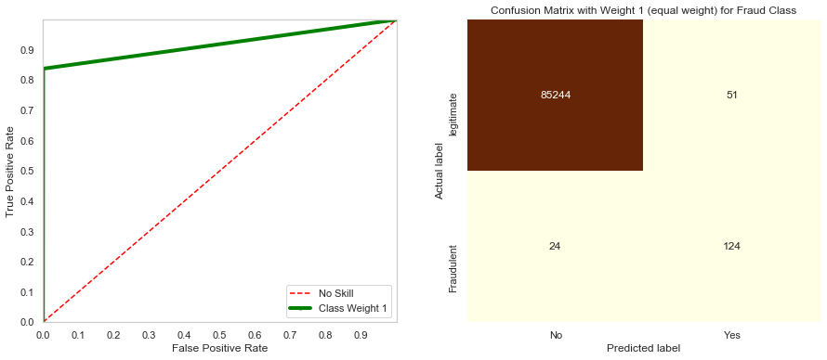
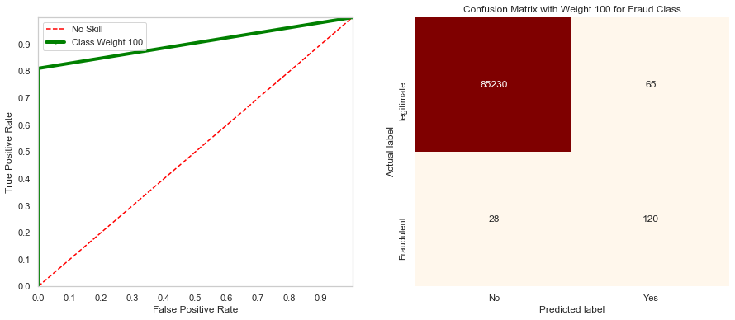
Cost Sensitive Decision Trees
Results
Class Weight = 1
Class Weight = 100

Slide 33
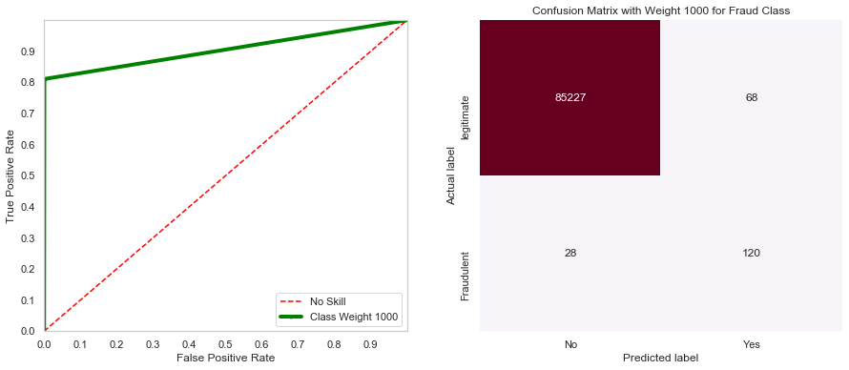
Cost Sensitive Decision Trees
Results
Class Weight = 1000
Results Table
Class_Weight | Confusion Matrix |  | Recall (Sensitivity) | AUC-ROC | Accuracy
{0:1, 1:1} | 85244 | 51 | 0.837838 | 0.91862 | 0.999099
 | 24 | 124
{0:1, 1:100} | 85230 | 65 | 0.797297 | 0.905024 | 0.998865
 | 28 | 120
{0:1, 1:1000} | 85227 | 68 | 0.810811 | 0.905007 | 0.998771
 | 28 | 120
Results Summary
Accuracy of the Algorithm was High
However, Change in class_weight did NOT Significantly Increase Recall & AUC

Slide 34
Cost Sensitive Gradient Boosting XGBoost
Efficient Implementation of Stochastic Gradient Boosting Machine
Very Effective for Large Range of Regression & Classification Problems [19]
XGBoost Offers Ways to Fine-Tune Training Algorithm for Misclassification [20]
XGBoost Offers a Few HyperParameters to Control Balance of Weights
scale_pos_weight Controls Balance of Positive & Negative Weights
class_weight Constrains Value of Delta Step for Each Leaf Output

Slide 35
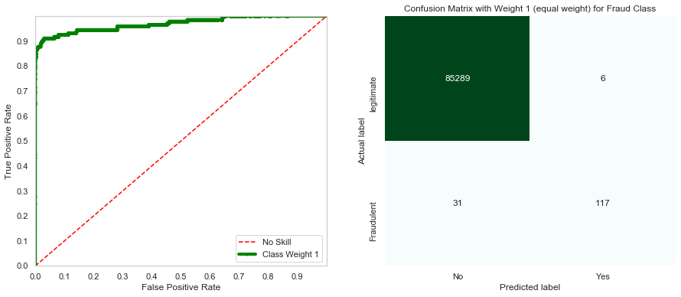
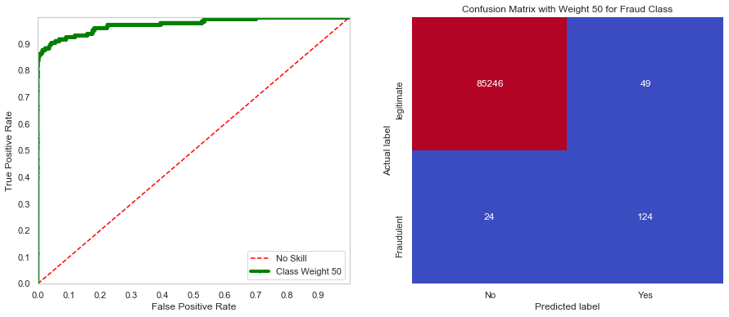
Cost Sensitive Gradient Boosting XGBoost
Results
Class Weight = 1
Class Weight = 50

Slide 36

Cost Sensitive Gradient Boosting XGBoost
Results
Class Weight = 1000
Results Table
Scale_Pos_Weight | Confusion Matrix |  | Recall (Sensitivity) | AUC-ROC | Accuracy
1 | 85289 | 6 | 0.790541 | 0.970665 | 0.999567
 | 31 | 117
50 | 85275 | 49 | 0.824324 | 0.974359 | 0.999146
 | 24 | 122
1000 | 85221 | 74 | 0.837838 | 0.957629 | 0.998853
 | 24 | 124
Results Summary
XGBoost has Given Spectacular Results
With XGBoost, We have Incredibly High Accuracy of Higher than 99.95%
Along with High Accuracy we also have Solidly High ROC-AUC

Slide 37
Cost Sensitive Artificial Neural Network
Neural Networks Perform Well on Wide Range of Problems
Use Backpropagation Algorithm to Calculate Errors & Update Model Weights
However, they Treat Majority Class Preferentially in Imbalanced Datasets [21]
This Can be Changed by Changing the Weightage of Error Scores Based on Class [22]
For Imbalanced Datasets, Large Error Weight is Applied to Minority Class
Actual Tuning is Done Using HyperParameter class_weight

Slide 38
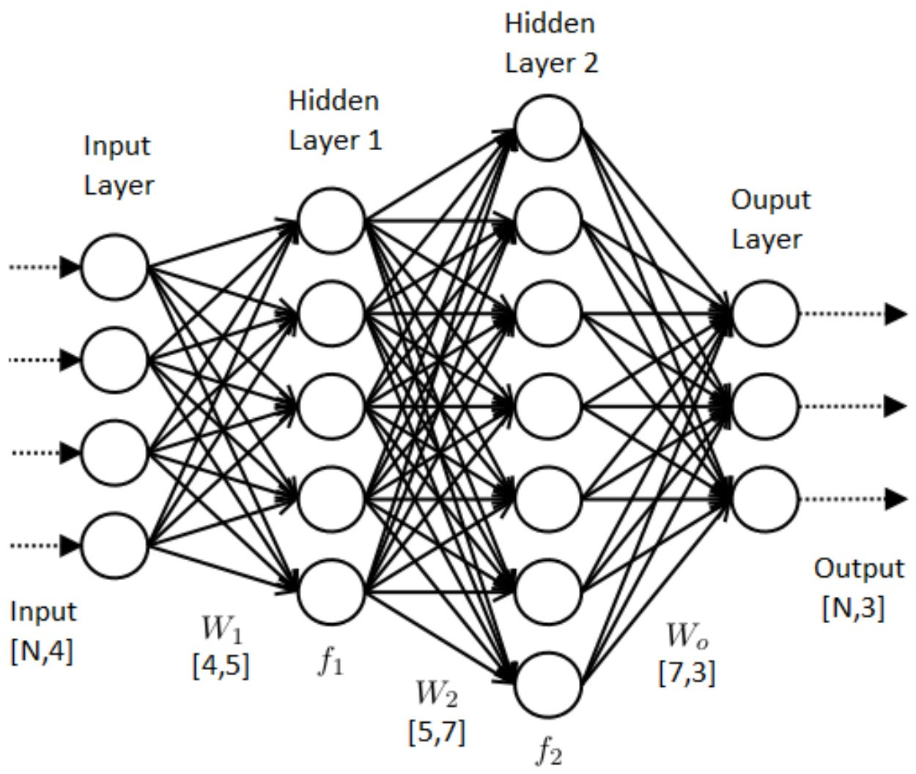
Cost Sensitive Artificial Neural Network
Neural Networks are Especially Suited for this Dataset for Following Reasons
Elimination of Need for Feature-Engineering
High Level of Configurability
Outline of the 3 Neural Network Models We have Built is Described in the Table Below
 |  | Activation Function | Cost Function
Input Layer | No of input features | tanh
2 Hidden Layers | 32,32 | tanh
Output Layer | 1 | sigmoid | binary_crossentropy
Regularization | Dropout regularization (0.4)
Optimizer | Adam
Cost Sensitive Weights | This will cause the model to pay more attention to fraud class (1) {0:1, 1:1} : No Weight {0:1, 1:5} : Weight 5 for fraud class {0:1, 1:500} : Weight 500 for fraud class
Early Stopping | Precision (Although FNs are costly, FPs are also costly for punishing the legitimate transactions. Also, model showed significantly higher accuracy [about 99 %]. The precision is made the parameter for early stopping.

Slide 39
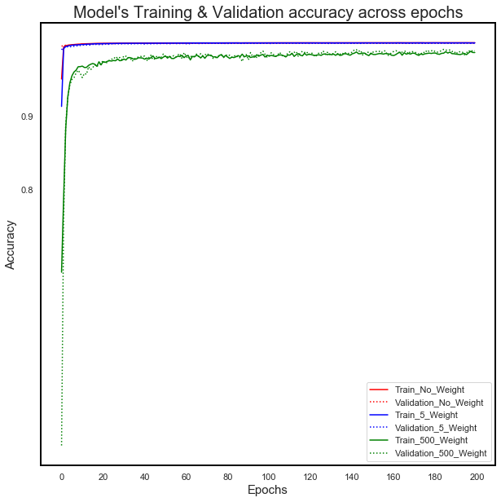
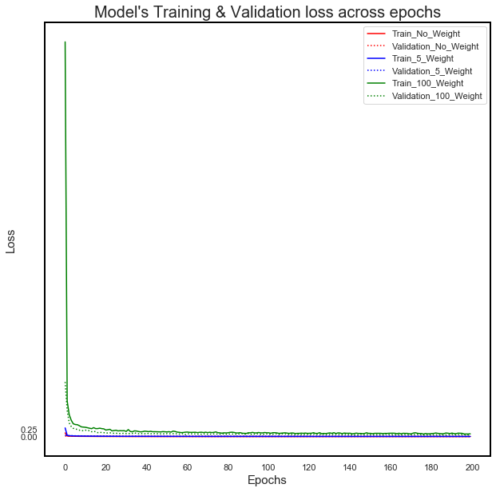
Cost Sensitive Artificial Neural Network
Training & Validation Accuracy AND Loss Across Epochs

Slide 40
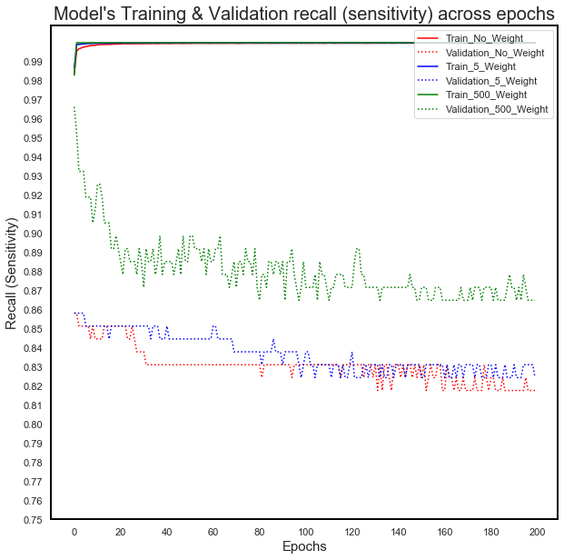
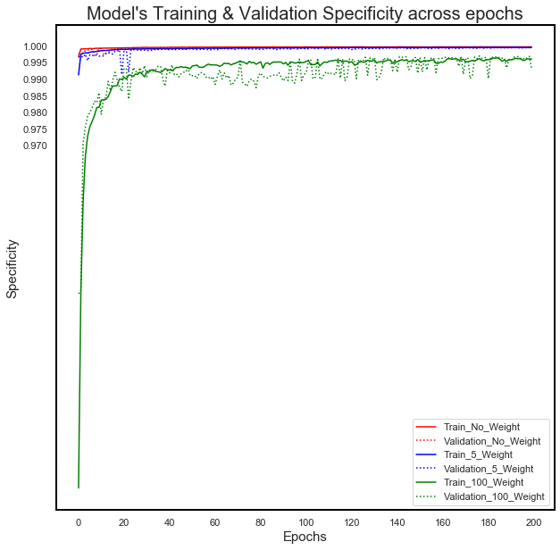
Cost Sensitive Artificial Neural Network
Training & Validation Recall AND Specificity Across Epochs

Slide 41
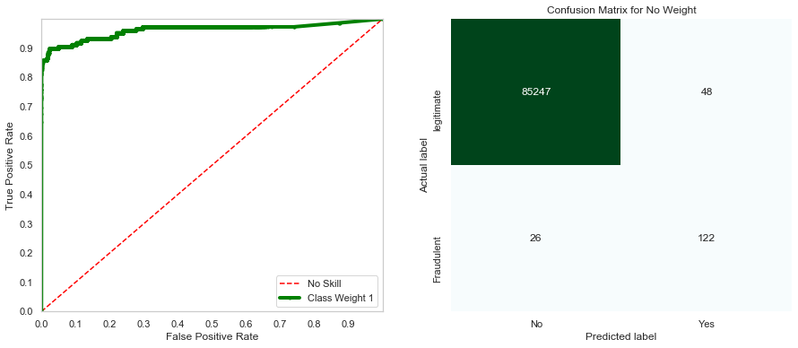
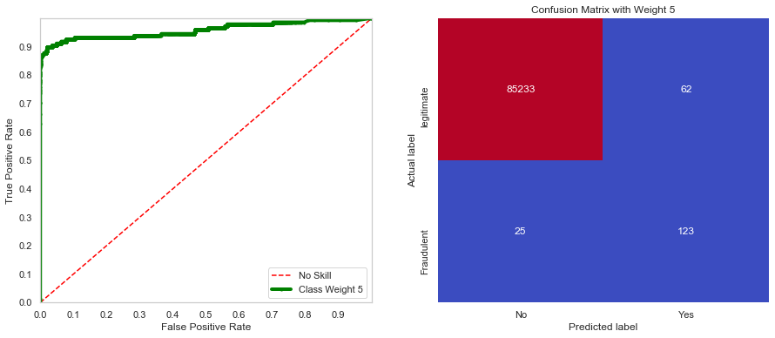
Cost Sensitive Artificial Neural Network
Results
Class Weight = 1
Class Weight = 5

Slide 42
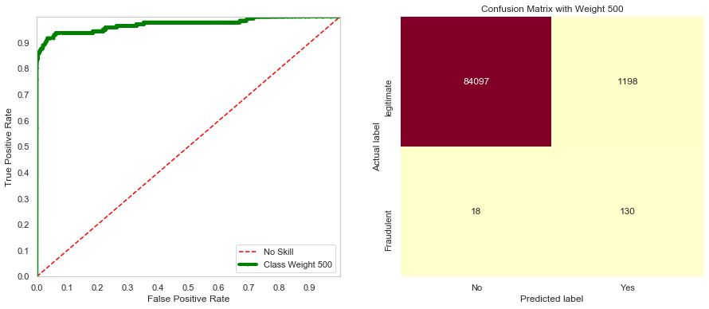
Cost Sensitive Artificial Neural Network
Results
Class Weight = 1000
Results Table
Class_Weight | Confusion Matrix |  | Recall (Sensitivity) | AUC-ROC | Accuracy
{0:1, 1:1} | 85247 | 48 | 0.824324 | 0.962304 | 0.999134
 | 26 | 122
{0:1, 1:5} | 85233 | 62 | 0.831081 | 0.958601 | 0.998982
 | 25 | 123
{0:1, 1:500} | 84097 | 1198 | 0.878378 | 0.972720 | 0.985768
 | 18 | 130
Results Summary
ANNs have Given Spectacular Results
Achieved High Accuracy along with High Recall & ROC-AUC Values & Predictable Configurability
Best Functional Solution for our Dataset

Slide 43
Results Summary

Slide 44
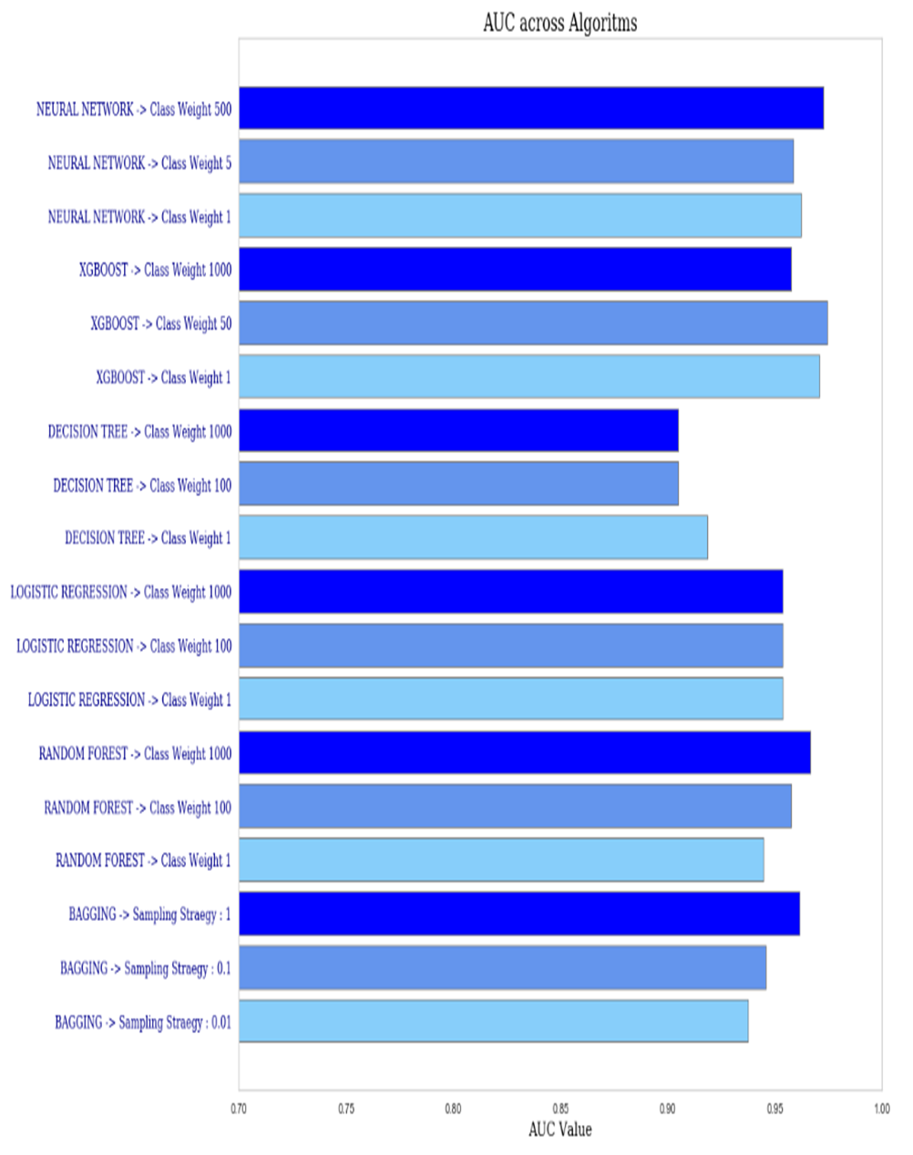
Results Summary
ROC-AUC across Algorithms

Slide 45
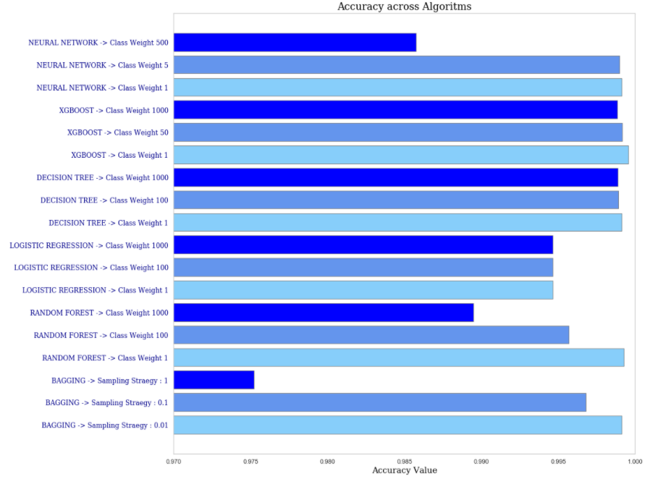
Results Summary
Accuracy across Algorithms

Slide 46
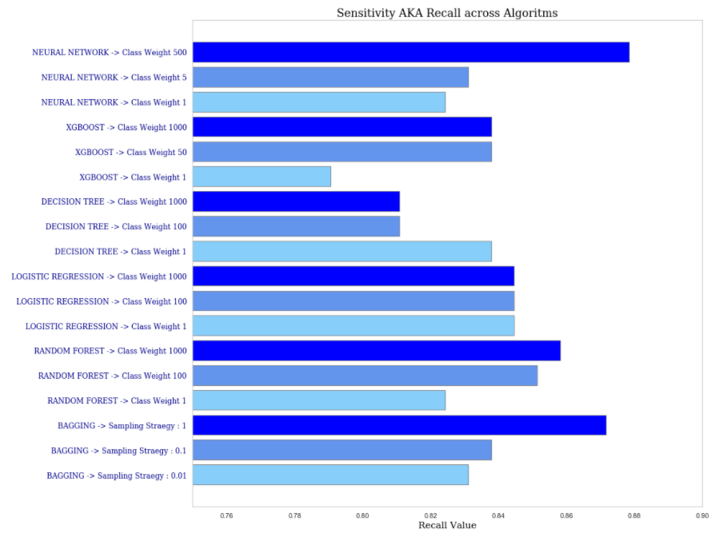
Results Summary
Sensitivity AKA Recall across Algorithms

Slide 47
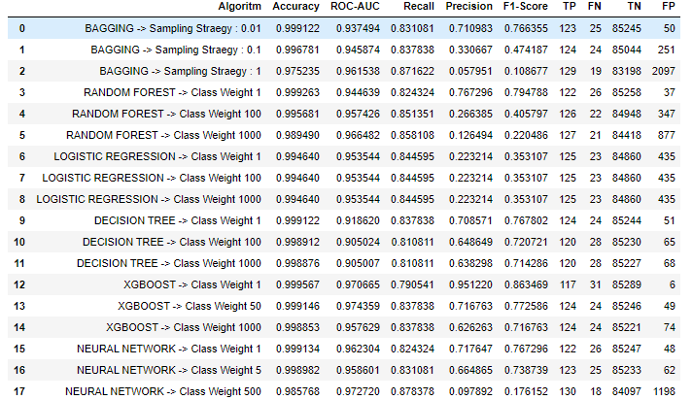
Results Summary
Results Summary Table

Slide 48
Conclusions

Slide 49
Conclusions
Goal of the Project was to Create Suitable Algorithm(s) to
Prevent Fraud while Allowing Legitimate Transactions to go through Smoothly
i.e. Achieve High Level of Accuracy along with High Recall & AUC
We Took Following Steps to Create Algorithm(s)
1. Exploratory Analysis
2. Identifying the Challenges
3. Data Pre-Processing
4. Identifying Suitable Algorithms
5. Build Models
6. Compare Results

Slide 50
Conclusions
Greatest Challenge was Imbalance in the Dataset
To Address Imbalance We Used SVMSMOTE Oversampling [23]
We Used Following Algorithms which Can Handle Class Imbalance
1. Balanced Bagging Classifier
2. Random Forest Classifier with Class Weighing
3. Cost Sensitive Logistic Regression
4. Cost Sensitive Decision Trees
5. Cost Sensitive Gradient Boosting XGBoost
6. Cost Sensitive Artificial Neural Network

Slide 51
Conclusions
All of the Algorithms (except Logistic Regression) had High Accuracy
Very High ROC-AUC was Achieved with XGBoost & ANN
High Recall was Best Achieved by Random Forest & ANN
Overall, Neural Networks Scored Well Across All Parameters
Artificial Neural Networks are the Best Solution for this Dataset

Slide 52
References
[1] Leah Hendry (2016). “Bank didn't do enough to prevent online credit card fraud” Retrieved from
https://www.cbc.ca/news/canada/montreal/vincenzo-lingordo-credit-card-fraud-bank-1.3900001
[2] Machine Learning Group, ULB (2018). “Credit Card Fraud Detection Anonymized credit card transactions labeled as fraudulent or genuine” Retrieved from https://www.kaggle.com/mlg-ulb/creditcardfraud
[3] Andre Violante (2018) “An Introduction to t-SNE with Python Example” Retrieved from
https://towardsdatascience.com/an-introduction-to-t-sne-with-python-example-5a3a293108d
[4] Paula Branco, Luıs Torgo, Rita P. Ribeiro1(2015) "A Survey of Predictive Modelling under Imbalanced
Distributions" Retrieved from https://web.cs.dal.ca/~ltorgo/publication/2015_btr15/
[5] Roberta Pollastro (2020) "How to handle Class Imbalance Problem" Retrieved from
https://medium.com/quantyca/how-to-handle-class-imbalance-problem-9ee3062f2499
[6] Gustavo E. A. P. A. Batista, Ronaldo C. Prati , Maria Carolina Monard (2004) "Study Of The Behavior Of Several Methods For Balancing Machine Learning Training" Retrieved from
https://citeseerx.ist.psu.edu/viewdoc/download?doi=10.1.1.58.7757&rep=rep1&type=pdf

Slide 53
References
[7] Haibo He, Yunqian Ma Imbalanced Learning: Foundations, Algorithms, and Applications Hardcover. New York: Wiley,
2013.
[8] Victor E. Irekponor (2019) "CREATING AN UNBIASED TEST-SET FOR YOUR MODEL USING STRATIFIED SAMPLING TECHNIQUE" Retrieved from https://blog.usejournal.com/creating-an- unbiased-test-set-for-your-model-using-stratified-sampling-technique-672b778022d5
[9] Jason Brownlee (2020) "How to Use StandardScaler and MinMaxScaler Transforms in Python" Retrieved from https://machinelearningmastery.com/standardscaler-and-minmaxscaler-transforms-in-python/
[10] Max Kuhn, Knell Johnson Applied Predictive Modeling. New York: Springer, 2018.
[11] Nguyen, Hien M., Eric W. Cooper, and Katsuari Kamei (2011). “Borderline over-sampling for imbalanced data classification.” Retrieved from https://pdfs.semanticscholar.org/5c0b/e11c0dfb22a50b59570a06768d0d86188057.pdf
[12] Cheng G. Weng Josiah Poon (2006) "A New Evaluation Measure for Imbalanced Datasets" Retrieved from https://www.researchgate.net/profile/Josiah_Poon/publication/221338017_A_New_Evaluation_Measure_fo r_Imbalanced_Datasets/links/5566437d08aefcb861d198ed/A-New-Evaluation-Measure-for-Imbalanced- Datasets.pdf

Slide 54
References
[13] Yun Qian, Yanchun Liang, Mu Li, Guoxiang Feng, Xiaohu Shi (2011) "A resampling ensemble algorithm for classification of imbalance problems" Retrieved from http://xuebalib.oss-cn- shanghai.aliyuncs.com/xuebalib.com.37042.pdf
[14] Charles X. Ling, Victor S. Sheng (2008) "Cost-Sensitive Learning and the Class Imbalance Problem" Retrieved from http://citeseerx.ist.psu.edu/viewdoc/download?doi=10.1.1.164.4418&rep=rep1&type=pdf
[15] Imblearn (2016) “BalancedBaggingClassifier” Retrieved from https://imbalanced- learn.readthedocs.io/en/stable/generated/imblearn.ensemble.BalancedBaggingClassifier.html
[16] Leo Breiman (2001) "Random Forests" Retrieved from https://www.stat.berkeley.edu/~breiman/randomforest2001.pdf
[17] Dinesh Yadav (2020) "Weighted Logistic Regression for Imbalanced Dataset" Retrieved from https://towardsdatascience.com/weighted-logistic-regression-for-imbalanced-dataset-9a5cd88e68b
[18] Kai Ming Ting, "An instance-weighting method to induce cost-sensitive trees," in IEEE Transactions on Knowledge and Data Engineering, vol. 14, no. 3, pp. 659-665, May-June 2002, doi:10.1109/TKDE.2002.1000348.

Slide 55
References
[19] Tianqi Chen, Carlos Guestrin (2016) "XGBoost: A Scalable Tree Boosting System" Retrieved from https://www.kdd.org/kdd2016/papers/files/rfp0697-chenAemb.pdf
[20] XGBoost Docs (N.A.) "Notes on Parameter Tuning" Retrieved from https://xgboost.readthedocs.io/en/latest/tutorials/param_tuning.html
[21] S. Wang, W. Liu, J. Wu, L. Cao, Q. Meng and P. J. Kennedy, "Training deep neural networks on imbalanced data sets," 2016 International Joint Conference on Neural Networks (IJCNN), Vancouver, BC, 2016, pp. 4368-4374, doi: 10.1109/IJCNN.2016.7727770.
[22] Matjaz Kukar, Igor Kononenko (1998) "Cost-Sensitive Learning with Neural Networks" Retrieved from https://pdfs.semanticscholar.org/bdef/7eb9b62e2a12b870957879f7a097b41f6012.pdf?_ga=2.146525431.250 973509.1597029313-870585035.1597029313
[23] N. V. Chawla, K. W. Bowyer, L. O. Hall, and W. P. Kegelmeyer, “Smote: synthetic minority over-sampling technique,” JAIR, vol. 16, pp. 321–357, 2002
[24] Ryan Miller (2019) "Data Preprocessing: what is it and why is important" Retrieved from https://ceoworld.biz/2019/12/13/data-preprocessing-what-is-it-and-why-is-important/

Slide 56

THANK YOU

