Slide 1
In Memory Data Grid

Slide 2

What modern business needs
High Performance
High Availability
High Scalability

Slide 3
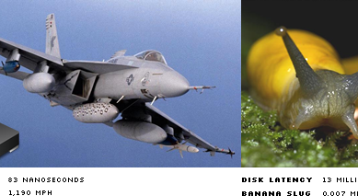
Comparison Vs Disk & RAM
Courtesy : http://blog.scoutapp.com/articles/2011/02/10/understanding-disk-i-o-when-should-you-be-worried

Slide 4

High Availability & Scalability
http://cdn.skim.gs/image/upload/v1456337318/msi/children-sharing-toys_tbpwc1.jpg

Slide 5
Shared Nothing (SN)
What is SN
Distributed
Each node is self sufficient
No single point of contention
None of nodes share any resource (specially memory or disk)
Advantage
Eliminate any single point of failure
Allowing self healing
Offering non-disruptive upgrades

Slide 6
Introducing Hazelcast
In memory data grid
Open Source
Alternatives to many popular solutions
Coherence
Teracotta
Gemfire
Redis
Memcached
And many more

Slide 7
Main Features
Scale-out Computing: every node adds their CPU to the cluster
Resilience: nodes can fail randomly without data loss or significant performance impact to running applications
Programming Model: A way for developers to easily program the cluster of machines as if it were a single machine
Fast, Big Data: it enables very large data sets to be manipulated in main memory
Dynamic Scalability: nodes (computers) can dynamically join the other computers in a grid (cluster)
Elastic Main Memory: every node adds their RAM to the cluster’s memory pool

Slide 8
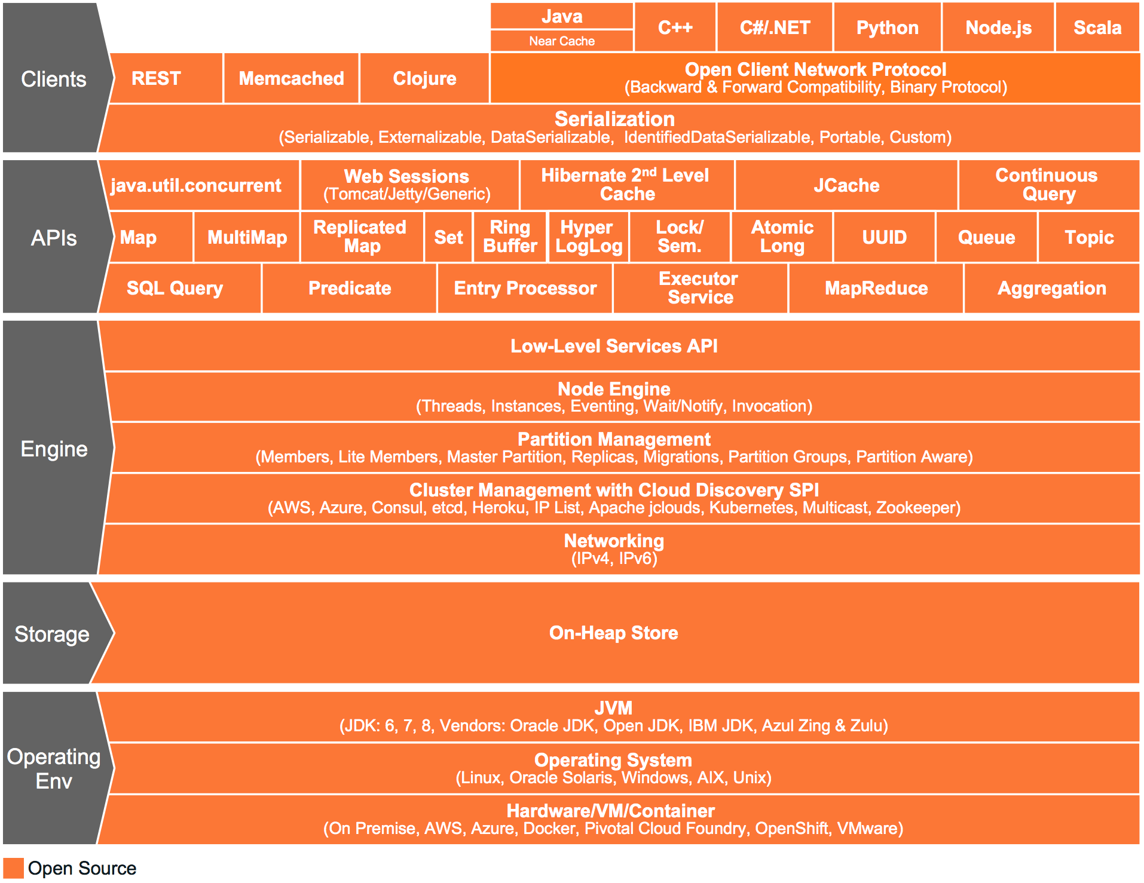
Hazelcast Architecture
Courtesy: https://hazelcast.org/features/

Slide 9
Advantages
Simple
Peer to Peer
Scalable
Fast
Redundant
Keeps the backup of each data entry in multiple member

Slide 10
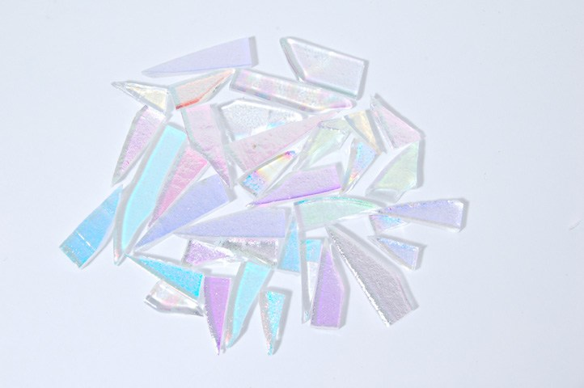
Sharding

Slide 11

Partition (Shard) with 1 Node
Source:http://docs.hazelcast.org/docs/3.7-EA/manual/html-single/#data-partitioning

Slide 12
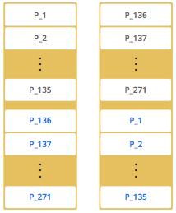
Partition (Shard) with 2 Node
Source:http://docs.hazelcast.org/docs/3.7-EA/manual/html-single/#data-partitioning

Slide 13
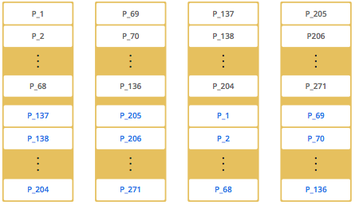
Partition (Shard) with 4 Nodes
Source:http://docs.hazelcast.org/docs/3.7-EA/manual/html-single/#data-partitioning

Slide 14
Advantage of Partiton strategy
In case of one node failure, only minimum amount of paritions will be moved to scale out Hazelcast

Slide 15
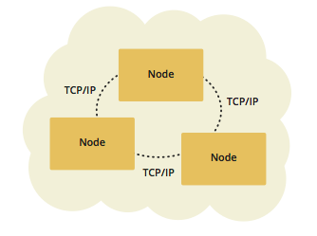
Topology - Embedded
low-latency data access
Advantage
low-latency data access

Slide 16
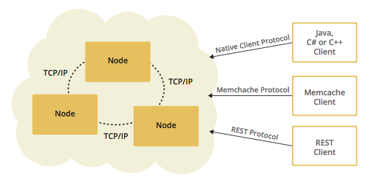
Topology – Client / Server
Advantage
More predictable and reliable performance
Easier identification of problem causes
Better scalability

Slide 17
More predictable and reliable performance
Easier identification of problem causes
Better scalability

Slide 18
Our Topology
To be added

