Slide 1
Java 8
Amit Agrawal
Github.com/amitpagrawal
@amitpagrawal
2017

Slide 2
Java Evolution
Source: Wikipedia

Slide 3
Java 8 Features
Lambda expression (JSR 335)
Nashorn – JavaScript Runtime (JSR 223)
Date & Time API
Stream API

Slide 4
Before we Jump
Functional programming
Functional interface

Slide 5
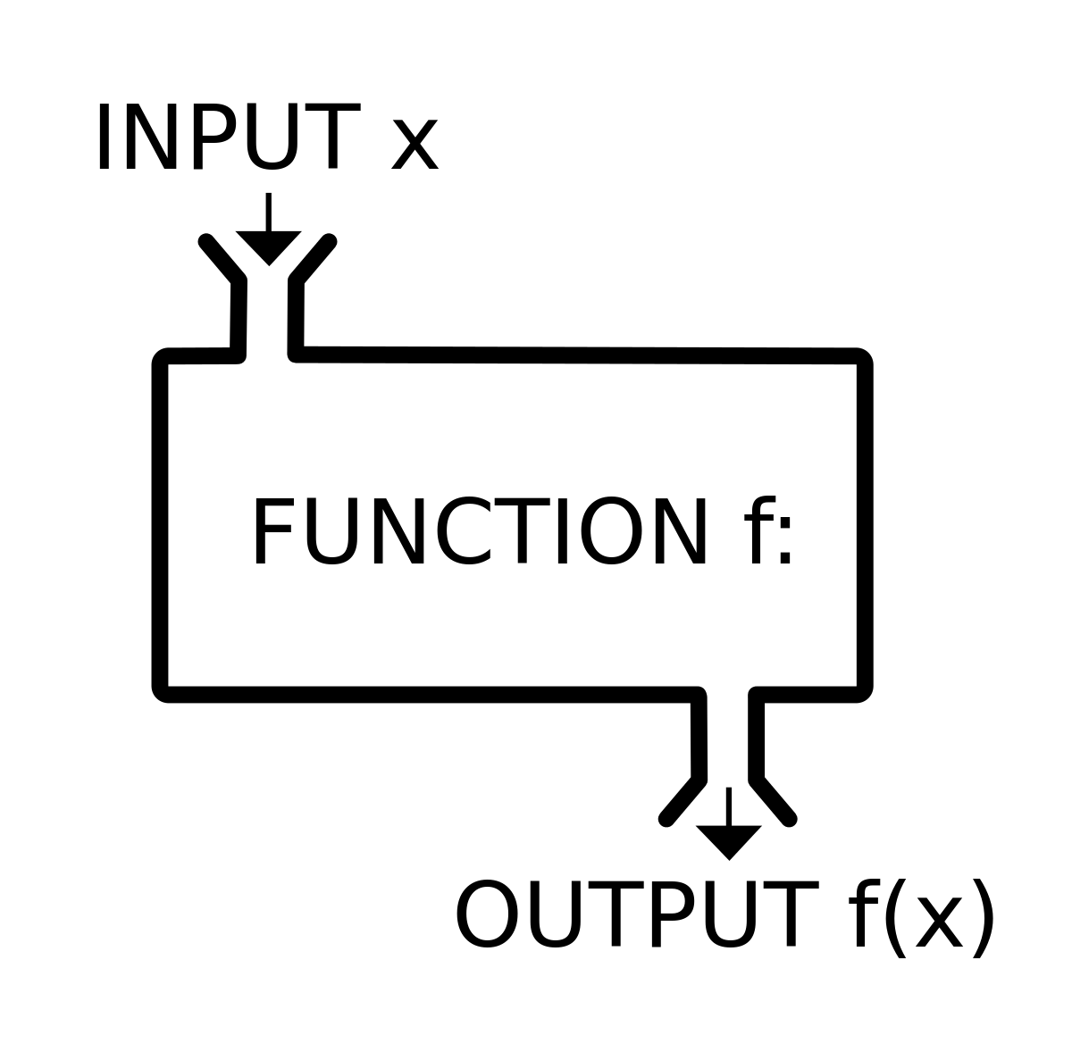
Functional Programming
Declarative programming paradigm
Programming is done with expressions or declarations instead of statements.
Output value of a function depends only on the arguments that are input to the function
More on What to do rather than How to do
Side effect free
Image courtesy : http://blakehaswell.com/post/119761850327/my-one-piece-of-advice

Slide 6
Functional Programing
List of Functional Programming language
Python
Haskell
Perl
Erlang
Elixir
Lisp
Clojure
D
Scala

Slide 7
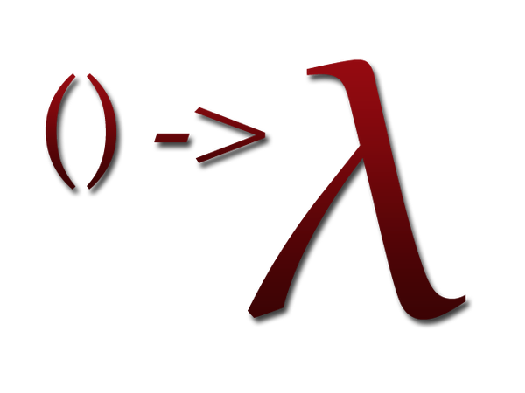
Functional Interface
A functional interface has exactly one abstract method
Can be annotated with @FunctionalInterface
instances of functional interfaces can be created with lambda expressions , More at
https://docs.oracle.com/javase/8/docs/api/java/lang/FunctionalInterface.html

Slide 8


