Slide 1

Beyond Polynomial Time: Angry Birds as an NP-Hard Problem
Comparative Study of Brute Force, Genetic Algorithm, and Piotrowski’s Heuristic
Name: Amit Pal
Professor: Prof. Neelima Gupta, UoD

Slide 2
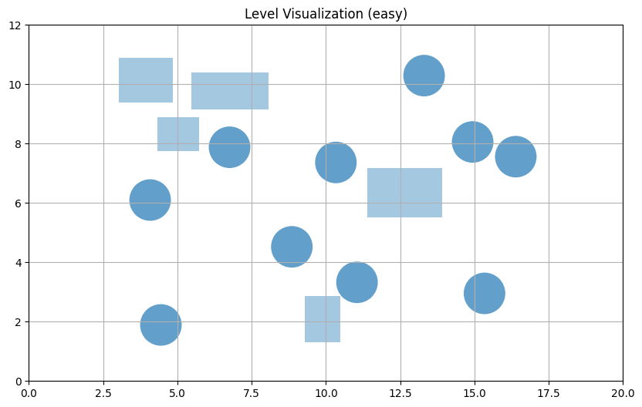
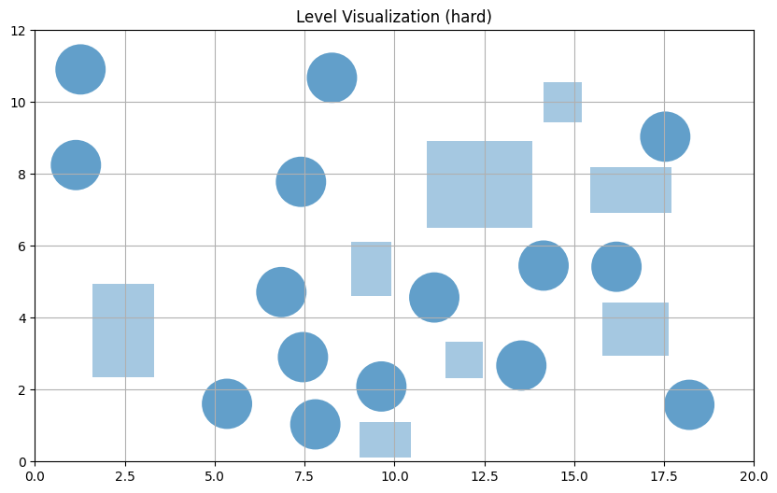
Problem Statement
Angry Birds isn’t just a casual game — solving a level optimally is NP-hard.
Objective: Compare algorithms that balance accuracy vs runtime.
As level complexity grows, the search space explodes.
Pigs
Blocks (Unbreakable)

Slide 3
Objective
Generate synthetic datasets with varying difficulty (easy, medium, hard)
Study combinatorial complexity as number of pigs & blocks increase
Compare Brute-Force, Piotrowski’s Heuristic, and Genetic Algorithm on:
success rate
runtime
efficiency

Slide 4
Approximation is not known
Proven to be NP-Hard, and in extended forms, PSPACE or EXPTIME-hard
Complexity arises from continuous physics and combinatorial explosion of shots
No polynomial-time approximation algorithm is known or expected to exist
Continuous parameters (angle, velocity, collisions) block discrete approximation proofs

Slide 5
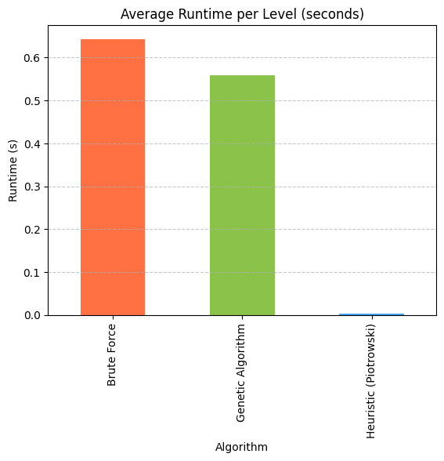
Algorithm 1: Brute Force
Tests all possible shot angles & velocities
Guarantees optimality but explodes in runtime
Acts as baseline for comparison

Slide 6
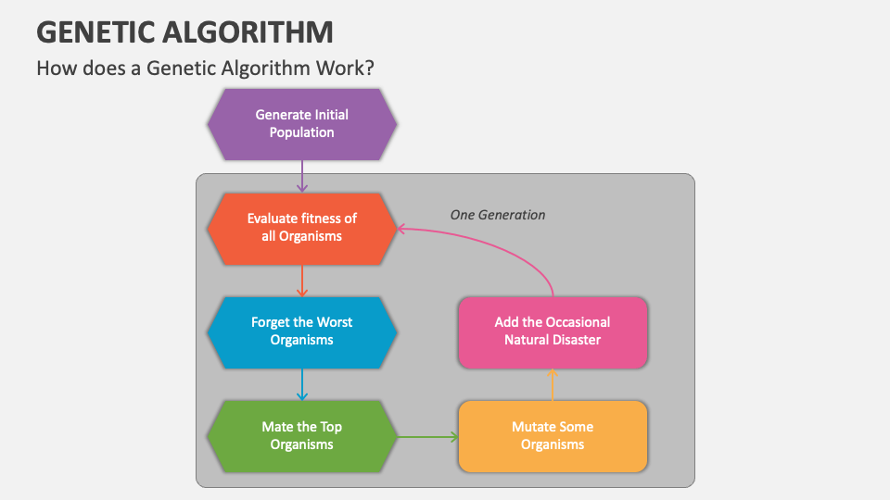
Algorithm 2: Genetic Algorithm
Evolution-based search using fitness, crossover, mutation
Explores better shots over generations
Not physics-aware → moderate success but improves scalability

Slide 7

Algorithm 3: Piotrowski’s Heuristic
Physics-aware: filters out impossible trajectories
Focuses on feasible shots → higher efficiency
Performs best across metrics

Slide 8
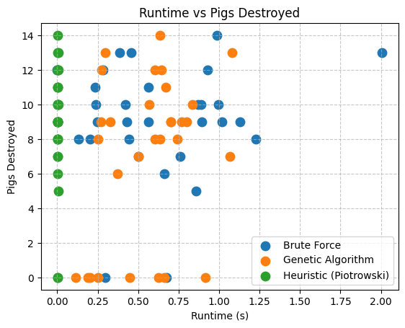
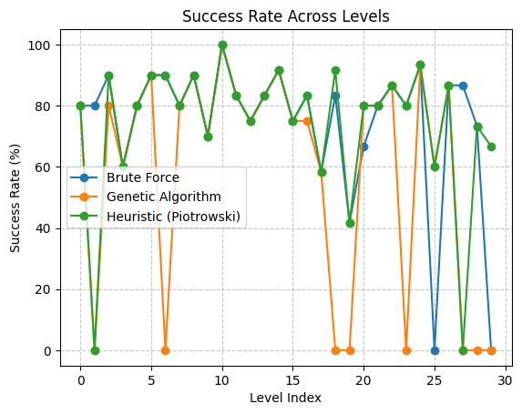
Results & Comparison
Algorithm | Pigs Destroyed | Success Rate | Runtime (s) | Efficiency
Brute Force | 9.07 | 74.6 % | 0.64 | 2.16
Genetic Algorithm | 7.10 | 58.6 % | 0.56 | 1.65
Piotrowski’s Heuristic | 9.10 | 74.0 % | 0.004 | 2.17

Slide 9
Conclusion
Brute Force finds good solutions but fails to scale with increasing level complexity
Genetic Algorithm improves shots through evolution but remains limited by computation time
Piotrowski’s Heuristic achieves the fastest runtime and highest efficiency overall
Physics-aware heuristics outperform both blind search and evolutionary guessing
Smart shot selection proves more effective than raw computational power in physics-based problems

Slide 10
References
[1] Wiktor Piotrowski et al. Heuristic Search For Physics-Based Problems: Angry Birds in PDDL+. 2023. arXiv: 2303.16967 [cs.AI]. url: https://arxiv.org/abs/2303.16967
[2] Matthew Stephenson, Jochen Renz, and Xiaoyu Ge. “The Computational Complexity of Angry Birds and Similar Physics-Simulation Games”. In: Proceedings of the AAAI Conference on Artificial Intelligence and Interactive Digital Entertainment 13.1 (June 2021), pp. 241–247. doi: 10.1609/aiide.v13i1.12947. url: https://ojs.aaai.org/index.php/AIIDE/article/view/12947

