Slide 1

DevOps and IT Agility DevOps CoE
November 2018
TCS Confidential

Slide 2
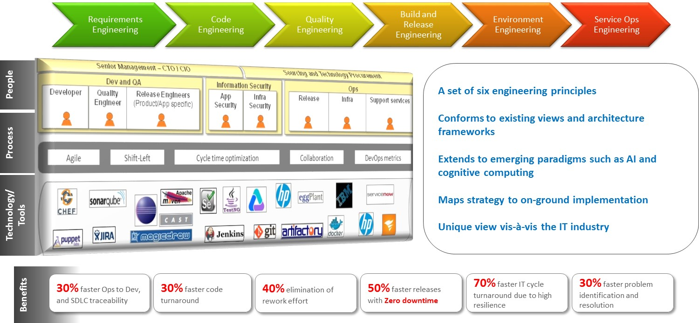
CoE Point of View
Notes:
EBS Finance Functional Consultants – 350+
EBS Finance Techno Functional Consultants – 900+
EBS Finance Technical Consultants – 2100+

Slide 3
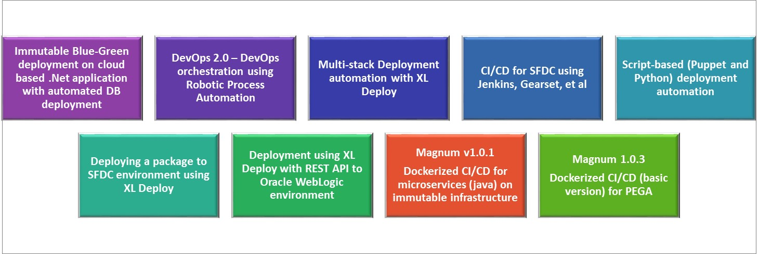
Solutions Catalog
Current Solution Backlog
Analytics for DevOps infrastructure reliability
Ops to Dev incorporating automated incident resolution using machine learning
Adaptive bots for DevOps orchestration
Extending Magnum for .NET and Guidewire

Slide 4
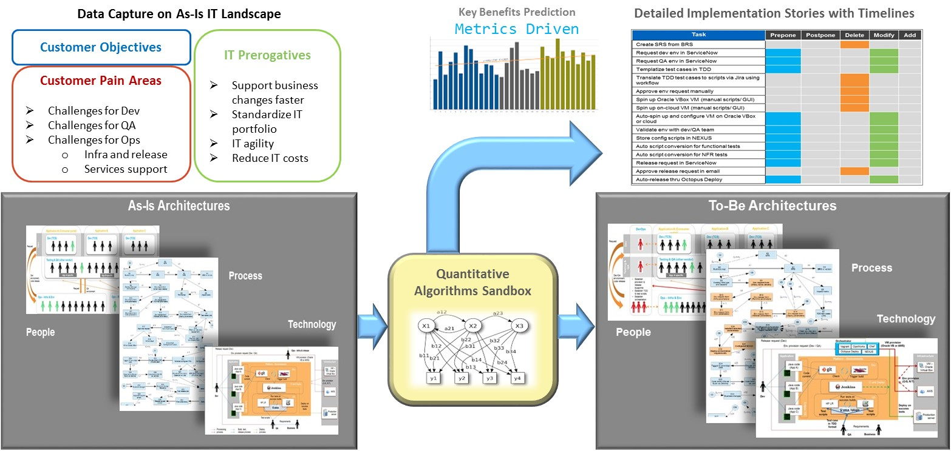
QODE: Quantitatively Optimized DevOps Evaluation

Slide 5
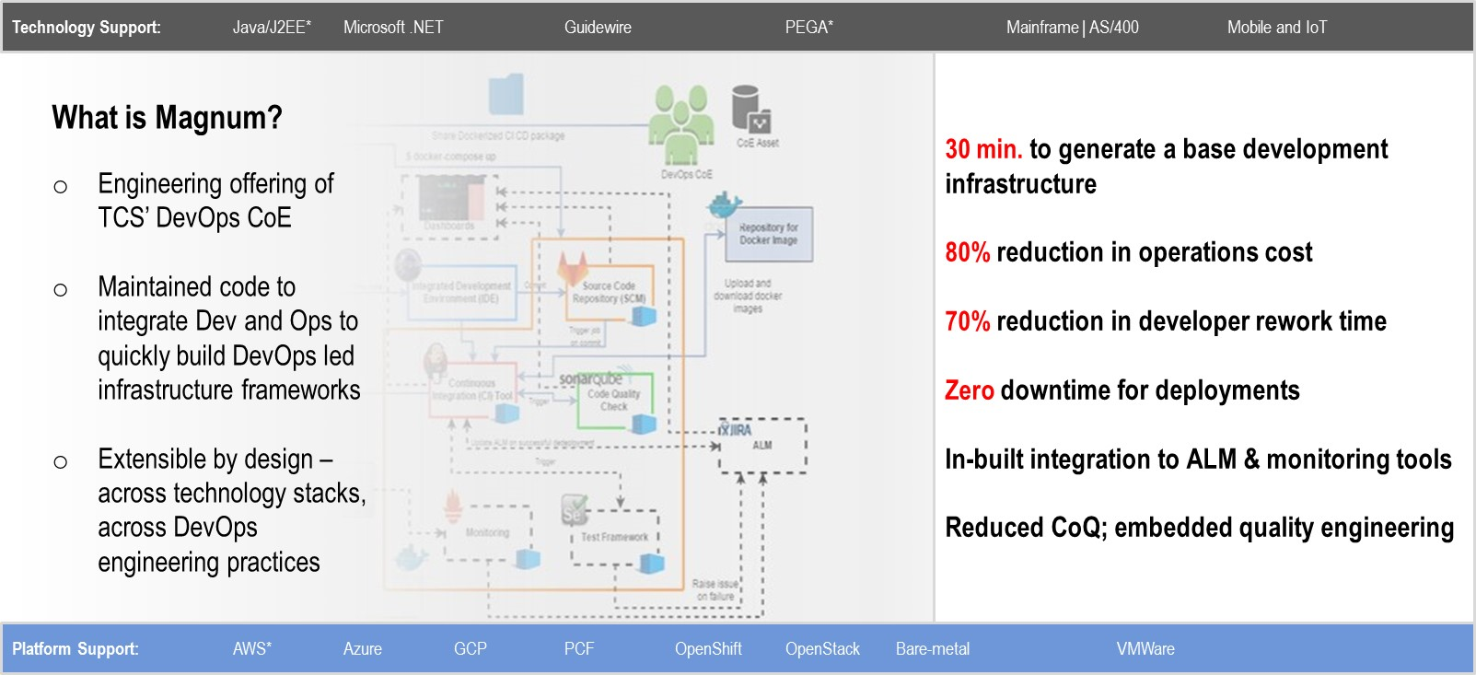
Solution Asset: Magnum v1.0.3
* Current implementation

Slide 6
Success Stories
1. Large US-based bank
2. Large Australian bank
3. Large US-based financial firm
Longer release cycles impacting time to market for credit card division
People issues with migration from mainframe text console to GUI based
Multiple points of truth with multiple sources of data
Data integrity issues
Long cycle time for data based decision making
Error-prone and slow deployments
SLA slippages
Manual and semi-manual processes
Multiple stack dependencies
Continuous integration in mainframe with IBM RDz Explorer (with IBM RTC and ChangeMan)
Code development in Windows
Actual deployment in M/F backend
Single view through integration of multiple data systems
Data lake supporting Big Data
Container based infrastructure (Docker and Puppet based)
Unified deployment for multiple stacks using IBM UrbanCode Deploy
Java, .NET, Dweb, SQL, SQL+, Oracle, Sybase, TIBCO, IBM Cognos, Mesh, Control-M
Dev driven Ops for deployments
8% effort savings in development
33% faster time to market (9 to 6 months)
20%+ reduction in bad data incidents
Faster time to market using integrated analytics
50% reduction in deployment cycle time
Flexible new deployment configuration
200% RoI for SDLC cycles

Slide 7
Additional Views

Slide 8
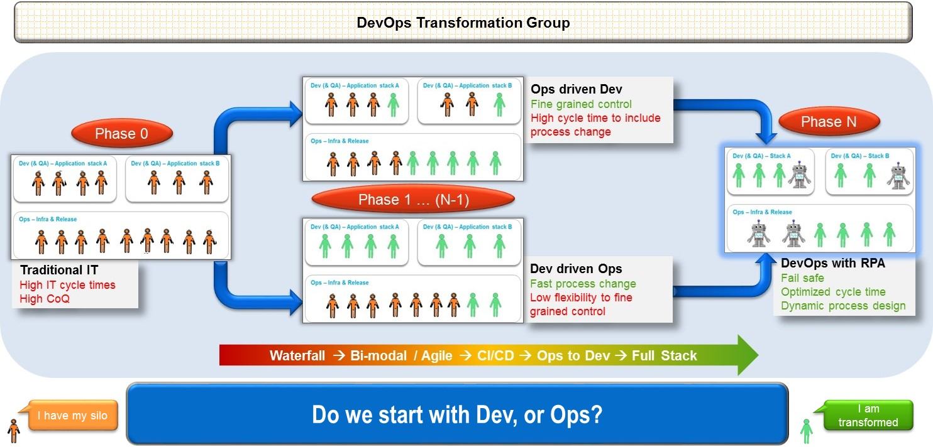
People Architecture: Starting the DevOps Journey

Slide 9
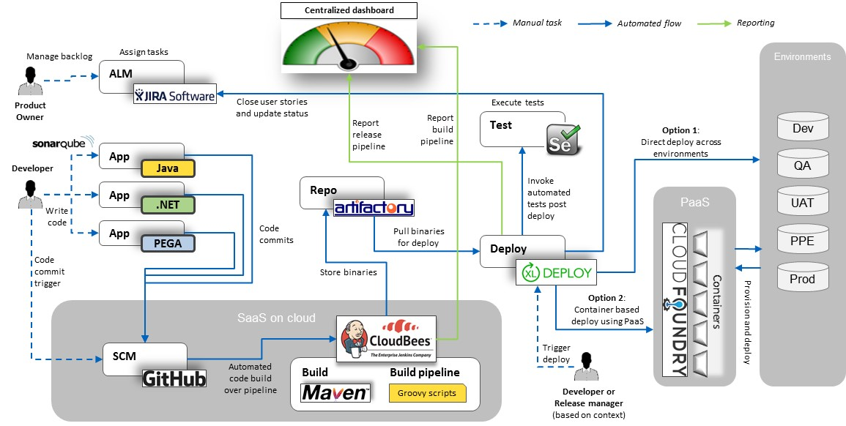
Showcase: Multi-stack Release Automation

Slide 10
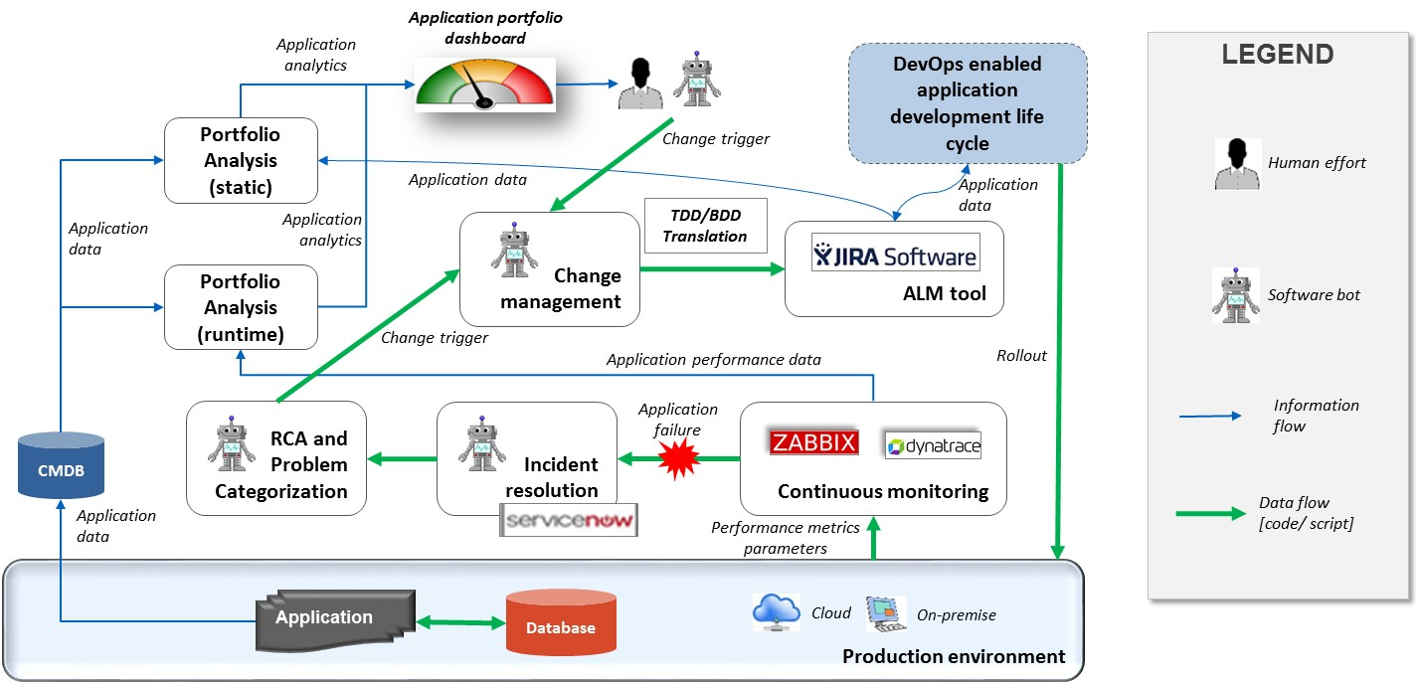
Showcase: Representative Architecture for Ops to Dev

Slide 11
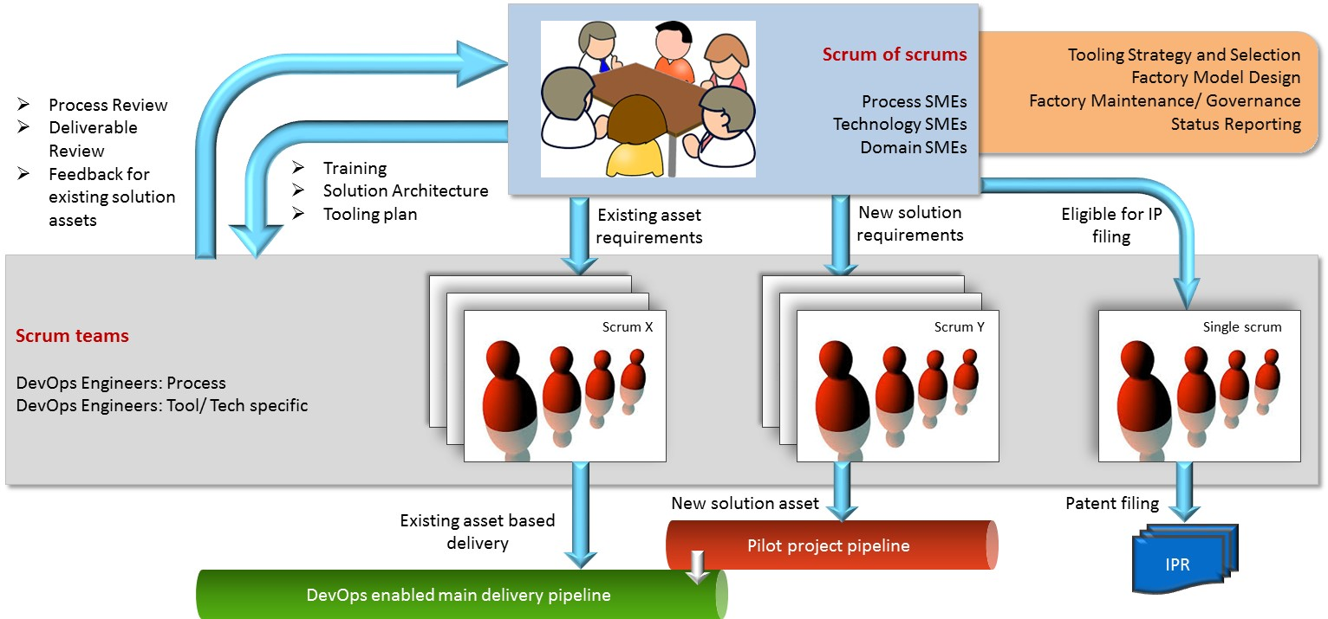
Representative DevOps CoE Model

