Slide 1
Secure Retail
Product Catalogue
Final Project Showcase and Assessment
Capstone B · Sprint 4 · Pop Culture Clothing
12–15 minute group presentation and live demonstration
2026
Notes:
Welcome the assessors and introduce the group.
State that the team will show the problem, design, implementation, evidence, live CRUD demonstration, and reflection.
Target time: 20 seconds.

Slide 2
Project overview
02
A full-stack catalogue for customers and retail administrators
The problem
The solution
Customers need accurate product details before buying. Staff need one reliable place to maintain products, variants and stock-related data.
Responsive customer storefront with search, filters, product detail, wishlist and cart
Administrator portal with database-backed product management
Express API connecting the interface to a structured SQLite database
Automated validation and CRUD integration testing
18
6
2
1
prepared catalogue products
product categories
user roles
integrated application
POP CULTURE CLOTHING
Capstone B · Sprint 4
Notes:
Explain the customer and administrator needs in plain language.
The completed system combines the former frontend and backend projects in one repository.
Target time: 50 seconds.

Slide 3
Requirements and research
03
Three interviews and competitor analysis shaped the minimum viable product
Research finding | System requirement | Implemented response
Product decisions need detail | Price, description, images and variants | Database product and variant entities
Shoppers want fast discovery | Search, sorting and category filters | Responsive catalogue controls
Trust depends on clarity | Returns, contact and checkout information | Visible policy and support pages
Staff must maintain records | Admin Create, Read, Update and Delete | Product CRUD through the Express API
The server is the source of truth | Validation before database writes | HTTP 400 errors with validation details
Business rules
Positive prices · unique emails and product variants · role separation · controlled order and payment statuses
POP CULTURE CLOTHING
Capstone B · Sprint 4
Notes:
Source: docs/user-research-summary, docs/industry-investigation, and docs/product-data-investigation.
Emphasise that research changed the design: variants, filters, trust information and administrator maintenance all map to findings.
Target time: 60 seconds.

Slide 4
Sprint journey
04
Each sprint added evidence and reduced technical risk
1
2
3
4
Sprint 1
Sprint 2
Sprint 3
Sprint 4
Research
Design
Build
Integrate
User interviews, industry review and product data investigation
Requirements, business rules, data dictionary and relational model
React frontend, SQLite database, Express API and endpoint evidence
Database-backed CRUD, automated testing, final documentation and showcase
Final outcome
One repository now contains the source code, database, API, testing evidence and presentation materials.
POP CULTURE CLOTHING
Capstone B · Sprint 4
Notes:
Use the sprint progression to show planning before coding and testing after integration.
Git history preserves the research and development milestones.
Target time: 50 seconds.

Slide 5
Frontend, backend and database integration
05
A user action travels through one controlled request and response path
User
React frontend
Express API
SQLite database
Browses or manages products
Sends JSON requests
Validates and runs SQL
Stores relational data
Response path
SQLite returns rows → Express converts them to JSON → React updates the customer catalogue or administrator table
Production uses one server: Express serves both the compiled frontend and `/api` routes.
POP CULTURE CLOTHING
Capstone B · Sprint 4
Notes:
Walk through one example: an administrator changes a price, React sends PUT /api/products/:id, Express validates it, SQLite updates the row, and React refreshes the list.
This is the most important integration explanation in the rubric.
Target time: 70 seconds.

Slide 6
Database design and ERD
06
Nine tables support products, variants, users, carts, orders and payments
USERS
CATEGORIES
ORDERS
PK user_id
role, email
PK category_id
name
PK order_id
FK user_id
CARTS
PRODUCTS
ORDER_ITEMS
PK cart_id
FK user_id
PK product_id
FK category_id
PK orderitems_id
FK order_id, variant_id
CART_ITEMS
PRODUCT_VARIANTS
PAYMENTS
PK cartitems_id
FK cart_id, variant_id
PK variant_id
FK product_id
PK payment_id
FK order_id
POP CULTURE CLOTHING
Capstone B · Sprint 4
Notes:
Primary keys uniquely identify each row. Foreign keys connect related records and protect data integrity.
Important relationship: one product belongs to one category and can have many size and colour variants.
The schema also defines constraints, indexes and three readable SQL views.
Target time: 75 seconds.

Slide 7
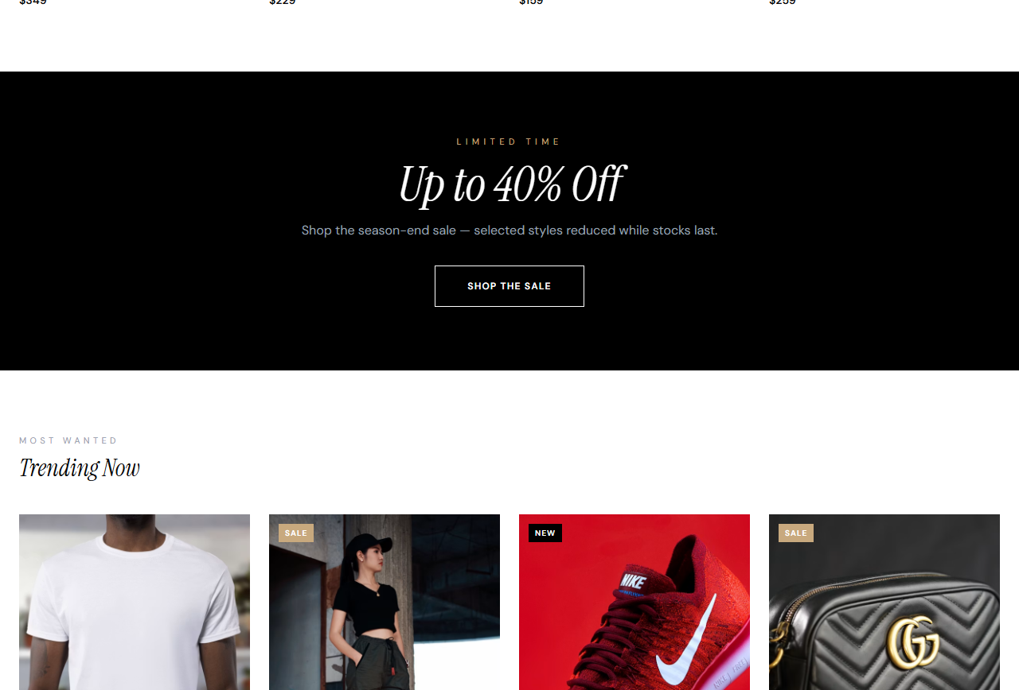
Frontend development
07
The responsive interface supports customer and administrator journeys
Customer experience
Homepage and product discovery
Search, category filters and sorting
Product detail with variants
Wishlist, cart and checkout prototype
Administrator experience
Role-specific sign-in
Product management and inventory views
Orders, customers, promotions and analytics
POP CULTURE CLOTHING
Capstone B · Sprint 4
Notes:
Explain responsive React components, reusable navigation, and role-specific pages.
The frontend does not own product data. It fetches the catalogue from the API and refreshes after CRUD operations.
Target time: 60 seconds.

Slide 8
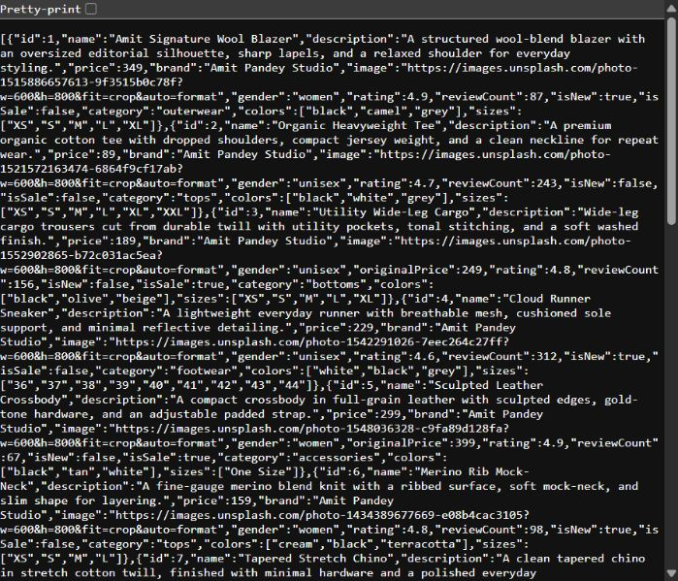
Backend and API development
08
Express validates product data and translates requests into SQL operations
GET
/api/products
Catalogue with variants
GET
/api/products/:id
Single product
POST
/api/products
Create product
PUT
/api/products/:id
Update product
DELETE
/api/products/:id
Delete product
Validation covers required text, positive prices, recognised categories, rating limits and at least one size and colour.
POP CULTURE CLOTHING
Capstone B · Sprint 4
Notes:
Explain that Express opens the SQLite database, validates the payload and uses parameterised queries.
Transactions keep the product row and variant rows consistent during create and update.
Target time: 65 seconds.

Slide 9
CRUD functionality
09
Administrator actions now persist in SQLite and return clear HTTP outcomes
CREATE
POST
New product and variants
HTTP 201
READ
GET
Catalogue or one product
HTTP 200
UPDATE
PUT
Edited product and variants
HTTP 200
DELETE
DELETE
Unused product removed
HTTP 204
Safe failure states
400 invalid data · 404 missing product · 409 product referenced by a cart or order · 500 unexpected database failure
POP CULTURE CLOTHING
Capstone B · Sprint 4
Notes:
Use one temporary record during the live demonstration: create it, read it, change the price, then delete it.
Mention that foreign keys prevent deletion when another record depends on the product.
Target time: 60 seconds.

Slide 10
Testing and validation evidence
10
The automated integration test completed every prepared scenario successfully
Scenario | Expected | Observed | Result
Production build | Bundle compiles | 2,217 modules transformed | PASS
Invalid create | HTTP 400 | Validation details returned | PASS
Create | HTTP 201 | Database ID returned | PASS
Read | HTTP 200 | Created product returned | PASS
Update | HTTP 200 | Name and price persisted | PASS
Delete | HTTP 204 | Record removed | PASS
Read after delete | HTTP 404 | Product not found | PASS
Repeatable command
npm test
The test cleans up its temporary record after completion.
POP CULTURE CLOTHING
Capstone B · Sprint 4
Notes:
Source: docs/sprint4-testing-evidence.md and tests/api-crud-test.mjs.
Mention manual checks for health, database connection, product count and category count.
Target time: 60 seconds.

Slide 11
GitHub evidence and collaboration
11
The repository records research, implementation, integration and verification
4eae6ba
Initial project repository
Research
Data investigation, user research and industry findings
c28a935
Sprint 3 backend and SQLite database
93d9f0a
Frontend and backend combined into one application
Repository
Final
Database CRUD, tests and assessment evidence
github.com/amitpandeyvu-gif/
secure-retail-capstone-b
POP CULTURE CLOTHING
Capstone B · Sprint 4
Notes:
Show the repository folders: src, backend, database, tests, docs and postman.
Point to commit history and merged work rather than relying on verbal claims.
Target time: 50 seconds.

Slide 12
Team contributions
12
Documented roles align presentation ownership with project evidence
Team member | Main contribution | Presentation section
Amit Pandey | Leadership, frontend, backend and final integration | Overview, backend and demo
Sujal | Frontend development and product data investigation | Frontend and requirements
Manish | Interface design and user research | Design and target users
Manoj | GitHub collaboration | Sprint journey and GitHub
Nabin | Development and merchandise user research | CRUD and testing
Ashok | Industry investigation and code review | Research and reflection
Group leader check before submission
Confirm student IDs, name spelling and the final speaking order in docs/team-contribution-record.md.
POP CULTURE CLOTHING
Capstone B · Sprint 4
Notes:
Source: original frontend README roles and Git commit history.
Each member should describe one concrete decision or artifact from their own section.
Target time: 45 seconds.

Slide 13
Live demonstration
13
A short prepared path proves the integration without risking untested features
1
2
3
4
5
Read
Create
Update
Delete
Verify
Open Shop and show database product details
Add one clearly named demonstration product
Change its price and confirm the saved result
Remove the same temporary record
Run npm test and show the passing evidence
Demo rule
Use only the temporary record. Keep the prepared catalogue unchanged and finish with the automated test.
POP CULTURE CLOTHING
Capstone B · Sprint 4
Notes:
Source: docs/live-demo-script.md.
Prepare the admin credentials and terminal before presenting. Keep the demonstration under four minutes.
Target time before demo: 30 seconds. Live demo: about 4 minutes.

Slide 14
Reflection and future improvements
14
The project proved the architecture and identified the next production priorities
What we learned
Next version
Plan the data model before connecting interface state
Use transactions when one action changes several tables
Automated tests make a live demonstration safer
Git history works best when commits explain one clear change
Replace prototype credentials with hashed passwords and sessions
Add role middleware, audit logging and rate limiting
Persist carts, orders, inventory updates and payment events
Deploy with managed backups, monitoring and image storage
Current boundary
Checkout and sign-in demonstrate the user experience. They require production authentication and payment services before real customer use.
POP CULTURE CLOTHING
Capstone B · Sprint 4
Notes:
Be honest about the prototype boundary. The catalogue and product CRUD are integrated. Authentication and payment remain demonstration features.
Explain how security would improve with sessions, password hashing, authorisation middleware and audit logs.
Target time: 65 seconds.

Slide 15
Complete, integrated
and ready to demonstrate
The final system connects a responsive React storefront to an Express API and relational SQLite database, with persistent product CRUD and repeatable testing evidence.
Questions
github.com/amitpandeyvu-gif/secure-retail-capstone-b
Notes:
Close by restating the complete flow from customer interface to API to database.
Invite questions. Use the Q&A topics in the assessment brief to prepare each team member.
Target time: 30 seconds.

