Slide 1
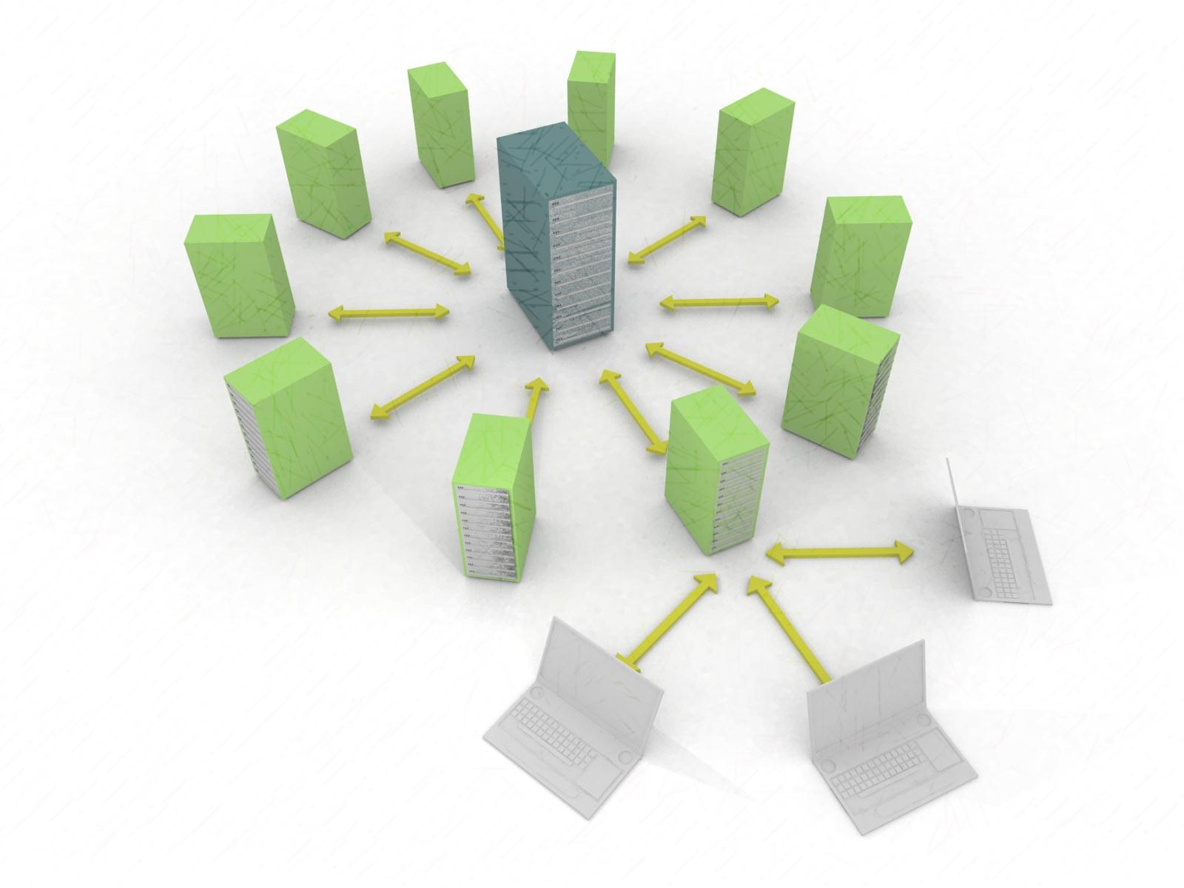
Para-scheduling algorithm for “Architectural Framework for Virtual Computing Lab”
Group 2
Presented By :
1 ] Amit Pandit
2 ] Akanksha Bhalla

Slide 2
Contents
Cloud overview
Cloud services
What is Virtual Computing Lab
Comparative study of different cloud architectures
Problem statement formulation
Proposed Architecture
User Case View / Activity View
Need of Algorithm
Advantages / Disadvantages

Slide 3
Cloud Overview
Allows to access , manage and process the data from remote locations
Five Features :
“on- demand service “
“Broad network access”
“Resource pooling”
“Rapid elasticity”
“Measure Service”

Slide 4
Cloud Services
Three Services are provided :
IAAS ( Infrastructure as a Service )
PAAS ( Platform as a service )
SAAS (Software as a service )
Cloud computing – Virtual Computing
IAAS :
Provides :
Hardware
Storage
Networking

Slide 5
What is Virtual Computing Lab ?
Virtual computing allows computer users remote access to software applications and processes when they need it.
Creates an virtual environment
No need to buy resources
Increases the resources utilization
High Availability and Secure
This makes the need to have virtual computing environment

Slide 6
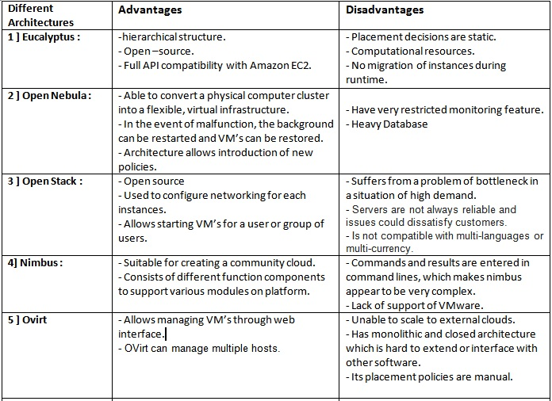

Slide 7
PROBLEM STATEMENT
VCL is intended for designing a private cloud computing system
in an efficient manner.
The VCL is developed using eucalyptus which has several features.
But, it suffers from certain drawbacks
e.g. to serve 48 students in a laboratory simultaneously, we had setup a server with 2 Xeon 6 core each processor and 48 GB RAM.
This limits the number of resources and thus the perception
of infinite resources in a private cloud fails.
Thus, this leads to design an architecture which ensures that
sufficient resources are always available and the cloud never dies.

Slide 8
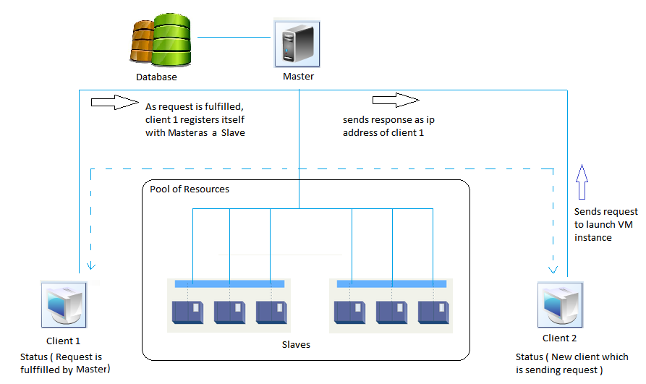
PROPOSED ARCHITECTURE

Slide 9
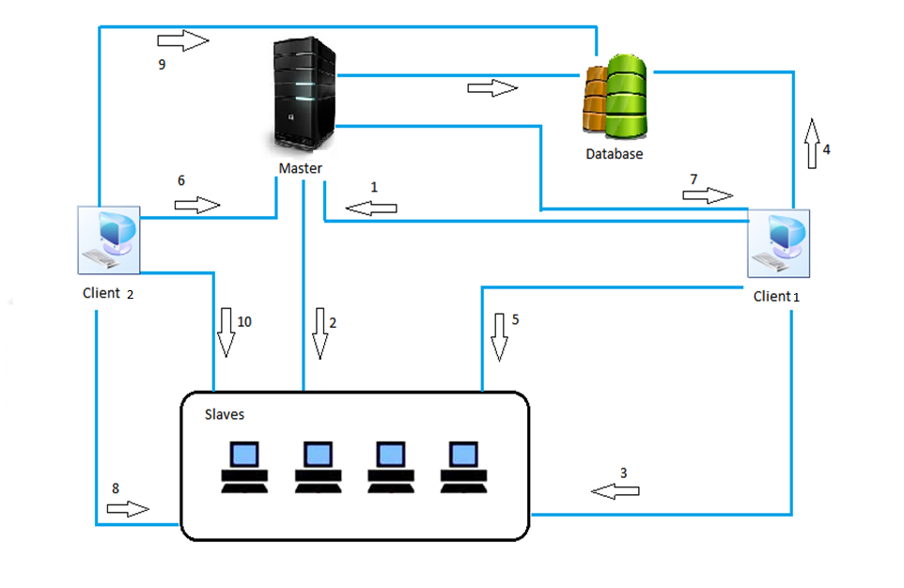
WORKING OF ARCHITECTURE

Slide 10
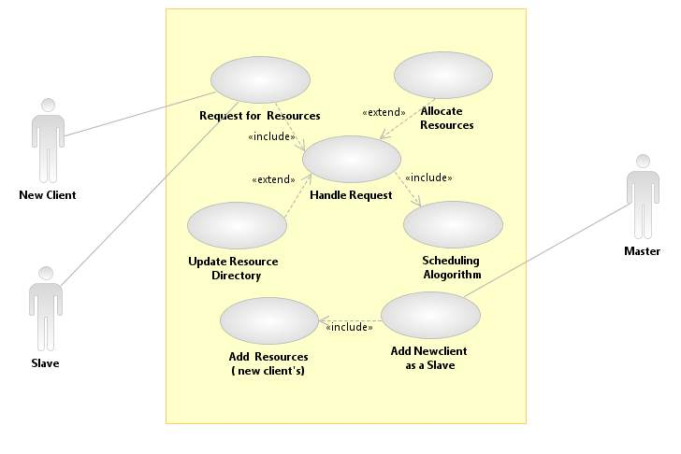
USECASE VIEW

Slide 11
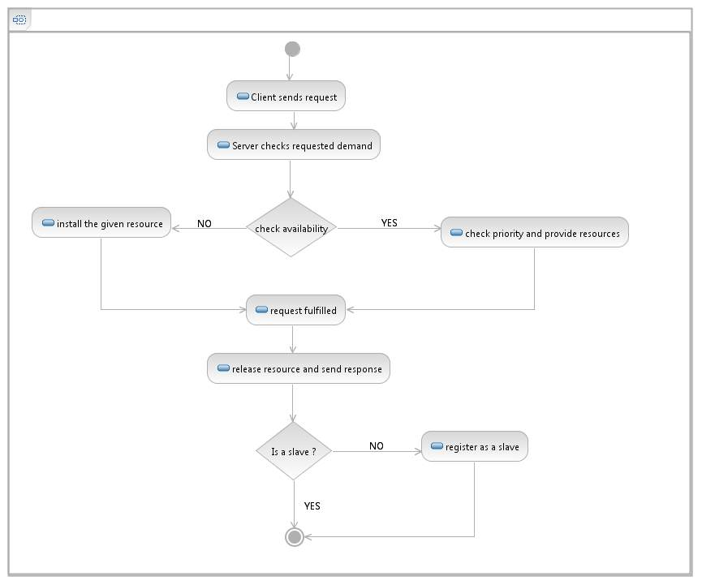
ACTIVITY DIAGRAM

Slide 12
Need of Algorithm
Two types of scheduling
Dynamic - user can define the priorities and other parameters for the scheduling purpose, but it is not possible to change the scheduling policies.
Based on current state of system.
Static - scheduling decisions made only for the new requests.

Slide 14
Mathematical Modeling
Let M be a Master with finite set of resources defined by
following tuple:
M = ( c , m , s , b )
Where, c = CPU resources
m = memory resources
s = Disk storage
b = Network bandwidth

Slide 15
Mathematical Modeling Continued...
Let A=(a1,a2,….,an) be a set of clients , and
Let S=(s1,s2,…..,sn) be a set of slaves.
Each Slave ,
Sk = ( Sk(cpu) , Sk(ram) )
Specifies the CPU capacity and the memory capacity of the VM.
After a client ai registers itself as a slave into set S , S is updated as
S = ∑Sk U ∑an-1 .

Slide 16
PARA-SCHEDULING ALGORITHM
Focus :
Prioritizing client requests
Handling the different conflicts that may arise
Handles the race in conditions
Removes the bottleneck problem
Parameters that will be deciding the priorities and thereby scheduling the requests for the resources
Parameters such as :
Type of resource demanded
Amount of resource required
Time for which the resource is required
Need to maintain at least resource available in the pool of slaves should be satisfied by the algorithm

Slide 17
PARA-SCHEDULING ALGORITHM
No Algorithm – No efficiency !
There could be situation where even the resources is available but cannot be allocated to the client.
Calculation OF Priority :
Where,
PfV = Platform value
RAS = Re as a Slave
R = RAM required in MB
E = Execution time in minute
MON= Member or Not

Slide 18
Current Approaches
Gang scheduling Algorithm
special case of scheduling parallel jobs in which tasks of jobs need to communicate very frequently
Round Robin algorithm
Content-Based Virtual Machine Scheduling Algorithm
lowering the amount of data transferred between racks in the data center when virtual machines disk image are being copied to the host node
Amazon Ec2 Spot instances example
Based on bid price.

Slide 19
ADVANTAGES
Drawbacks of existing open source architecture removed(bottleneck ,etc..).
Adaptive Cloud Approach
Availability of Sufficient resources
Algorithm has Prioritization , Critical Limit . It is Dynamic.
When used in College Environment
Cloud created using existing architecture
Various virtual machine instances
Own storage space for stakeholders of college
Pendrives can’t be detected. No cheating.
No virus problem.
No misuse of Internet bandwidth.

Slide 20
LIMITATIONS
Time required to launch an instance for a new client
Security Issues

Slide 21
CONCLUSION
This adaptive cloud approach will improve the performance of the server and allows cloud servers to extend their computational power, thus allowing increased service capability. An adaptive cloud starts with one master and one slave but grows dynamically as new clients are added to a set of slaves. It ensures availability of sufficient resources.
This will be a good advancement in the way of setting up VCL for college and institutional requirements ensuring maximum efficiency with average amount of resources.

Slide 22
REFERENCES
T. Grance, and P. Mell, “The NIST definition of Cloud Computing,” National Institute of Standards and Technology (NIST), 2009.
Stefan Wind, “Open Source Cloud Computing Platforms”, 2011 IEEE Conference on Open Systems (ICOS2011), Sept 2011, Malaysia
M. Rambhadjan, and A. Schutijse, “SURFnet Cloud Computing Solutions”, Universiteit van Amsterdam, System and Network Engineering, March 2010
Eucalyptus, “Eucalyptus Cloud Management –Elastic, Open, Proven”, In: http://eucalyptus.com, 2011.
OpenNebula, “The open source toolkit for cloud computing”, In. http://opennebula.org, 2011
B. P. Rimal, E. Choi, and I. Lumb, “A Taxonomy and Survey of Cloud Computing Systems”. Fifth International Joint Conference on INC, IMS and IDC, pp. 44–51, 2009
Borja Sotomayor, Ruben, Ignacio, Llore, “An Open Source Solution for Virtual Infrastructure Management in Private and Hybrid Clouds”, IEEE Internet Computing, Special Issue on Cloud Computing, 2009
http://www.academia.edu/6880963/A_Review_on_Virtual_Machine_Scheduling_in_Cloud_Computing_

Slide 23
THANK YOU

