Slide 1
CA-3 · AGENTIC SYSTEMS
TestPilot AI
Agentic software testing
and bug detection
Team: [Add team names] · [Course / date]
Python · FastAPI · React · SQLite
Notes:
Hello. Our project is TestPilot AI, an agentic software testing and bug-detection platform for Python modules. It coordinates a bounded sequence of specialized agents, records what each did, and reports the evidence it actually collected. The system keeps the original file untouched and can propose a verified patch. I will cover the problem, the agent workflow, the architecture, and measured results from the three bundled samples. Please replace the team and course placeholders before presenting.

Slide 2
PROBLEM AND DOMAIN
The testing gap
Why this matters
Chosen domain: Python QA
• Edge cases are easy to miss
• Test writing takes focused time
• Generated tests need trustworthy expectations
• A suggested fix must not silently break passing behavior
Input: source + requirements
Process: analyze → test → review
Output: evidence + findings + patch diff
Design rule: make test status and oracle quality explicit.
02
Notes:
The problem is feedback speed and coverage. A developer may know the intended behavior but not have time to explore every boundary or invalid input. A generator can help, but it must distinguish examples with explicit expected values from heuristic robustness checks. TestPilot AI takes Python source and optional requirements, then returns generated cases, observed outcomes, findings, and possibly a patch. The chosen domain fits a multi-agent workflow because planning, analysis, test design, execution, review, repair, and reporting have clear responsibilities and evidence boundaries.

Slide 3
EXISTING CHALLENGE → PROPOSAL
From single app to contract-driven system
Repository foundation
CA-3 system
Streamlit UI
Shared orchestration core
SQLite persistence
Sandbox-aware runner
Fix proposal and report tools
React + TypeScript client
FastAPI JSON contract
54 checked API operations
Seven registered agents
Browser E2E and evidence docs
→
03
Notes:
The starting repository already had the domain workflow and the seven-agent core in a Streamlit application. The CA-3 work preserves the domain logic while adding a React and TypeScript frontend, a typed FastAPI boundary, and live route and browser verification. The API contract is checked against all 54 method and path operations, and the browser flow exercises registration, sign-in, sample analysis, fix review, downloads, and reports. This is an extension around the existing system rather than a new QA engine invented for the presentation.

Slide 4
COOPERATION AND CONTROL
Seven agents, one bounded workflow
1
Planner
2
Code Analysis
3
Test Generation
6
Fix
5
Critic
4
Test Execution
7
Reporting
Critic may request another evidence cycle only while the configured iteration bound allows it.
04
Notes:
The sequence is explicit in the orchestrator. Planner checks objective and tool availability. Code Analysis parses the module and produces static findings. Test Generation combines deterministic cases with requirement examples and doctests. Test Execution runs them through the configured runner. The Critic separates confirmed failures from heuristic evidence and can ask for a bounded follow-up cycle. Fix evaluates candidate changes against the same tests, and Reporting persists the merged evidence. Tool calls include names, summaries, results, success state, and duration, so this is inspectable cooperation rather than an opaque agent chat.

Slide 5
COMPONENTS AND DATA FLOW
System architecture
Browser → React/Vite → FastAPI → background worker → orchestrator
Seven agents use analysis, test generation, isolated execution, fix verification, and report tools. SQLite stores accounts and run evidence; reports are downloadable through the API.
05
Notes:
This diagram follows the running implementation. The browser uses React and the Vite development proxy to call FastAPI. The API validates and authorizes requests, records run state, then dispatches work to a background worker. The orchestrator shares structured state among the seven agents and invokes domain tools. SQLite stores run and account evidence. Reports and downloads return through typed API routes. Docker is the recommended code-execution boundary; local trusted mode is explicitly not a sandbox. The optional model adapter is separate and requires configuration and consent for remote use.

Slide 6
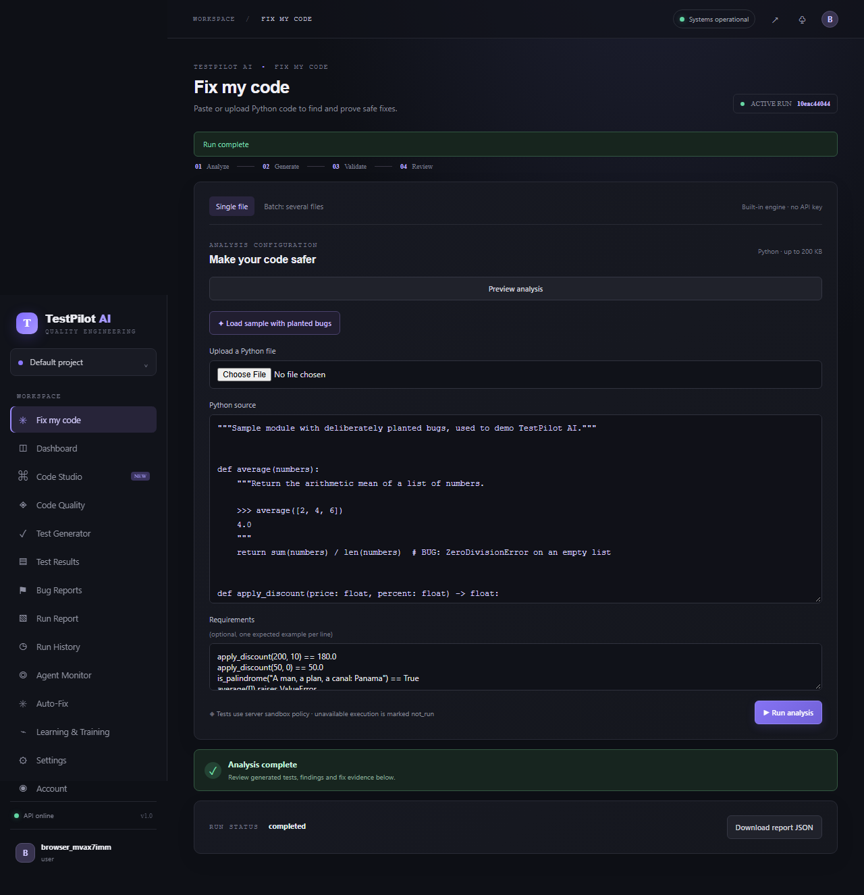
DEMO EVIDENCE
Live flow: sample to verified patch
Demo path
Load sample
Run analysis
Inspect tests
Review diff
Download report
06
Notes:
This screenshot is from the running React application during the browser end-to-end flow. In a live demo, open Fix my code, load the planted-bug sample, and run the analysis. Show the generated tests and findings, then inspect the Auto-Fix diff and download the report. The browser test also verified registration, explicit sign-out and sign-in, downloads, and the agent monitor. No API key was entered, and the sample workflow used the built-in deterministic engine.

Slide 7
EVIDENCE, NOT A BROAD ACCURACY CLAIM
Measured results on bundled samples
Sample | Cases | Before pass/fail/error | After pass/fail/error | Fixes
sample_buggy.py | 84 | 77 / 6 / 1 | 82 / 1 / 1 | 3 verified
sample_inventory.py | 135 | 123 / 9 / 3 | 131 / 1 / 3 | 7 verified
sample_shop.py | 26 | 23 / 3 / 0 | 26 / 0 / 0 | 2 verified
Total: 245 cases · passing 223 → 239 · 12 accepted fixes · 0 regressions
Local trusted execution · deterministic engine · three planted-bug samples · 2 failures + 4 errors remained
Future scope: larger corpus · Docker evaluation · CI feedback · optional MCP / LangGraph exploration
07
Notes:
These are measured results from real Orchestrator.start runs, using the supplied requirements files and local trusted execution on bundled samples. Across 245 generated cases, passing outcomes increased from 223 to 239 after 12 accepted fixes. The fix agent reported zero regressions. Two failed assertions and four errors remained, so this is not a claim that all defects were fixed. The dataset contains only three intentionally buggy samples; it is too small to support a general accuracy claim. Future scope includes a larger independent corpus, Docker evaluation, CI integration, MCP-backed tools, more languages, and an optional LangGraph comparison. The exact settings, findings, timings, and limitations are documented in the validation report and JSON artifact.

Slide 8
CONCLUSION AND NEXT STEPS
Evidence-led testing, with clear limits
What the system demonstrates
Next
• Coordinated, bounded agent workflow
• Confirmed and heuristic evidence labeled
• Fixes re-tested before acceptance
• API, frontend, and browser journey verified
Broaden sample corpus
Add isolated execution coverage
Measure across independent modules
08
Notes:
TestPilot AI demonstrates a complete evidence path from source to report, with a bounded workflow, explicit oracle quality, and patch verification. The browser and endpoint checks cover the client-to-service integration, while the three sample runs show actual before and after outcomes. The main next step is evaluation on a larger, independently selected corpus and validation under the recommended Docker isolation mode. We should continue to report unresolved cases and avoid treating heuristic success as proof. Thank you; I am ready for questions.

