Slide 1

SEER BHARAT: an early-warning prototype for forest-edge villages
Service Learning, AY 2026-27 · Group 15
Multi-sensor predator detection, long-range alerts and a map that protects both people and animals
Gaurang Yogesh Surte (25070126514) · Aditya Shelar (24070126019)
Amit Pawar (25070126501) · Akshat Chandekar (24070126022)
Lakshya Saxena (25070126502)
NGO: SEER BHARAT Foundation, Pune Faculty coordinator: Dr. Aditi Saxena
Notes:
Group 15, SEER BHARAT. Order of the talk: the NGO and the problem, how the whole system works, the team-built app and portal, then my own hardware work in three parts, the test results, how we protect animals and data, and finally the challenges and next steps. Everything shown is a prototype: the app displays demo records only, and the field node has been exercised in a simulator, not in a forest.

Slide 2
Our project and who did what
Why we chose it
Area | Who | What was done
Hardware and coding | Gaurang, Aditya | Part research, circuit and pin map, solar power, ESP32 code, Wokwi tests
Public app and Forest portal | Amit, Akshat, Lakshya | Screen layout, sighting capture, alert list, SMS-style notice, map with safe-area finder
Research and planning | Lakshya | NGO study, community problem survey, topic choice, workflow
NGO handover set | Team | Manual, user guide, demo video, hardware guide, implementation guide
Predators now wander close to farms and roads
Forest areas often have no mobile data
It brings AI, embedded design and apps together
Our goal
Build a working path from detection to alert: a solar-powered node senses a predator, reports where it is across a long-range radio link, and warns residents and forest staff.
This is a prototype: demo records in the app, a simulator for the hardware.
Period: 1 July to 17 October 2026 (14 logbook weeks) Hours: 123 verified, signed by the NGO
Notes:
The NGO asked us to look at how technology can help people and the environment. We picked human-wildlife safety because warnings reach villagers late and the forest has no reliable network. My part is hardware and coding, together with Aditya Shelar; Amit, Akshat and Lakshya built the app and portal, and Lakshya led the research and planning. The 123 hours are recorded in my signed time log.

Slide 3






The NGO and the problem we picked
Shrinking green cover
People meet predators
Habitat loss pushes animals towards settlements
Villagers hear about an animal only when it is close
SEER BHARAT Foundation
A non-profit in Wakad, Pune, working across education, environment and empowerment. It applies technology to practical problems and keeps endangered information from being lost.
Years of unused data
Weak connectivity
Deforestation records never became maps or rates
Apps alone fail, so radio and SMS are needed
Hardware in the open
Parts that must agree
Weather, power and cost all limit a field device
Detection, radio, location, app and portal as one system
Problem statement: warn people early and reliably about predators near settlements, even without internet, while keeping the animal's exact position away from the public.
Notes:
These six problems came out of our early meetings with Mr. Talhande and the first weeks of research. They explain every design choice later: radio and SMS because of poor network, solar power because of no mains supply, and a blurred public map because a precise position can put animals in danger.

Slide 4
Fourteen weeks, start to finish
1-15 Jul
15-31 Jul
Aug
1-15 Sep
15-30 Sep
1-17 Oct
Meet the NGO
Research
Pick and plan
Build the app
Portal + hardware
Code and hand over
First online meeting; how the NGO works
Office visit; AI and technology ideas
Community issue study; topic; hardware needs
Sighting capture, alerts, SMS notice, map
Staff portal; LoRa clusters; Wokwi begins
Circuit, power, code, tests, documents
123
verified hours
7
progress reports
14
signed logbook weeks
Notes:
Read the line left to right. The first month was understanding the NGO and choosing a topic. September was the busiest software month, with the camera, alert and SMS screens and the live map. Late September and October moved to the hardware: research, circuit, solar power, code and tests. The bar chart uses the hours in each fortnightly progress report; they add up to 123.

Slide 5

How the system works
SENSE
DECIDE
SEND
ALERT
AI vision + infrared camera
LoRa SX1262
long-range link
Gateway decoder (Python)
Ground vibration (ADXL355)
ESP32
fusion score
Microphone (ICS-43434)
Public app + Forest portal
SIM800L GSM
SMS fallback
GPS (NEO-M8)
SD card log
Nearby phones (SMS)
Power: a 40-50 W solar panel charges a 12 V, 20 Ah LiFePO4 battery through an MPPT controller, which runs the whole node
Several kinds of evidence must agree before an alert is raised, so one noisy sensor cannot set off a warning by itself.
Notes:
The node watches with four inputs. The ESP32 turns the camera, vibration and sound readings into one score, writes the event to an SD card, and sends it by LoRa to a gateway. Where residents have no internet, a GSM module sends an SMS instead. The gateway decoder passes records on to the resident app and the staff portal. A solar panel, charge controller and battery keep it running without mains power.

Slide 6


Who benefits, and why it matters
Villagers
Wildlife
Forest staff
The NGO
Earlier, clearer warnings that still reach them without internet
Less chance of panic, chase or retaliation after a sighting
Located, verified reports gathered in one place
A documented design it can build on without us
Linked UN Sustainable Development Goals
SDG 3
SDG 9
SDG 11
SDG 15
Good health and well-being
Industry, innovation, infrastructure
Sustainable communities
Life on land
Safer daily life near forests
Low-power field technology
Alerts built for villages
Predators and habitat protected
Notes:
The system is meant to protect people first, but also the animals, because a late or vague warning often leads to panic and retaliation. The SDG links are our own mapping of the project to the goals, not an official classification.

Slide 7
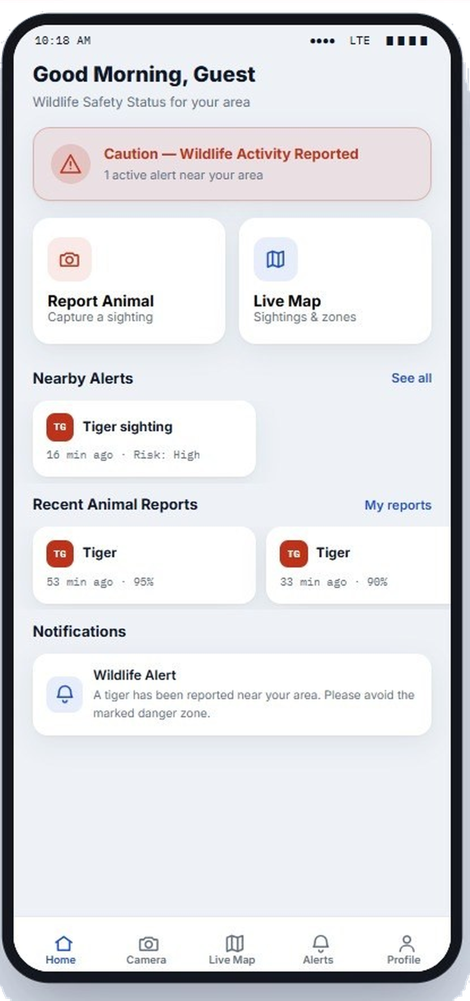
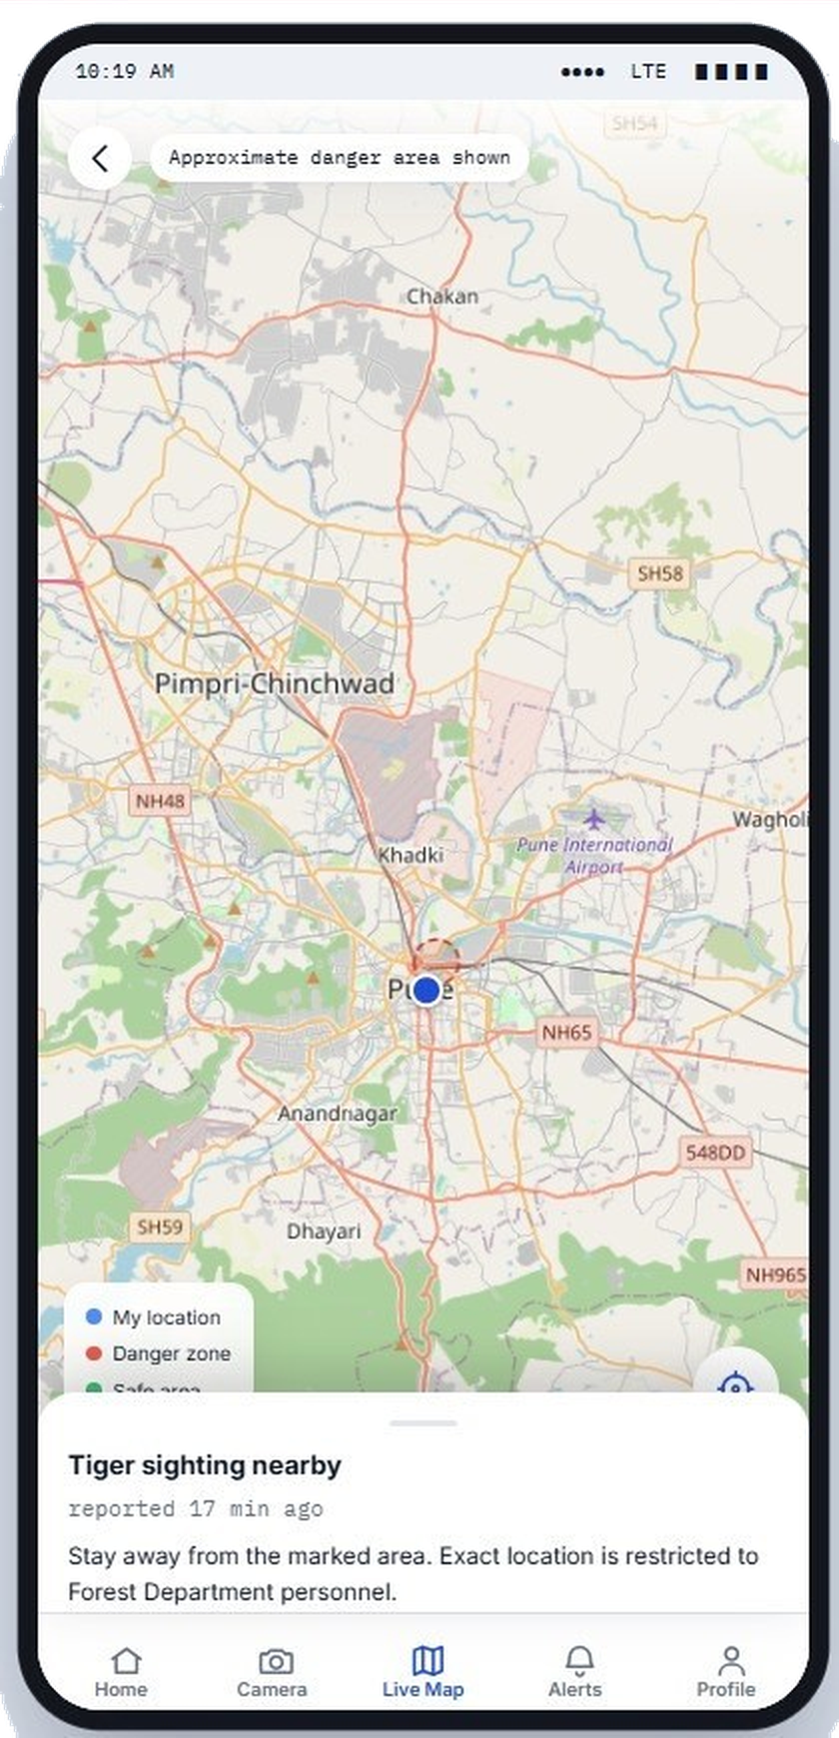
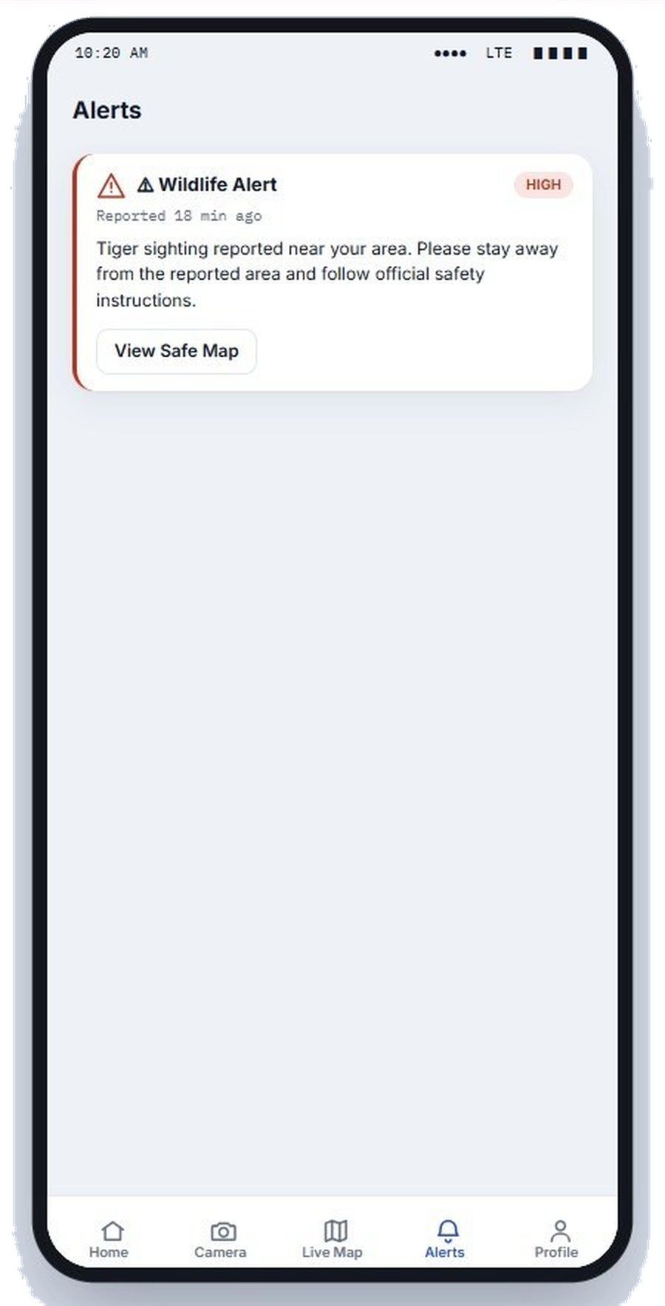
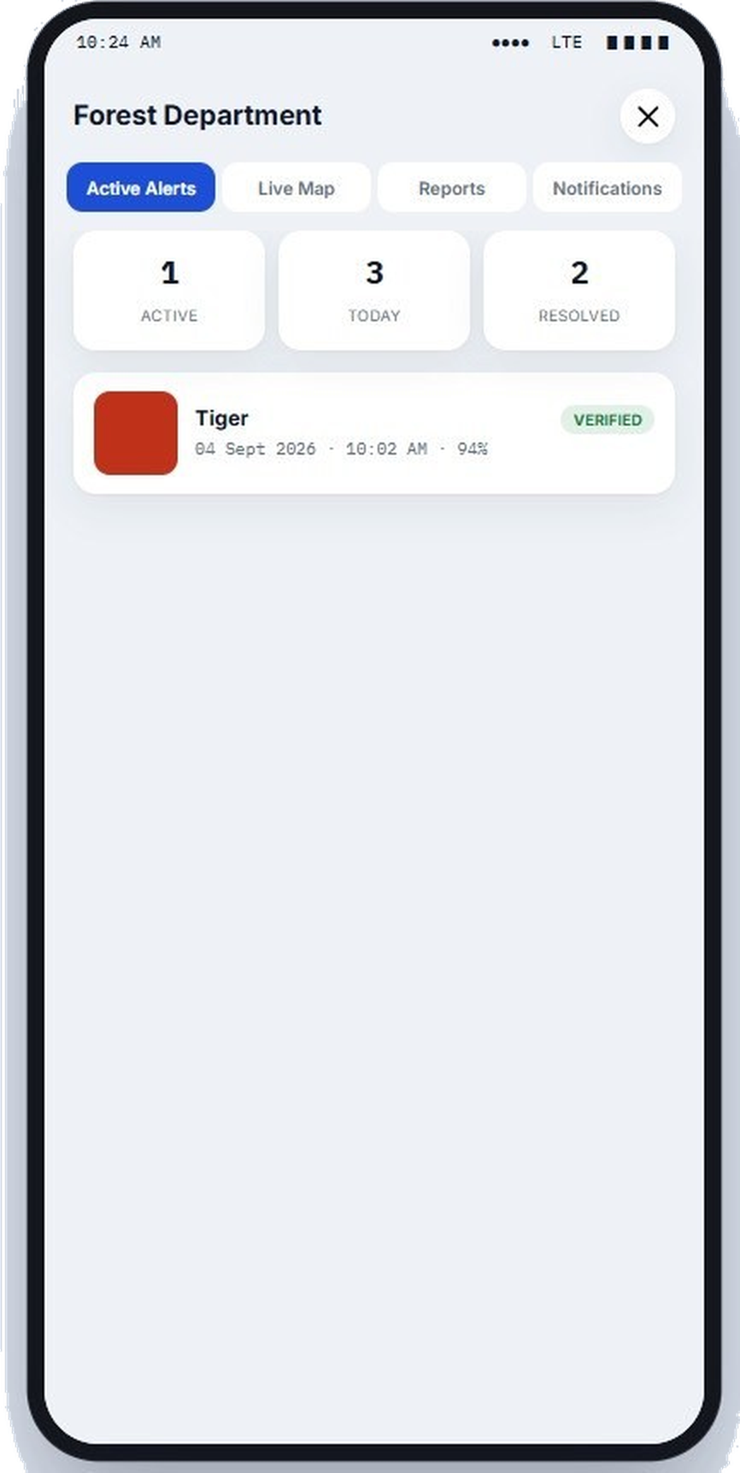
Screens for residents and forest staff
Built by Amit, Akshat, Lakshya
Two sign-in roles: resident and forest staff
A home screen with status, nearby alerts and a sighting report
A map marking a danger zone and safe areas
Staff tabs for alerts, map, reports and notices
Every screen shows demo records behind a dummy sign-in. No real accounts or personal details are stored.
Home: status and alerts
Map: approximate zone
Alert with risk level
Forest portal (sample)
Notes:
Amit Pawar, Akshat Chandekar and Lakshya Saxena built this frontend. It has a public side and a forest-staff side. The camera report, alert list and live map are working screens, but they run on sample data. Notice the map banner: residents get a rough danger area, while the precise spot stays with forest staff. I include it because the hardware I built is what will eventually feed these screens.

Slide 8


Choosing the hardware
Gaurang Yogesh Surte 25070126514, Aditya Shelar 24070126019 Individual work 1 of 3 Weeks 6-11 (22 Aug - 26 Sep)
Sense
Think
What we looked for
Grove AI vision module with NPU and IR camera; ADXL355 vibration sensor; ICS-43434 microphone; NEO-M8 GPS
ESP32 DevKit reads every sensor, scores the evidence, logs and sends
Runs AI detection at the edge
Survives weather and rough use
Low power draw, solar friendly
Works in clusters with long range
Parts and libraries that fit together
Talk
Store and power
SX1262 LoRa radio for range; SIM800L GSM module for SMS where there is no internet
SD card keeps a local log; a 40-50 W solar panel and MPPT controller charge a 12 V, 20 Ah LiFePO4 battery
Result: a parts list that covers sensing, decision, radio and power, and fits together.
Notes:
In week 6 the main worry was whether our parts could compete with ordinary systems, and whether they were compatible. By week 10 I had researched which boards run AI well and survive outdoors. In week 11 I studied how nodes would work as a cluster and talk to real LoRa towers, and I collected ready-made libraries so I could begin prototyping.

Slide 9
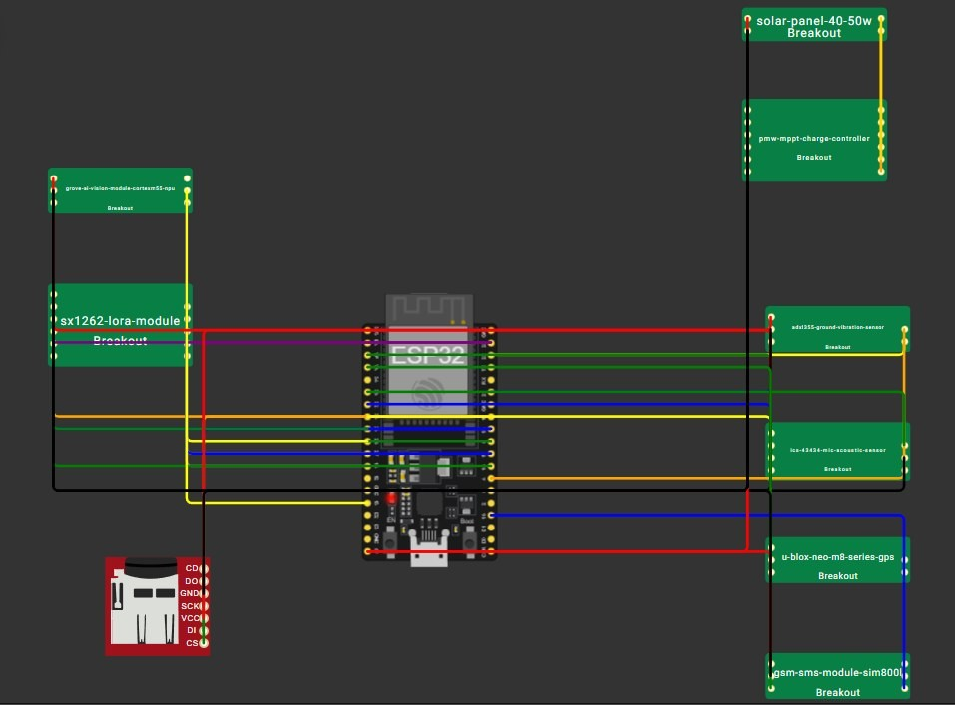
Circuit and solar power design
Gaurang Yogesh Surte 25070126514 Individual work 2 of 3 Weeks 11-13 (26 Sep - 10 Oct)
ESP32 at the centre, every module wired to it
Pin map worked out for each sensor and radio
Solar panel and MPPT controller feed the battery
Proved online first, to be built physically later
Week-13 review by an electrical engineer
Solar
MPPT
LiFePO4
Node
Power chain that lets the node run without mains supply
Circuit diagram of the node in the Wokwi simulator
Result: a complete, reviewed wiring and power plan for the field node.
Notes:
Red wires carry power, black wires ground, and the other colours carry signals. The solar panel and its controller are drawn in the upper right corner. Most of week 12 went into finding libraries that work with the chosen hardware. The plan was to prove everything in the simulator before buying parts, and an electrical engineer examined the design and approach the following week.

Slide 10
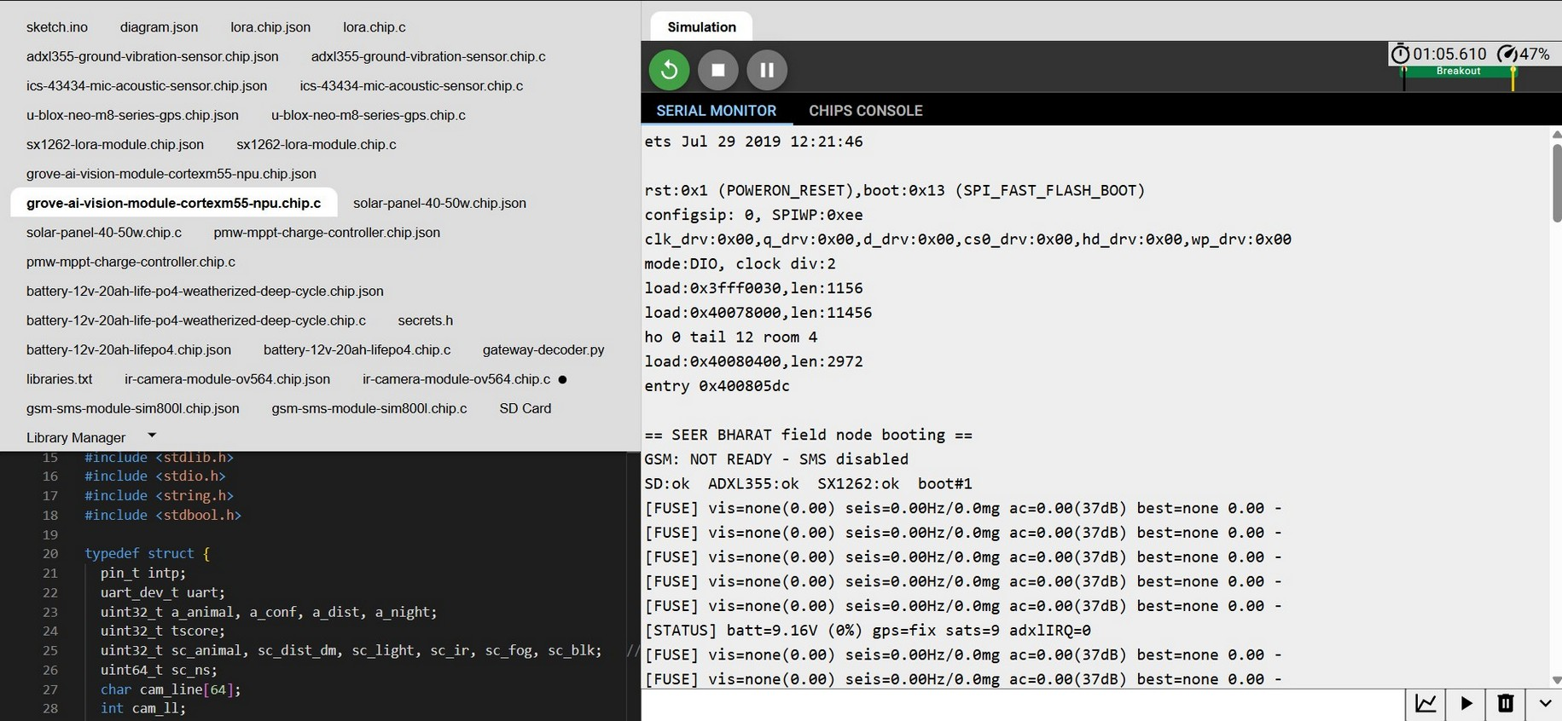
Firmware and the fusion score
Gaurang Yogesh Surte 25070126514, Aditya Shelar 24070126019 Individual work 3 of 3 Weeks 12-14 (3 - 17 Oct)
1
Read
Vision result, ground vibration in Hz and mg, sound level in dB
2
Score
Animal type, confidence, distance, light, infrared, fog and obstruction each add to the score
3
Combine
One total score decides whether an alert message is built
4
Act
Simulator view: code on the left, serial monitor on the right
Log to SD card, then send by LoRa or SMS
[FUSE] lists each evidence reading and the winning score
[STATUS] reports battery level, GPS lock and the vibration flag
Result: a working firmware prototype that fuses evidence and reports its own status.
Notes:
On start-up the node prints a banner and a self-check, then keeps printing two kinds of lines. The FUSE line lists the vision, ground-vibration and sound readings together with the winning score, where 0.00 means nothing was spotted. The STATUS line reports the battery, whether the GPS has a fix, and the vibration flag. The final coding was completed and tested part by part in week 13, and the NGO document set was prepared in week 14.

Slide 11

What the tests showed
Check in the simulator | Observed | Status
SD card, ADXL355, SX1262 start-up | All three reported ok | Passed
GPS status | Fix with 9 satellites | Passed
Fusion with no animal present | Score stayed at 0.00 | Passed
GSM module | Reported not ready, SMS disabled | Open
LoRa chip model | Logged an unknown opcode note | Open
Not done yet
No physical node has been built
No forest trial has taken place
No real SMS or LoRa message delivered
Detection not trained on real forest data
App shows demo records only
In the run we captured, the GSM module never became ready and the LoRa model flagged a command it lacks. Both are noted as fixes for the driver stage, not as completed radio or SMS tests.
Result: a design that starts up correctly in simulation, with its gaps stated openly.
Notes:
I tested each part separately instead of trusting a single run. The start-up check, GPS and fusion behaved as expected. In the run I captured, the GSM module had not become ready, and the LoRa model printed an unknown-opcode message; I logged both as jobs for the driver stage rather than passes. These are honest limits: the right-hand box lists what still has to happen before any alert can be trusted.

Slide 12



Protecting animals, people and data
Approximate zone for the public
Exact position for staff only
Residents see a danger area and safety advice, never a pin on the animal.
Precise locations stay inside the Forest Department portal.
Location sharing is optional
No real personal data in the prototype
A public user can switch location use off and still read alerts.
Demo sign-in, sample reports and local SD logging only.
Before any real deployment
Link the screens to a real server with proper accounts and secure login, try the radio and SMS chain outdoors, and check the detection model on forest data so the false-alarm rate is known.
Notes:
Two groups need protecting here. Animals can be harmed if their exact position is public, and villagers should not be forced to share their location. That is why residents see only a rough area and the precise position is kept for forest staff. The prototype stores no real personal data. A real rollout would need secure accounts and field validation first.

Slide 13
Challenges and how we handled them
Challenge | What we did
No mobile network in forests | Designed a LoRa link with an SMS fallback instead of an app-only alert
Reliable detection on a small device | Chose a vision module with its own NPU and combined three kinds of evidence
Libraries that fit the chosen parts | Spent most of week 12 matching them, and tested each part in Wokwi first
Hardware only half done in week 6 | Kept researching boards and LoRa clusters in weeks 10 and 11
Exact animal location could invite harm | Showed the public only an approximate zone
What we learnt
Test in small steps and read what the system tells you
Prove a design in simulation before spending on parts
Real limits (network, power, weather) shape the design
Privacy is a design rule, not an afterthought
Notes:
The first challenge, network range, shaped the whole architecture. Detection reliability and camera capture on a low-power node were open concerns we noted in our report, and combining several evidence streams is one way we addressed them. The panel on the right sums up what the project taught us.

Slide 14
Outcome, next steps and thanks
Group 15 | SEER BHARAT
Completed
Impact
Next steps
Project topic and workflow settled with the NGO
Public app and Forest portal prototype
Simulated, reviewed node design with code
Manual, user guide, demo video, hardware guide
A clear path from detection to alert
Staff see located, verified reports
The public sees approximate zones only
Build and field-test a physical node
Train the model on real forest data
Finish and test the LoRa and SMS chain
A live server with secure accounts
Thank you Mr. Darshan Talhande (Founder, SEER BHARAT Foundation), Dr. Aditi Saxena (Faculty coordinator) and our teammates. Questions welcome.
Notes:
To close: the NGO now has a settled workflow, working app and portal screens, a reviewed hardware design with its code, and a document set it can use on its own. The next steps all concern moving from simulation to the field. Thank you to Mr. Talhande for guiding the project, to Dr. Saxena for the programme, and to my teammates. Questions are welcome.

