Slide 1
RECONDITION HOUSE MANAGEMENT SYSTEM
Presented by : Amit Pradhan
Module : Computing Project
Level 5 diploma in computing
Softwarica college of it & e-commerce

Slide 2
Project Introduction
The project is about the online motorcycles booking system.
The project is organization based system.
Developed using Waterfall Model.
Tools used for software development are:
PHP as programming language on (LARAVEL framework)
MySQL as DBMS.
Sublime Text 3 as Editor.

Slide 3
Problem Statement
Clients will have direct interaction which keeps agents (brokers) away.
Clients will have more options or favor according to their desire.
Clients do not have to worry about prices (No bargains) due to reasonable prices.

Slide 4
Aims
Automatize the Data Management System.
Provide online services to the clients.

Slide 5
Objectives
Proper analysis on the market situation
Meeting the requirement
Providing online services to the clients
Creating attractive design (GUI)
Designing secure Database
Performing proper Testing
Performing Maintenance

Slide 6
Features of the project
Authentication
Booking System
Data Management
Security
Data Inquiry

Slide 7
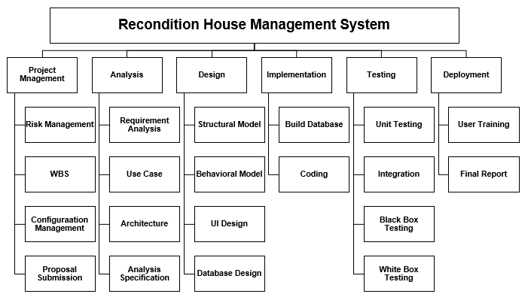
WBS

Slide 8
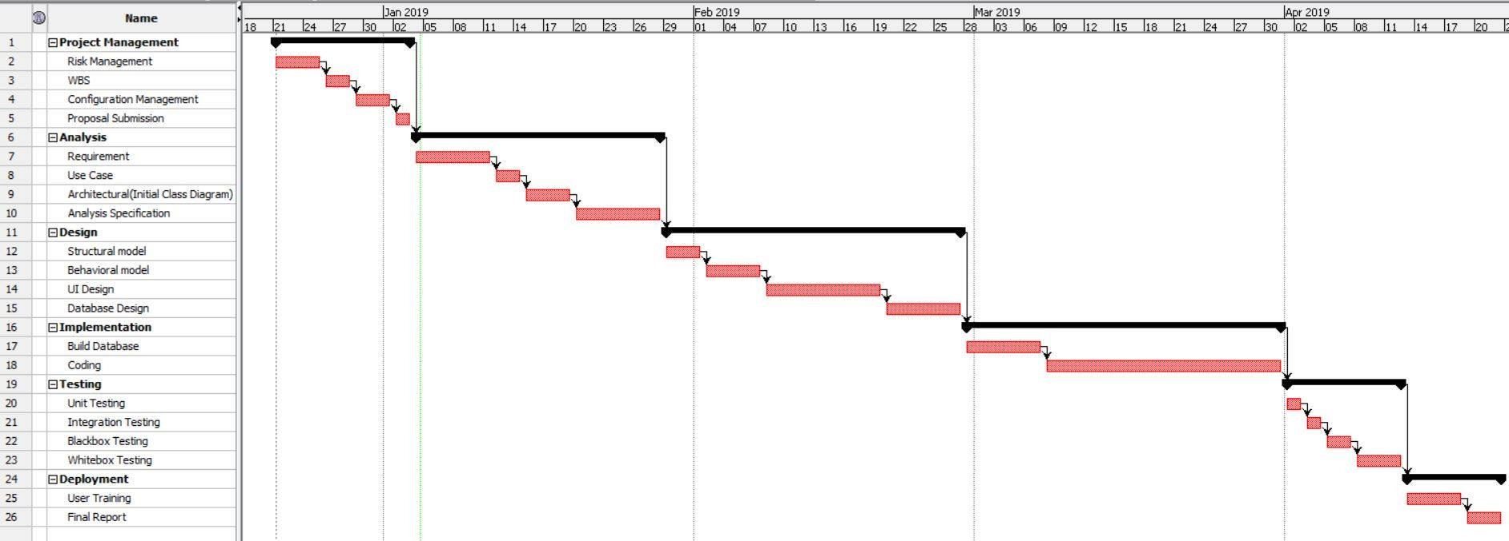
Gantt chart

Slide 9
Development Methodology
Software developed with Waterfall Methodology. Stages are as follows:
Requirements Analysis
System Design
Implementation
Testing and verfication
Deployment and Maintenance

Slide 10
System architecture
3-Tier Architecture:
Client (UI)
Application (Business logic)
Database (Data storage)

Slide 11
Design Pattern
MVC (Model View Controller):
Model :
Represents an objects.
View :
Represents the visualization of the data that model contains.
Controller :
Controls the data flow into model object and updates the view whenever data changes

Slide 12
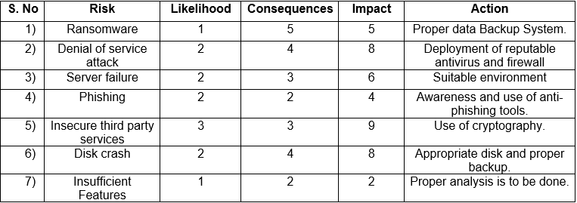
Risk and Configuration Management: 1
Risk Management:

Slide 13
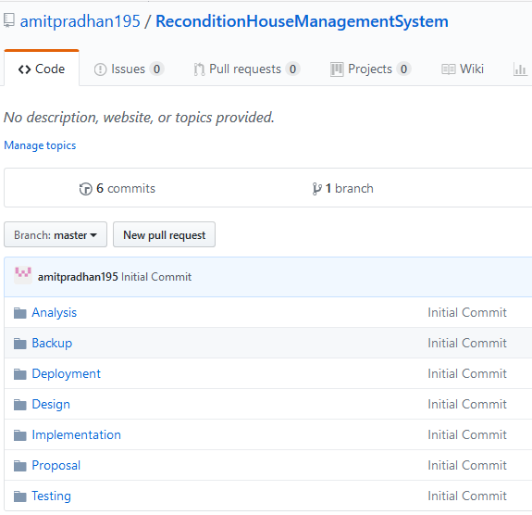
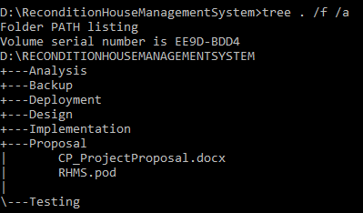
Risk and Configuration Management: 2
Configuration Management

Slide 14
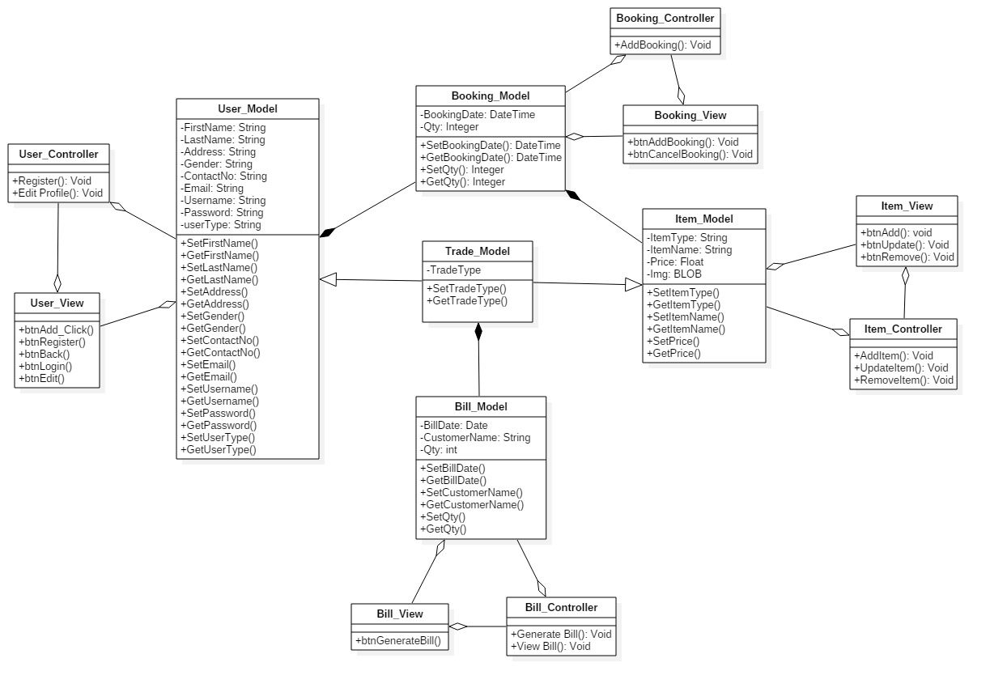
Design

Slide 15
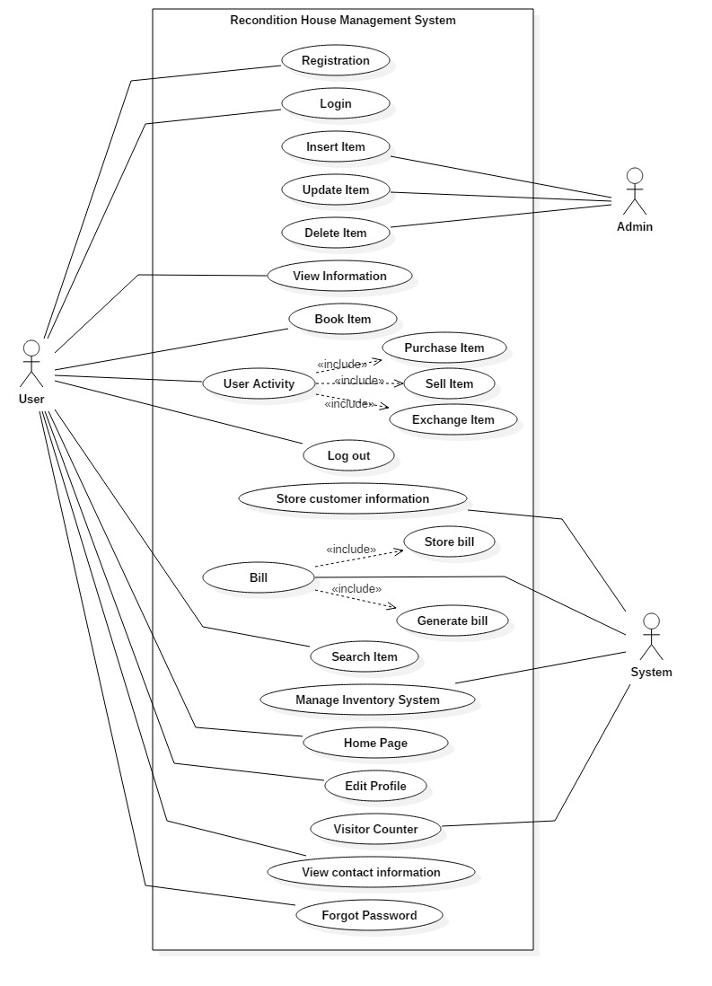
Use Case Diagram

Slide 16
Future Work
Purchase from customer
Exchange offer

Slide 17
Scope and limitation of project
Scope:
Digital marketing.
Direct interaction with end users.
Limitation:
Lacks online payment system.

Slide 18
User Manual

Slide 19
Conclusion
The proposal defines all the requirements and plans about the project that provides an online services to allow book products, manage products stocks, and distribute relevant information about the products inventory.

Slide 20
References
https://www.codecademy.com/articles/mvc
http://toolsqa.com/software-testing/waterfall-model
https://en.wikipedia.org/wiki/Work_breakdown_structure
https://www.tutorialspoint.com/uml/uml_class_diagram.htm
https://www.tutorialspoint.com/uml/uml_use_case_diagram.htm
https://www.tutorialspoint.com/uml/uml_activity_diagram.htm
https://stackoverflow.com/questions/16475979/what-is-the-difference-between-functional-and-non-functional-requirement

