Slide 1

Employee Record Management System
BY- VIKASH CHAURASIYA
PRITAM PRAJAPATI

Slide 2


The Employee Record Management System is a web-based application
developed using the Django framework.
Manage the employee information efficiently in the organization.
The application is designed with separate login access for employees
and administrators.

Slide 3



‎
Enable CRUD (Create, Read, Update, Delete) operations.
Facilitate filtering and searching of employee data.
Facilitate exporting employee data into csv, pdf, excel
and can also copy the data
Secure admin-based access.
This Photo by Unknown Author is licensed under CC BY-SA

Slide 4



DJANGO
Technology Used:
PYTHON
HTML,
CSS,
BOOSTRAP
MYSQL
JAVASCRIPT

Slide 5







System Architecture
Client: Browser(HTML, CSS +Bootstrap)
Server: Django Framework
Database: MySQL
Flow:
Database: SQLite/MySQL
Django (Processes Logic & Routes)
Database (Stores/Fetches Data)
Django (Renders Response)
Browser (Displays Output)

Slide 6

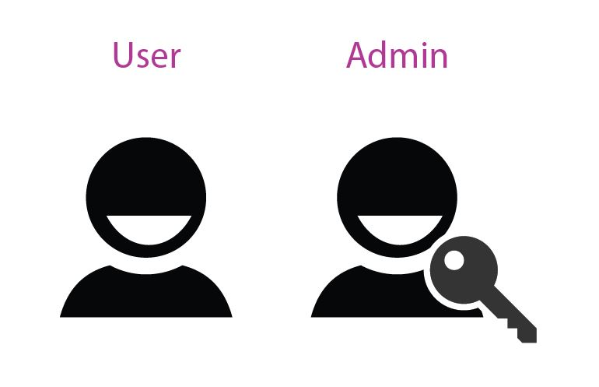
Core Modules
It has two modules: Admin and User
Admin Module: Manages all employee records such
as view, edit, delete.
Admin can filter the employee as well as export
the employee's data.
User Module: Register and view personal records.
User can also edit personal profile, education
details, etc.

Slide 7



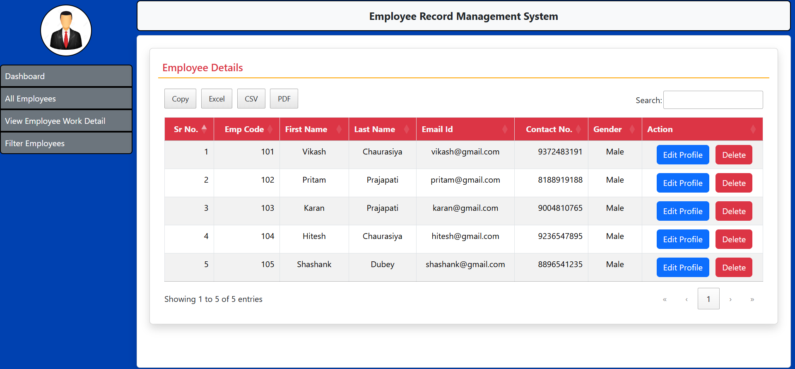
Features Implemented
Implemented Features are:
Add new employee.
View employee list.
Edit and delete employee records.
Filter by department, role, etc.
Admin authentication i.e. Login, Logout, etc..
User authentication i.e. Login, Logout, etc.

Slide 8

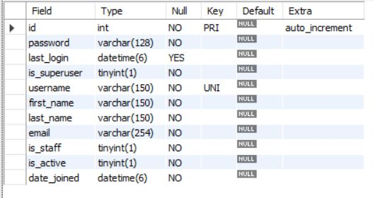
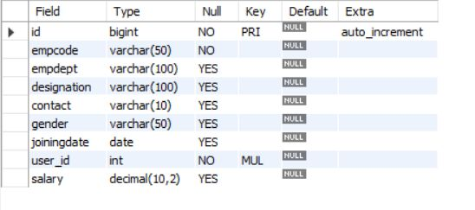
Database Tables
User table:
employee_employeedetail table:

Slide 9
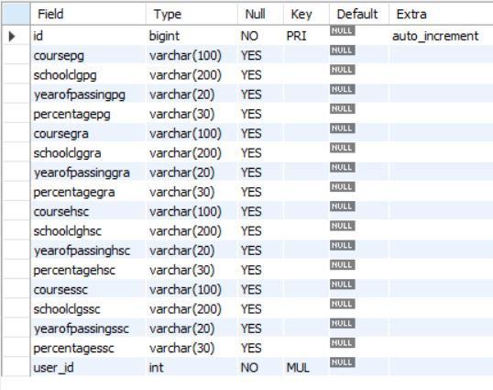
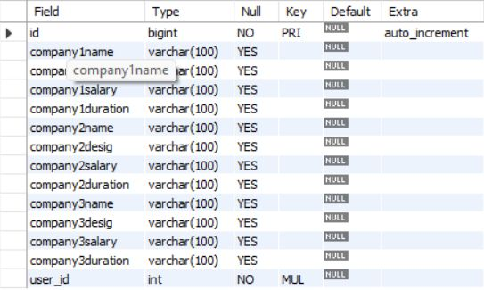
employee_employeeeducation table:
employee_employeeexperience table:

Slide 10

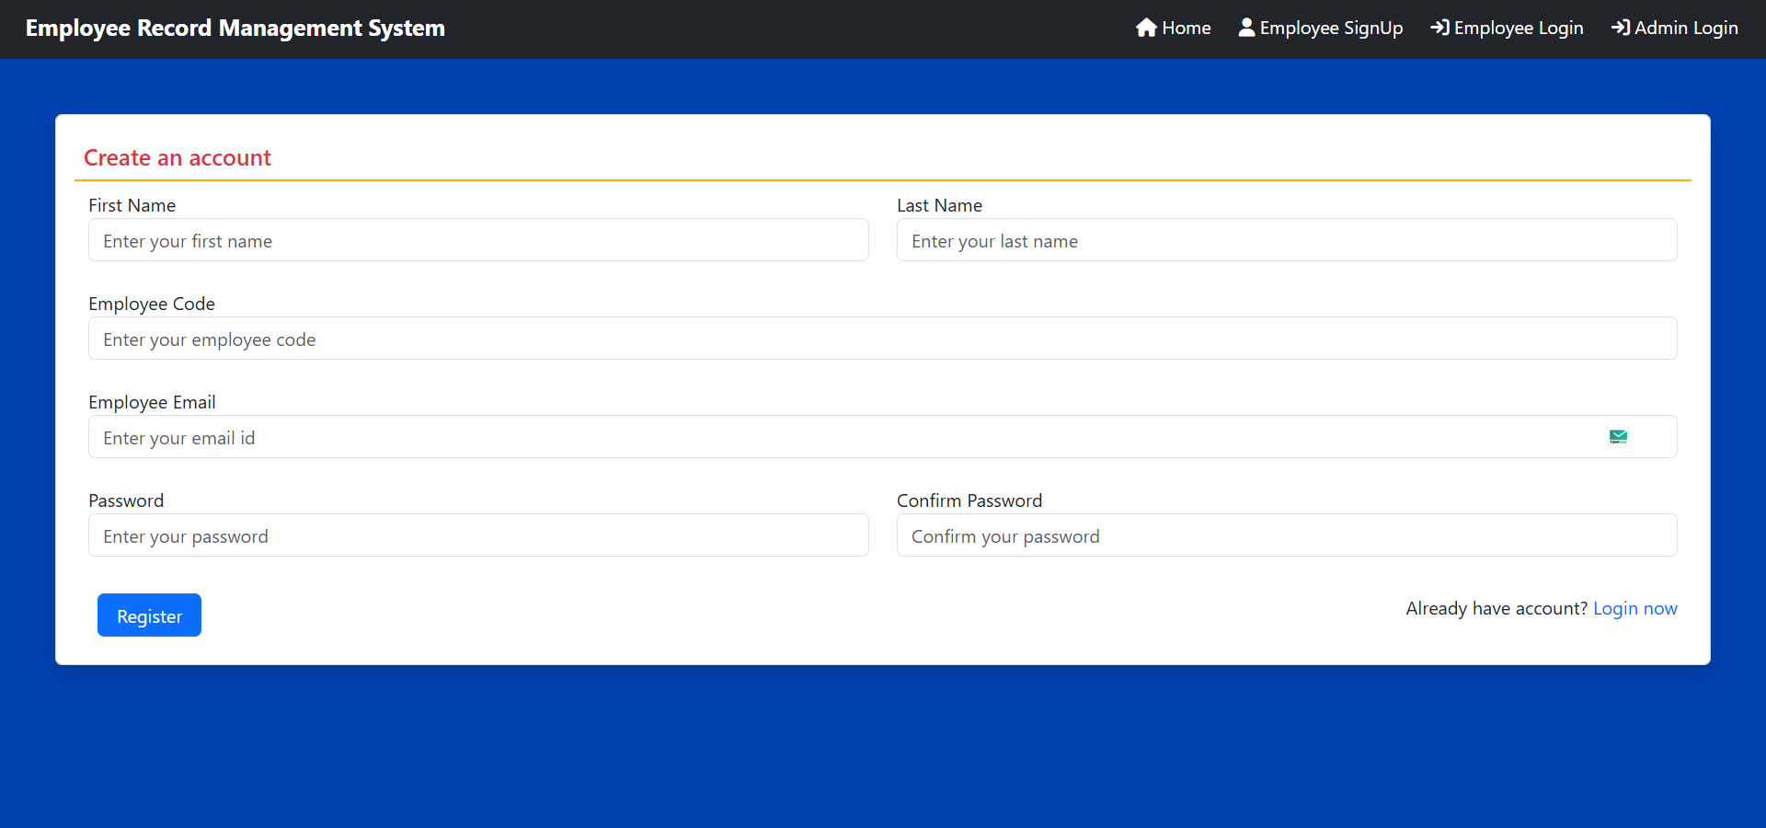
System Screens
Home Page:
Employee Registration Page:

Slide 11
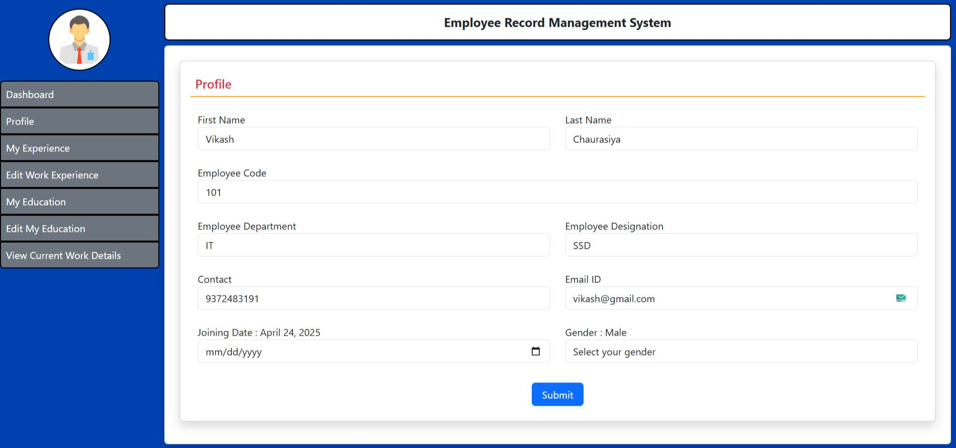
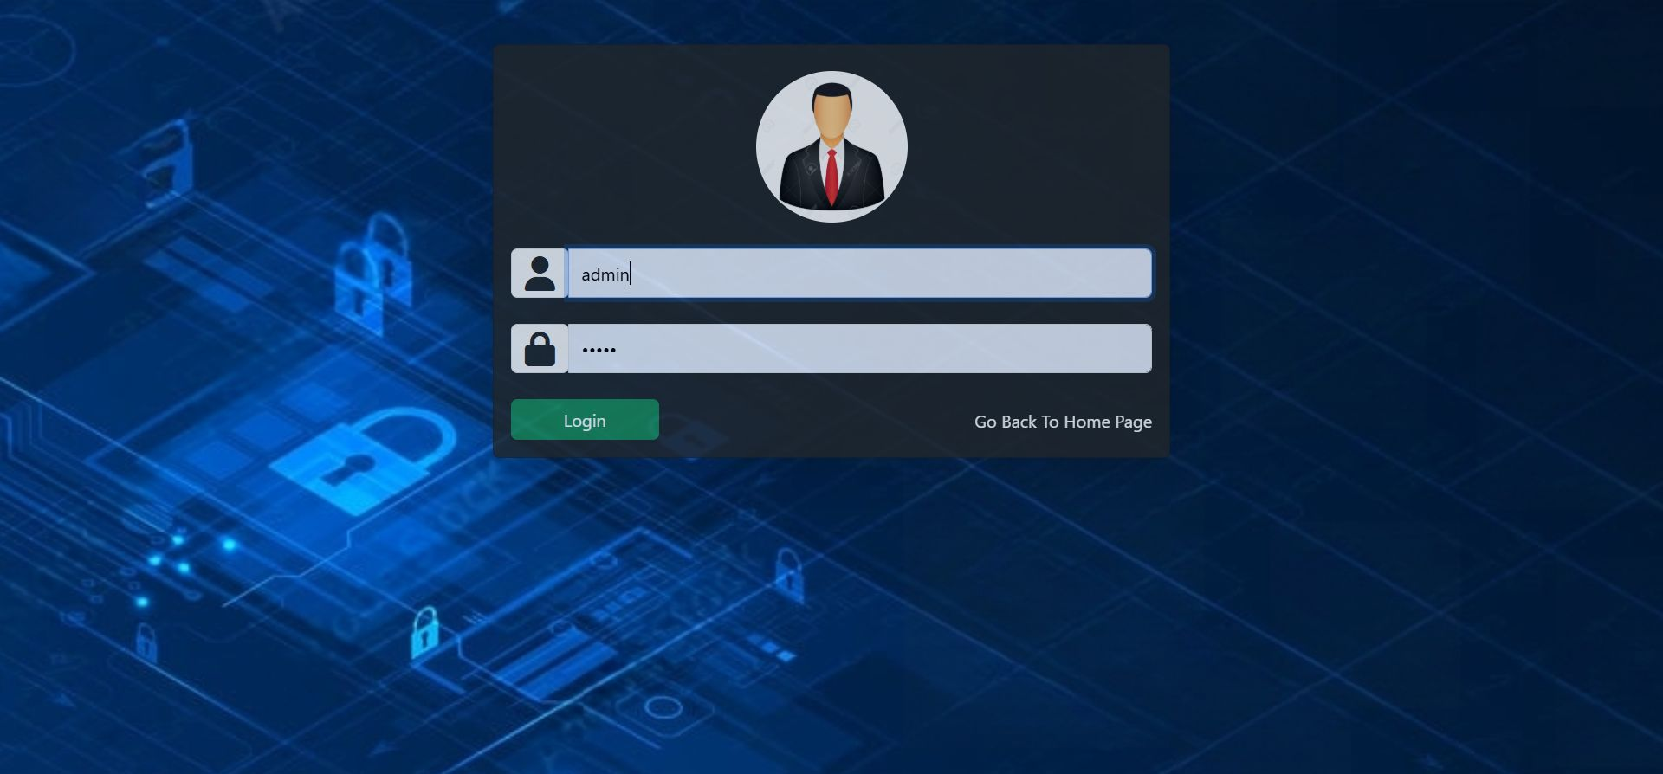
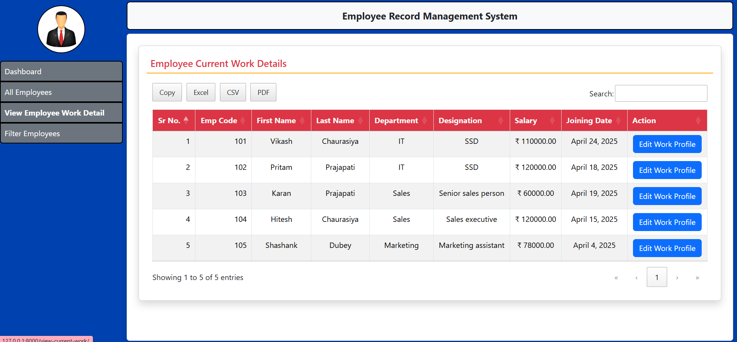
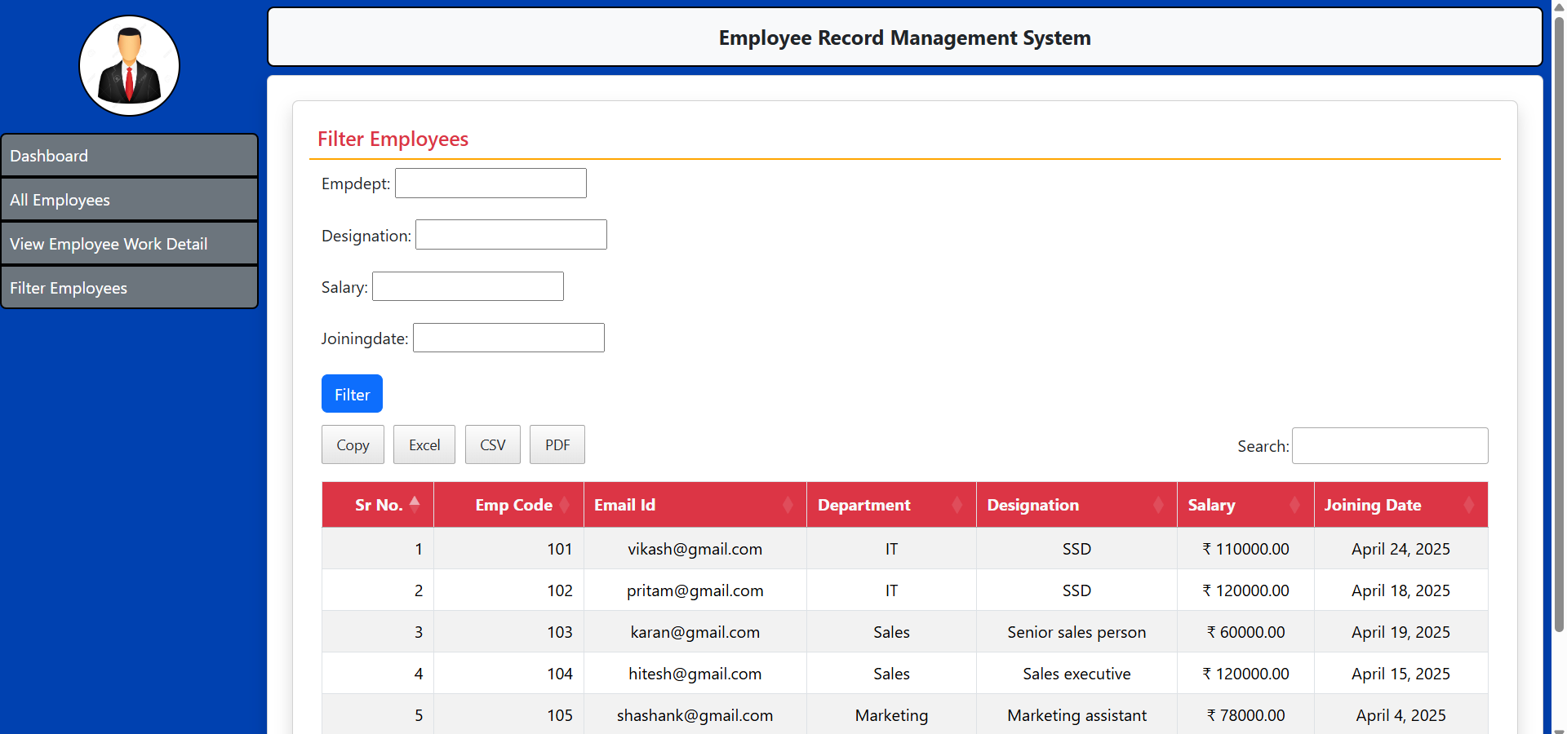
Employee Profile Page:
Admin Login Page:
Employee Edit Page:
Filter Employee Page:

Slide 12
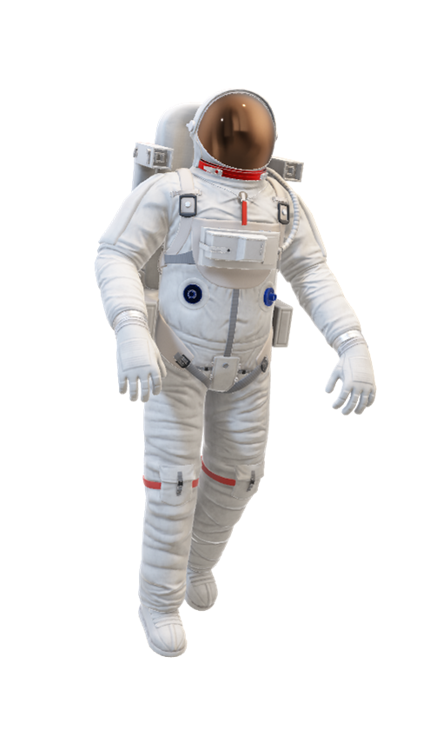
Future Development
Role-Based Access Control (RBAC) and Permissions
Employee Performance Management
Leave Management System
Document Management

Slide 13

GitHub Link
Click Me

Slide 14


